Slide 1
M A P W I S E
EVERY PIXEL OF THE EARTH, CLASSIFIED
A U-Net that reads satellite imagery and labels every pixel as urban, agriculture,
forest, water, rangeland or barren — then reports how much ground each one covers.
PRIYANSHU SINGH · AI / ML ENGINEER

Slide 2
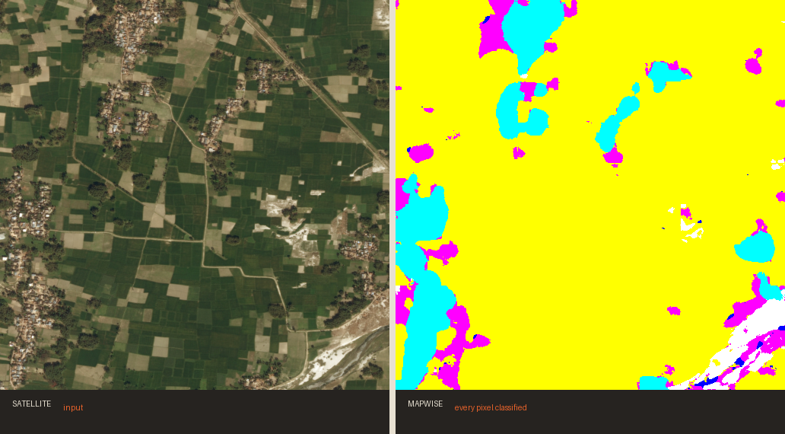
M A P W I S E
THE IDEA
Satellites see everything.
Nobody can look at it all.
Terabytes of imagery arrive every day. The questions asked of it are simple — how much forest was lost, where did the city expand, which fields are planted — but answering them by eye does not scale.
MapWise answers them per pixel, automatically, and returns the percentages rather than just a picture.
SATELLITE TILE → CLASSIFIED MAP
54%
84%
MEAN IoU
02
PIXEL ACCURACY

Slide 3
M A P W I S E
ARCHITECTURE
How it works
A U-Net: a pretrained encoder reads the image, a decoder written from scratch rebuilds it as labels.
01
02
03
04
ENCODE
DECODE
CLASSIFY
MEASURE
A ResNet-34 compresses the tile into a feature pyramid, from fine texture to coarse context.
Four upsampling blocks rebuild full resolution, each re-joining the matching encoder detail.
A 1x1 convolution turns every pixel's features into seven class scores.
Pixel counts become ground-cover percentages — the number a client actually uses.
Skip connections are why the edges stay sharp.
03

Slide 4
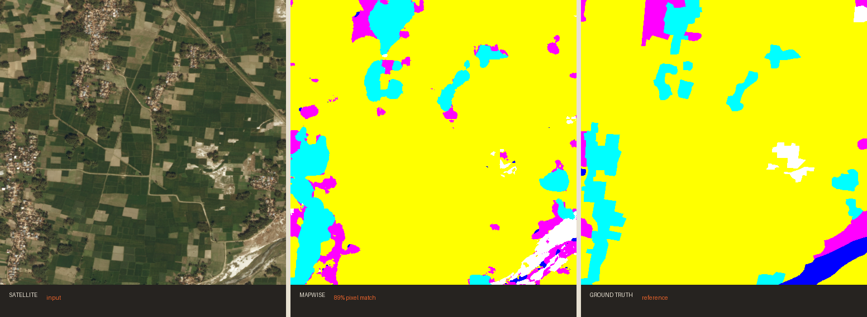
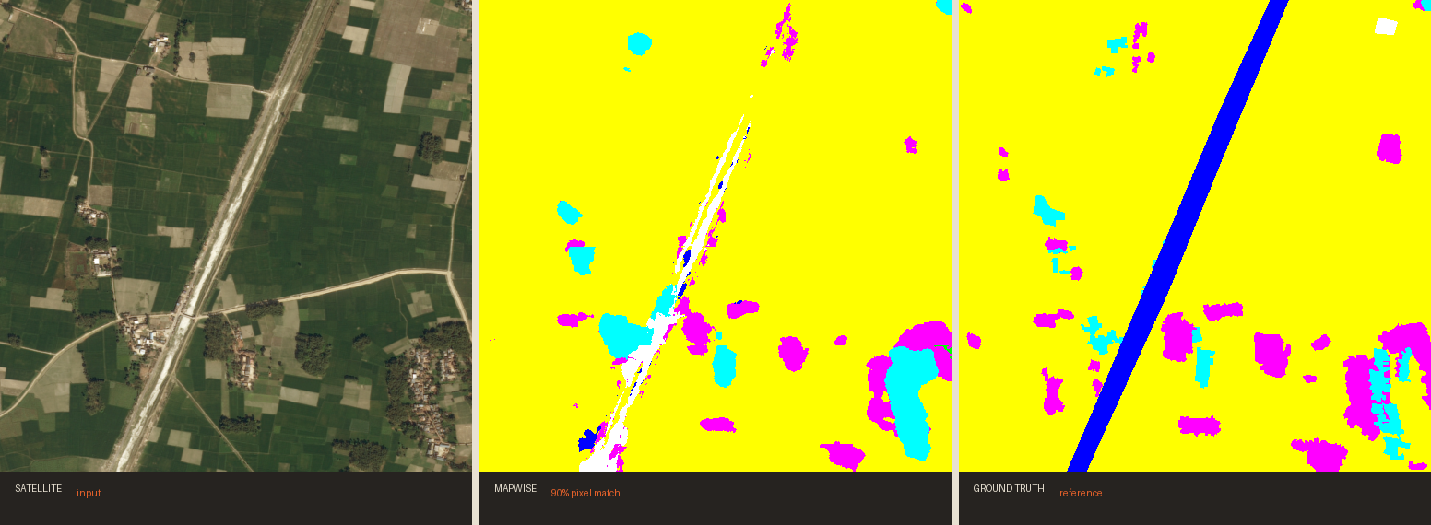
M A P W I S E
RESULTS IN THE FIELD
Satellite in, map out
04
Left: the satellite tile. Centre: MapWise. Right: the reference map a human analyst drew.

Slide 5
M A P W I S E
ACCURACY, CLASS BY CLASS
What it gets right — and what it doesn't
The rare classes are hard.
84%
80%
74%
63%
DeepGlobe is heavily imbalanced. Weighted Dice loss lifts rangeland (34%) and barren (45%) into usefulness, but 'unknown' is a few dozen pixels a tile and stays at zero.
So the numbers are published per class, not averaged away.
AGRICULTURE
URBAN
WATER
FOREST
Mean IoU 54% · pixel accuracy 84% · 24 epochs in 41 minutes on one T4
05

Slide 6
M A P W I S E
PROCESS
How it's built
01
02
03
04
DATA
ARCHITECTURE
TRAINING
DEPLOY
2448px tiles, random 512px crops, flips and rotations — aerial imagery has no 'up'.
ResNet-34 encoder, U-Net decoder written from scratch.
Dice + weighted cross-entropy, mixed precision, cosine schedule.
ONNX export, int8 quantisation, inference inside the browser.
06

Slide 7
M A P W I S E
WHO IT'S FOR
The mask is the demo.
The number is the product.
AGRICULTURE
URBAN PLANNING
ENVIRONMENT & RISK
Planted area per field, season over season, without anyone walking the land.
Where the built-up edge moved, measured rather than estimated.
Deforestation, water extent and wildfire fuel — inputs insurers price on.
07

Slide 8

M A P W I S E
See the ground as data.
Try it on your own satellite tile. The model runs inside your browser,
so the image never leaves your device.
SCAN TO TRY IT LIVE
priyanshu-singh-git.github.io/mapwise
PRIYANSHU SINGH · AI / ML ENGINEER
github.com/Priyanshu-Singh-git/mapwise

