Slide 1
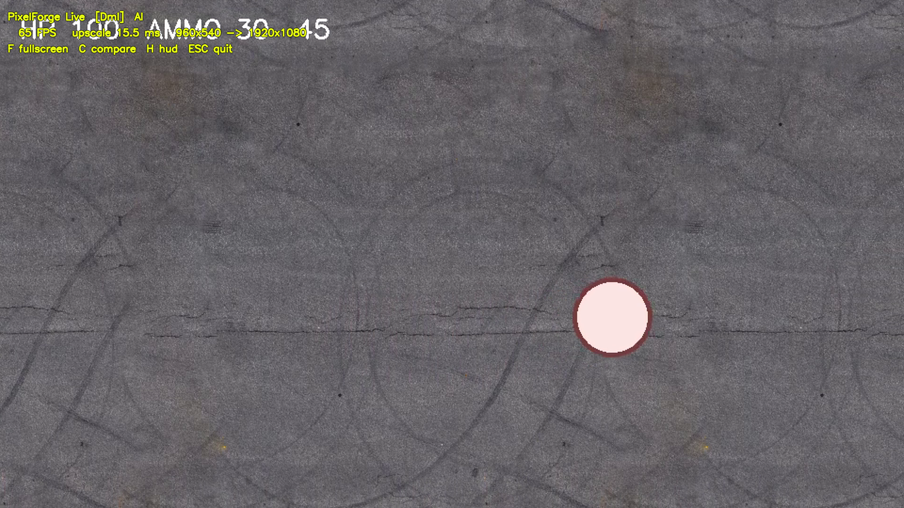
AI GAME UPSCALER · DESKTOP APP
PixelForge Live
Play your games in crisp HD — even on an old GPU.
One click. Any game. No settings to tweak.
PixelForge Live

Slide 2
THE PROBLEM
Blurry games on modest PCs
1
2
3
Old or budget GPUs
Millions of gamers run laptops and entry cards that can't drive sharp, high-res visuals.
Upscaling is clunky
Built-in options are per-game, hard to find, or simply absent in older titles.
The best tool costs money
The popular desktop upscaler is paid and uses simple filters, not a trained AI model.
PixelForge Live fixes all three: free, one-click, and AI-powered.
PixelForge Live

Slide 3
THE SOLUTION
Sharper games, instantly
Works with any game
Launch your game, launch PixelForge Live, play. No per-game configuration.
Trained on game art
An AI model that understands textures and edges — not just a blur-and-stretch filter.
Runs on your GPU
Smooth, real-time upscaling. Your game and your data stay on your machine.
PixelForge Live

Slide 4

WHY IT STANDS OUT
Smoother AND smarter
Full HD, 60+ FPS
Real AI model
Free & open
65 FPS at 1080p on a laptop RTX 3050 — fluid, not a slideshow.
Trained on game textures; keeps text and edges clean where simple filters smear.
The leading alternative is paid. PixelForge Live is free and the code is open.
Same frame, same moment — PixelForge (right) keeps the HUD text and detail crisper than a plain filter (middle).
PixelForge Live

Slide 5
GET IT
Try it, or let's build your version
For gamers
For studios & devs
For me
Free download, run it on any offline game. One click to sharper visuals.
Want AI upscaling tuned to your game's art, or built into your engine? I take that on.
Freelance AI / ML engineer — real-time model deployment, from research to shipped app.
github.com/Priyanshu-Singh-git/pixelforge · Priyanshu Singh, Freelance AI / ML Engineer
PixelForge Live

