Slide 1
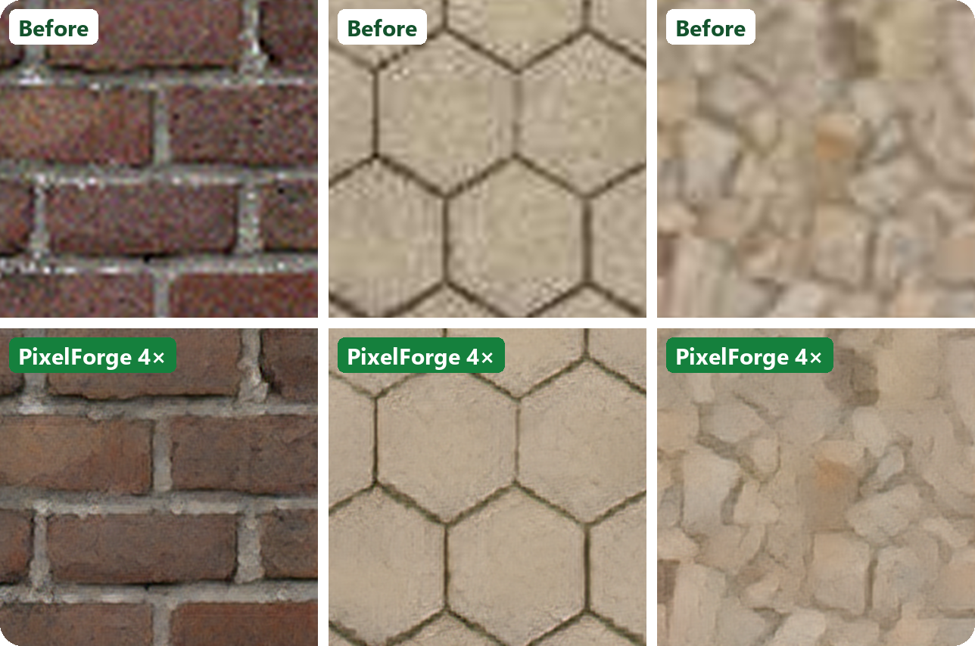
AI FOR GAME ARTISTS & MODDERS
PixelForge
Old game textures in.
4× HD out.
4× upscale
Trained on game art
Runs in browser
Notes:
0-8s: drag the before/after slider on an old texture. 'Same texture, 4x the detail.'

Slide 2
HD screens expose every old texture.
THE PROBLEM
1
2
3
Remasters need thousands of textures
Simple resizing just blurs
Generic AI upscalers aren't tuned for games
Redrawing every wall, floor and prop by hand is the slowest, most expensive part of a remaster or HD mod.
Stretching a texture 4× with bicubic gives soft, muddy surfaces that look worse on a modern monitor.
Tools trained on photos can smear tiling patterns or invent the wrong kind of detail.
PixelForge does the first pass for you: seconds per texture, in your browser.
Notes:
Remastering means redrawing thousands of textures; resizing blurs; generic AI isn't tuned for game art.

Slide 3
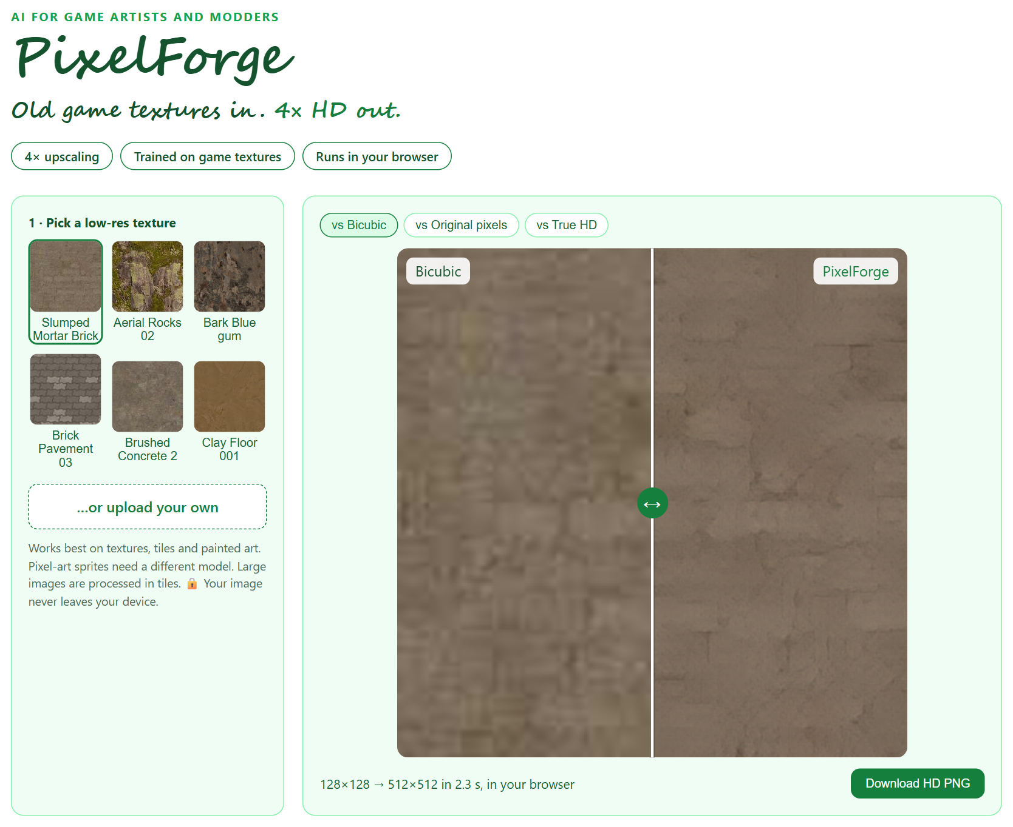
Drop in a texture. Drag the slider.
TRY IT YOURSELF
1
Before/after slider
Compare against bicubic, the original pixels, or the true HD texture.
2
Runs in your browser
No upload, no server, no install. Your art never leaves your machine.
3
Download the HD file
Large images are processed in tiles; get a 4× PNG in seconds (2.3 s for a 512×512 result in a laptop browser).
Notes:
Live demo: pick a texture, drag the slider, toggle 'vs True HD', download the PNG.

Slide 4
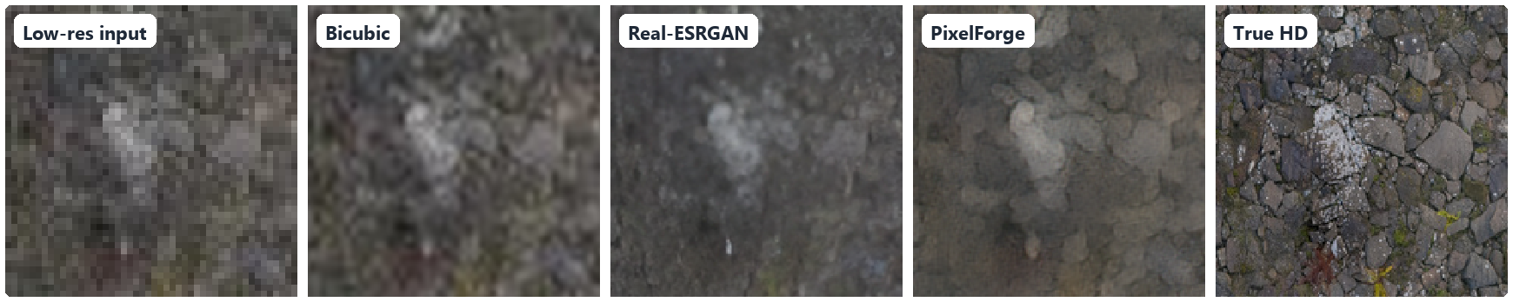
Looks like real HD. Small enough for a browser.
RESULTS
41%
15×
2.3 s
closer to the real HD look than bicubic
LPIPS perceptual distance, 60 unseen game textures
smaller than Real-ESRGAN (1.1M vs 16.7M parameters)
LPIPS 0.414 vs 0.454 (lower is better)
to upscale a texture 4× in a laptop browser
128×128 → 512×512, no GPU, no upload
Notes:
One number that proves it works: closer to the real HD texture than bicubic, at a fraction of the big model's size.

Slide 5
Trained to undo old-texture damage.
HOW IT WORKS
1
2
3
Collect game textures
Damage them on purpose
Learn to undo it
738 free (CC0) textures: bricks, wood, metal, ground, fabric, stone.
Blur, downscale, noise and JPEG compression, applied at random, the way old assets get degraded.
A compact generator learns to rebuild the missing detail at 4×, sharpened with a GAN stage.
For engineers: compact ESRGAN-style RRDB generator (1.1M params) trained from scratch in PyTorch: L1 stage, then VGG-perceptual + U-Net-discriminator GAN stage with EMA (Real-ESRGAN recipe), exported to ONNX. Benchmarks are in the appendix.
Notes:
Technical peek: the training trick is damaging clean textures on purpose so the model learns to undo it.

Slide 6
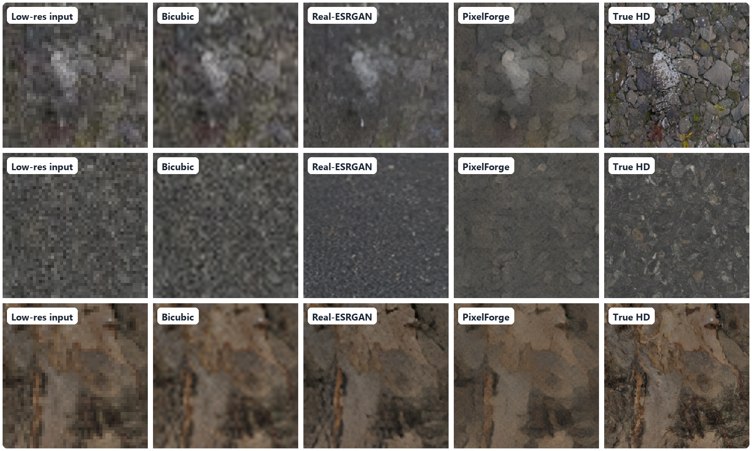
Real results on textures it never saw.
REAL RESULTS
Median-improvement textures, different materials, zoomed. PixelForge clears noise and JPEG blocks; detail the tiny input no longer has can't be fully recovered.
Notes:
Run three textures live; toggle 'vs True HD' to show it's honest.

Slide 7
Start with a test pack. Scale to the whole library.
HOW WE'D WORK TOGETHER
STEP 1
STEP 2
STEP 3
Send 10–20 textures
Test pack back
Batch the library
A representative sample of your game's textures or asset pack.
I upscale them, optionally fine-tune on your art style, and send before/after comparisons.
Folder in, folder out, file names kept, ready to drop into your mod or engine.
What you get: the HD texture set · a batch tool you can rerun on new assets · optional model fine-tuned on your art style · before/after report
Notes:
Lower the risk: a small test pack first.

Slide 8

NEXT STEP
Send me 10 of your textures.
I'll send them back in HD.
Try the live demo
priyanshu-singh-git.github.io/pixelforge/
Code and full benchmark
github.com/Priyanshu-Singh-git/pixelforge
Priyanshu Singh · Freelance AI / ML Engineer · Trained on Poly Haven CC0 textures. Commercial use of the code needs a licence; see the repo.
Notes:
The live demo is linked. Send me ten textures and I'll send them back in HD.

Slide 9
The numbers behind it.
APPENDIX · FOR ENGINEERS
Held-out test set: 60 game textures, realistic degradation, ×4. PSNR/SSIM higher is better; LPIPS lower is better.
Method | Params | PSNR ↑ | SSIM ↑ | LPIPS ↓ | GPU ms
Bicubic | – | 29.31 | 0.612 | 0.707 | –
Lanczos | – | 29.24 | 0.608 | 0.711 | –
Real-ESRGAN x4plus (pretrained) | 16.70M | 27.76 | 0.545 | 0.454 | 185.4
Real-ESRGAN general-v3 (pretrained) | 1.21M | 28.93 | 0.597 | 0.547 | 26.9
PixelForge SRVGG-S, L1 ★ | 0.16M | 29.66 | 0.617 | 0.636 | 15.2
PixelForge RRDB-S, L1 ★ | 1.12M | 29.73 | 0.620 | 0.659 | 39.0
PixelForge RRDB-S, GAN ★ | 1.12M | 28.76 | 0.571 | 0.414 | 36.0
Architecture: the 7× smaller SRVGG-S (0.16M) gets within 0.07 dB PSNR of RRDB-S (1.12M) and slightly better LPIPS (0.636 vs 0.659), at 15 vs 39 ms: a strong candidate for real-time use.
L1 vs GAN: the GAN stage cuts LPIPS from 0.659 to 0.414 (looks far more real) at a cost of 0.97 dB PSNR, the classic fidelity vs realism trade-off.
Versus Real-ESRGAN x4plus (trained on photos): LPIPS 0.414 vs 0.454, PSNR 28.76 vs 27.76 dB, with 15× fewer parameters.
Single training run per model; synthetic degradations; pixel art and alpha channels not yet evaluated.
Notes:
For technical buyers: architectures compared, L1 vs GAN, and the official Real-ESRGAN models as references.

