Slide 1
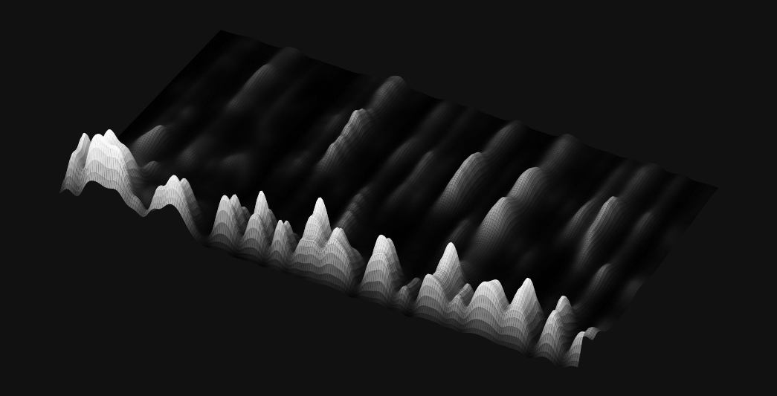
Voice
-Shield
Detects AI-cloned and synthetic voices from a few seconds of audio.
1.40%
71,237
equal error rate
test clips
Real voice or AI clone? Know in a second.
Graph-attention network · runs in the browser · audio never leaves your device
✳

Slide 2
Anyone's voice
can be cloned
Seconds of audio
Convincing calls
Ears aren't enough
Screen automatically
Free tools clone a voice from a short recording.
Fraudsters use cloned voices to pose as a boss, a relative or a customer.
Good synthetic speech is hard to spot by listening alone.
Call centres, banks and platforms need a fast, automatic check.
01
02
03
04

Slide 3
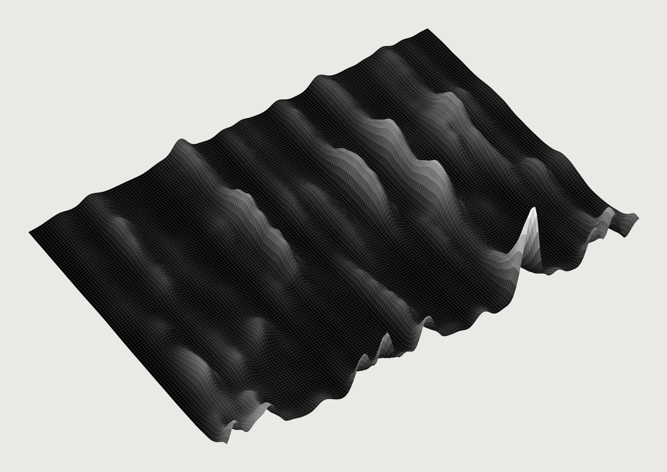
Real voice
or AI clone?
VoiceShield listens to a few seconds of speech and flags synthetic or cloned voices, the tiny vocoder artefacts that ears miss. It runs in the browser, so recordings never leave the device.
Try the live demo →
Record · upload · test clips
✳

Slide 4
Catches AI voices
it has never heard
1.40%
83.9%
0.042
1.1 s
equal error rate
lower is better
AI clips caught
0.1% of real voices flagged
min t-DCF
official ASVspoof metric
per clip in a browser
no server, no upload
How it was measured ASVspoof 2019 LA evaluation set: 7,355 real and 63,882 AI clips from 13 attack systems, 11 of them never seen in training. The pass/fail threshold is fixed on the separate development set.
✳

Slide 5
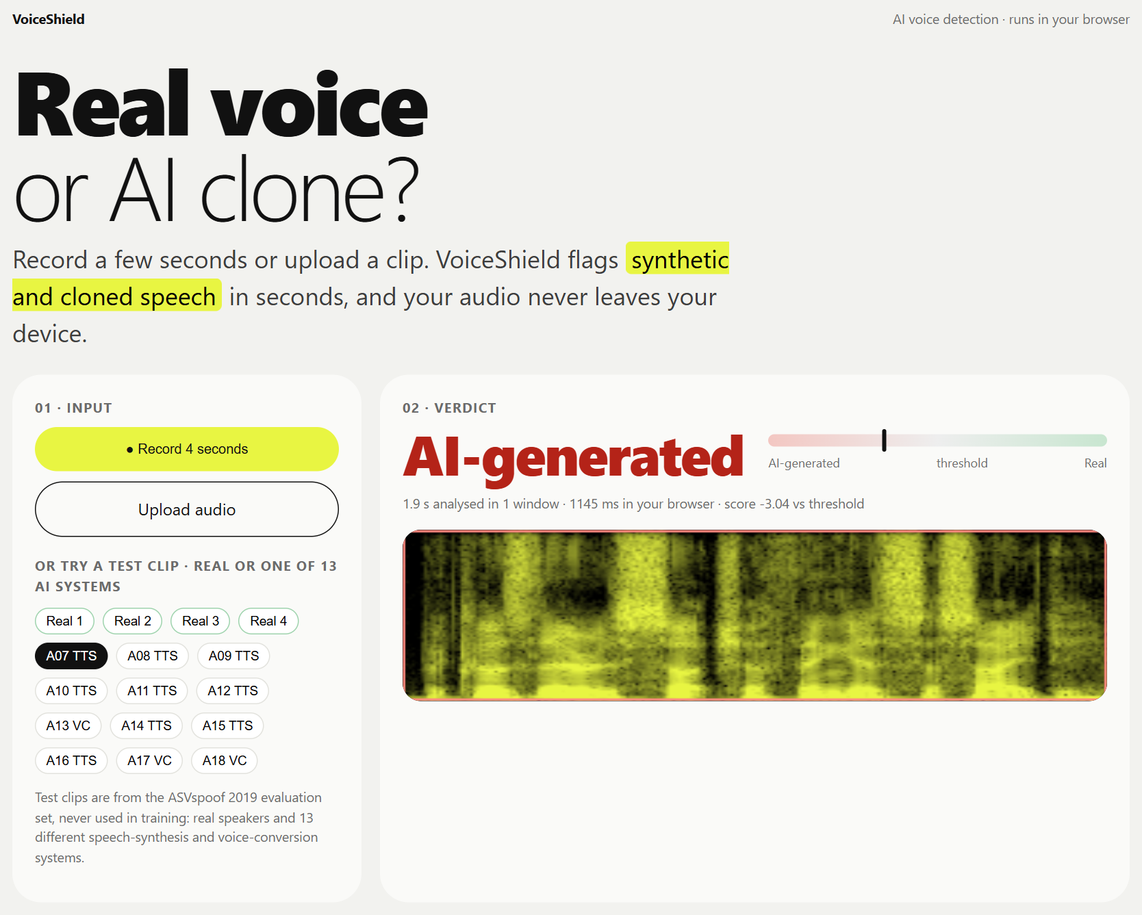
Product
overview
01
Record or upload
4-second mic recording, or any audio file
02
Instant verdict
Real voice vs AI-generated, with a confidence needle
03
See the evidence
Spectrogram with each analysed window marked
04
Private by design
The model runs in the browser; nothing is uploaded

Slide 6
01
Raw waveform in
No hand-made features: 4 s of 16 kHz audio.
Graph attention
on raw audio
02
Learnable band-pass filters
70 sinc filters split the sound into frequency bands.
AASIST learns from raw audio which frequency bands and moments give a synthetic voice away, then lets the two graphs vote through a shared master node. 297,866 parameters: small enough to run in a web browser.
03
Two graphs
One graph over frequency bands, one over time frames, each with attention.
04
Fused by a master node
A heterogeneous graph links both views and scores real vs AI.
AASIST · ICASSP 2022 · built from scratch

Slide 7
Every attack
type, tested
Error rate per attack system on the evaluation set. Hardest: A18 at 4.9%. Systems marked grey reuse an algorithm from the training set; the rest were never seen.
Yellow = never seen in training

Slide 8
Benchmarked
against the field
Model | Parameters | EER ↓ | min t-DCF ↓ | Source
LFCC + LCNN (mine) | 158,146 | 5.75% | 0.1665 | this work · 30 epochs
RawNet2 (mine) | 17,621,410 | 6.04% | 0.1421 | this work · 30 epochs
AASIST-L (mine) | 85,306 | 1.61% | 0.0491 | this work · 30 epochs
AASIST (mine) | 297,866 | 1.40% | 0.0424 | this work · 38 epochs
AASIST (official model) | 297k | 0.83% | 0.0275 | clovaai/aasist (100 epochs)
AASIST-L (official model) | 85k | 0.99% | 0.0309 | clovaai/aasist (100 epochs)
My models: trained on Kaggle T4 GPUs for fewer epochs than the official recipe (12-hour session limit). Official numbers: the authors' released pretrained models, from github.com/clovaai/aasist.

Slide 9
A vision backed
by clear steps
01
02
03
Send sample calls
A few minutes of your real recordings (and any known fakes).
Calibrated pilot
I tune the threshold on your audio and report catch rate vs false alarms.
Deploy
Browser, API or on-premise service: your audio stays with you.
✳

Slide 10

Screen your calls
for AI voices
Live demo
priyanshu-singh-git.github.io/voiceshield/
Code, benchmark and limits
github.com/Priyanshu-Singh-git/voiceshield
✳
Send me sample calls · I'll run a pilot
Scan for the live demo
Priyanshu Singh · Freelance AI / ML Engineer · Data: ASVspoof 2019 (ODC-By)

