Slide 1
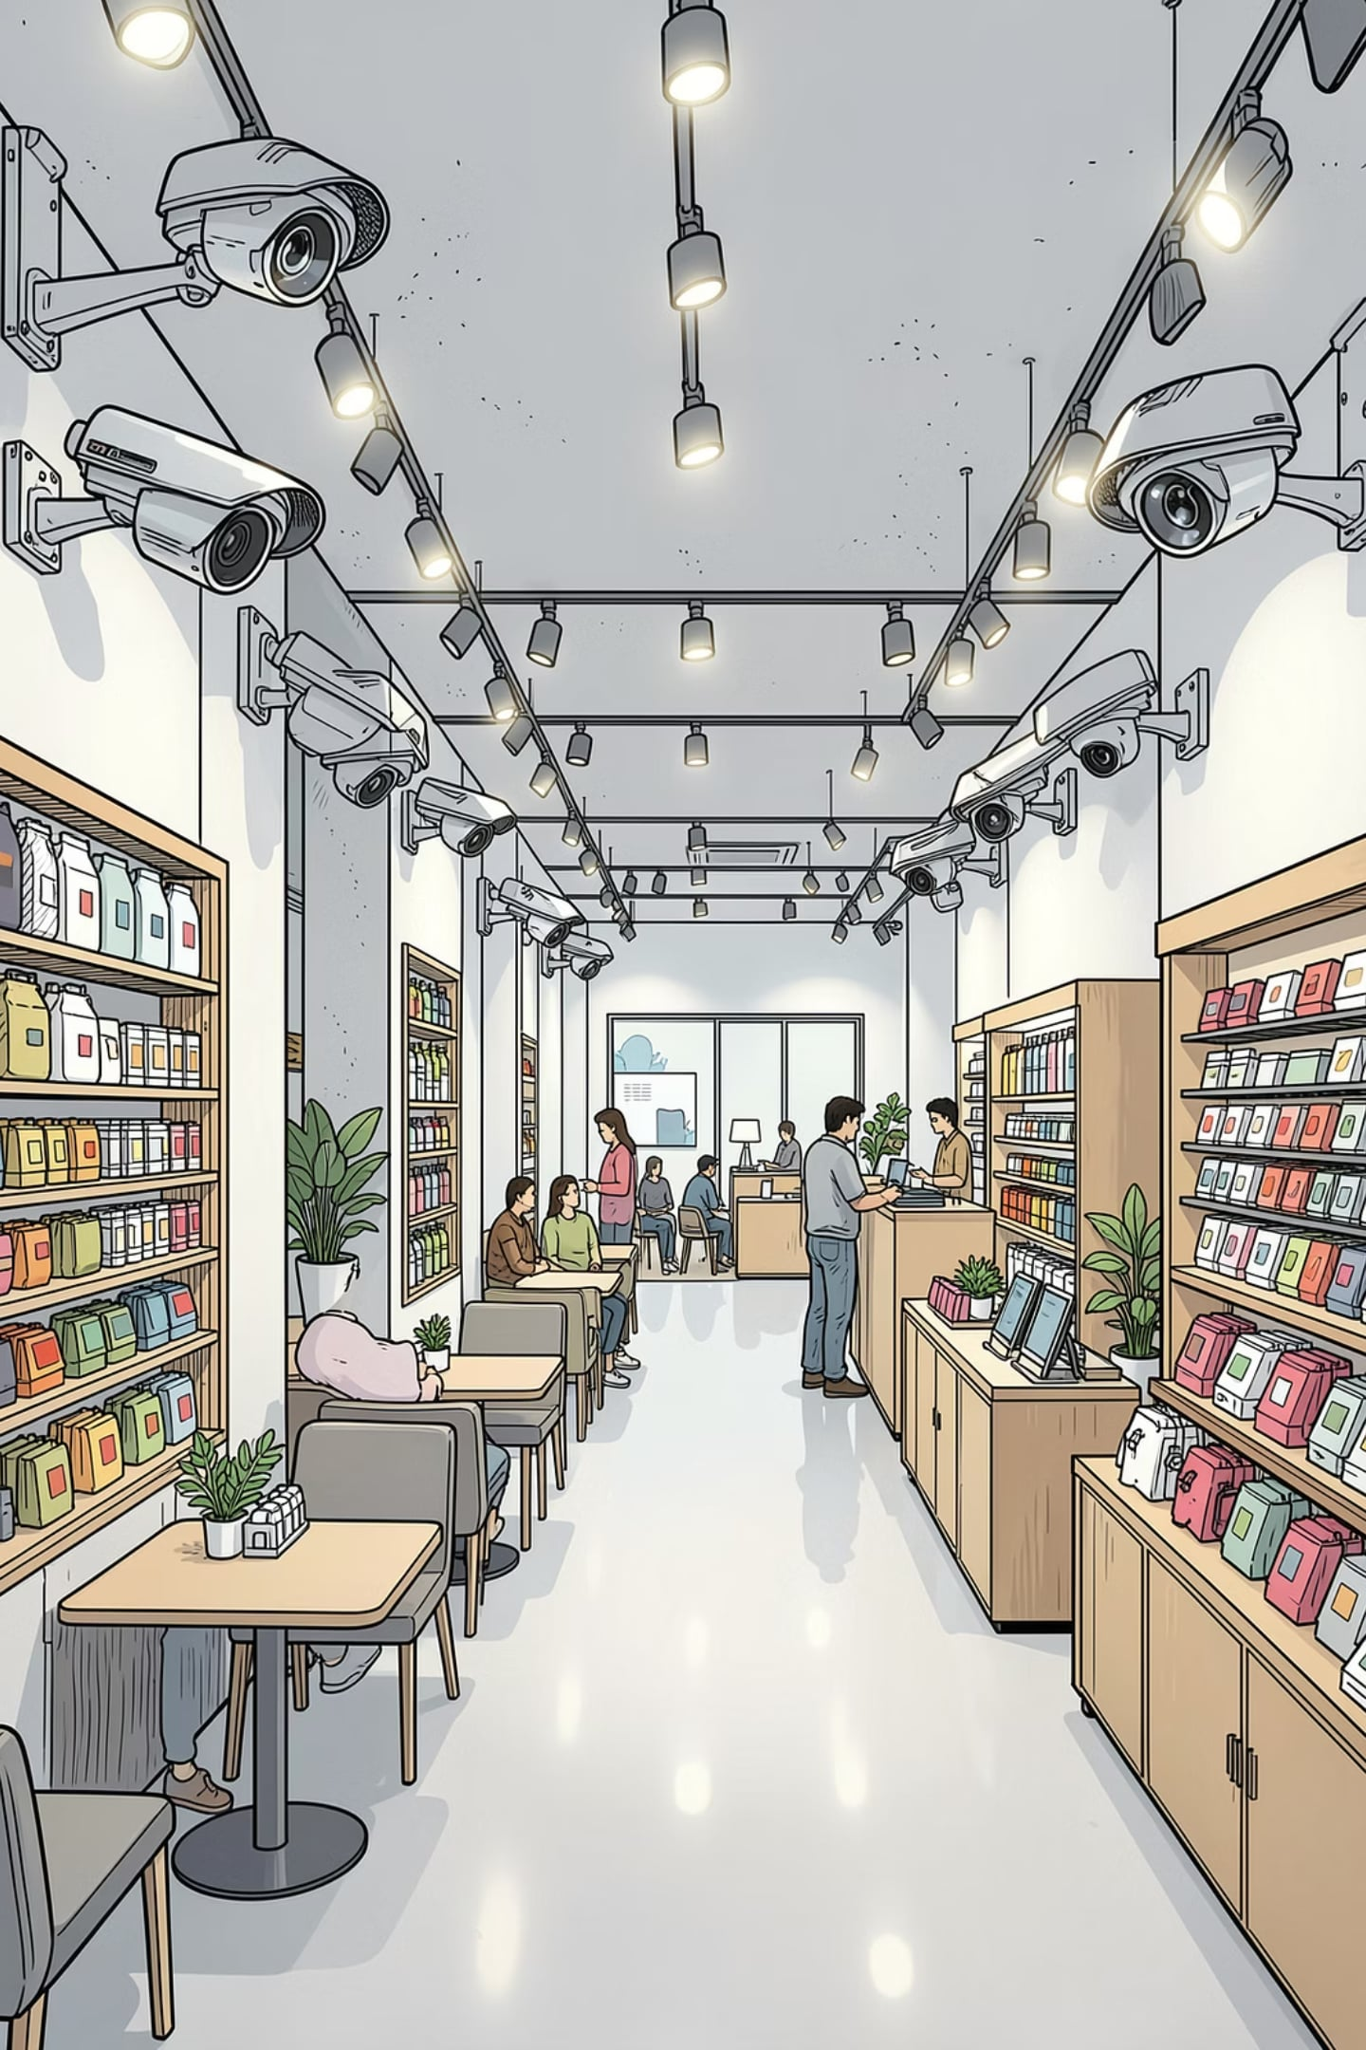
AI-Powered Intelligent Security Ecosystem
Smarter protection for modern spaces
Traditional security systems often generate too many false alarms, miss subtle threats, and require constant human monitoring. This research explores how AI can unify surveillance, detection, and response into a more adaptive security ecosystem for retail and experience environments.

Slide 2
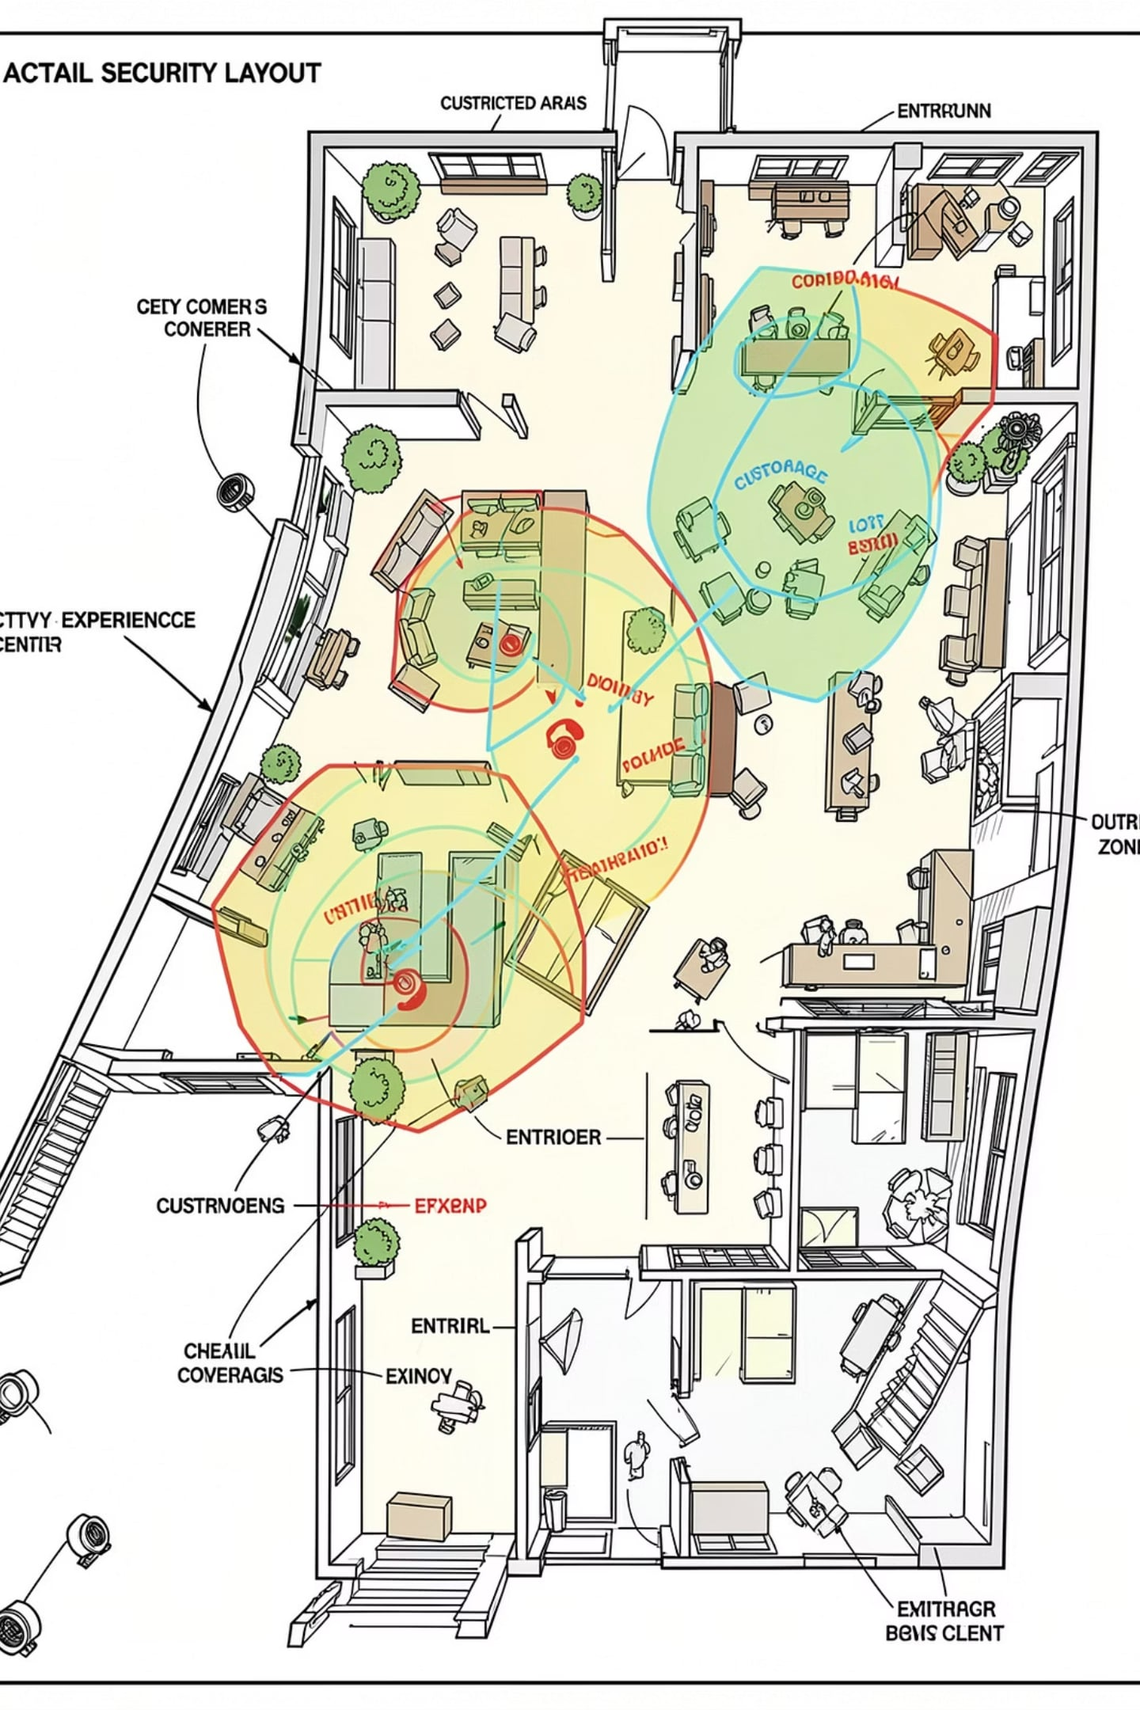
Experience Centers: Security and Operational Context
Existing CCTV infrastructure generates valuable security and operational data — but it remains passive, underutilized, and reactive by design.
Physical Zones
CCTV Infrastructure
Customer areas and product displays
High-value zones and restricted areas
Entrances, exits, and staff-only zones
Multiple fixed and PTZ cameras
Continuous recording capability
Underutilized real-time intelligence
The Core Gap
Surveillance captures everything but understands nothing in real time — valuable data is lost without intelligent analysis.

Slide 3
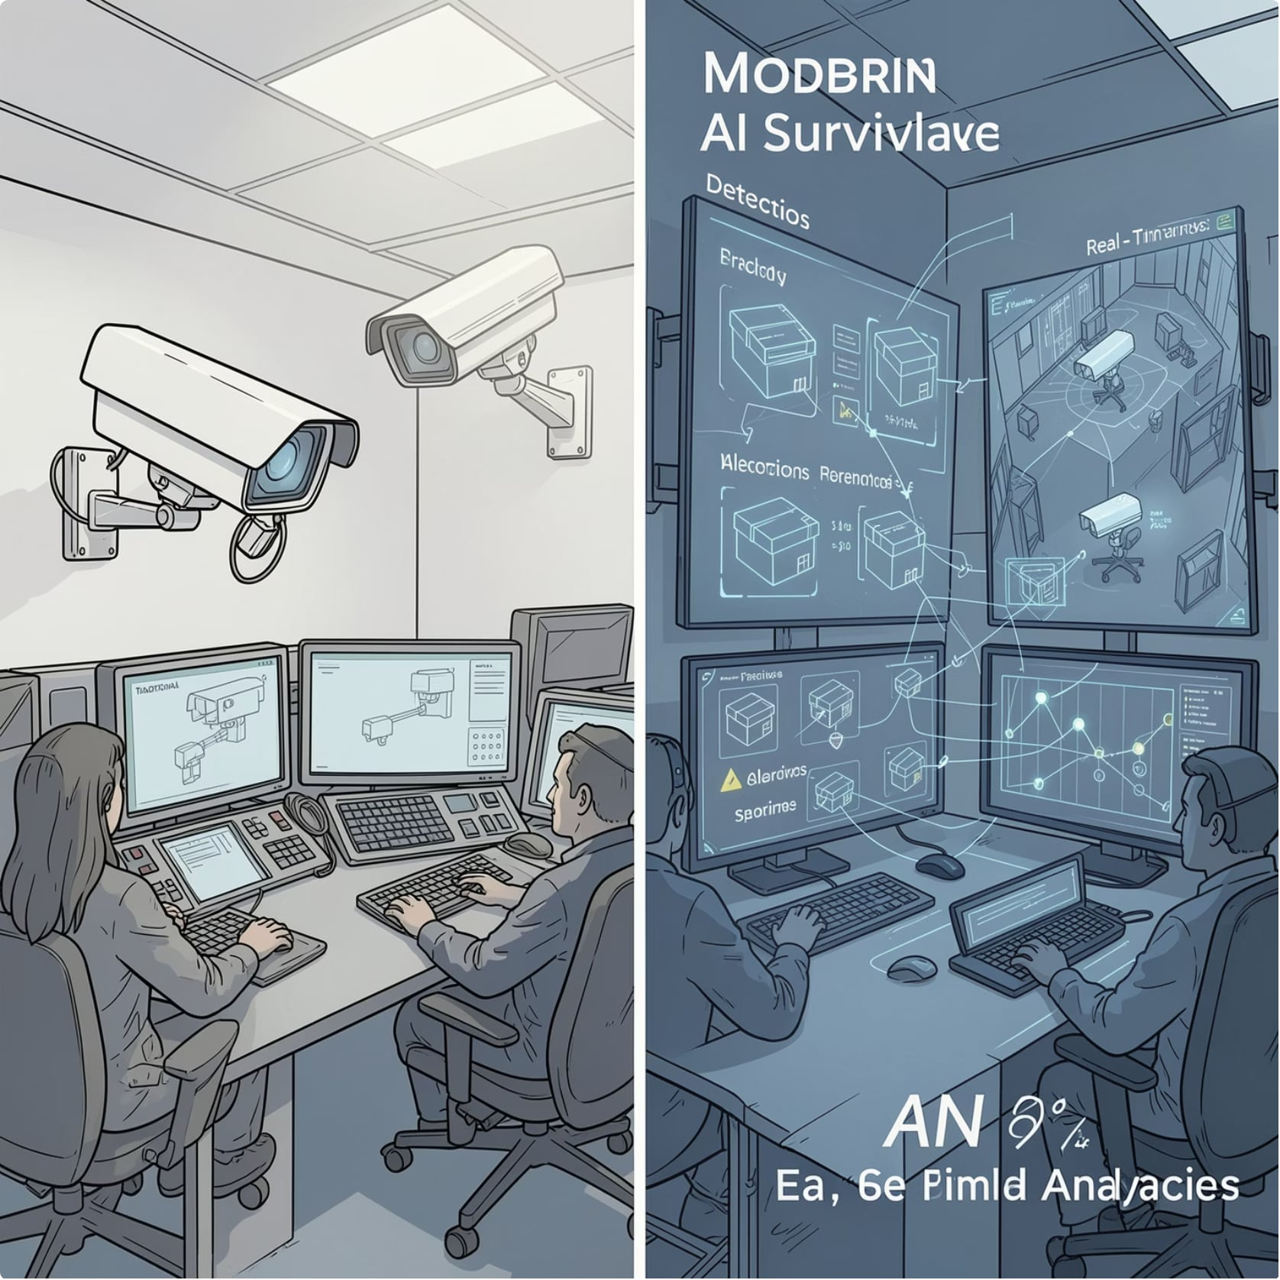
Limitations of Conventional CCTV and Standard AI Surveillance
The Dual Problem
Traditional CCTV is passive and reactive — events are discovered only after they occur. Standard AI surveillance attempts to fix this but introduces a new problem: every model runs on every frame of every camera, regardless of scene activity.
High computational cost with no activity-based filtering
Multi-camera scaling becomes prohibitively expensive
No prioritization of critical events over routine activity

Slide 4

Core Research Question
"Can an adaptive, event-driven multimodel computer vision architecture reduce unnecessary computational workload while maintaining acceptable security-event detection and customer-analytics performance compared with standard continuous inference?"
Accuracy
Detection and event-recall performance
Real-Time Performance
Latency and inference speed
Computational Efficiency
GPU, VRAM, and CPU utilization
Scalability
Multi-camera deployment feasibility

Slide 5
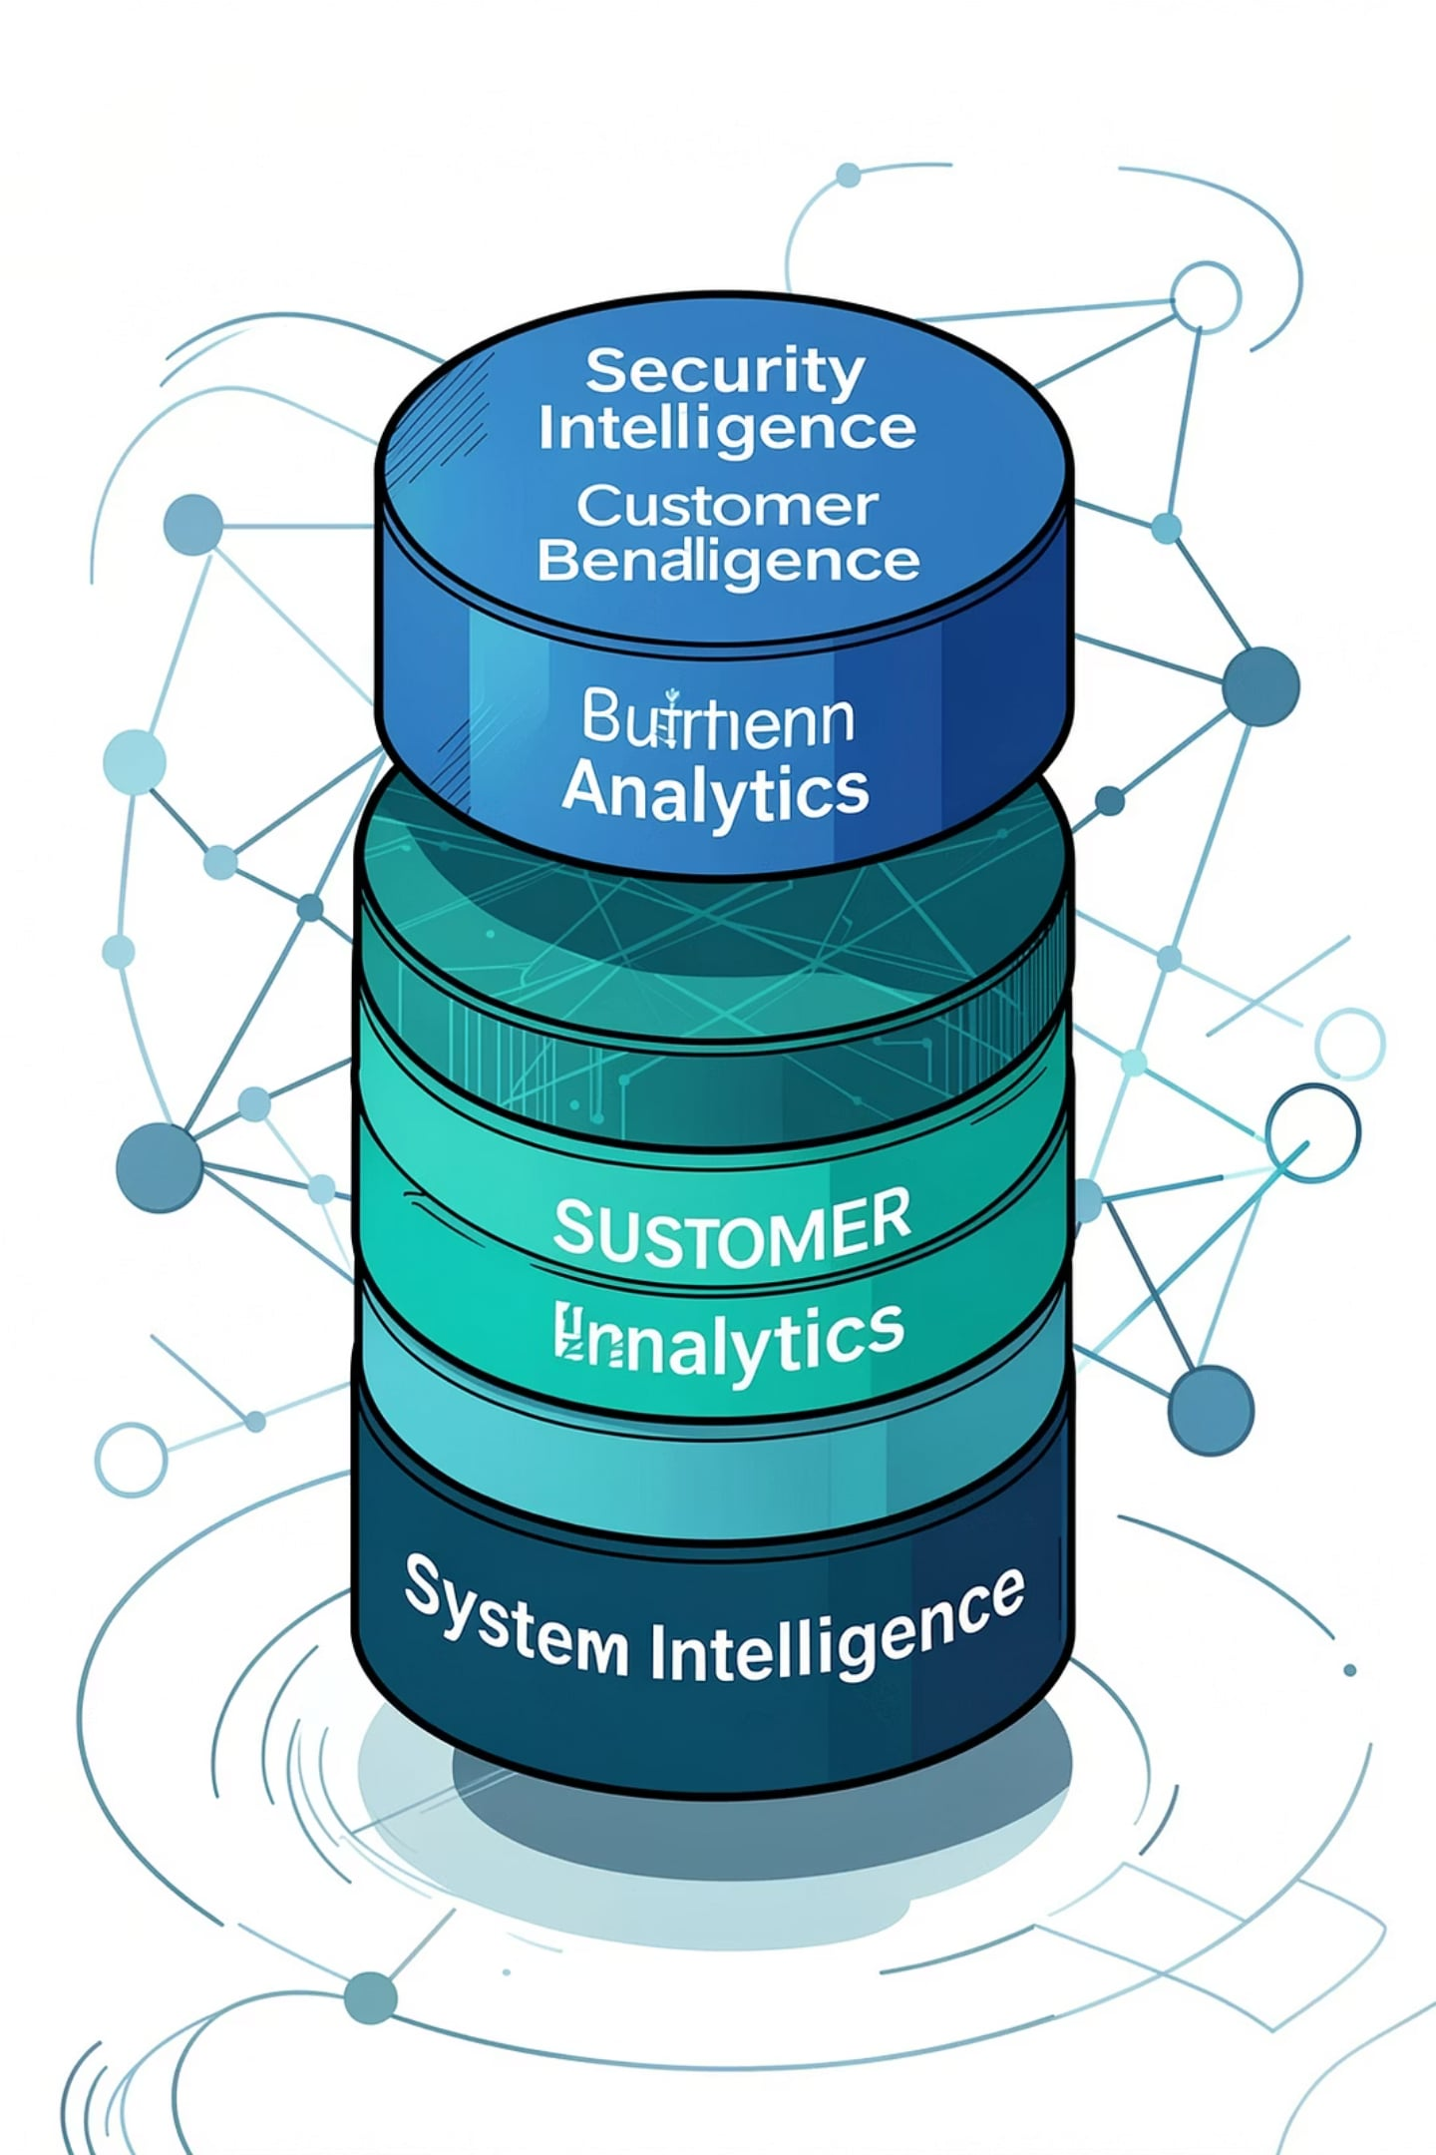


Project Objectives
1
2
Technology Research and Selection
Custom AI Model Development
Research and select open-source AI and computer vision technologies suited to experience-center security and analytics requirements.
Develop and train custom AI models using domain-relevant datasets, transfer learning, and systematic experimentation.
3
Intelligent Ecosystem Development
Build an integrated security and customer behavior analytics ecosystem with adaptive, event-driven AI orchestration.

Slide 6
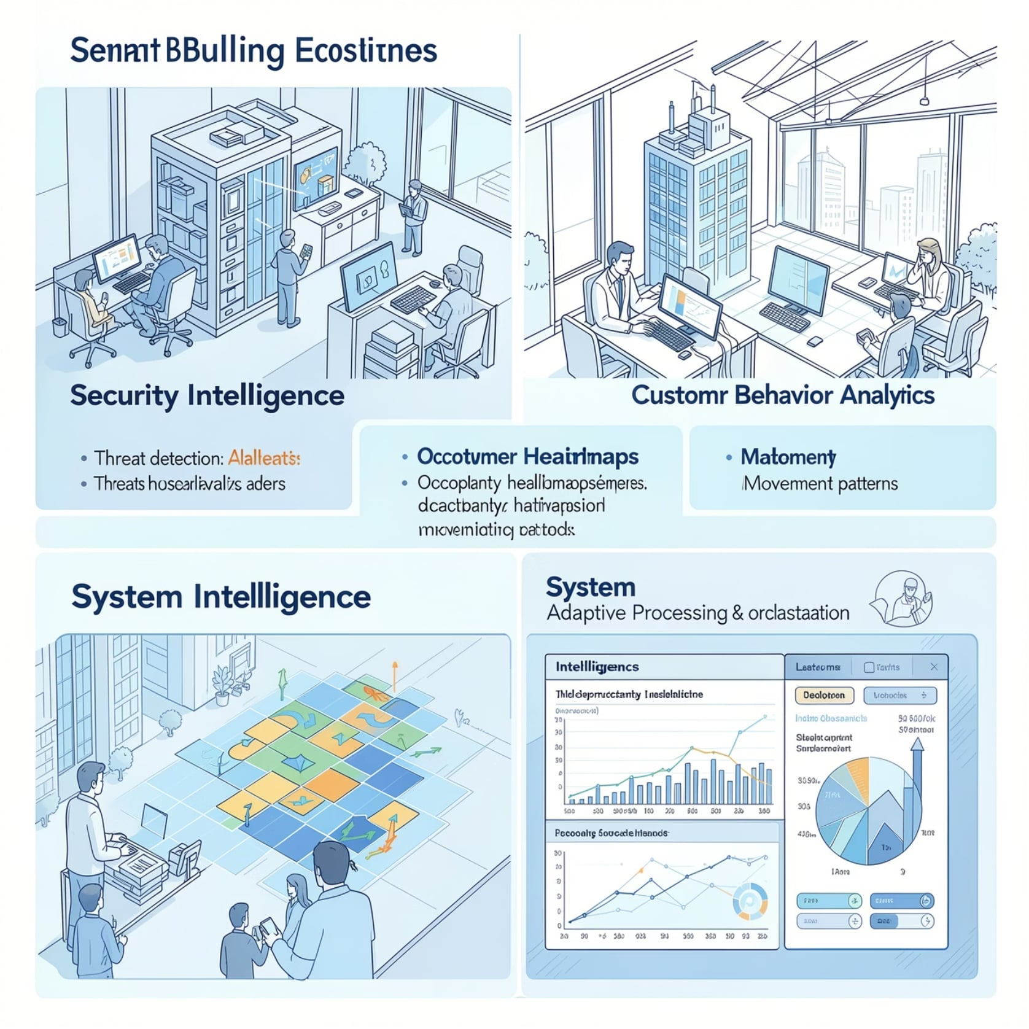
Scope of the Intelligent Ecosystem
Three Intelligence Layers
The ecosystem addresses three interconnected domains — each requiring distinct AI approaches and processing strategies.
Security Intelligence: Real-time threat and anomaly detection across defined zones
Customer Analytics: Anonymous behavioral insights for operational decision-making
System Intelligence: Adaptive orchestration that optimizes resource utilization dynamically

Slide 7

Research and Development Methodology
Research & Data
Model Development
Survey technologies and datasets
Train and validate multiple approaches
System & Benchmarking
Data Preparation
Integrate system and run comparisons
Clean, annotate, and format data
The project follows a structured four-phase methodology — from initial technology and dataset research through data preparation, multi-approach model training, and finally system integration with rigorous comparative benchmarking.

Slide 8

Dataset Strategy, Selection, and Preparation
Multi-Dataset Strategy
No single dataset covers the complete experience-center problem. Task-specific datasets are maintained separately to prevent incompatible label conflicts and class mismatches.
View more
Untitled card
Sources: Kaggle, Roboflow Universe, academic repositories
Final dataset registry: under project documentation
Preparation Pipeline
Raw Download → Archive Validation → Corrupt File Detection → Label Validation → Class Mapping → Duplicate Detection → Format Conversion → Train/Val/Test Split → Dataset Statistics

Slide 9
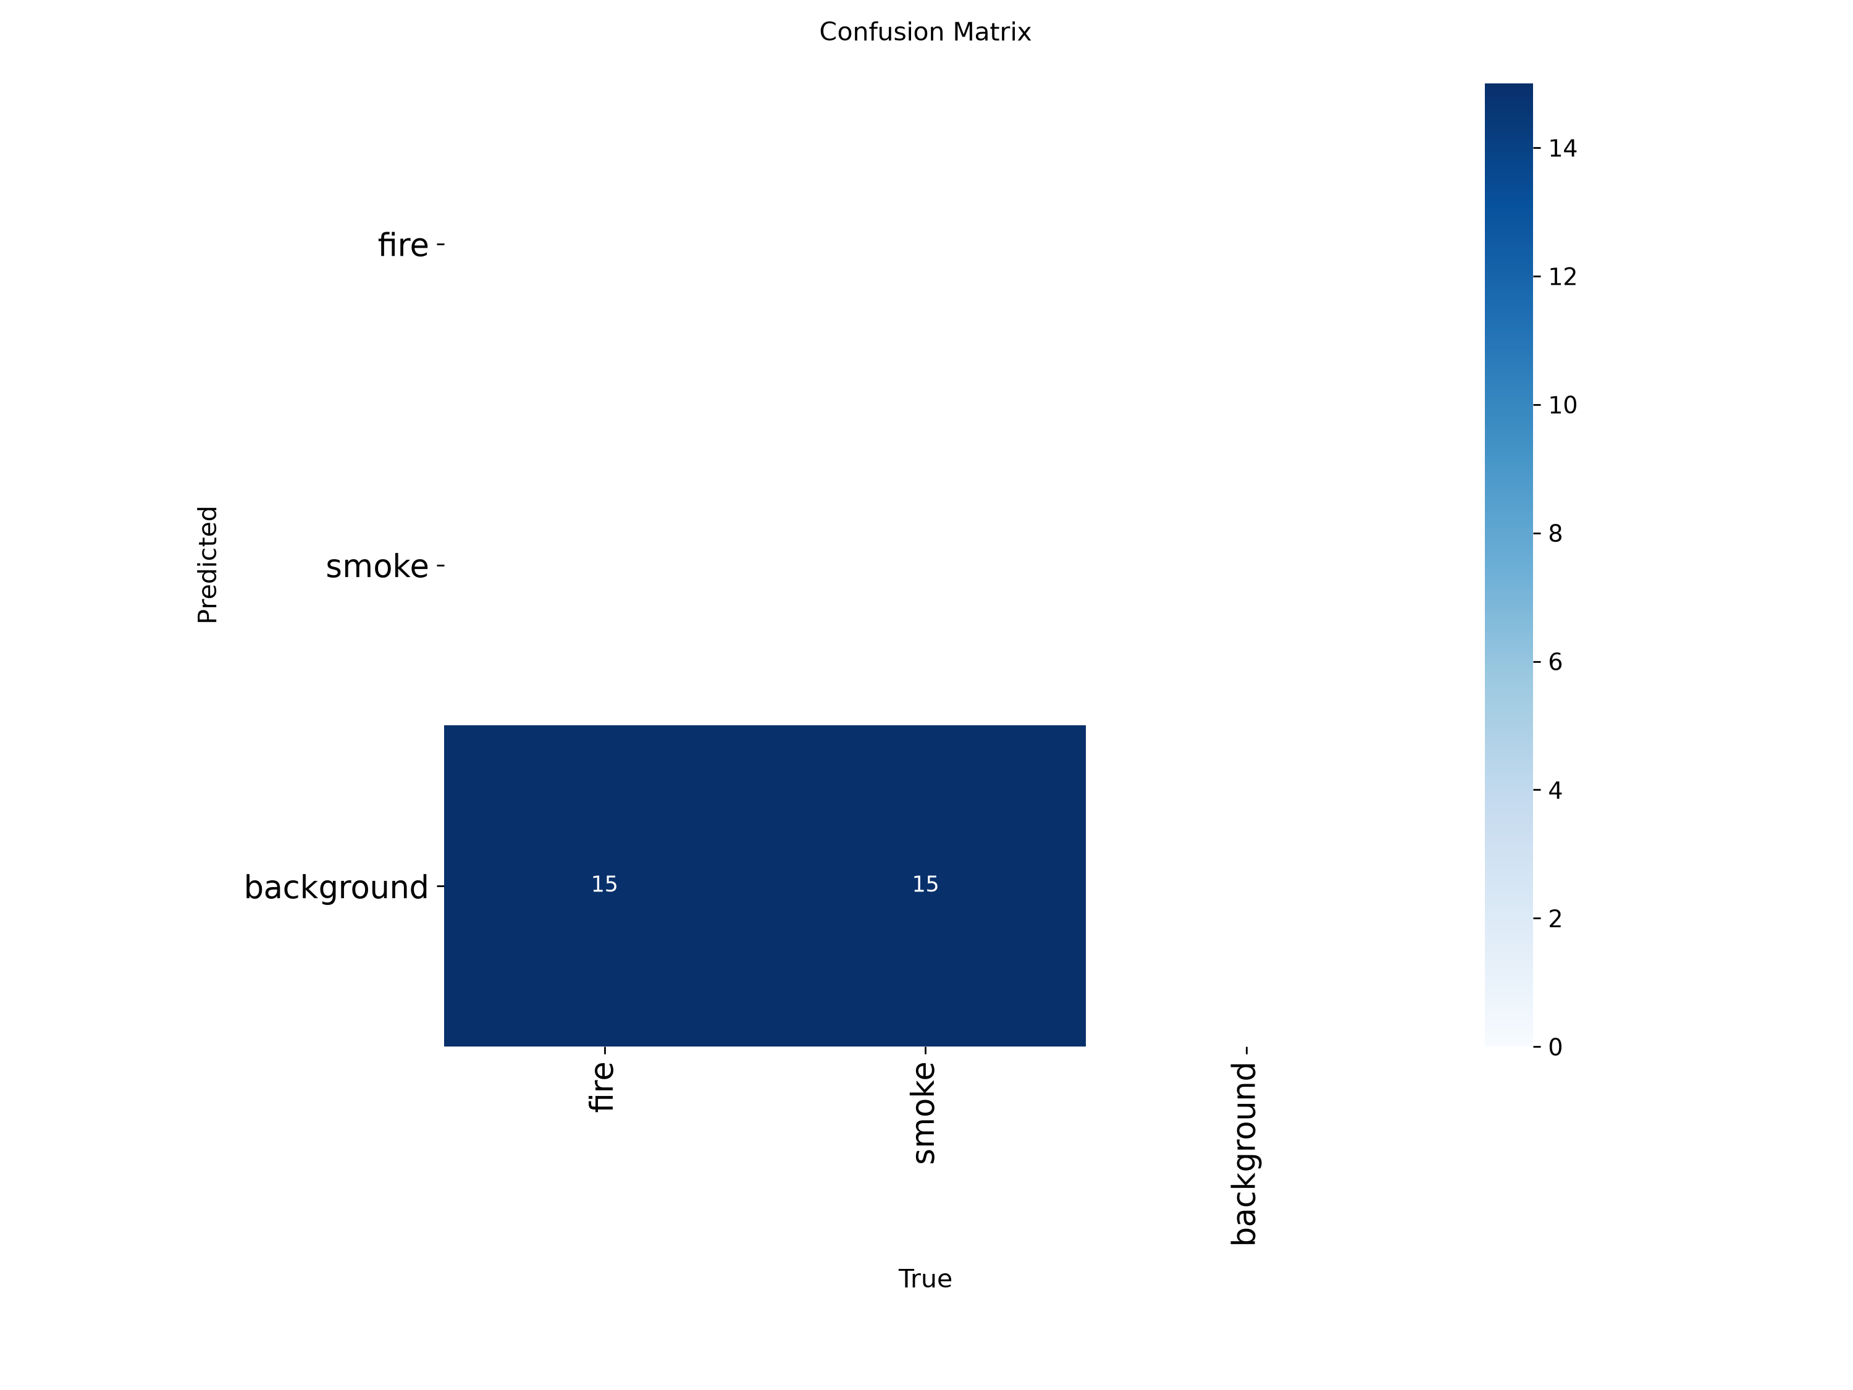
Experimental Evaluation & Results
Empirical measurements from model training, tracking comparison, and system orchestration.
Custom Model Training
• Person Detector (YOLOv8n)
- mAP50: 0.3733 on COCO-Person
- Optimized for lightweight tracking
• Tuned Fire Detector (YOLOv8n)
- mAP50: 0.6383 | mAP50-95: 0.4611
- Fine-tuned with optimized augmentation
• Specialist Fire (YOLOv8s)
- mAP50: 0.6950 | mAP50-95: 0.3953
- Higher capacity validation model
System Performance
• Tracking (TownCentre Benchmark)
- ByteTrack: 100.0% count accuracy
- BoT-SORT: 93.8% count accuracy
• Standard vs. Adaptive System
- Frame Rate: 30.0 -> 12.6 FPS (-58%)
- VRAM Saving: 1.8GB -> 0.9GB (-50%)
- Event Recall: 100.0% (No missed events)
- Achieved substantial compute reduction
without sacrificing security recall

Slide 10
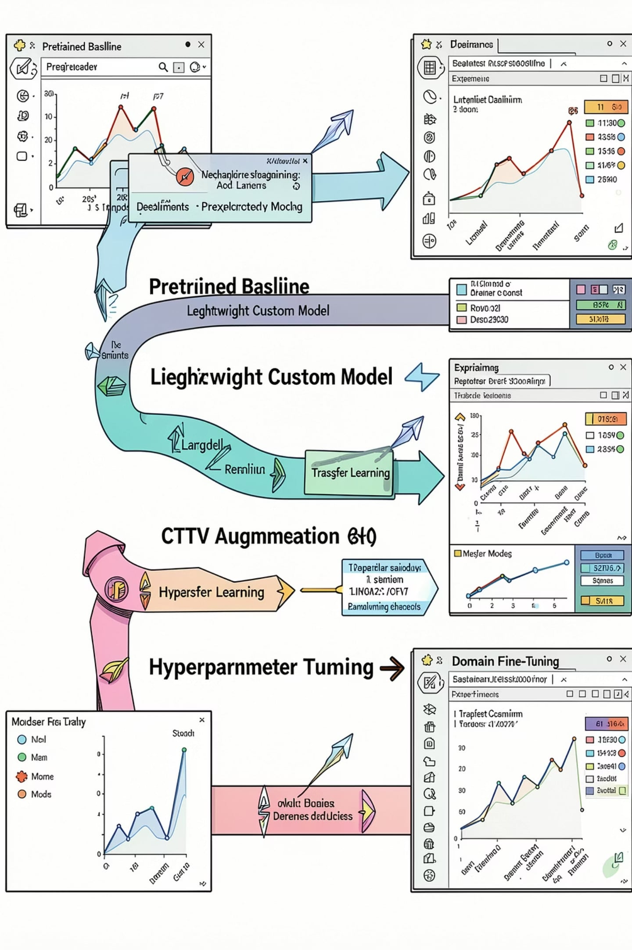

Multiple Experimental Training Approaches
1
Pretrained Baseline
Off-the-shelf weights for initial performance reference
2
Lightweight Custom Model
Smaller architecture optimized for edge deployment
3
Larger Model Comparison
Higher-capacity model for accuracy ceiling assessment
4
Transfer Learning
Domain adaptation from pretrained checkpoints
5
CCTV-Oriented Augmentation
Augmentation strategies specific to surveillance footage
6
Hyperparameter Tuning
Systematic optimization of learning parameters
7
Domain Fine-Tuning
Experience-center-specific final refinement
Each approach is evaluated on precision, recall, F1, mAP50, mAP50–95, latency, FPS, and VRAM. The final deployment model is selected based on the accuracy-efficiency balance — not accuracy alone.
Training and evaluation successfully completed. Fine-tuned model weights and results have been validated and uploaded to Hugging Face.

Slide 11
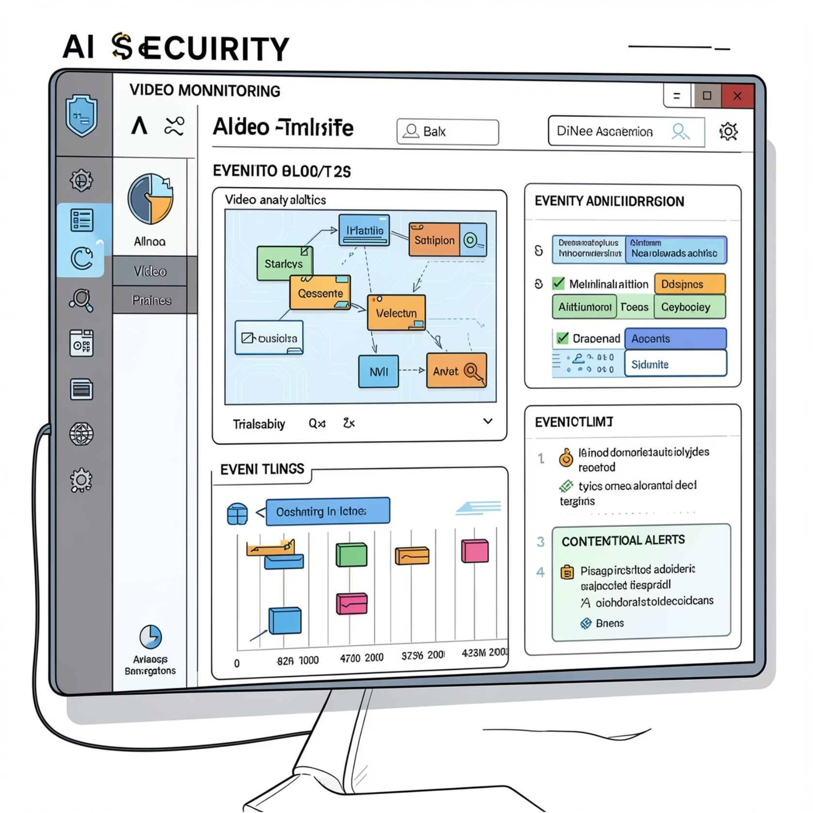
Why YOLO Alone Is Not Enough
Complex Events Require Temporal Intelligence
A single object detector cannot address all security and analytics requirements. Each event type demands a specialized AI approach combining detection, tracking, temporal analysis, and contextual reasoning.
Static detection is insufficient for behavioral events
Temporal and contextual layers are essential
Specialist models are triggered only when contextually relevant

