Slide 1
APEXLOGIX SOLUTIONS
Q4 & FY2025 Financial Performance Review

Slide 2
Executive Summary: FY2025 Highlights
• Record annual revenue of $7.25M across all business units.
• Software Subscriptions (SaaS) ARR grew 75% YoY, representing $2.1M in Q4.
• Gross margins improved to 71% in Q4, driven by software scale and robotics optimizations.
• CAPEX investment of $600K focused on robotics manufacturing equipment and logistics updates.

Slide 3
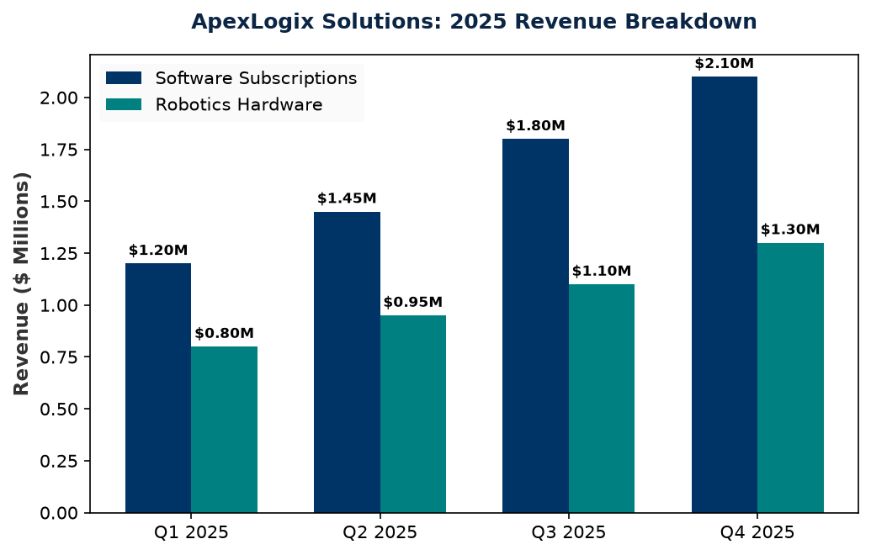
2025 Quarterly Revenue Growth
• Software SaaS is our primary growth engine, scaling from $1.2M in Q1 to $2.1M in Q4.
• Robotics Hardware revenue shows stable growth, pacing with customer deployment rollouts.
• Professional consulting services maintain a steady pipeline matching integration schedules.

Slide 4
Key Financial Profitability Ratios
• Operational efficiencies in robotics parts sourcing led to margin expansion.
• Net Margins reached a record high of 18.5% in Q4.
• Expect stable 70%+ Gross Margins heading into FY2026.
Ratio | Q1 2025 | Q2 2025 | Q3 2025 | Q4 2025
Gross Margin % | 65.0% | 67.0% | 69.0% | 71.0%
Operating Margin % | 18.0% | 20.0% | 22.0% | 25.0%
Net Margin % | 12.0% | 14.2% | 15.0% | 18.5%

