Slide 1
OPERATIONS REVIEW Q3 2025
Fulfillment Operations and Robot Fleet Performance

Slide 2
Operations Performance Overview
• Fleet utilization exceeded 94% across all customer sites during Q3.
• Total items picked grew by 42% YoY due to path planning updates.
• Supplier lead time remains a bottleneck for brushless motors (RL-202) at 30 days.
• Safety incidents: 0 reportable safety events across all deployments.

Slide 3
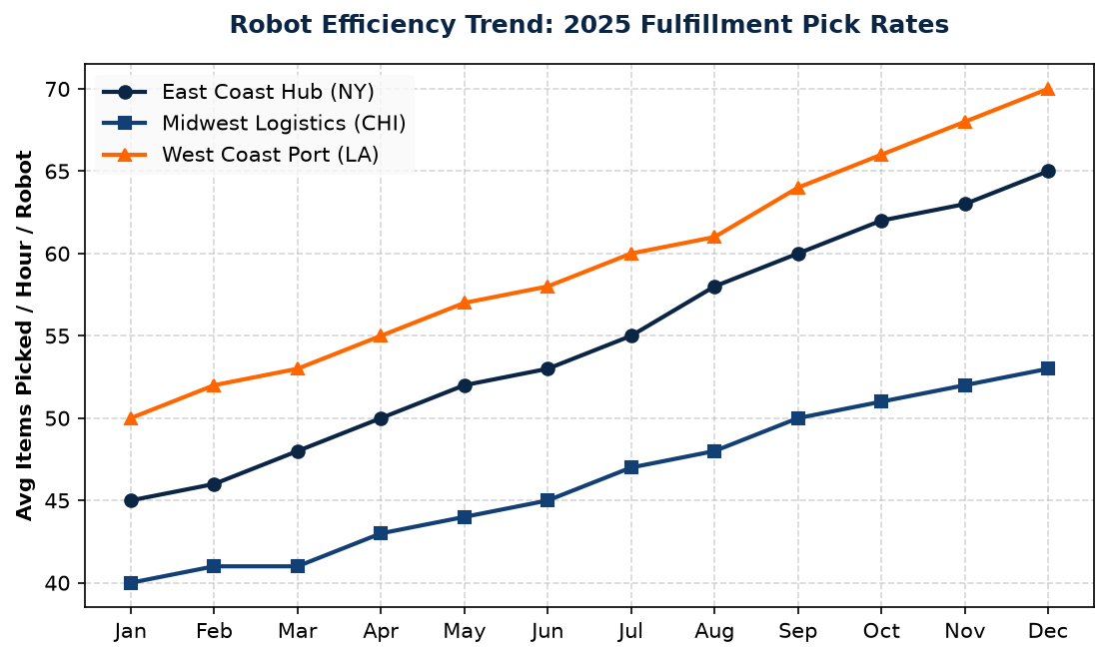
Logistics Pick Rate Optimization
• West Coast Port (LA) fleet reached a record peak of 70 picks/hour in Dec.
• East Coast Hub (NY) showed consistent gains after introducing pathing SOPs.
• Midwest Logistics (CHI) remains stable but requires lidar sensor recalibration.

