Slide 1
APEXLOGIX TECH ROADMAP 2026
Engineering Milestones and Architecture Evolution

Slide 2
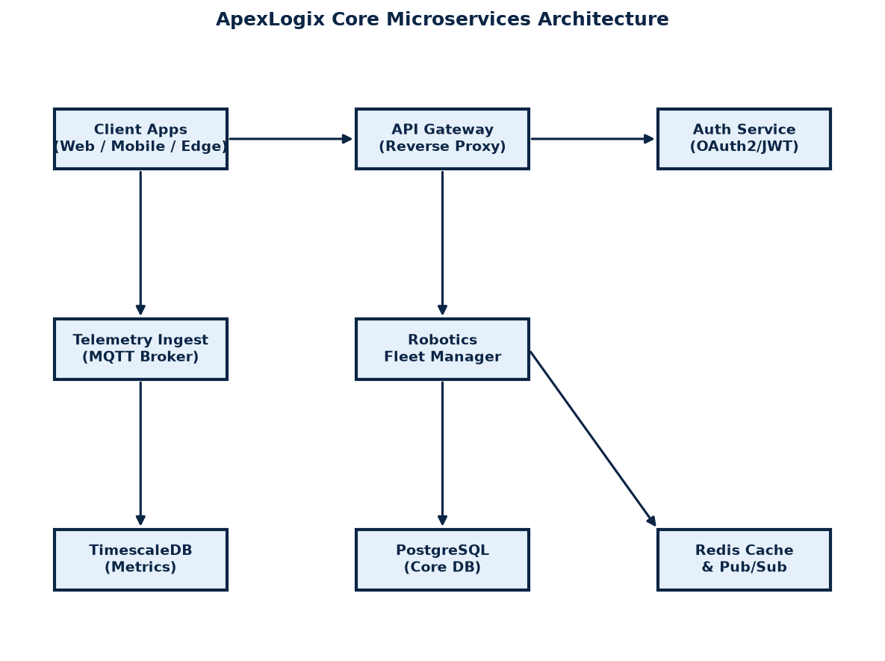
Core Platform Microservices Layout
• Decoupled telemetry ingestion uses high-speed MQTT brokers.
• Client requests route through an Auth-secured API Gateway.
• Postgres stores core configuration; TimescaleDB logs robot metrics.
• Redis cache reduces db load by 60% for frequent routing requests.

Slide 3
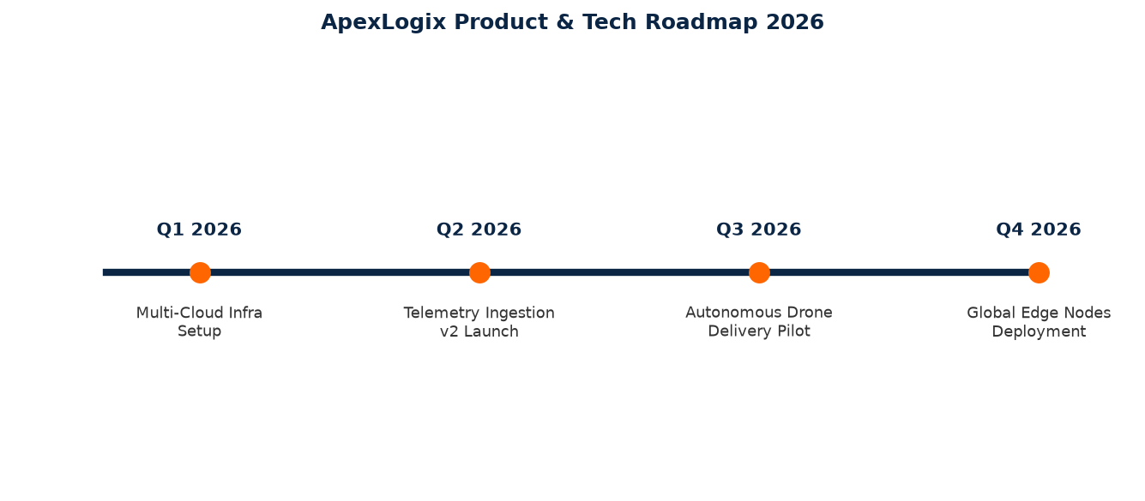
Product & Tech Roadmap 2026 Timeline
• Q1 2026: Rollout multi-cloud active-active failover for Kubernetes cluster.
• Q2 2026: Ingestion v2 launch supporting up to 50,000 concurrent robot telemetry feeds.
• Q3 2026: Autonomous Drone pathing collision avoidance pilot program in Phoenix.
• Q4 2026: Edge Compute controller nodes deployment in global logistics centers.

