Slide 1
Auto-program generation
Presented by : mentor:
Priyanshu Gautam 15103019 prof. padmavati
Pranjal kaler 15103041
Hima Mahajan 15103051
Siddharth dangwal 15103091

Slide 2
Introduction
What is Program Synthesis ?
Auto-generating program from given specifications
User specifies intent in high level description
Neural Networks have made this problem more approachable

Slide 3
Recursive program synthesis
Input parameters:
Input-Output examples
Corpus of possible tokens
Use inductive heuristic search as a means to search the corpus to synthesise valid recursive programs
Output: Program in the language of input corpus

Slide 4
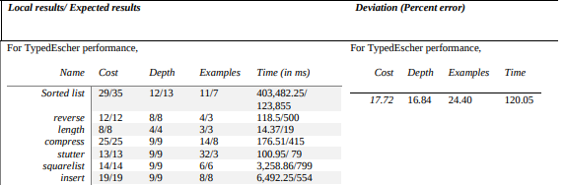
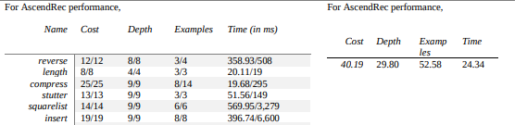
Validations
Title – Recursive Program Synthesis

Slide 5
AI BF-PROGRAMMER
Input parameters: No input required
Uses Genetic algorithm to generate program from tokens and fitness function
Output: Source code in BF language.

Slide 6
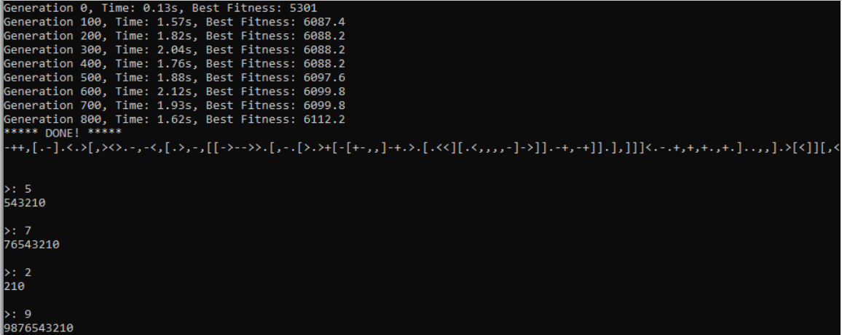
Validations
Program tested: Countdown – Prints number until 0 from the given number.
Results: Took 800 epochs while expected epochs were 900

Slide 7
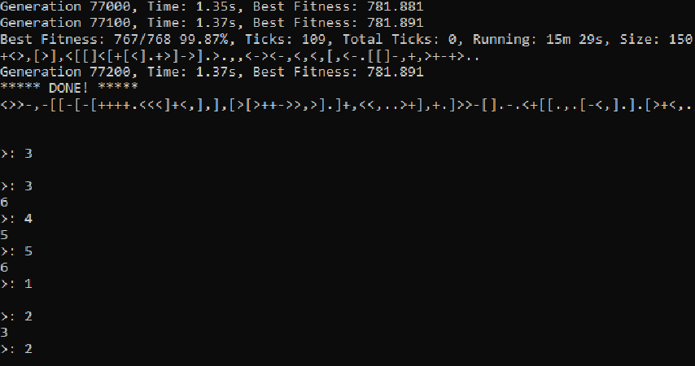
Validations
Program tested: Add given two numbers
Result – Unfamiliar Results. Took 77,100 epochs (Took 92,400 epochs, as mentioned in the paper).

Slide 8
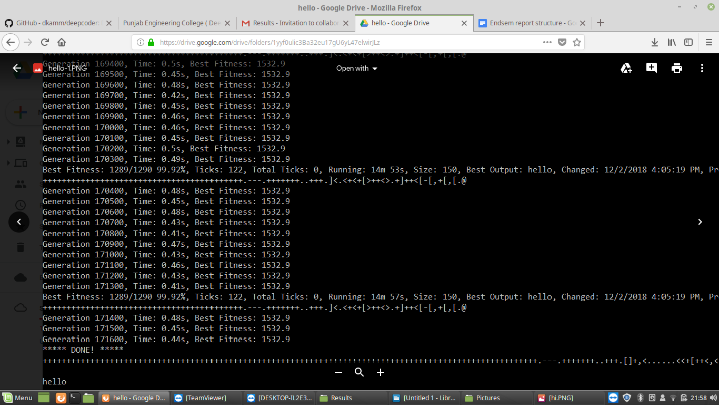
Validations
Program tested: Printing “hello” on screen
Results: Took 171,600 epochs while expected epochs were 252,000

Slide 9
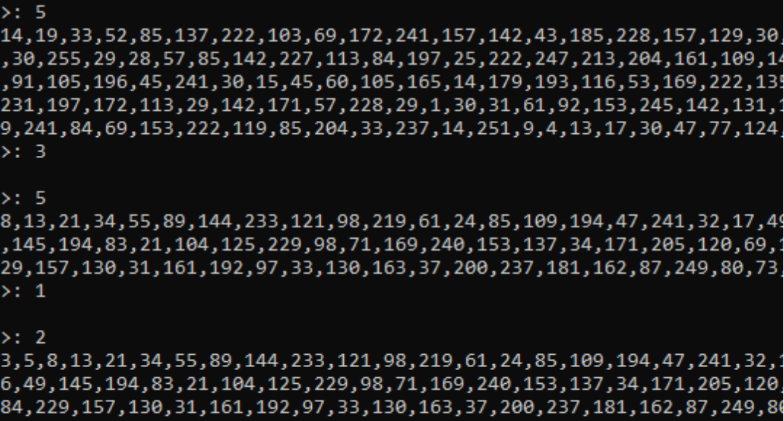
Validations
Program tested: Printing Fibonacci series on screen
Result - Does not work as expected. Took 21, 800 epochs (Took 151,900 epochs as in the paper)

Slide 10
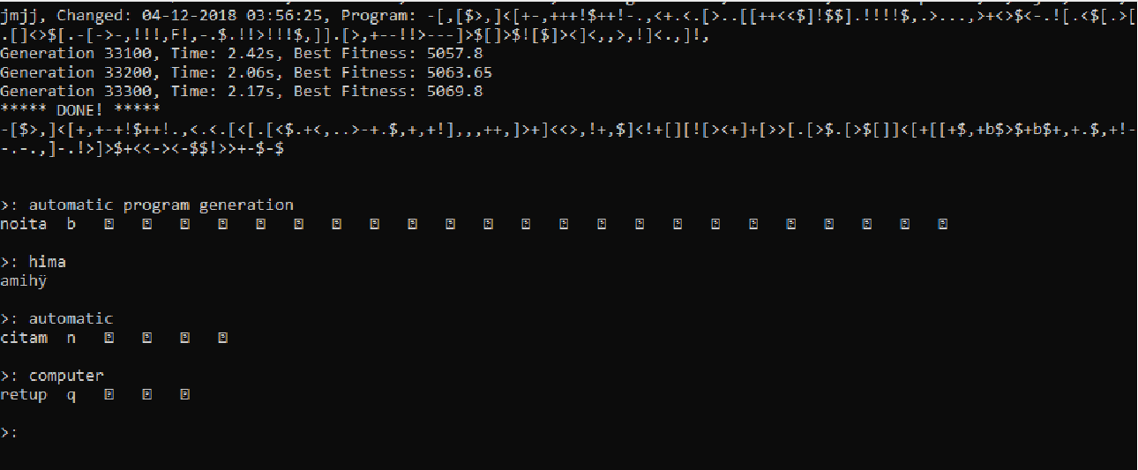
Validations
Program tested: Program to reverse a string
Result – Does not work as expected. Took 33,300 (Took 2,600 epochs as in paper)

Slide 11
Deep-coder
Input parameters: Input-Output examples
Uses machine learning to predict cues from problem description to aid search based technique.
Converts search problem to big data problem by training neural network on ISPs.
Program output: DSL

Slide 12
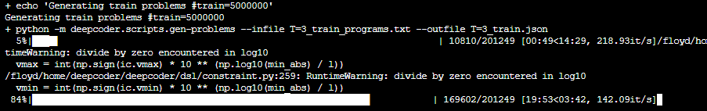
Deep-coder
Snapshot of logs during training of the model

Slide 13
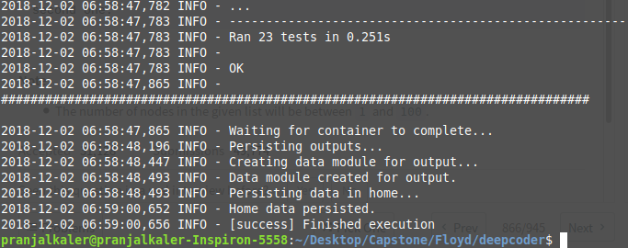
Deep-coder
Snapshot of logs during testing of the model

Slide 14
Future work
See if combining approaches of two or more models helps.
Publish research when better results are obtained with any of the above methods.

Slide 15
THANK YOU

