Slide 1
CRM Analytics
Presented by ANISH KUMAR
04/03/2026

Slide 2
CRM analytics opportunity DASHBOARD
Objective:
To analyze performance and risk indicators using KPIs.
In summary, our dashboards are designed for CRM Analytics to transform opportunity data into actionable insights that drive higher conversions, reliable forecasts, and smarter sales strategies.

Slide 3
Introduction
The Opportunity Dashboard is a comprehensive business analytics tool designed to provide visibility into sales performance, revenue trends, and opportunity management. It consolidates data from multiple sources into a single, interactive view, enabling stakeholders to monitor key metrics such as expected revenue, win/loss rates, industry distribution, and pipeline health.
By presenting information through charts, graphs, and filters, the dashboard transforms raw data into meaningful insights that are easy to interpret and act upon.
Purpose
Understand overall performance and growth patterns
Identify strengths, risks, and improvement opportunities
Support management with data-driven decisions

Slide 4
PURPOSE :
Evaluate Sales Effectiveness – Track closed deals, win/loss rates, and conversion performance.
Identify Growth Opportunities – Highlight industries and opportunity types that contribute most to revenue.
Support Strategic Planning – Compare forecast vs. expected revenue to guide resource allocation.
Monitor Pipeline Health – Assess total, active, and closed opportunities to ensure sustainable growth.
Enable Data‑Driven Decisions – Provide leadership with actionable insights for improving sales strategies and maximizing ROI.

Slide 5
Tools
.
Excel
Power Bi
Project Management Tools
Tableau
MYSQL

Slide 6
Objectives – KPIs
Expected Amount
Active Opportunities
Conversion Rate
Win Rate-Win Rate
Loss Rate
Expected Vs Forecast
Active Vs Total Opportunities
Closed Won Vs Total Opportunities .
Closed Won Vs Total Closed
Expected Amount by Opportunity Type
Opportunities by Industry

Slide 7
Scope
Data collection and validation
Data visualization and analysis
Performance monitoring across key metrics
Tools & Technology
Data Processing & Validation
Visualization Dashboard (Tableau/ Reporting Tool)
Structured database sources

Slide 8
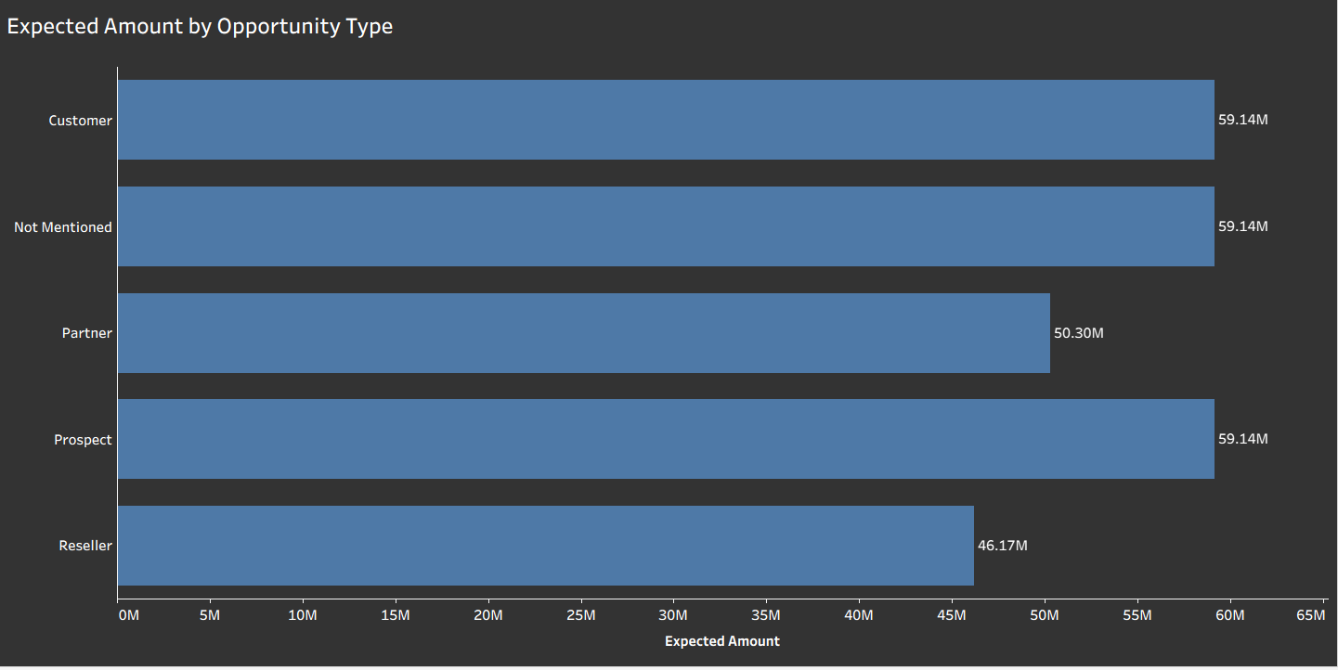
Expected Amount by Opportunity Type
Insight :
Customer, Prospect, and “Not Mentioned” each hold the highest expected amount (59.14M), showing strong potential but also data quality issues.
Partner opportunities (50.30M) highlight valuable collaboration potential.
Reseller segment (46.17M) contributes less, suggesting smaller deal sizes or limited activity.
The “Not Mentioned” category signals incomplete classification, reducing the accuracy of insights and masking true business drivers.

Slide 9
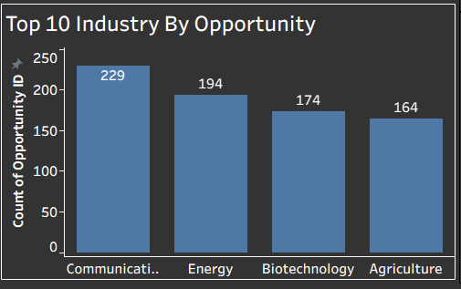
Top 10 Industry by opportunity
Insight :
Communication sector leads with 229 opportunities, reflecting strong market engagement.
Energy follows with 194 opportunities, indicating consistent demand and growth potential.
Biotechnology (174) and Agriculture (164) highlight emerging and steady opportunities, suggesting diversification beyond traditional tech.
Takeaway: Focus on Communication and Energy for immediate impact, while nurturing Biotechnology and Agriculture for long‑term growth.

Slide 10
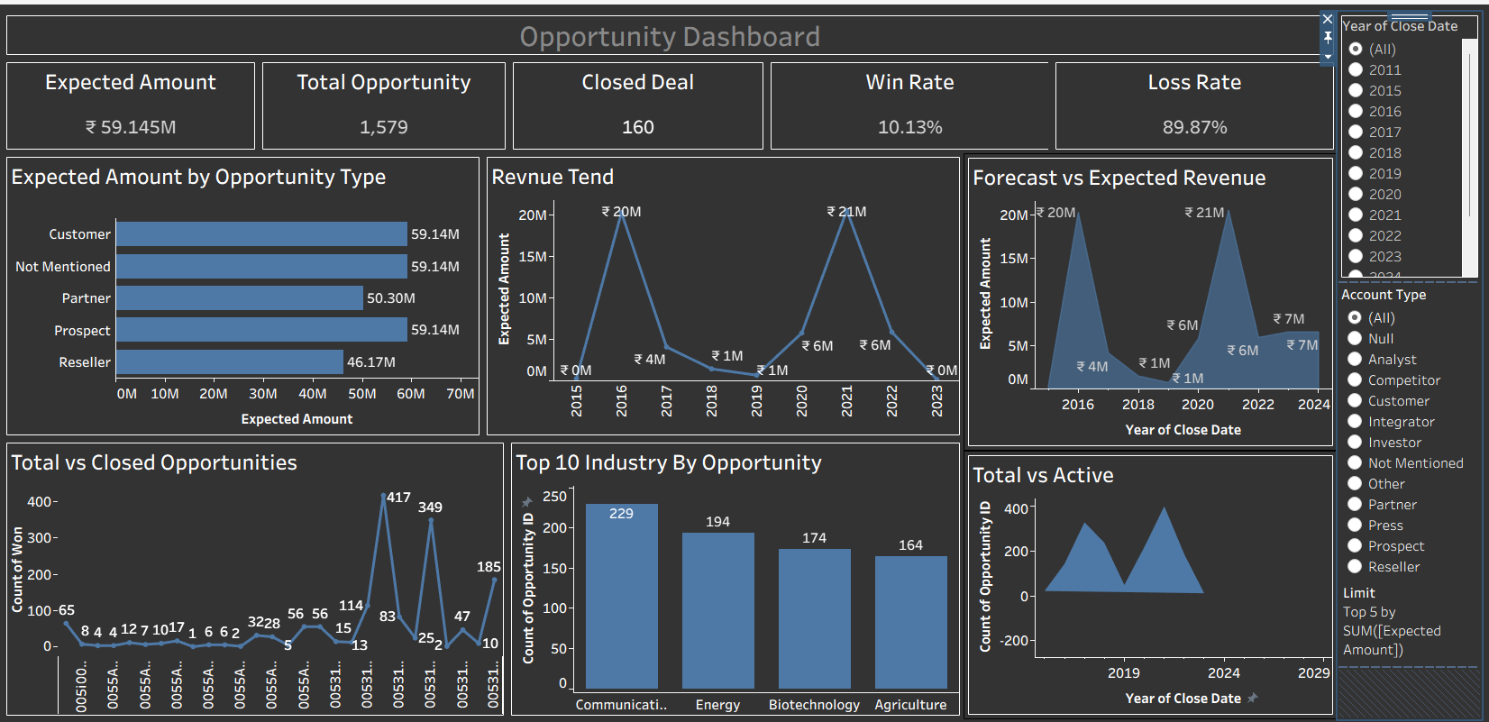
Dashboard (Tableau):

Slide 11
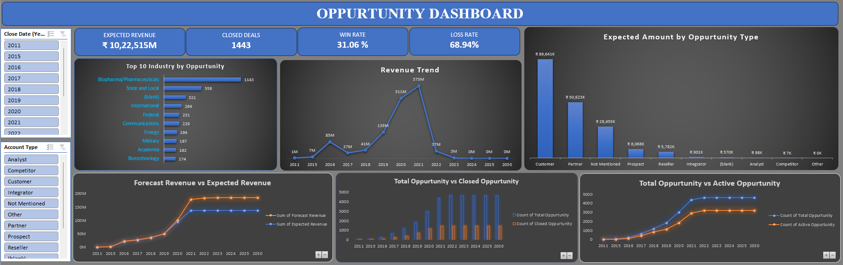
DASHBOARD (EXCEL)

Slide 12
LEAD DASHBOARD
Tool Used: Tableau
Dataset: Lead Dashboard Analytics
Objective:
Track lead sources, industries, and stages
Measure conversion efficiency
Identify high-performing channels

Slide 13
Introduction
About the Project
Delivers actionable insights on lead sources, industry trends, and conversion performance
Identifies high-value opportunities to improve targeting and resource allocation
Enables data-driven decision-making across marketing and sales functions
Optimizes campaign effectiveness to increase lead quality and conversion rates.
PURPOSE
Analyze lead data to understand generation trends, conversion rates, and overall sales performance.
Identify high-performing channels and track lead movement across different stages of the funnel.
Provide data-driven insights to improve decision-making, optimize marketing strategies, and increase business growth.

Slide 14
Introduction
Scope
Deliver interactive analysis of lead data to uncover trends, customer behavior, and acquisition patterns.
Evaluate the complete sales funnel to identify drop-offs, improve conversions, and enhance lead quality.
Generate actionable insights through dashboards to optimize marketing strategies and drive business growth.
Tools & Technology
Data processing & validation
Visualization dashboard (tableau/ reporting tool)
Structured database sources

Slide 15
OBJECTIVES - KPIS
Total Leads: 10K
Converted Accounts: 1,006
Converted Opportunities: 367
Conversion Rate: 8.95%
Expected Revenue: ₹38,724K
Lead By Source
Lead By Industry
Lead Conversion
Lead By Stage

Slide 16
PROCESS
Step 1: Data Cleaning (Null check, format correction)
Step 2: Created Calculated Fields
Step 3: Built Charts (Customer ID, Customer Name, Account Number)
Step 4: Dashboard Design and KPI Cards

Slide 17
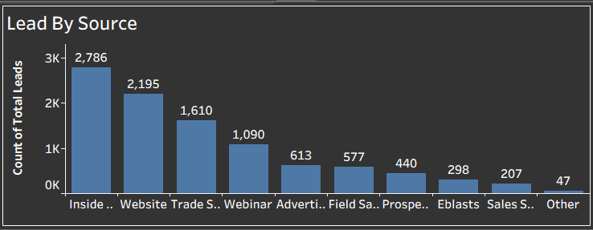
KPI -01
Inside Sales is the most effective lead generation channel
Digital platforms (Website, Webinars) also play a strong role
Some channels contribute very little and may need optimization

Slide 18
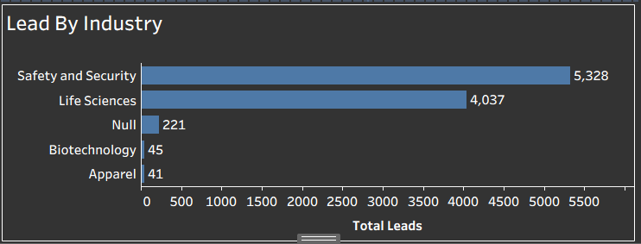
KPI -02
Safety & Security is the dominant industry for lead generation
Life Sciences is the second major contributor
Other industries have very low engagement and potential

Slide 19
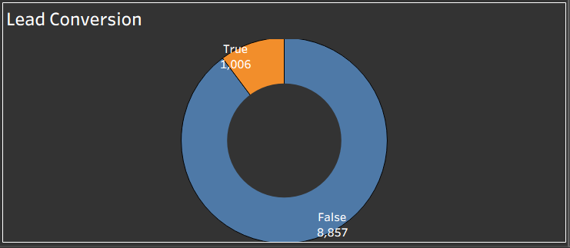
KPI -03
Very small portion of leads are converted
Majority of leads are lost or remain unconverted
Conversion rate is relatively low and needs improvement

Slide 20
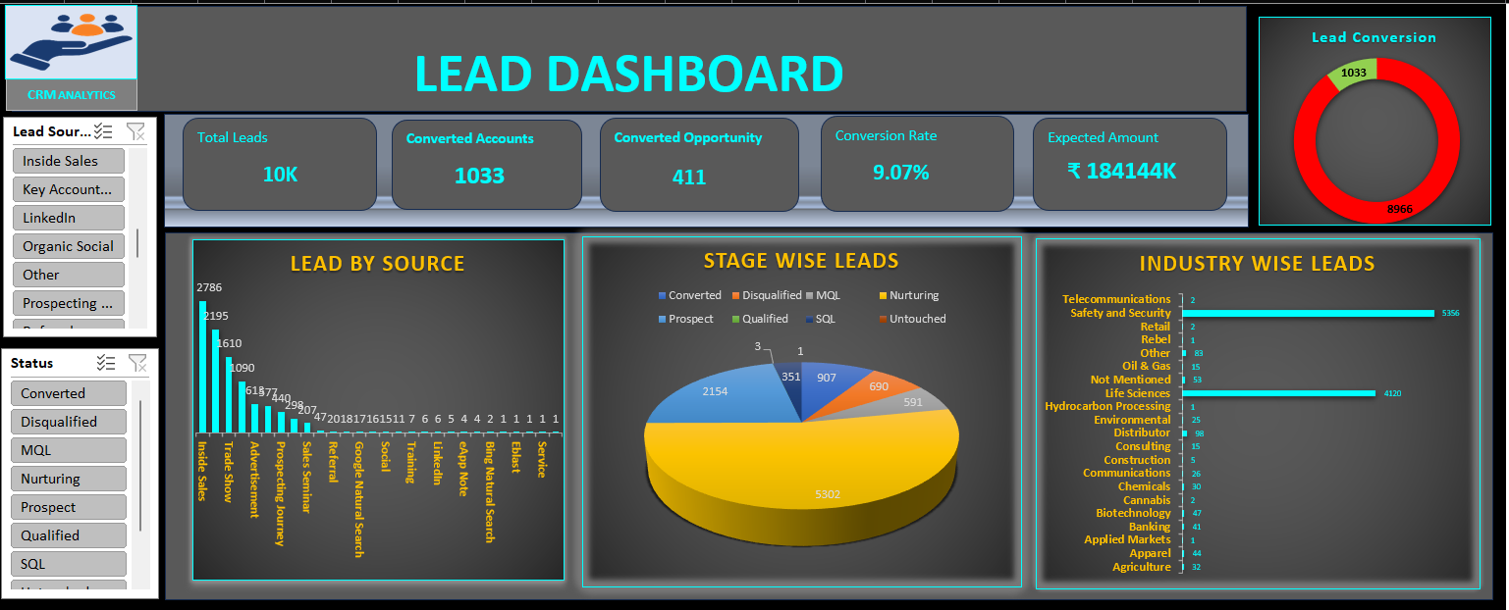
EXCEL

Slide 21
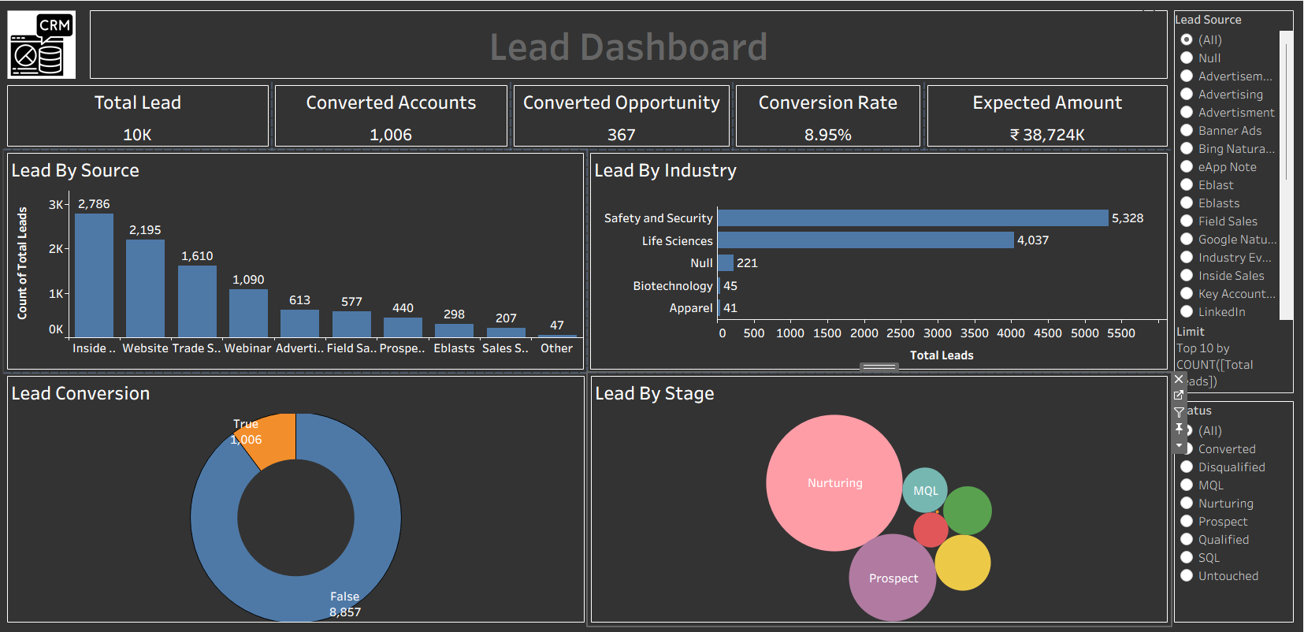
TABLEAU

Slide 22
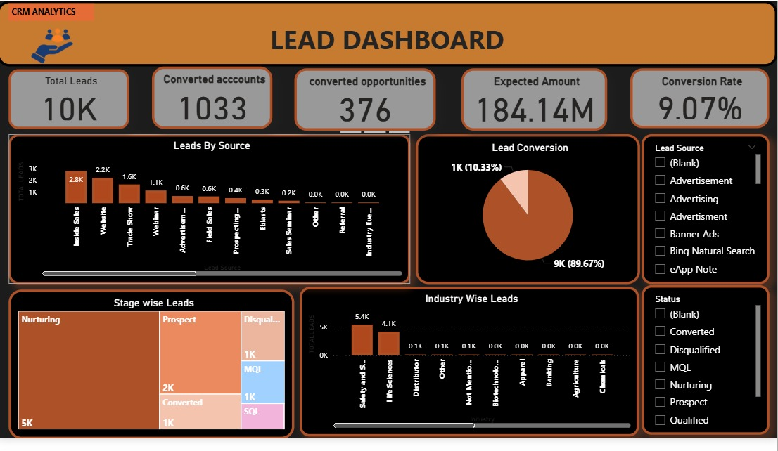
POWER BI

Slide 23


