Slide 1
RoleFitAI
A job portal and Human Resource Management System (HRMS) powered by Large Language Models (LLMs)
Contributors:
Atharva Mohite
Priyanshu Rao
Tanishq Selot

Slide 2
Job Description Evaluation
Scoring Job Descriptions by Title
The similarity score between the Job Title (JT) and the Job Description (JD) represent an average of two distinct scores:
Semantic Similarity Score: By utilizing Sentence Transformers, both the JT and each sentence within the JD are transformed into vectors. A cosine similarity score is subsequently computed between each sentence vector and the JT vector. The highest cosine similarity score attained is selected as the Semantic Similarity score.
Word Match Score: This score denotes the count of shared words between the JT and the JD, divided by the total word count of the JT.
The Similarity Score ranges between 0 and 1, with a value of 1 indicating the highest degree of similarity between the JT and JD.

Slide 3
Providing improvements/elaboration for the Job Description
For this task, we employed the open-source language model LLM - GPT4ALL. Given the limitations of the LLM, we segmented the job description (JD) into chunks of 137 characters each.
Subsequently, we inputted each chunk into the LLM, which generated refined and more detailed versions. These enhanced segments were seamlessly integrated into our application, granting HR users the option to conveniently download the improved job description versions.

Slide 4
CV Ranking
Calculating the similarity score for JD and CVs
We devised an algorithm for ranking CVs in accordance with the Job Description. This algorithm extracts keywords from both the CVs and the Job Description, subsequently verifying the presence of job description keywords within the resume content.
If a keyword from the job description is identified in the resume, a score of 1 is appended to the score list. Conversely, if the keyword is absent, the cosine similarity score is computed between the keyword in the Job Description and the corresponding keyword in the resume. The cumulative CV score is then determined by summing up all individual scores for each keyword and subsequently dividing the total by the number of keywords within the job description.

Slide 5
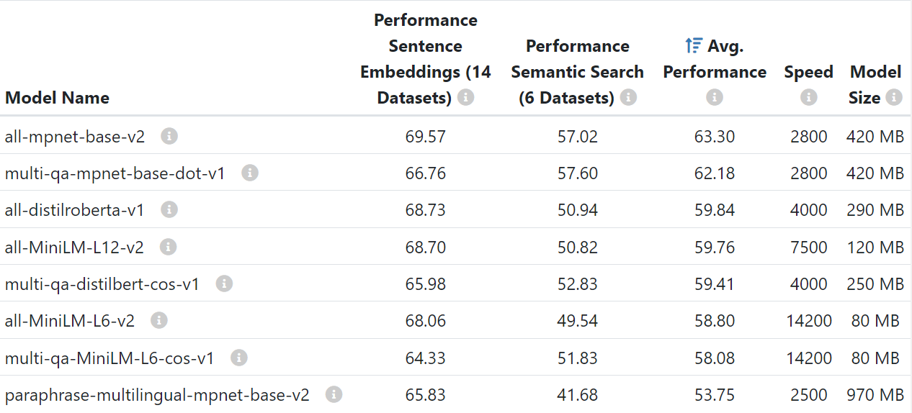
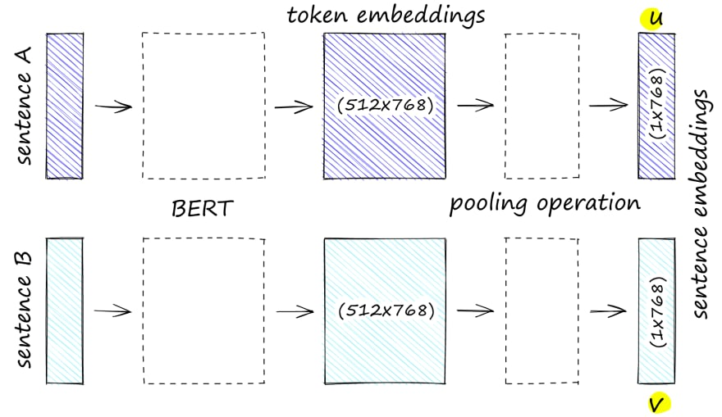
Following experimentation with several Sentence Transformers available on Hugging Face, the all-mpnet-base-v2 model was employed to generate vector embeddings for both the job title (JT) and job description (JD) sentences.

Slide 6

Communication with the HR
Integration into the application and mailing the candidate regarding further rounds
Introducing our Dynamic Platform, designed for candidates to effortlessly submit their details and resume. The candidate data along with their score generated by our Machine Learning Model, find its place within our robust MySql DataBase.

Slide 7

This Platform extends its capabilities to HR Managers , granting them the power to upload job descriptions, subsequently fine tuned by our proficient ML Model

Slide 8
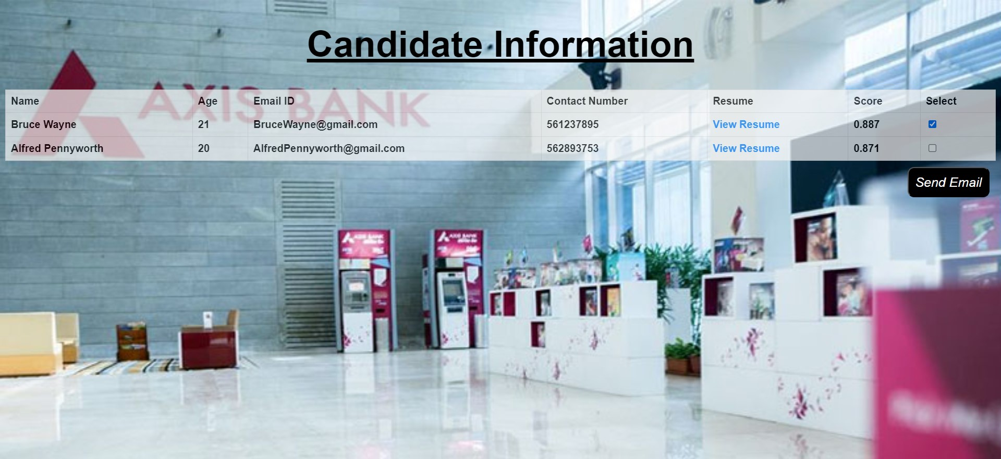
HR Managers can conveniently access candidate data along with their score and send a mail to the selected candidates as well.

