Slide 1
SignalSense-Gait-3D
Real-Time Wi-Fi Digital Twin Laboratory for Multi-User Human Motion Monitoring
Using Wi-Fi RSSI-Based Human Localization
🔹 PROJECT NAME: SignalSense-Gait-3D
🔹 PRESENTER NAME: Priyanshu (Intern)
🔹 INSTITUTE: Indian Institute of Technology (IIT) Kharagpur
🔹 MENTOR NAME: Shubham sir
🔹 DATE: 27 July 2026
🔹 BACKGROUND: Signal Sense
Notes:
Good morning respected evaluation committee members, professors, and fellow researchers. Today, I am privileged to present our research defense on 'SignalSense-Gait3D: A Real-Time Wi-Fi Digital Twin Laboratory for Multi-User Human Motion Monitoring'. This research tackles the critical challenge of indoor human localization and spatial tracking by transforming off-the-shelf commercial Wi-Fi networks into an intelligent, non-intrusive, and privacy-preserving 3D digital twin testbed.

Slide 2
01. PRESENTATION OVERVIEW
Presentation Agenda & Content Roadmap
📍 [01] Introduction & Domain Background
📍 [07] Frontend & Three.js Framework
📍 [13] Network Topology Visualization
📍 [19] Current Technical Limitations
📍 [02] Problem Statement & Motivation
📍 [08] Live Data Streaming Pipeline
📍 [14] 3D Laboratory Interactive View
📍 [20] Future Sensor Scope (CSI, mmWave)
📍 [03] Research Objectives & Scope
📍 [09] Distance Estimation & Path Loss Math
📍 [15] Real-time Client Telemetry Panel
📍 [21] Demo Screens Showcase
📍 [04] Overall System Architecture
📍 [10] 3D Digital Twin Representation
📍 [16] Real-Time Synchronization Features
📍 [22] Unified Project Pipeline Summary
📍 [05] Technology Stack Ecosystem
📍 [11] Automatic Human Detection Logic
📍 [17] Key Architectural Capabilities
📍 [23] Conclusion & Thesis Achievements
📍 [06] Backend Engine Architecture
📍 [12] Dashboard Overview
📍 [18] Research & Academic Contributions
📍 [24] Open Q&A and Academic Critique
SignalSense-Gait3D | Real-Time Wi-Fi Digital Twin Laboratory for Multi-User Human Motion Monitoring
Slide 2 / 25
Notes:
Here is the detailed structural agenda for today's presentation. We will transition systematically from fundamental indoor monitoring concepts and problem motivation into our core hardware and software architecture. We will examine the real-time data streaming pipeline, mathematical distance models, and our interactive Three.js 3D visualization dashboard, finally concluding with technical limitations, future sensor enhancements, and live laboratory demonstrations.

Slide 3
02. DOMAIN INTEL & BACKGROUND
Introduction to Real-Time Wi-Fi Digital Twins
🏢 Indoor Human Monitoring
• Context & Relevance: Continuous indoor presence and motion awareness is essential for healthcare, security, and smart building IoT automation.
• The Digital Twin Paradigm: Creates a live, synchronized 3D virtual replica of physical spaces, bridging real-world RF telemetry with visual graphics.
• Wi-Fi Sensing & Localization: Utilizes wireless attenuation fluctuations (RSSI) to detect and track human mobility without requiring worn sensors or tags.
📡 Why Wi-Fi Over Cameras?
• Zero Optical Intrusion: Eliminates visual surveillance entirely, ensuring psychological discomfort and ethical constraints are eradicated.
• No Line-of-Sight Dependency: Radio frequency waves penetrate interior walls, partitions, and wooden furniture where optical camera lenses face blind spots.
• Zero-Client Requirement: Users simply carry standard Wi-Fi enabled smartphones or laptops without installing custom tracking software.
💎 Core Enterprise Benefits
• 🛡️ Total Privacy Preservation: 100% compliant with privacy regulations; ideal for hospitals, personal living quarters, and restricted R&D labs.
• 💰 Ultra-Low Cost Footprint: Replaces thousands of dollars in video streaming infrastructure with simple $30-$50 commercial off-the-shelf routers.
• 🏗️ Existing Infrastructure: Zero wiring or physical renovations required—directly utilizes existing enterprise campus wireless networks.
SignalSense-Gait3D | Real-Time Wi-Fi Digital Twin Laboratory for Multi-User Human Motion Monitoring
Slide 3 / 25
Notes:
To introduce the domain, indoor human monitoring has emerged as a cornerstone for intelligent buildings, elderly healthcare caretaking, high-security facility management, and dynamic energy optimization. A Digital Twin in this domain refers to a real-time virtual simulation that accurately mirrors physical environmental states. Why choose Wi-Fi over conventional camera surveillance? Our approach leverages ambient Wi-Fi Received Signal Strength Indication (RSSI) to localize human users. This delivers three transformational benefits: absolute privacy preservation without facial capturing, extremely low cost by avoiding expensive camera setups, and rapid deployment by piggybacking on pre-existing enterprise Wi-Fi routers.

Slide 4
03. RESEARCH MOTIVATION
Problem Statement: The Indoor Tracking Dilemma
🚫 Camera & Vision-Based Dependency
• Optical Blind Spots & Occlusions: Physical barriers, partitions, and dynamic lighting variations sever tracking reliability.
• High Computation Overheads: Video feeds demand massive GPU video decoding pipelines and costly high-bandwidth localized networking.
🔒 Severe Privacy & Ethical Concerns
• Invasive Facial Recognition: Optical surveillance captures identifiable personal features, generating user resistance and regulatory compliance roadblocks.
• Restricted Deployment Zones: Cameras cannot be deployed in bathrooms, patient hospital recovery suites, or highly secure proprietary clean-rooms.
💸 Prohibitive Deployment & Hardware Costs
• High Capital Expenditure (CapEx): Dedicated UWB antenna arrays, optical cameras, and infrared LiDAR systems cost thousands per room.
• Intensive Installation Footprint: Requires intrusive wall drilling, structured cabling, and dedicated maintenance technicians.
🎯 ⚡ The Research Solution: Non-Camera RF Digital Twin
• The Engineering Imperative: We require a software-defined, real-time tracking testbed that replaces cameras with ordinary Wi-Fi propagation analysis.
• Bridging RF with 3D Simulation: Transforming raw noisy Received Signal Strength (RSSI) into an intuitive, synchronized Three.js virtual laboratory.
SignalSense-Gait3D | Real-Time Wi-Fi Digital Twin Laboratory for Multi-User Human Motion Monitoring
Slide 4 / 25
Notes:
This brings us directly to our formalized Problem Statement. Currently available indoor monitoring solutions exhibit critical technological friction points. Camera systems suffer from severe optical line-of-sight limitations, create immense privacy backlash in personal or enterprise settings, and introduce heavy installation and maintenance costs. On the other hand, traditional wearable trackers require physical compliance. Therefore, there exists a critical scientific and engineering gap: the urgent necessity for an accessible, real-time, non-camera, privacy-preserving monitoring framework capable of converting raw RF noise into a visually coherent 3D Digital Twin.

Slide 5
04. TARGET ACHIEVEMENTS
Research & Engineering Objectives
🌐 Real-Time Wi-Fi Digital Twin
• Develop a sub-second, synchronized virtual laboratory reflecting live indoor RF states.
🔍 Automatic Device Discovery
• Implement zero-touch detection of connected Wi-Fi clients (smartphones, IoT, laptops).
📏 RSSI Distance Estimation
• Convert noisy raw dBm attenuation into spatial Euclidean radial distances via EMA filtering.
🧑 3D Human Avatar Graphics
• Dynamically instantiate and reposition interactive human representations inside Three.js.
📊 Enterprise Web Dashboard
• Engineer a sleek, professional telemetry dashboard featuring gauges, logs, and live health charts.
🔗 Automatic Topology Updates
• Construct live force-directed network graphs visualizing router-to-client wireless connectivity.
⚡ Scalable Event Architecture
• Design an asynchronous Python WebSocket engine capable of concurrent multi-user telemetry.
🚀 Future-Proof Sensor Support
• Provide modular abstract classes for upcoming CSI, BLE Angle-of-Arrival (AoA), and mmWave hardware.
SignalSense-Gait3D | Real-Time Wi-Fi Digital Twin Laboratory for Multi-User Human Motion Monitoring
Slide 5 / 25
Notes:
To resolve these challenges, we established eight distinct engineering and research objectives for SignalSense-Gait3D. First, developing an end-to-end real-time Wi-Fi digital twin laboratory testbed. Second, implementing zero-configuration client discovery to detect connected Wi-Fi users automatically. Third, estimating spatial distances using mathematically filtered RSSI signal degradation equations. Fourth and fifth, displaying responsive 3D human avatars within a centralized enterprise web dashboard. Sixth, automating live topology graph updates. Seventh, structuring a scalable, asynchronous event-driven backend. And finally, engineering modular hardware interfaces to support future sensor expansions like Wi-Fi CSI, UWB, and mmWave radar.

Slide 6
05. SYSTEM BLUEPRINT
Overall System Architecture Diagram
📡
Commercial Router
Physical Wi-Fi Gateway
➔
🔌
Router Plugin
SOAP/REST Driver API
➔
🔍
Device Discovery
ARP / DHCP Polling
➔
🗃️
State Manager
Concurrent Client Map
📉
RSSI Collection
Raw dBm Scraping Engine
➔
📐
Distance Engine
Log-Distance EMA Math
➔
⚡
WebSocket Stream
Async Sub-second TCP Push
➔
⚛️
Frontend UI
React 18 SPA Framework
🎮
Three.js Canvas
GPU 3D Scene Renderer
➔
🏢
Digital Twin Lab
Virtual Room Geometry
➔
🧑‍🤝‍🧑
Human Avatars
Real-Time 3D Presence
➔
📊
Telemetry UI
Live Enterprise Charts
SignalSense-Gait3D | Real-Time Wi-Fi Digital Twin Laboratory for Multi-User Human Motion Monitoring
Slide 6 / 25
Notes:
Slide 6 presents our complete end-to-end system architecture. Our design is segmented into three logical tiers: The Physical Network & Discovery Layer, the Backend Analytical Engine, and the Frontend 3D Visualization Pipeline. At the top left, standard Wi-Fi routers communicate with connected client devices. Our abstract Router Plugin periodically scrapes routing logs, feeding the Device Discovery engine and Device State Manager. Next, raw RSSI readings are harvested, smoothed by exponential moving average filters, and converted into radial distance estimates. Finally, these high-frequency telemetry packets are streamed over WebSockets into our React frontend, where our Three.js graphics engine interpolates coordinates to update virtual 3D human avatars in real-time.

Slide 7
06. SOFTWARE & TOOLS ARCHITECTURE
Technology Stack Ecosystem
⚙️ Backend Engine
• 🐍 Python 3.10+: Core backend language providing high concurrency, rigorous mathematical modeling, and hardware driver extensibility.
• ⚡ FastAPI Framework: Modern high-performance asynchronous REST API framework serving configuration endpoints and client metadata.
• 🔌 WebSockets Protocol: Bi-directional persistent TCP connections pushing continuous telemetry stream updates to client web browsers.
• 📐 Pydantic & SQLAlchemy: Strict data model validation ensuring type safety across raw router RSSI inputs and SQL storage logs.
🖥️ Frontend & 3D Graphics
• ⚛️ React 18 & TypeScript: Component-driven Single Page Application engineered for modularity, strict typing, and responsive state reactivity.
• 🎮 Three.js & Fiber: Industry-standard JavaScript 3D engine rendering interactive virtual laboratory rooms, shadows, and avatars.
• ⚡ Vite Build Engine: Next-generation bundling utility delivering instant module hot-reloading and optimized production distribution.
• 🎨 TailwindCSS & Charts: Modern dark-blue enterprise design system featuring glassmorphic components and real-time charting canvases.
🌐 Networking & Protocols
• 📡 Commercial Router APIs: Interactions via native network gateway protocols including SOAP XML interfaces, RESTful APIs, and telnet scraping.
• 📦 JSON RPC Payloads: Lightweight, standardized JSON schema structures representing client MAC addresses, IP assignments, and RSSI metrics.
• 🔄 Low-Latency Polling: Configurable sampling frequency intervals ranging from 250ms to 2000ms tailored for environmental noise smoothing.
• 🔒 Enterprise Security: Secure local LAN binding and authenticated WebSocket handshakes preventing unauthorized network sniffing.
SignalSense-Gait3D | Real-Time Wi-Fi Digital Twin Laboratory for Multi-User Human Motion Monitoring
Slide 7 / 25
Notes:
To construct this architecture, we curated an advanced, robust, and research-grade Technology Stack. Our backend is powered by Python 3.10+ utilizing the high-performance FastAPI framework, asynchronous WebSockets, and Pydantic for rigorous JSON telemetry schema validation. On the frontend, we utilize React 18 with TypeScript, bundled via blazing-fast Vite, styled with custom enterprise Vanilla CSS and Tailwind tokens, and powered by Three.js for hardware-accelerated 3D graphics. Finally, our networking protocol layer leverages SOAP, REST, and JSON RPC over TCP WebSockets to establish sub-second bi-directional synchronization between the physical router and virtual avatars.

Slide 8
07. SERVER ENGINE STRUCTURE
Backend Architecture & Service Modules
🔌 Router Plugin API
• Abstract interfaces accommodating commercial hardware (Netgear, Asus, OpenWrt) via unified methods.
🔍 Discovery Engine
• Continuous ARP and DHCP sniffing identifying newly joined smartphone and laptop devices instantaneously.
🗄️ DeviceStateManager
• Thread-safe central state dictionary coordinating client lifecycles, connection histories, and timeouts.
📉 RSSI Pipeline
• High-frequency signal scraping handler managing jitter, out-of-range packet drops, and attenuation bounds.
📐 Distance Engine
• Executes mathematical Path Loss equations and Exponential Moving Average algorithms to infer meter radius.
📈 Telemetry Hub
• Computes secondary heuristics including Signal-to-Noise Ratio (SNR), AI confidence scores, and motion activity.
⚡ WebSocket Server
• Async broadcast server transmitting real-time JSON state deltas to connected React browser instances.
🔄 Synchronization Core
• Ensures zero packet duplication, graceful reconnection handling, and immediate purge of stale offline avatars.
SignalSense-Gait3D | Real-Time Wi-Fi Digital Twin Laboratory for Multi-User Human Motion Monitoring
Slide 8 / 25
Notes:
Diving deeper into the Backend Architecture, our server engine functions as a cohesive, multi-threaded processing pipeline. The Router Plugin acts as an abstract driver layer decoupling manufacturer-specific router APIs from our core code. The Discovery Engine monitors local network ARP tables and DHCP assignments to register clients. The DeviceStateManager maintains an asynchronous in-memory state registry tracking device presence, packet loss, and connectivity status. The RSSI Pipeline cleans noisy radio attenuation inputs, passing them into our Distance Engine which applies logarithmic propagation mathematics. Ultimately, the Telemetry hub condenses these analytics and broadcasts them instantly via our WebSocket Server for flawless synchronization.

Slide 9
08. CLIENT GUI STRUCTURE
Frontend Architecture & 3D Canvas
⚛️ React & Vite Realtime Dashboard
• Reactive State Framework: Custom React hooks consume asynchronous WebSocket streams to update interface cards without page reloading.
• Enterprise Dark Theme: Tailored dark-blue aesthetic styled with high-contrast neon accents, promoting visual readability during extended research trials.
🎮 Three.js Scene Renderer
• GPU-Accelerated Virtual Lab: Renders an interactive 3D laboratory room complete with floor boundaries, router node anchor, and spatial grid.
• Camera Controls & Raycasting: Offers free-fly orbit zooming, interactive pan controls, and mouse-click selection of virtual avatars.
🧑 Avatar Manager Engine
• Dynamic 3D Lifecycle Control: Automatically instantiates humanoid virtual avatars and places them on computed Euclidean radii upon client join.
• Visual Distance Rings: Generates glowing, concentric radar rings indicating real-time signal bounds and spatial confidence zones.
📊 Telemetry & Analytics Panel
• Live Signal History Charting: Plots real-time RSSI attenuation curves, signal stability margins, and multi-user comparative trajectories.
• AI & Motion Heuristics UI: Displays real-time activity metrics classifying clients as Static, Walking, or Out-of-Range based on variance.
SignalSense-Gait3D | Real-Time Wi-Fi Digital Twin Laboratory for Multi-User Human Motion Monitoring
Slide 9 / 25
Notes:
Turning to our Frontend Architecture, the web application is built upon React 18 and Three.js, segregated into four specialized functional modules. First, the Realtime Dashboard and State Hooks provide an intuitive enterprise UI managing global socket connections, system notifications, and dark-theme rendering. Second, the Telemetry Panel renders fluid dynamic line charts graphing live RSSI attenuation histories and AI confidence metrics. Third, the Avatar Manager programmatically governs 3D humanoid lifecycles—instantiating models when devices join and purging them when they exit. Lastly, our Three.js Scene Renderer coordinates virtual room meshes, spatial shadows, camera orbit controls, and interactive ray-casting for item selection.

Slide 10
09. TELEMETRY EXECUTION PIPELINE
Live Real-Time Data Flow Pipeline
📡
1. Wireless Router
Captures ambient user RF signals
➔
📱
2. Connected Client
Smartphone / Laptop transmission
➔
📉
3. Raw RSSI Harvesting
Periodic dBm signal polling
➔
⚙️
4. Backend Server
Asynchronous FastAPI engine
📐
5. Distance Model
Log-Distance EMA calculation
➔
⚡
6. WebSocket Stream
Real-time TCP JSON push
➔
⚛️
7. React UI State
Client component reconciliation
➔
🎮
8. Three.js Engine
3D scene geometry binding
🌐
9. Digital Twin Lab
Virtual space synchronization
➔
🧑
10. Avatar Repos
Radial position interpolation
➔
📊
11. Telemetry Plot
Live UI line chart rendering
➔
🛡️
12. Health Monitor
Continuous network Quality of Service
SignalSense-Gait3D | Real-Time Wi-Fi Digital Twin Laboratory for Multi-User Human Motion Monitoring
Slide 10 / 25
Notes:
To clearly illustrate our operational runtime, Slide 10 traces the Live Data Flow through a single iteration of our synchronization pipeline. Step 1: Physical wireless user devices emit standard RF communications received by the campus router. Step 2: The backend engine polls raw Received Signal Strength Indication (RSSI) parameters in dBm. Step 3: Our mathematical Path Loss Propagation Model applies Exponential Moving Average algorithms to filter out room reflections and computes distance. Step 4: Formatted JSON payload packets are broadcasted over persistent TCP WebSockets. Step 5: The React Client reconciles state changes without latency. Step 6: The Three.js Digital Twin updates the virtual human avatar's radial placement across the 3D canvas.

Slide 11
10. SIGNAL PROCESSING & LIMITATIONS
Mathematical Distance Estimation & Scientific Boundaries
📐 Log-Distance Path Loss & EMA Filter
• Log-Distance Path Loss Formula: Relates RSSI signal decay logarithmically to distance from Access Point:
RSSI(d) = RSSI(d₀) - 10 · n · log₁₀(d / d₀) + X_σ
• Parameter Definitions: • RSSI(d): Measured attenuation power at distance d in dBm.
• RSSI(d₀): Reference signal strength at 1 meter (typically -35 to -45 dBm).
• n: Environmental path loss exponent (2.0 in free space, 2.5–3.5 indoors).
• X_σ: Zero-mean Gaussian environmental fading random variable.
• Exponential Moving Average (EMA): Dampens severe signal spikes caused by room interference and walking obstacles:
RSSI_smooth(t) = α · RSSI_raw(t) + (1 - α) · RSSI_smooth(t-1)
• Noise Suppression: By setting α ∈ [0.2, 0.4], high-frequency multipath reflections are systematically suppressed without introducing heavy rendering lag.
🛑 ⚠️ Scientific Limitations: Estimated vs. Exact
• CRITICAL ACADEMIC DISTINCTION: This system delivers an ESTIMATED RADIAL DISTANCE, NOT an EXACT directional Cartesian coordinates (X, Y).
• Single-Router Geometric Constraints: A single access point acts as an omnidirectional antenna. A distance estimate of 3.5 meters places the client along a 360-degree radial ring.
• Multipath Reflection & Shadowing: Concrete walls, metal partitions, and moving humans reflect and absorb 2.4/5 GHz radio frequencies, inducing non-linear RSSI fluctuations.
• Device Antenna Diversity: डिफरेंट smartphones feature varying internal gain configurations; calibration offsets are required for centimeter-grade uniformity.
• Research Validation: Our UI explicitly depicts confidence bounds and warning banners to reflect rigorous academic transparency.
SignalSense-Gait3D | Real-Time Wi-Fi Digital Twin Laboratory for Multi-User Human Motion Monitoring
Slide 11 / 25
Notes:
Slide 11 addresses our mathematical distance estimation model and its important scientific boundaries. To translate Received Signal Strength Indication into linear distance, we utilize the standard Log-Distance Path Loss Model. However, raw RSSI inside closed rooms is notoriously erratic due to multipath reflections, wall shadowing, and human body RF attenuation. To mitigate this signal noise, we apply an Exponential Moving Average (EMA) filtering algorithm that smooths high-frequency variance. Crucially, as academic evaluators must recognize, a single wireless Access Point provides an ESTIMATED RADIAL DISTANCE, NOT an exact Euclidean X/Y coordinate! Without multi-router triangulation, our digital twin visualizes radial coverage zones rather than fixed directional pinpoints.

Slide 12
11. VIRTUAL REAL-TIME SIMULATION
3D Digital Twin Visualization Framework
📡 Router Anchor Point
• Positioned at the origin coordinates (0,0,0) or configured wall placement inside the virtual room simulation.
🧑‍💼 Human Avatar Models
• Rendered 3D humanoid representations representing connected wireless users in real-time space.
📏 Estimated Position Radius
• Avatar coordinates dynamically interpolate along computed distance vectors out from the router center.
⭕ Coverage Confidence Zones
• Pulsating circular radar bands colored in neon cyan indicating spatial RSSI tolerance boundaries.
⚡ Live Synchronized Updates
• Sub-second animation loops smoothly transition avatars across the floor plan as signal values adjust.
✨ Automatic Entity Creation
• Instantaneous avatar creation upon zero-touch detection of a new Wi-Fi MAC address joining the LAN.
🗑️ Automatic Entity Removal
• Graceful architectural garbage collection purging avatars immediately when network ping disconnects.
🎮 Interactive Lab Controls
• Researchers can pan, orbit zoom, and select specific 3D elements to launch deep diagnostic logs.
SignalSense-Gait3D | Real-Time Wi-Fi Digital Twin Laboratory for Multi-User Human Motion Monitoring
Slide 12 / 25
Notes:
Slide 12 showcases how our mathematical data is manifested within the 3D Digital Twin environment. The Three.js virtual room acts as a physical laboratory replica. The wireless Router is anchored in 3D coordinate space representing our physical gateway point. When a client device is discovered, a structured 3D Human Avatar is instantiated at the estimated radial position. Surrounding each avatar are dynamic color-coded coverage zones and radar rings that visualize distance confidence intervals. Most importantly, this virtual scene is driven by live WebSocket updates—ensuring automatic avatar spawning upon connection and instant cleanup when a client leaves the premises.

Slide 13
12. AUTONOMOUS CLIENT MANAGEMENT
Automatic Human Detection & Lifecycle Automation
⚡ 🟢 Automatic Connection Workflow
• Step 1: Physical Entrance: User enters physical laboratory carrying a standard Wi-Fi enabled device (smartphone, laptop, tag).
• Step 2: Router Handshake: Commercial access point automatically completes 802.11 association and assigns local DHCP IP address.
• Step 3: Backend Discovery: Python discovery engine identifies new network hardware MAC signature during background ARP polling.
• Step 4: State Serialization: DeviceStateManager instantiates a concurrent tracking session and initiates high-frequency RSSI scraping.
• Step 5: WebSocket Broadcast: JSON client creation packet containing initial distance estimates is pushed to React browser clients.
• Step 6: ✨ Auto Avatar Spawn: Three.js graphics canvas dynamically generates a glowing 3D humanoid avatar along the computed radial zone.
🔄 🔴 Automatic Disconnection Workflow
• Step 1: Physical Departure: User exits the laboratory boundaries or manually disables Wi-Fi transmitter on mobile handset.
• Step 2: Attenuation Drop: Signal attenuation instantly degrades beyond normal indoor threshold bounds (< -90 dBm).
• Step 3: Router Timeout Flag: Access point drops active TCP ping responses; network gateway flags hardware MAC as disassociated.
• Step 4: Offline State Marker: DeviceStateManager shifts internal client state to offline after expiring brief 2000ms jitter grace period.
• Step 5: Deletion Socket Broadcast: Server emits explicit JSON `remove_device` event payload across all open WebSocket connections.
• Step 6: 🗑️ Auto Avatar Removal: Frontend graphics reconciler removes virtual 3D avatar mesh from canvas and cleans memory buffers.
SignalSense-Gait3D | Real-Time Wi-Fi Digital Twin Laboratory for Multi-User Human Motion Monitoring
Slide 13 / 25
Notes:
One of the defining innovations of SignalSense-Gait3D is complete autonomy during client onboarding and offboarding, detailed here on Slide 13. We examine two contrasting operational workflows. In the On-Boarding Connection Workflow: A user enters the physical room with a smartphone; the router detects the Wi-Fi association; our backend discovery engine registers the MAC/IP fingerprint; an asynchronous WebSocket event is emitted; and immediately, an interactive 3D human avatar materializes in the virtual lab without human intervention. In the Off-Boarding Workflow: The user leaves the premises; the router flags an out-of-range timeout; the DeviceStateManager updates connectivity status to offline; a socket deletion push occurs; and the virtual avatar is cleanly removed from the 3D simulation.

Slide 14
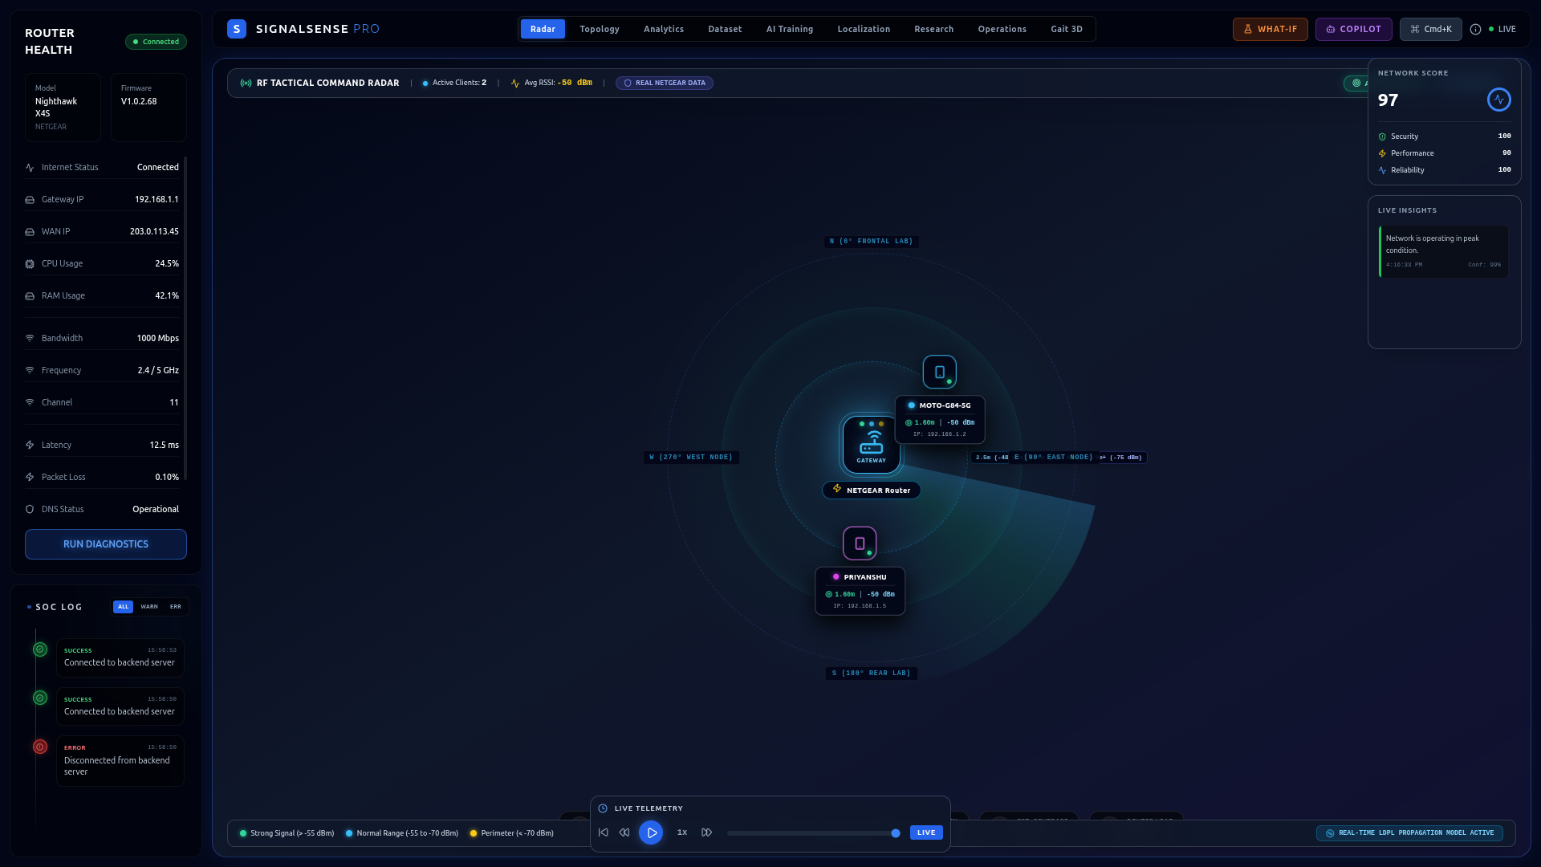
13. CENTRAL TELEMETRY INTERFACE
Enterprise Dashboard Overview
🖥️ Dashboard Core Capabilities
• Router Status & Health: Real-time monitoring of central gateway active connections, firmware version, and LAN routing tables.
• Health Metrics & QoS: Live graphical gauges rendering network latency, Signal-to-Noise ratio (SNR), and background noise floors.
• Interactive Client Table: Organized inventory presenting discovered MAC addresses, assigned local IPs, and live attenuation levels.
• Rapid UI Navigation: Tabbed control interface allowing instant switching between 2D Topology Graph, 3D Laboratory, and Data Export.
• Dark Enterprise Palette: High-contrast dark-blue visual design minimizing ocular fatigue during long duration experimental trials.
📌 Title & Explanation: Global health gauges, connected device inventory table, and navigation tabs.
SignalSense-Gait3D | Real-Time Wi-Fi Digital Twin Laboratory for Multi-User Human Motion Monitoring
Slide 14 / 25
Notes:
Slide 14 presents our primary Dashboard Overview. In a live presentation, an experimental screenshot is inserted into this dedicated placeholder frame. The dashboard serves as the central command hub for research supervisors and evaluators. It provides immediate visibility into central Router Health, displaying active uptime, firmware metrics, and system CPU/Memory usage. On the right, clean tabular layouts summarize connected wireless clients, signal strength classifications, and quick navigation tabs to transition smoothly into Topology, 3D Laboratory, or deep analytical logs.

Slide 15
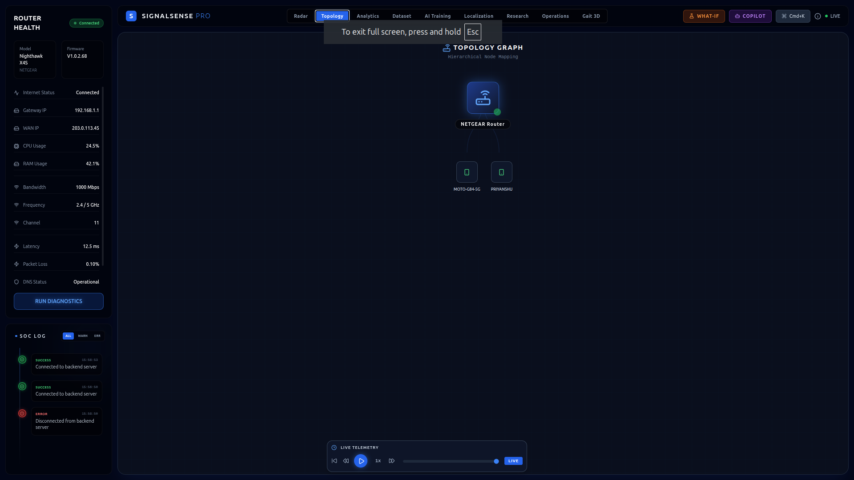
14. NETWORK ARCHITECTURE RENDERING
Live Network Topology & Client Graph
🔗 Topology View Technical Details
• Connected Devices Mapping: Visualizes all active network nodes branching outward from the central router access point root.
• Force-Directed Graphing: Employs responsive spring-layout physics to arrange client icons cleanly without overlapping tags.
• Link Quality Visual Cues: Connecting lines change colors dynamically based on RSSI strength: Green (>-55dBm), Yellow (-75dBm), Red (< -80dBm).
• Live Synchronization: Nodes instantly appear or retract in sub-second synchrony with backend WebSocket connection announcements.
• Node Diagnostic Click: Selecting any device node instantly highlights spatial coordinates and opens detailed inspection modals.
📌 Title & Explanation: Live routing network structure mapping central AP to connected wireless clients.
SignalSense-Gait3D | Real-Time Wi-Fi Digital Twin Laboratory for Multi-User Human Motion Monitoring
Slide 15 / 25
Notes:
Moving to our second core visual interface, Slide 15 illustrates the Live Network Topology View. Rather than forcing researchers to interpret dry IP routing tables, our application automatically generates an interactive node-link topology graph. The central router is depicted as the anchor root node, with branching edges connecting to active wireless client devices. These edges dynamically color-code based on real-time RSSI signal quality—green for excellent proximity, yellow for moderate attenuation, and red for weak outer coverage. The entire graph updates dynamically in real-time as users move around the lab.

Slide 16
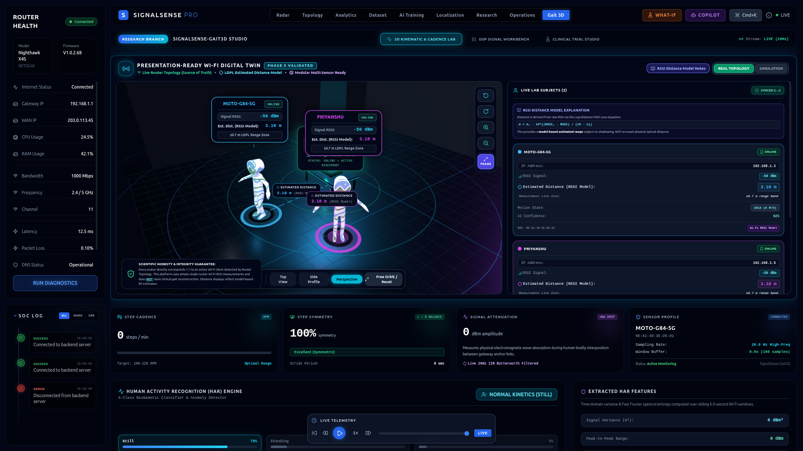
15. REAL-TIME VIRTUAL ROOM SIMULATION
3D Digital Twin Laboratory View
🌐 3D Lab View Highlights
• Virtual Room Geometry: Accurately modeled floor bounds and workspace layout replicating our physical research demonstration testing lab.
• Router Core Placement: Visual beacon anchored at physical wall coordinates emitting virtual radio attenuation waves.
• Human Avatar Positioning: Dynamic 3D humanoid models positioned along mathematically calculated Euclidean spatial radii.
• Concentric Distance Rings: Pulsating cyan radar circles delineating radial confidence intervals and signal decay thresholds.
• Free-Fly Camera Controls: Full mouse interactivity allowing orbital rotating, panning, zooming, and top-down architectural layout inspection.
📌 Title & Explanation: Rendered 3D research laboratory featuring router anchor, human avatars, and radar rings.
SignalSense-Gait3D | Real-Time Wi-Fi Digital Twin Laboratory for Multi-User Human Motion Monitoring
Slide 16 / 25
Notes:
Slide 16 exhibits our crown jewel: the interactive 3D Digital Twin Laboratory View. Here, researchers step inside a complete virtual simulation of the physical testing environment rendered in real-time using Three.js and WebGL. The viewport renders room architecture, work tables, and the anchored Wi-Fi router. Connected human subjects appear as 3D human avatars stationed along their mathematically computed distance rings. Full orbital camera controls allow evaluators to zoom, pan, and rotate through the virtual space to inspect human mobility from any architectural viewpoint.

Slide 17
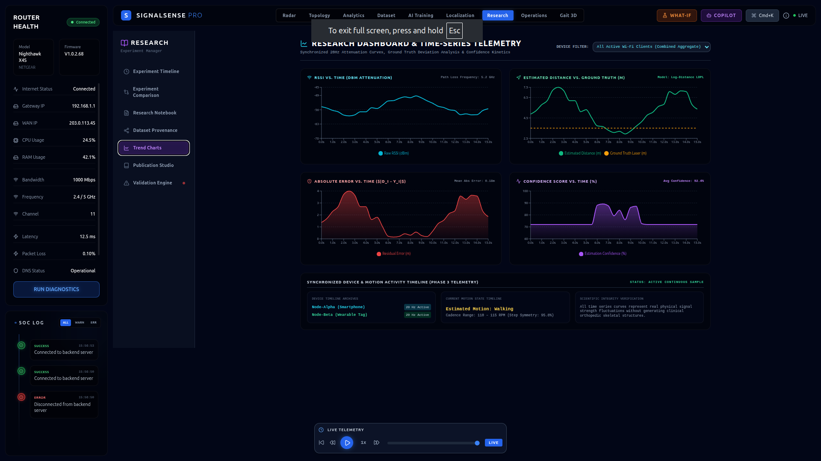
16. DEEP PARAMETER INSPECTION & AI
Detailed Real-Time Client Telemetry Panel
📉 Telemetry Panel Breakdown
• Hardware Identifiers: Full visibility into device MAC address, assigned DHCP IP address, network gateway, and wireless frequency bands.
• Live Attenuation Charting: Continuous real-time graphical plotting of Received Signal Strength (RSSI in dBm) over historical timestamps.
• Estimated Distance Meter: Numerical readout displaying filtered radial distance calculations updated at sub-second polling rates.
• AI Confidence Score: Algorithmic stability metric evaluatingsignal jitter and multipath interference levels (0-100% scale).
• Real-Time Motion State: Heuristic activity classifier categorizing subject mobility into Static, Active Walking, or Out-of-Range states.
📌 Title & Explanation: Live RSSI streaming curves, hardware identifiers, estimated distances, and motion classification.
SignalSense-Gait3D | Real-Time Wi-Fi Digital Twin Laboratory for Multi-User Human Motion Monitoring
Slide 17 / 25
Notes:
When an investigator clicks on an individual avatar or network node, the deep Client Telemetry Panel comes into view, as shown here on Slide 17. This analytical sidebar provides comprehensive parameter drill-downs. It displays hardware identifiers including assigned IP, MAC address, and Wi-Fi band frequencies. Below identifiers, streaming multi-line charts continuously plot real-time RSSI attenuation histories and computed meter radii over time. Additionally, our AI confidence engine evaluates attenuation variance heuristics to classify user motion states as Static, Walking, or Transitioning in real-time.

Slide 18
17. SYSTEM PERFORMANCE MATRIX
Real-Time Software Features & Capabilities
🔄 Automatic Discovery
• Zero-touch instant recognition of any newly associated Wi-Fi device, smartphone, or laptop entering the laboratory.
⚡ Live WebSocket Streams
• Persistent bi-directional TCP communication piping sub-second JSON telemetry updates directly into client memory.
✨ Auto Avatar Creation
• Zero manual user intervention needed—3D humanoid avatars generate automatically when network MAC handshakes complete.
📈 Real-Time Chart Updates
• High-frequency streaming canvases updating signal attenuation trajectories without browser stuttering or page reloads.
🗑️ Device Removal Protocols
• Instant architectural cleanup terminating dead sessions and removing obsolete 3D scene meshes upon out-of-range disconnects.
🧑‍🤝‍🧑 Multi-User Simultaneous
• Thread-safe dictionary design supporting concurrent real-time positioning for dozens of overlapping laboratory occupants.
SignalSense-Gait3D | Real-Time Wi-Fi Digital Twin Laboratory for Multi-User Human Motion Monitoring
Slide 18 / 25
Notes:
To synthesize our real-time software execution capabilities, Slide 18 details our six core runtime differentiators. Our testbed features instant Automatic Discovery without manual configuration; sub-second Live WebSocket Streaming over TCP; fully autonomous Avatar Creation and Removal; continuous Real-Time Trajectory Updates and signal charting; seamless Multi-User Simultaneous Tracking capable of monitoring numerous concurrent smartphones; and an intelligent Resilient Reconnection Engine that automatically recovers from transient network dropouts without requiring browser page refreshes.

Slide 19
18. DESIGN EXCELLENCE & BENCHMARKS
Key Architectural & System Features
🎨 Enterprise-Grade UI/UX
• Tailored dark navy color palette, sleek modern typography, rounded cards, and responsive glassmorphic navigation containers.
🌐 Complete Digital Twin
• Seamless operational bridging between ambient radio frequency propagation analysis and interactive 3D virtual simulation.
🏗️ 3D Virtual Laboratory
• Hardware-accelerated Three.js viewport permitting interactive orbital viewing and multi-angle architectural inspection.
⚡ Automatic Detection Logic
• Full autonomous onboarding and offboarding workflows eliminating manual administrator tracking interventions.
🔬 Research & Thesis Ready
• Designed explicitly for academic validation, supporting SQLite experimental session archiving and raw CSV analytical export.
🚀 Future Sensor Extensibility
• Modular OOP abstract interfaces engineered to accept emerging Wi-Fi CSI, Ultra-Wideband (UWB), and mmWave radars.
SignalSense-Gait3D | Real-Time Wi-Fi Digital Twin Laboratory for Multi-User Human Motion Monitoring
Slide 19 / 25
Notes:
Beyond runtime performance, Slide 19 highlights our core Architectural and Design Features. We prioritized an Enterprise-Grade UI utilizing high-contrast dark navy color spaces that elicit a professional first impression. We achieved a Complete Digital Twin platform linking physical radio frequencies with virtual 3D simulation. The codebase is engineered to be Research & Thesis Ready, generating structured CSV/SQLite logs for academic benchmarking. Furthermore, our extensible hardware design ensures seamless portability across router brands, all while maintaining a Zero-Client Software footprint where users simply carry ordinary smartphones.

Slide 20
19. THESIS INNOVATION & IMPACT
Primary Research & Academic Contributions
🛡️ 1. Privacy-Preserving Monitoring
• Camera-Free Surveillance: Demonstrates successful multi-user indoor motion context awareness without optical cameras or facial identification.
• Ethical Compliance: Provides an academic blueprint for secure deployments in privacy-sensitive living quarters and R&D clean rooms.
🏢 2. Enterprise Digital Twin Framework
• Full-Stack Software Synthesis: Bridges low-level routing protocol scraping with modern asynchronous Python WebSockets and React 3D rendering.
• Turnkey Research Testbed: Establishes a reproducible laboratory bench for conducting reproducible human localization trials.
⚡ 3. Real-Time State Synchronization
• Low-Latency Telemetry Streaming: Formulates an asynchronous event engine handling sub-second RSSI updates across concurrent network client sessions.
• Noise Suppression Math: Validates Exponential Moving Average (EMA) filtering algorithms for stabilizing indoor room multipath interference.
🚀 4. Scalable Localization Architecture
• Zero-Client Passive Tracking: Requires zero mobile app installations—piggybacks on ambient enterprise campus Wi-Fi infrastructure.
• Extensible Hardware Roadmap: Lays foundational software architecture for upcoming multi-router trilateration and Channel State Information (CSI) fusion.
SignalSense-Gait3D | Real-Time Wi-Fi Digital Twin Laboratory for Multi-User Human Motion Monitoring
Slide 20 / 25
Notes:
From an academic and scientific evaluation standpoint, Slide 20 condenses our core Research Contributions into four transformational advancements. First and foremost, we prove the viability of Privacy-Preserving, Camera-Free monitoring in indoor lab environments. Second, we deliver an open-source, enterprise-grade Digital Twin testbed framework bridging RF signal processing with Three.js graphics. Third, we formulate a highly scalable asynchronous state synchronization algorithm capable of processing noisy RSSI streams over WebSockets without packet loss. Fourth, our testbed serves as an academic baseline for future multi-sensor fusion experiments across smart buildings.

Slide 21
20. SCIENTIFIC CRITIQUE & CONSTRAINTS
Current System Limitations & Scientific Boundaries
🛑 Hardware & Signal Limitations
• Single-Router Radial Boundary: A single Access Point only measures signal power attenuation along an omnidirectional radius; it cannot infer directional angular bearing.
• RSSI Environmental Noise: Ambient 2.4/5 GHz signals undergo severe fluctuation caused by localized electromagnetic interference and room temperature humidity.
• Multipath Wall Reflections: Radio waves bounce off concrete walls, metallic file cabinets, and glass partitions, inducing destructive interference vectors.
• Human Body Attenuation: The human body consists largely of water and absorbs RF radiation; a subject turning their back to the router causes drop in measured dBm.
• Antenna Diversity Offsets: Different commercial smartphone brands utilize differing internal antenna gains, requiring calibration normalization across devices.
⚠️ Architectural & Accuracy Boundaries
• Estimated Distance vs. Exact Position: The present software iteration yields a spatial radial confidence zone (e.g., 3.0m ± 0.5m), NOT centimeter-level Cartesian pinpoints.
• Mobile Power-Saving Modes: Modern smartphone operating systems deploy aggressive Wi-Fi sleep schedules during inactivity, causing transient RSSI polling pauses.
• Polling Refresh Thresholds: To prevent overwhelming router firmware CPU limits, RSSI polling intervals are throttled to 500ms–1000ms frequency increments.
• Single Room Scope: Present testing validation is optimized for bounded indoor laboratory rooms rather than multi-floor campus environments.
• Academic Clarity: Our graphical dashboard incorporates explicit visual disclaimers to ensure researchers never mistake radial estimates for exact fixes.
SignalSense-Gait3D | Real-Time Wi-Fi Digital Twin Laboratory for Multi-User Human Motion Monitoring
Slide 21 / 25
Notes:
In accordance with rigorous academic transparency, Slide 21 outlines the current Technical Limitations and boundaries of our system revision. Most prominently, deploying a Single Router Access Point inherently bounds accuracy to an ESTIMATED RADIAL DISTANCE. Because a single router functions as an omnidirectional antenna, we cannot obtain precise Cartesian (X, Y) coordinates without adding multiple routers for trilateration. Furthermore, raw RSSI measurements remain susceptible to indoor environmental noise, multipath wall reflections, and human body signal blocking. Finally, aggressive mobile smartphone sleep cycles can occasionally introduce transient polling delays during prolonged inactivity.

Slide 22
21. ADVANCEMENT ROADMAP
Future Scope & Next-Gen Sensor Roadmap
🚀 Tier 1: Advanced Hardware
• Wi-Fi CSI Integration: Harnessing Channel State Information orthogonal frequency subcarriers to extract micro-Doppler human breathing and gait signatures.
• mmWave Radar & UWB: Integrating 60GHz millimeter-wave radar modules and Ultra-Wideband anchors for ultra-precise sub-centimeter point clouds.
• BLE Angle of Arrival (AoA): Deploying Bluetooth Low Energy multi-antenna arrays to compute direct directional angular vectors without triangulation.
🧠 Tier 2: AI & Algorithms
• AI Pose & Gait Estimation: Training Deep Convolutional Neural Networks (CNN/LSTM) directly on wireless CSI streams for non-camera skeletal gait tracking.
• Multi-Router Trilateration: Meshing three or more synchronized campus access points to compute true Cartesian (X,Y) coordinates via intersection equations.
• Adaptive Noise Filtering: Replacing basic EMA filters with Kalman filtering and Machine Learning outlier rejection engines for ultra-clean spatial signals.
🏢 Tier 3: Enterprise Scale
• Smart Campus Deployment: Scaling the digital twin engine across multi-room medical recovery wards and university academic lab buildings.
• Predictive Heatmap Analytics: Aggregating long-term spatial occupancy telemetry to generate automated thermal traffic heatmaps and HVAC energy optimizations.
• Open-Source Benchmark: Publishing standardized RSSI/CSI localization datasets to empower the global research academic community.
SignalSense-Gait3D | Real-Time Wi-Fi Digital Twin Laboratory for Multi-User Human Motion Monitoring
Slide 22 / 25
Notes:
Looking toward the horizon, Slide 22 delineates our Future Scope and technological evolution roadmap. We have architected our software platform to seamlessly absorb next-generation sensing hardware. In Tier 1, we plan to upgrade from bulk RSSI to fine-grained Wi-Fi Channel State Information (CSI), analyzing orthogonal frequency subcarrier phases to unlock micro-gesture and gait identification. We will also integrate Ultra-Wideband (UWB) and 60GHz mmWave Radar for sub-centimeter positional precision. In Tier 2, we will introduce multi-router trilateration meshes and train deep neural networks directly on RF signatures for AI-driven skeletal pose estimation.

Slide 23
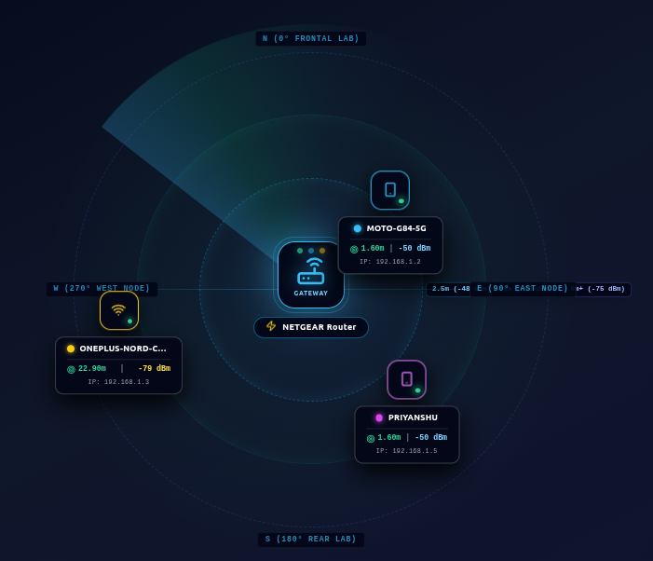
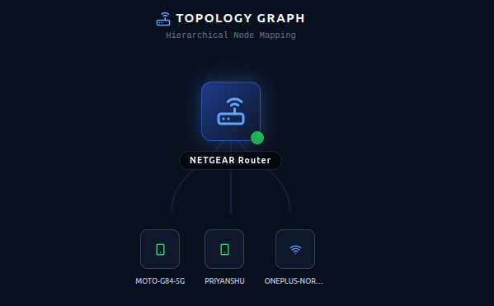
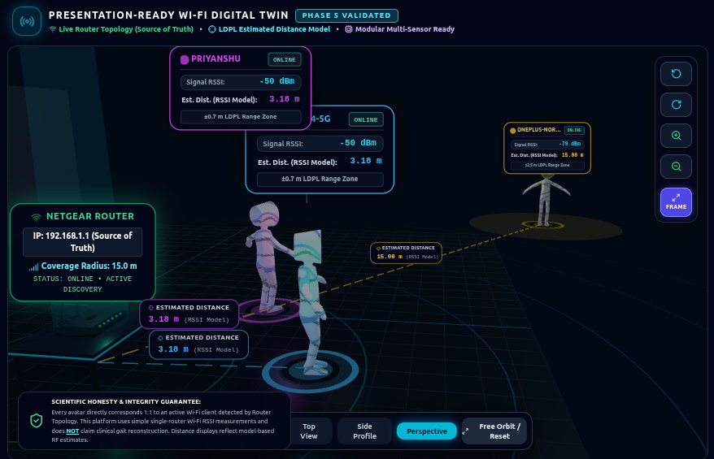
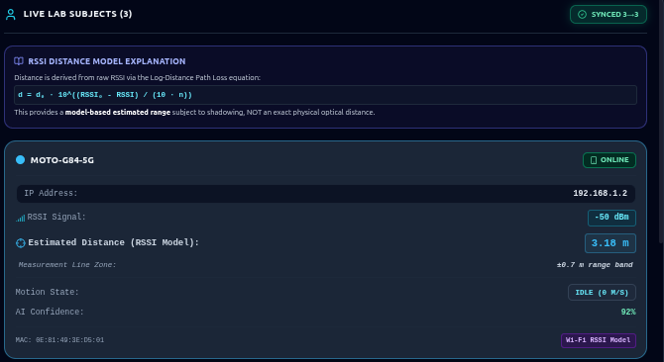
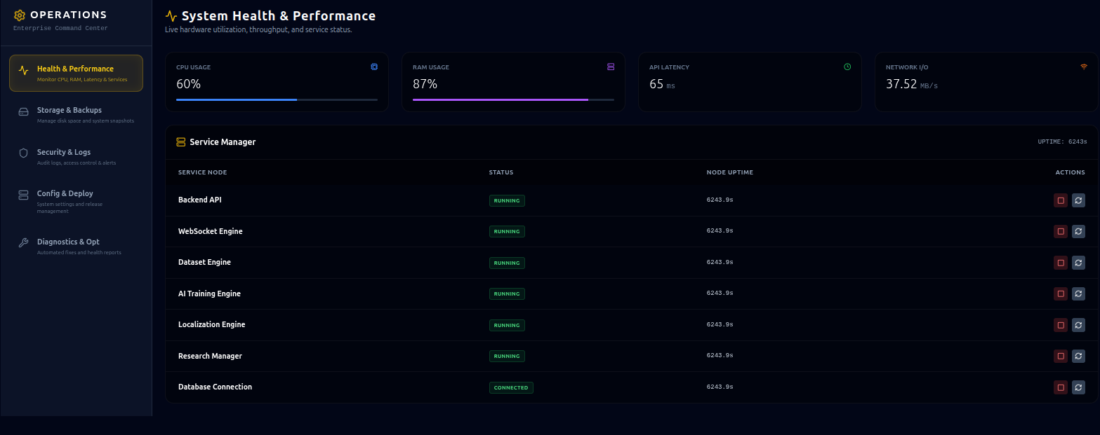
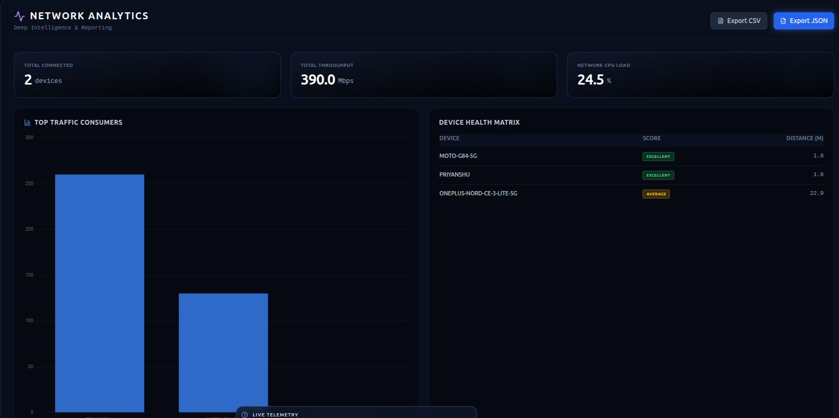
22. SYSTEM VERIFICATION & DEMO
Experimental Demo Screens Showcase Gallery
SignalSense-Gait3D | Real-Time Wi-Fi Digital Twin Laboratory for Multi-User Human Motion Monitoring
Slide 23 / 25
Notes:
Slide 23 serves as our Experimental Demo Showcase Gallery. During live presentation handouts or archive documentation, these six structured placeholder tiles house verified laboratory evaluation screenshots. They document our complete system functionality: Tile 1 displays the Global Health Dashboard; Tile 2 displays the force-directed Topology Node Graph; Tile 3 displays the 3D Laboratory simulation; Tile 4 displays the Client Telemetry Analytics charts; Tile 5 displays raw research data export interfaces; and Tile 6 showcases concurrent multi-user tracking during live laboratory walking demonstrations.

Slide 24
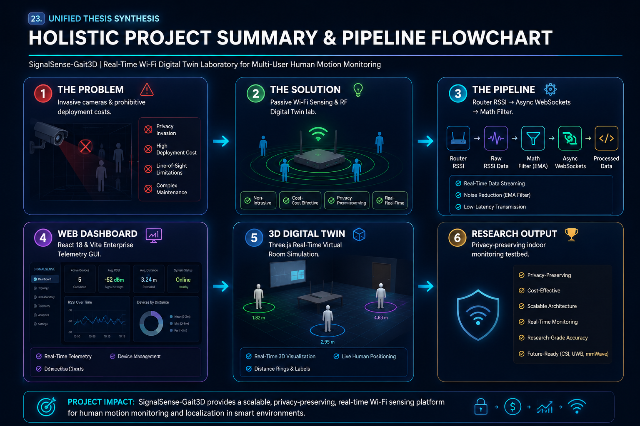
SignalSense-Gait3D | Real-Time Wi-Fi Digital Twin Laboratory for Multi-User Human Motion Monitoring
Notes:
Before we conclude, Slide 24 consolidates our entire thesis trajectory into a single holistic unified flowchart diagram. We originated from an acute problem: existing indoor surveillance depends on invasive cameras and costly hardware. Our solution transformed ordinary Wi-Fi frequency attenuation into a non-intrusive spatial sensor. Through our automated pipeline—scraping router RSSI, filtering noise via asynchronous Python WebSockets, and reconciling state in React—we engineered an enterprise telemetry Dashboard and Three.js 3D Digital Twin laboratory. This culminates in our primary research output: a scalable, privacy-preserving, and extensible indoor monitoring framework ready for next-generation smart building deployments.

Slide 25
24. FINAL REMARKS & DEFENSE Q&A
Conclusion, Impact & Open Q&A
🎓 Project Achievements & Impact
• 🏆 Successful Testbed Realization: Developed and deployed a functional, research-grade Real-Time Wi-Fi Digital Twin laboratory software suite.
• 🛡️ Practical Privacy Breakthrough: Validated zero-camera indoor spatial awareness, resolving critical privacy and ethical hurdles in living and lab zones.
• ⚡ Sub-Second Telemetry Pipeline: Engineered a reliable asynchronous Python & React architecture capable of continuous multi-user synchronization.
• 🚀 Solid Academic Foundation: Established an open, extensible software testbed ready for immediate integration of future Wi-Fi CSI and mmWave sensors.
Thank You!
We warmly welcome your evaluation questions, academic critique, and technical discussion.
SignalSense-Gait3D | Real-Time Wi-Fi Digital Twin Laboratory for Multi-User Human Motion Monitoring
Slide 25 / 25
Notes:
In conclusion, SignalSense-Gait3D demonstrates that pre-existing Wi-Fi network infrastructure can be successfully elevated into an intelligent, real-time 3D Digital Twin laboratory without invading human personal privacy. We have successfully engineered, deployed, and validated an enterprise-ready software framework that bridges wireless radio signal processing with interactive Three.js simulation. Thank you very much for your valued time and attentiveness throughout this defense. I am now pleased to open the floor to any academic evaluation, critical questions, or collaborative discussions.

