Slide 1
Semi-supervised Sound Event Detection with Consistency Training by Unsupervised Data Augmentation​
Aa
A
Arkaprava Biswas
Roll: 20204407
Priyanshu Kumar
Roll: 190651

Slide 2
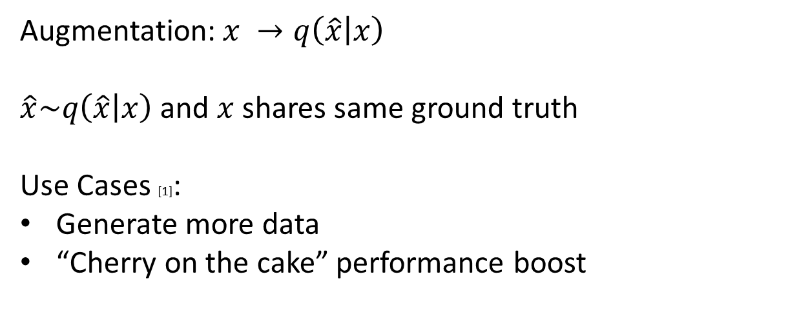
Augmentation in Supervised Setting:

Slide 3
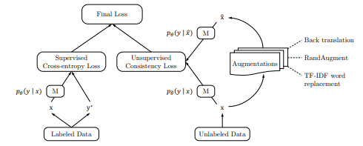
Unsupervised Data Augmentation and Consistency Training [2] :

Slide 4

Full Objective Function:

Slide 5
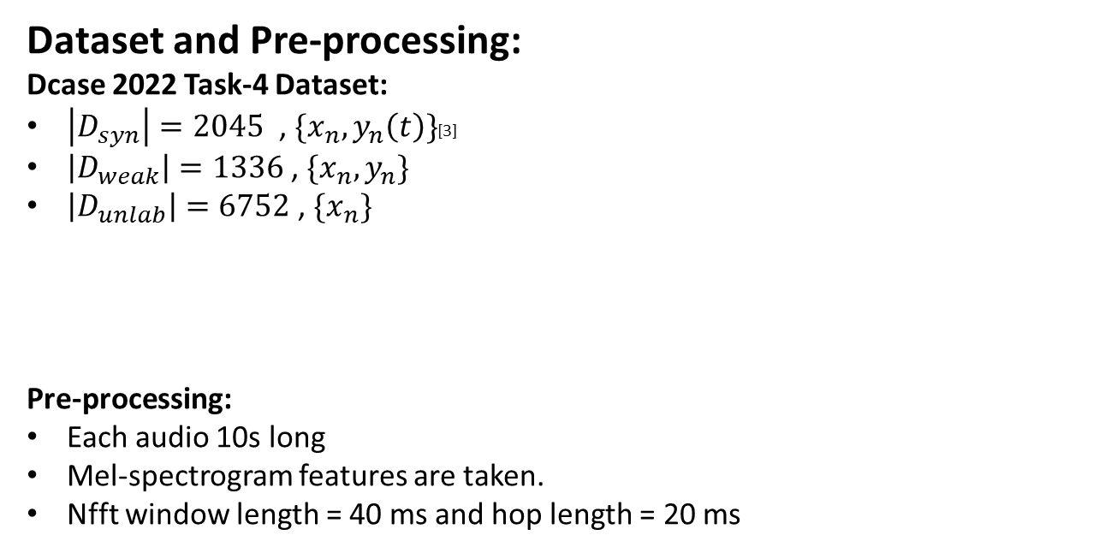

Slide 6
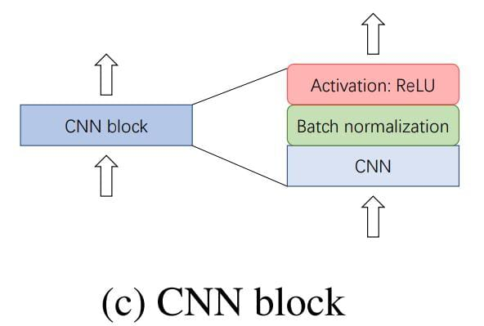
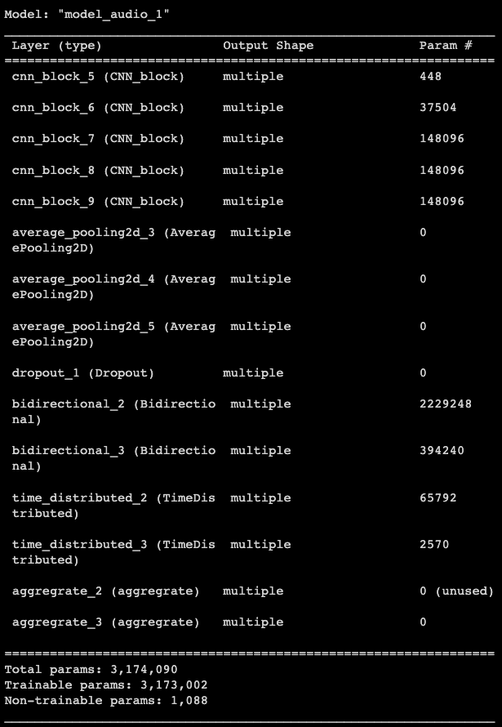
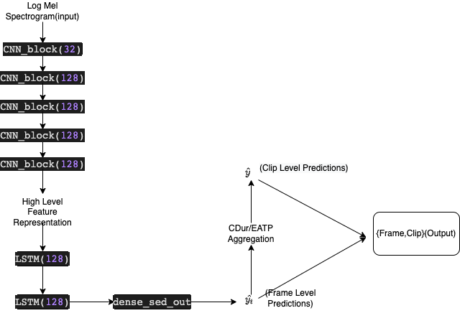
Model Architecture for SED:
~3M parameters
Avg pooling is used in feature extraction
(Only on frequency features)

Slide 7
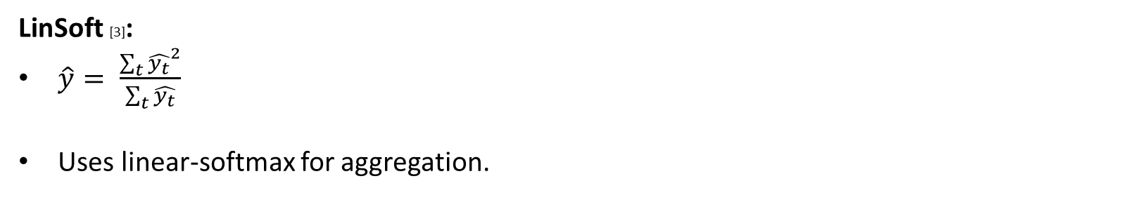

Aggregate Layer in detail:

Slide 8

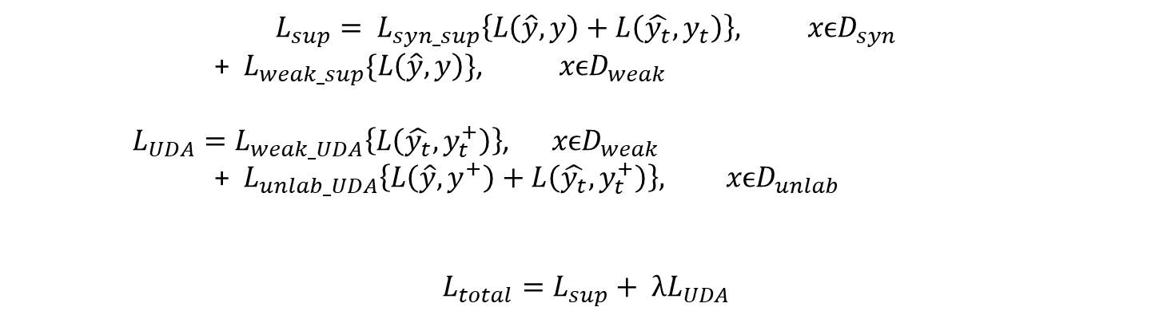
Complete objective for SED:

Slide 9
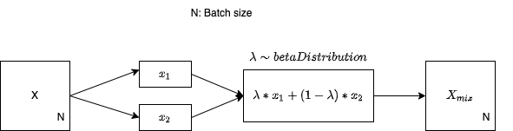
Augmentation Methods:
Random gain (-20 db to 10 db)[3]
Time masking
Frequency Masking
Time warping[6]
Mix-up[5]
Fig: Mix-up Augmentation

Slide 10
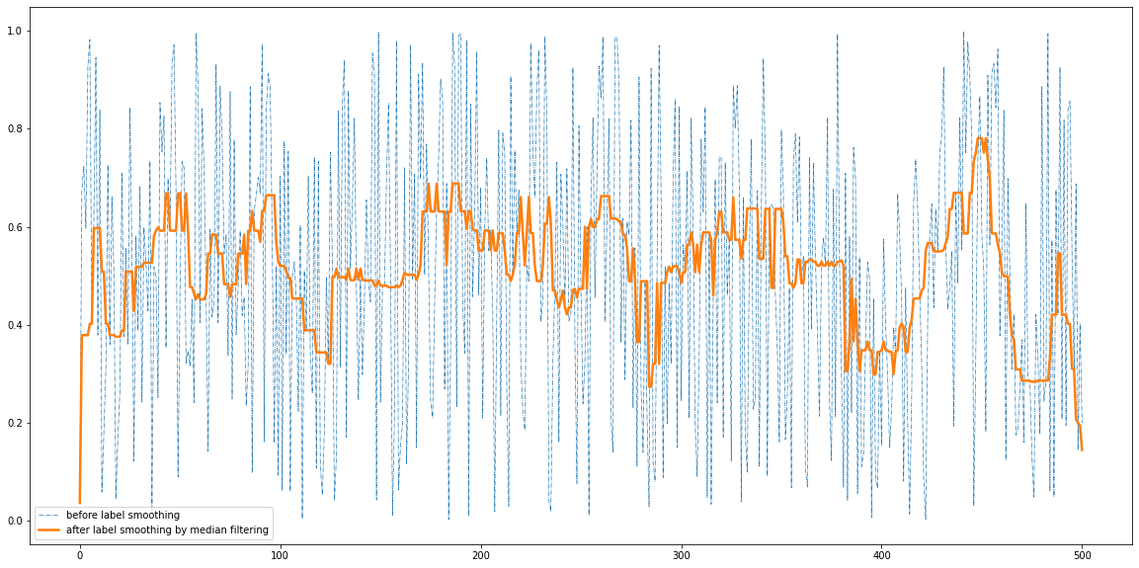
Post-processing:
Median Filtering[7]:
Window length of per class = Average frame length per class in synthetic hard-timestamp file.
Applied first over softmax predictions.

Slide 11
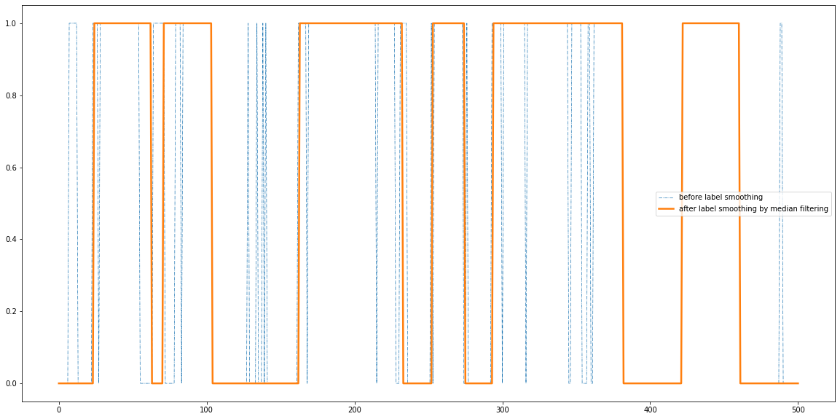
Post-processing:
Applied again over binary predictions.

Slide 12
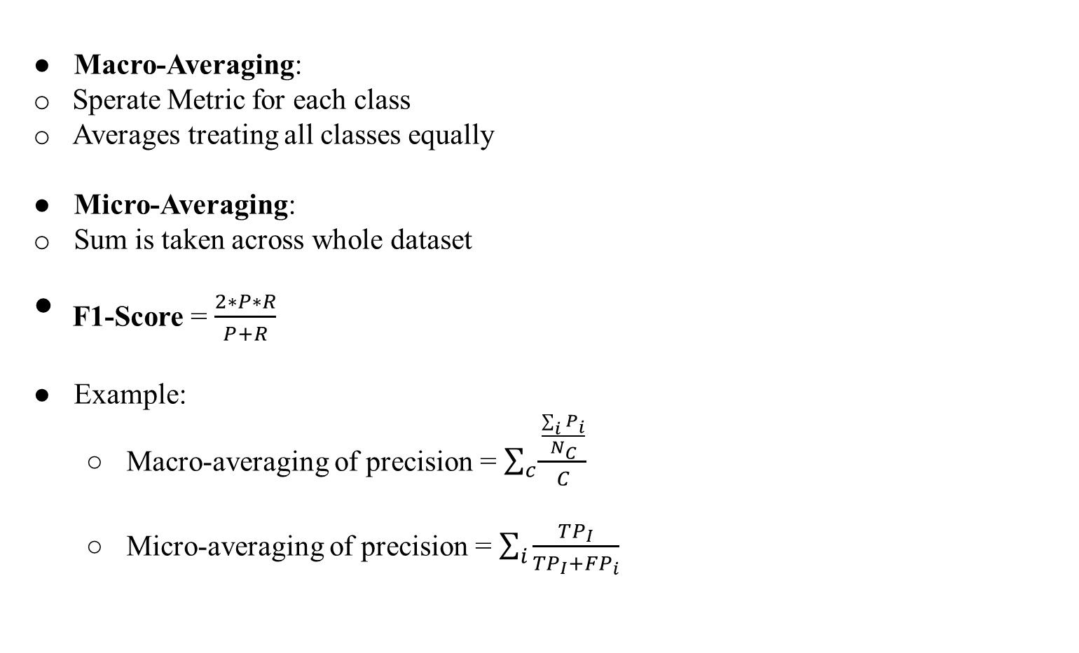
Evaluation[7]:

Slide 13
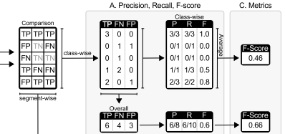

Evaluation:
Segment Based:
In a fixed time grid, the ground truth and system outputs are compared.
Fig: Segment Based Evaluation

Slide 14
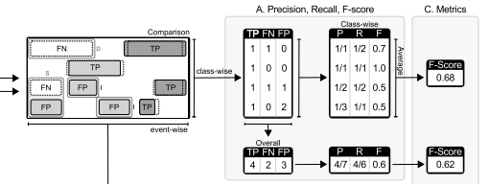
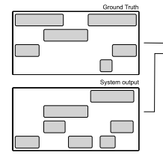
Evaluation:
Event Based:
TP, FP, FN calculated
Based on ONSET, OFFSET and COLLAR.
Fig: Frame Based Evaluation

