Slide 1

BENGAL COLLEGE OF ENGINEERING AND TECHNOLOGY , DURGAPUR
NAME : PRIYANSHU PANDEY
UNIVERSITY ROLL NO : - 12500222008
BRANCH :- INFORMATION TECHNOLOGY
SUB :- OPERATING SYSTEM
SUB. TEACHER :- PULLAK MAJHI
TOPIC :- Structure of an Operating System
SEMESTER : 5th
YEAR: 3rd

Slide 2
Structure of an Operating System

Slide 3
Title
Title: Structure of an Operating System
Subtitle: Understanding the Core Components and Architecture
Name: Priyanshu Pandey
Uni.Roll : 12500222008

Slide 4
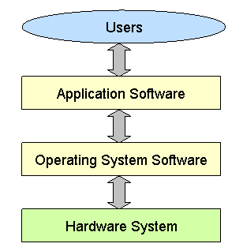
Introduction to Operating Systems
Definition:
  An Operating System (OS) is system software that manages hardware, software resources, and provides common services for computer programs.
Importance:
  The OS acts as an intermediary between users and the computer hardware, enabling efficient execution of applications and management of resources.

Slide 5
  Kernel:
    The core of the OS, responsible for managing system resources and communication between hardware and software.
    Functions: Process management, memory management, device management, and system calls.
  Shell:
    The interface that allows users to interact with the OS, either through a command-line interface (CLI) or graphical user interface (GUI).
  File System:
    Manages files on the storage devices, providing a way to store, retrieve, and organize data.
    Types: FAT, NTFS, ext4, etc.
  Device Drivers:
    Specialized software that allows the OS to communicate with hardware peripherals like printers, disks, and network cards.
Core Components of an Operating System

Slide 6
Operating System Architecture
Monolithic Architecture:
  Structure:
    All OS components run in a single layer, typically in kernel mode.
    Advantages: Fast performance due to minimal context switching.
    Disadvantages: Less secure, as a failure in one component can crash the entire system.
Microkernel Architecture:
  Structure:
    Minimal kernel with essential services like IPC (Inter-Process Communication) and basic scheduling. Other services run in user space.
    Advantages: More secure and stable, as components are isolated.
    Disadvantages: Slightly slower due to more context switches between user mode and kernel mode.
Layered Architecture:
  Structure:
    OS is divided into layers, with each layer built on top of the one below it.
    Advantages: Easier to manage and debug, as changes in one layer do not affect others.
    Disadvantages: May introduce overhead, leading to slower performance.

Slide 7
Process Management

Slide 8
Memory Management
Memory Hierarchy:
  RAM (Primary Memory): Fast, volatile memory used for active processes.
  Virtual Memory: Extends RAM using disk storage to allow more processes to run concurrently.
Paging and Segmentation:
  Paging: Divides memory into fixed-size pages for easier management.
  Segmentation: Divides memory into segments based on logical divisions, such as functions or modules.
Memory Allocation:
  Dynamic Allocation: Adjusts memory allocation as needed during runtime.
  Static Allocation: Memory is allocated at the start and remains fixed..

Slide 9
File System Management
File Systems:
  Hierarchy: Organizes files in directories for easier access and management.
  Operations: Create, delete, read, write, and manage files and directories.
  Types of File Systems:
    FAT (File Allocation Table): Simple, widely supported, but less secure.
    NTFS (New Technology File System): More advanced, with support for permissions and encryption.
    ext4: Commonly used in Linux, with features like journaling for data integrity.
Access Control:
  Manages permissions for different users and groups to enhance security.

Slide 10
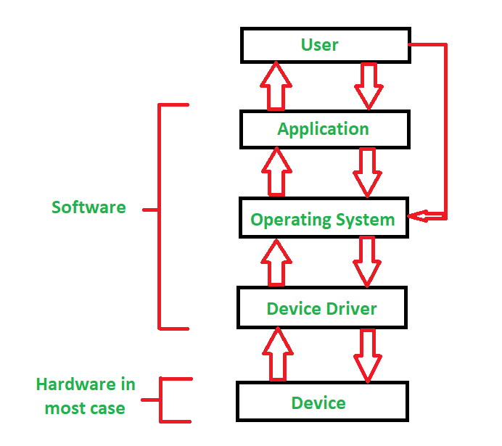
Device Management
Role of Device Drivers:
  Act as a bridge between the OS and hardware devices, translating OS commands into hardware actions.
Types of Devices:
  Block Devices: Store and retrieve data in fixed-size blocks (e.g., hard drives).
  Character Devices: Transfer data as a stream of characters (e.g., keyboards, serial ports).
  Network Devices: Handle data exchange between computers (e.g., network cards).
I/O Management:
  Buffering: Temporarily holds data to match the speed between devices and processes.
  Spooling: Manages the queue of print jobs in a printer.
  Caching: Stores frequently accessed data for quicker access.

Slide 11
Security and Protection
Access Control:
  User Authentication: Verifies user identity through passwords, biometrics, or tokens.
  Permissions: Define what actions users can perform on files and system resources.
Encryption:
  Data at Rest: Encrypts stored data to prevent unauthorized access.
  Data in Transit: Encrypts data during transmission to protect against interception.
Protection Mechanisms:
  Firewalls: Monitors and controls incoming and outgoing network traffic.
  Intrusion Detection Systems (IDS): Detects and responds to suspicious activities..

Slide 12
Conclusion:
Summary:
  The structure of an operating system is a complex but essential part of computing, ensuring that hardware and software work harmoniously to meet user needs.
  Key Takeaway: A well-designed OS structure is crucial for performance, security, and reliability.
Final Thought: Understanding the components and architecture of an OS provides the foundation for optimizing and securing computer systems.
THANK YOU

