Slide 1




Introducing the N-Queens Problem
The N-Queens problem is a classic puzzle in computer science. It challenges us to place N chess queens on an N x N chessboard, ensuring that no two queens threaten each other.
by Priyanshu Raj

Slide 2

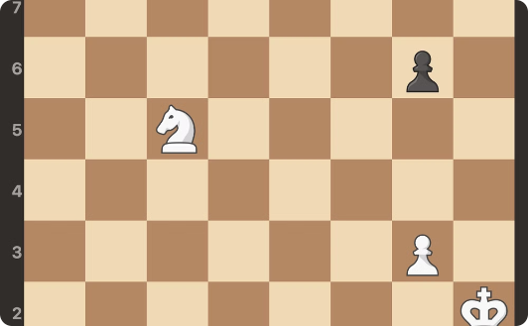
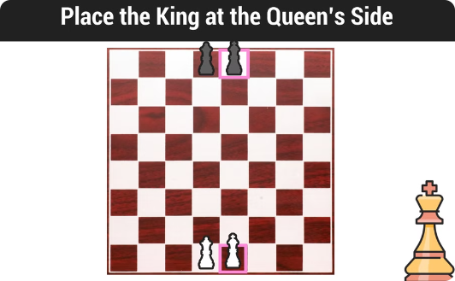
Visualizing the N-Queens Problem
Single Queen
Two Queens
Multiple Queens
A single queen on a chessboard occupies a row, column, and diagonal.
The challenge arises when placing multiple queens, as they cannot threaten each other.
The N-Queens problem aims to find all possible configurations where no queens are under attack.

Slide 3

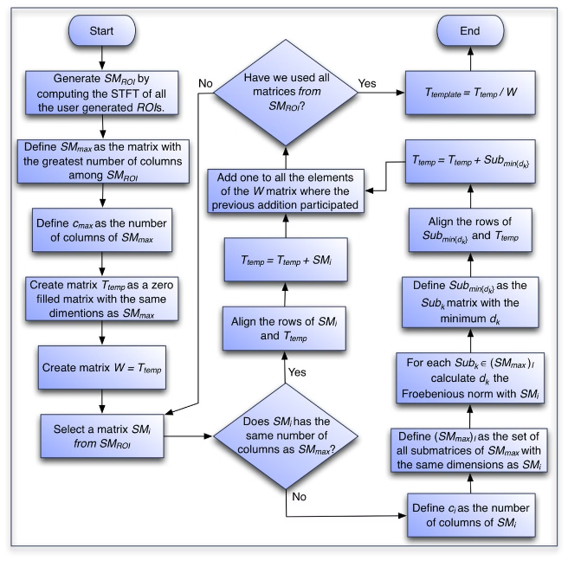
The Algorithm Behind the Visualizer
1
Backtracking
The visualizer utilizes backtracking to systematically explore all possible queen placements.
2
Constraints
Each placement is checked against constraints, ensuring no queens share a row, column, or diagonal.
3
Solutions
The algorithm identifies valid configurations, highlighting the placement of queens on the board.

Slide 4

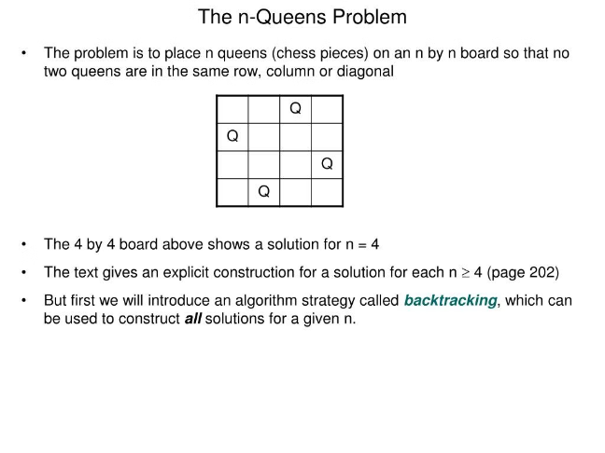
User Interface and Functionality
Board Size
The user interface allows for selection of different board sizes, from 4x4 to 8x8 and beyond.
Step-by-Step
The visualizer can be stepped through, revealing each placement and backtracking step.
Solution Display
Valid solutions are presented graphically, highlighting the safe queen placement.

Slide 5
Handling Different Board Sizes
Flexibility
Scalability
Optimization
The algorithm is designed to handle varying board sizes, from small 4x4 boards to large 8x8 boards and beyond.
The visualizer scales smoothly to accommodate larger boards, maintaining visual clarity.
Optimized algorithms are employed to ensure efficiency when handling larger board sizes.

Slide 6

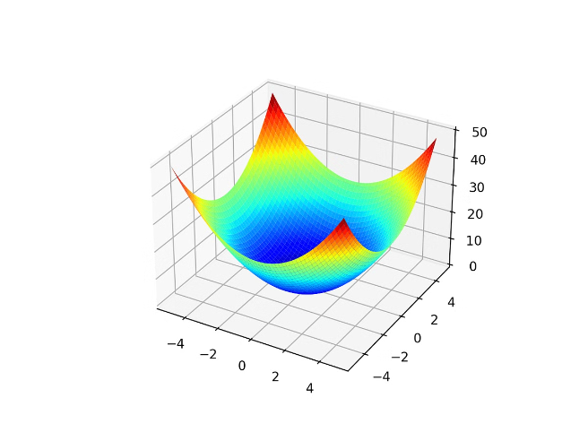
Optimizing the Visualization
1
Animation
Smooth animations guide the user through each step of the backtracking process.
2
Color Coding
Color coding differentiates between safe and threatened squares, enhancing visual understanding.
3
Interactive Elements
Interactive elements, such as pause/play buttons, offer greater control and engagement.
4
Performance
The visualizer prioritizes performance, ensuring a smooth and responsive user experience.

Slide 7

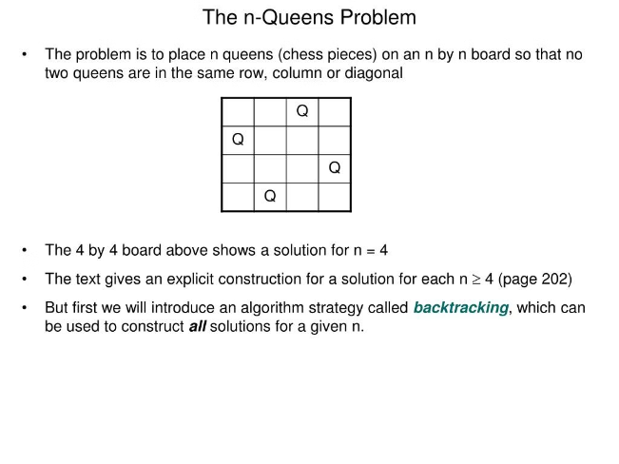

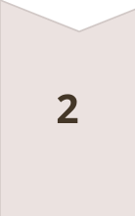

Exploring Variations and Extensions
Constraints
Variations can explore different board constraints, such as restricted queen movements or additional obstacles.
Multi-Player
Extensions might introduce multiplayer elements, allowing users to compete in placing queens.
AI Integration
Integrating AI could allow for automatic solution finding or even interactive gameplay against a computer opponent.

Slide 8

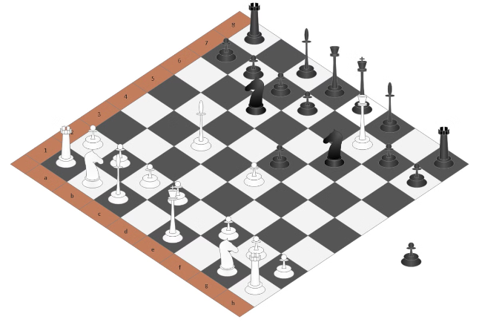
Conclusion and Future Developments
Impact
The N-Queens visualizer provides a captivating and educational tool for understanding algorithms and problem-solving strategies.
Future
Further developments could focus on incorporating advanced visualization techniques, supporting more complex variations, and integrating user-friendly features.

