Slide 1


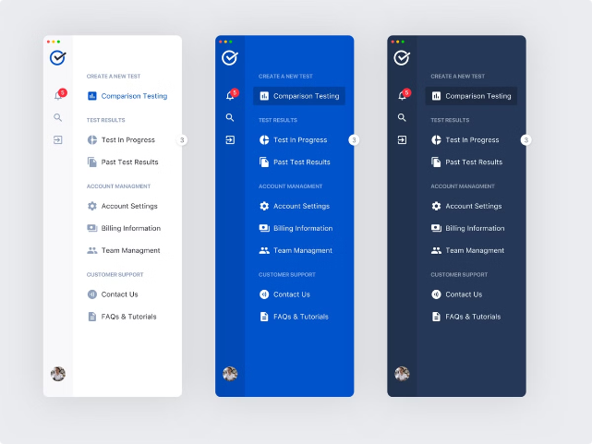

Interactive Navigation Menu
This presentation explores the creation of an interactive navigation menu that enhances user experience with color transitions and fixed positioning. We'll delve into the essential HTML, CSS, and JavaScript elements that make this feature possible.
by Priyanshu Dubey

Slide 2

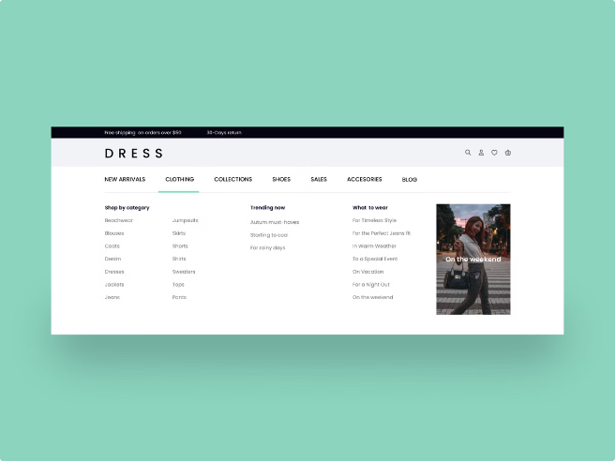
Interactive Navigation Menu
1
Enhanced User Experience
2
Accessibility
Adding interactive elements such as color changes on hover or scroll can make the menu more accessible to users with visual impairments.
A visually engaging navigation menu can improve website navigation by drawing attention to important elements, creating a more user-friendly experience.
3
Modern Design
4
User Engagement
Interactive navigation menus are a common feature of modern websites and can help elevate the overall design aesthetic.
Visual feedback from user interactions, such as color changes, can increase user engagement and make the website more interactive.

Slide 3
HTML Structure for Navigation Menu
Basic HTML Structure
Semantic HTML
Adding IDs and Classes
<nav>
<ul>
<li><a href="#">Home</a></li>
<li><a href="#">About</a></li>
<li><a href="#">Contact</a></li>
</ul>
</nav>
<nav aria-label="Main Navigation">
<ul>
<li><a href="#">Home</a></li>
<li><a href="#">About</a></li>
<li><a href="#">Contact</a></li>
</ul>
</nav>
<nav id="mainNav">
<ul class="nav-list">
<li><a href="#">Home</a></li>
<li><a href="#">About</a></li>
<li><a href="#">Contact</a></li>
</ul>
</nav>

Slide 4

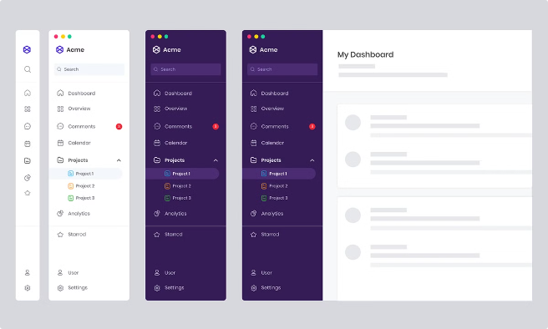
CSS Styling for Navigation Menu
Font Styles
Background Colors and Images
Define font families, sizes, weights, and colors for menu text and links. Ensure consistency with overall website design.
Select background colors or images for the navigation menu to create visual appeal and contrast. Consider website branding and color scheme.
Spacing and Layout
Hover Effects
Use padding, margins, and flexbox or grid layout to create visually appealing spacing between menu items, ensuring readability and accessibility.
Create a hover effect by adding CSS rules that change background color, font color, or other styles when a user hovers over a menu item.

Slide 5

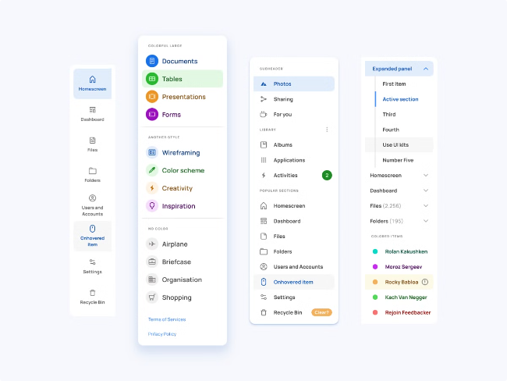



Positioning the Navigation Menu
Fixed Position
The fixed position property in CSS ensures the navigation menu stays fixed at the top of the viewport, regardless of scrolling.
Z-Index
Set the z-index property to ensure the navigation menu appears on top of other content when scrolling.
Viewport Width
Set the width property to make the navigation menu span the full width of the viewport, creating a consistent appearance across different screen sizes.

Slide 6

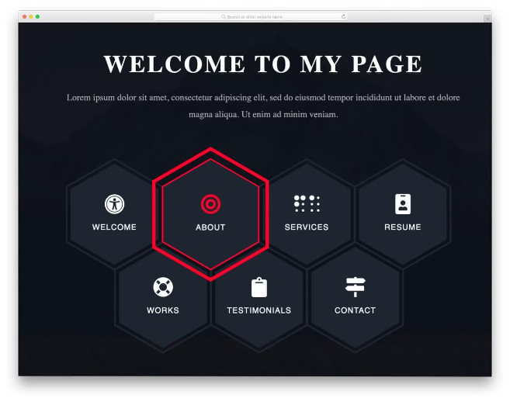
Ensuring Navigation Menu Visibility
1
Media Queries
Use media queries to ensure the navigation menu adapts to different screen sizes and orientations, maintaining a user-friendly layout.
2
Scroll Listener
Add a JavaScript event listener that triggers a function when the user scrolls. This function can adjust the navigation menu's display or style based on scroll position.
3
Smooth Transitions
Use CSS transitions to create smooth visual effects when the navigation menu changes size, color, or opacity based on scroll position.

Slide 7

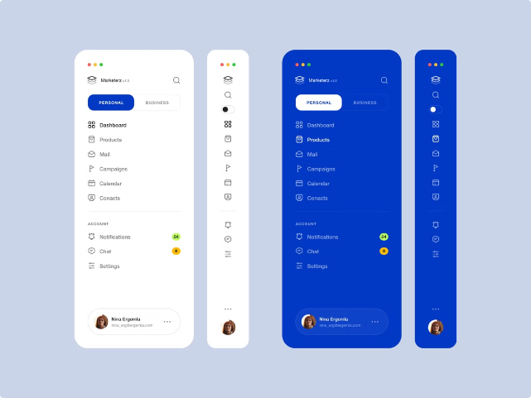
Changing Navigation Menu on Scroll
Event
Action
Scroll Down
Change background color to darker shade, fade out, or apply a shadow effect.
Scroll Up
Revert to original background color, fade back in, or remove shadow effect.

Slide 8

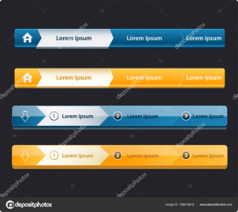




Changing Navigation Menu on Hover
Background Color
Font Color
Submenu Appearance
Underline
Change the background color of the menu item when the user hovers over it, using hover pseudo-classes in CSS.
Alter the font color of the menu item on hover, creating a visual contrast that highlights the selected item.
Add an underline to the menu item when hovered over, a classic and widely recognizable visual cue for interactive elements.
For nested menus, use hover effects to reveal submenus or change their appearance to indicate user interaction.

Slide 9

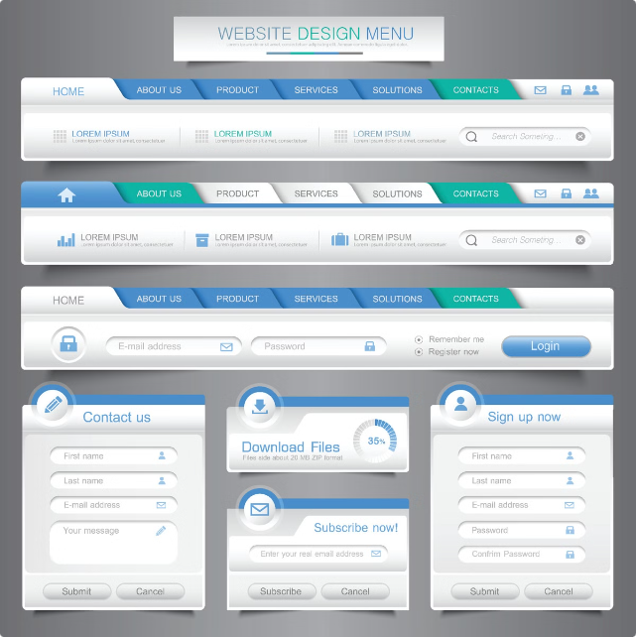
Conclusion
By utilizing HTML, CSS, and JavaScript, we can create a dynamic navigation menu that enhances user experience and provides visual feedback. The techniques explored in this presentation can be applied to various web design projects, enhancing their interactivity and overall appeal.

