Slide 1

Regime-Aware Quantitative Trading System for NIFTY Derivatives
Using Hidden Markov Models and Machine Learning
Notes:
1

Slide 2
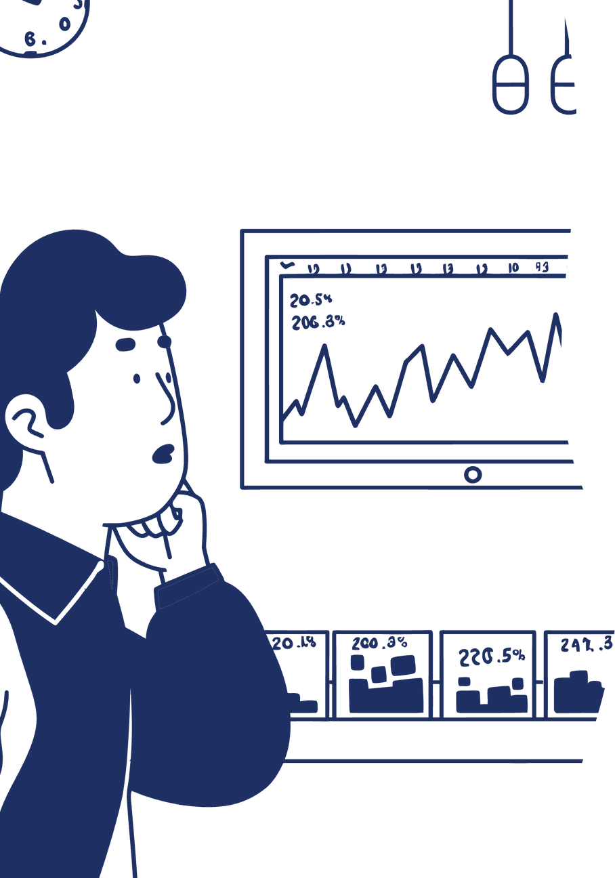
PROJECT OVERVIEW
Smarter Trading Through Market Intelligence
This project builds a regime-aware quantitative trading system for NIFTY derivatives using Python. The main goal: understand market behavior, identify different market phases, and trade only when conditions are favorable.
3
Market Regimes
Uptrend, sideways, downtrend detection
The system combines technical indicators, options-based features, regime detection, and machine learning to improve trade quality and reduce unnecessary losses.
5min
Data Frequency
Intraday OHLCV intervals
Notes:
2

Slide 3

SUBMITTED BY
Project Credentials
Name
Roll Number
Programme
Priyanshu Maheshwari
24/SCA/MCA/038
MCA
Notes:
3

Slide 4



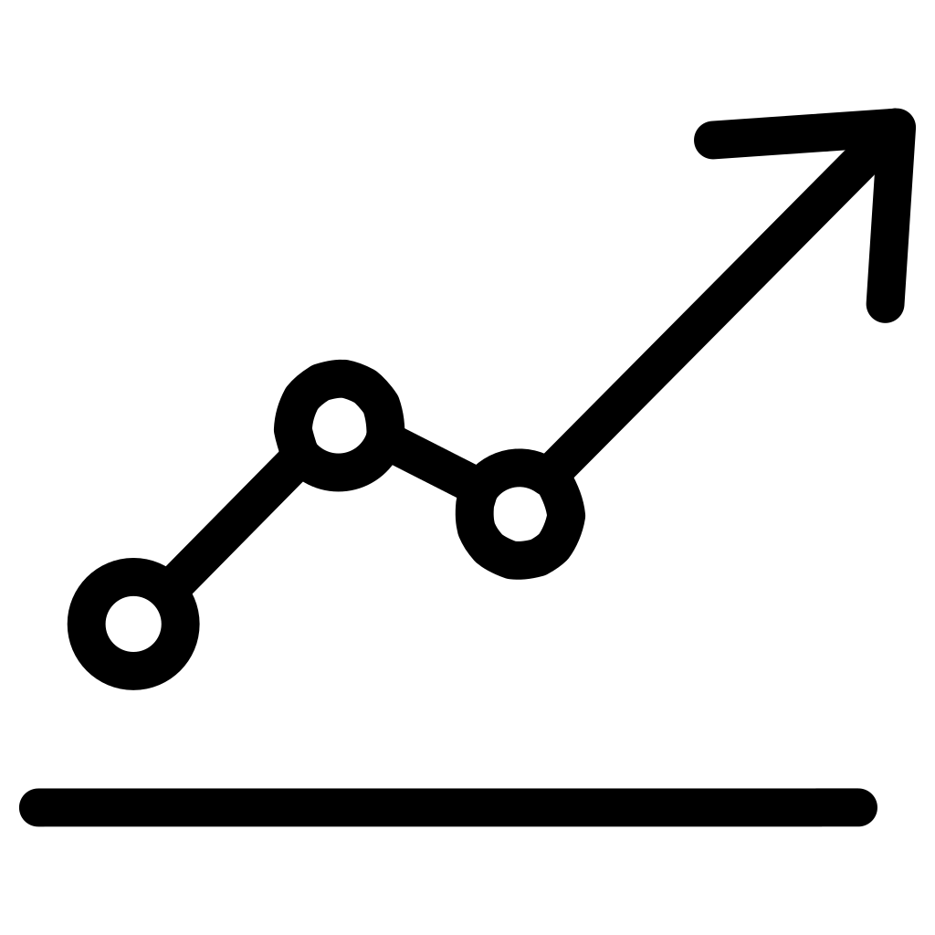


FOCUS AREAS
Five Pillars of the Trading System
Market Regime Detection
Feature Engineering
Regime-Aware Strategy
Using Hidden Markov Models to identify market phases
Price, futures, and options data transformation
EMA-based trading with regime filters
ML Trade Filtering
Performance Analysis
Machine learning to filter weak signals
Evaluation and outlier trade detection
Notes:
4

Slide 5
Executive Summary
01
02
03
Market Classification
Selective Trading
EMA Crossover Strategy
System classifies market into uptrend, sideways, or downtrend regimes
Trades executed only during trending regimes, avoiding sideways markets
Basic EMA crossover strategy forms the foundation
04
05
ML Enhancement
Improved Performance
Machine learning model filters weak signals for better results
Enhanced stability, reduced drawdown, and superior performance
Notes:
5

Slide 6




DATA PIPELINE
Multi-Source Data Integration
NIFTY Spot Data
Synthetic Futures Data
Synthetic Options Data
5-minute OHLCV data providing real-time market movements
Created from spot prices for derivatives analysis
IV and PCR based features for options intelligence
Notes:
6

Slide 7






Feature Engineering
Six critical features power the trading system's decision-making process:
EMA 5 and EMA 15
Spot Returns
Average Implied Volatility
IV Spread
Short and medium-term trend indicators
Price momentum measurement
Volatility differential tracking
Market uncertainty gauge
Put Call Ratio
Futures Basis
Market sentiment indicator
Spot-futures relationship
Notes:
7

Slide 8






Regime Detection & Trading Strategy
Hidden Markov Model
Strategy Rules
A 3-state Hidden Markov Model identifies market conditions:
EMA Crossover
Primary signal generation using exponential moving averages
Regime Filter
Trade only during uptrend or downtrend regimes
Sideways Exclusion
No trades executed in sideways markets to avoid whipsaws
Uptrend
Bullish momentum
Sideways
Range-bound market
Downtrend
Bearish momentum
Notes:
8

Slide 9






MACHINE LEARNING
XGBoost Trade Filtering
Signal Generation
ML Prediction
EMA crossover creates initial trade signals
XGBoost classifier predicts trade profitability
Signal Filtering
Enhanced Results
Only high-probability trades are executed
Improved win rate and reduced losses
Notes:
9

Slide 10

Conclusion
This project demonstrates that regime awareness and machine learning can significantly improve trading performance.
Proven Approach
Modular Design
Regime detection combined with ML filtering delivers superior results
System architecture supports easy modification and enhancement
Research Ready
Foundation suitable for further academic and practical research
Notes:
10

