Slide 1

DOCKER ESSENTIALS
Building, Shipping & Running
Software in Containers
A practical walkthrough of Docker's architecture, workflow and commands, from writing a Dockerfile to running containers in production.
COMMANDS · ARCHITECTURE · DEPLOYMENT

Slide 2
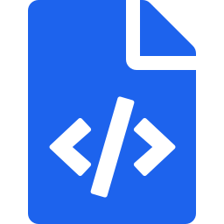
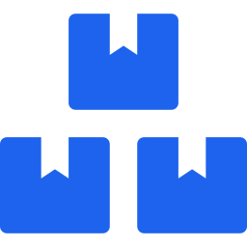
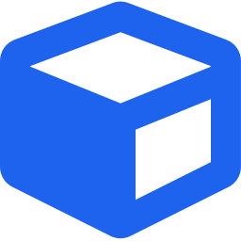

INTRODUCTION
What Is Docker?
Docker is a platform that packages an application together with everything it needs to run, code, runtime, system libraries and settings, into a single unit called a container.
FROM CODE TO CONTAINER
1. Write a Dockerfile
Define the base image, dependencies, and startup command.
Consistency
The same container runs identically on a laptop, a test server or the cloud, no more “it worked on my machine.”
2. Add Dependencies
Isolation
List packages and libraries the app needs to run correctly.
Each container has its own filesystem and process space, so apps never interfere with each other.
3. Build the Image
Efficiency
Docker packages everything into a portable, read-only image.
Containers share the host OS kernel, so they start in seconds and use far less memory than virtual machines.
4. Run the Container
Launch one or more running instances from that image.
INTRODUCTION
DOCKER ESSENTIALS
2

Slide 3

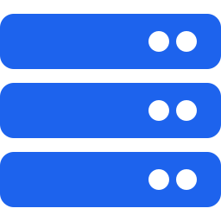


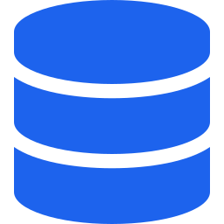
ARCHITECTURE
How Docker Is Put Together
Docker follows a client-server model. The pieces below work together every time you run a single docker command.
Docker Client
Docker Daemon (dockerd)
Docker Images
The CLI you type commands into (docker run, docker build). It talks to the daemon via a REST API.
The background engine on the host that builds images, and runs, monitors, and stops containers.
Read-only templates with the app and its dependencies, the blueprint a container is created from.
Docker Containers
Docker Registry
Volumes & Networks
Lightweight, isolated runtime instances of an image, the actual running application.
A storage/distribution service (like Docker Hub) that images are pushed to and pulled from.
Volumes persist data outside the container; networks let containers discover and talk to each other.
ARCHITECTURE
DOCKER ESSENTIALS
3

Slide 4

WORKFLOW
Dockerfile → Image → Container
A Dockerfile defines the environment and dependencies. Docker builds it into an image, and that image is run as an isolated container.
Dockerfile · Node.js example
FROM node:20
WORKDIR /app
COPY package*.json ./
RUN npm install
COPY . .
EXPOSE 3000
CMD ["npm", "start"]
Dockerfile
A text file of instructions: base image, files to copy, commands to run.
Image
The Dockerfile is built into a static, versioned, shareable image.
Container
What each line does
The image is run as a live, isolated process on any host.
FROM – starts from an official Node.js 20 base image
WORKDIR / COPY / RUN – sets up the app and installs packages
EXPOSE – documents the port the app listens on
CMD – the command that runs when the container starts
WORKFLOW
DOCKER ESSENTIALS
4

Slide 5




GETTING STARTED
Installing & Setting Up Docker
Terminal
1. DOWNLOAD DOCKER
$ docker --version
Docker version 27.x, build xxxxxxx
$ docker run hello-world
Hello from Docker!
This message shows that your
installation appears to be working correctly.
Visit docker.com/products/docker-desktop
Download Docker Desktop for your OS
Run the installer and follow the setup wizard
Restart your machine if prompted
If you see the “Hello from Docker!” message, the engine, CLI, and network access are all configured correctly.
2. VERIFY INSTALLATION
Open a terminal or command prompt and run the two commands on the right. Together they confirm the CLI works and that Docker can pull and run an image.
GETTING STARTED
DOCKER ESSENTIALS
5

Slide 6

REFERENCE
Essential Docker Commands
The commands developers reach for daily, grouped by what stage of the container lifecycle they belong to.
Build, Inspect & Run
Manage & Debug
docker build -t my-app:1.0 .
docker logs my-app
Build an image from the Dockerfile, tagged my-app:1.0
Stream a container's output for troubleshooting
docker run -d -p 3000:3000 my-app:1.0
docker exec -it my-app sh
Run it in the background, mapped to port 3000
Open a shell inside a running container
docker ps
docker stop my-app
List currently running containers
Gracefully stop a running container
docker images
docker rm my-app
List all images stored on this machine
Remove a stopped container to free resources
REFERENCE
DOCKER ESSENTIALS
6

Slide 7


NETWORKING
Port Mapping & Networking
Containers are isolated by default. Port mapping and Docker networks are how you deliberately open a controlled path in and between them.
Port Mapping
Container Networking
Host
localhost:3000
Container
port 3000
App
container
DB
container
app-network
docker run -d -p 3000:3000 \
--name my-app my-app:1.0
docker network create app-network
docker network inspect app-network
The format is host_port:container_port — traffic hitting the host port is forwarded straight into the container.
Containers on the same custom network can reach each other by container name — no hard-coded IP addresses needed.
NETWORKING
DOCKER ESSENTIALS
7

Slide 8
ORCHESTRATION
Docker Compose & Multi-Container Apps
Most real applications aren’t one container — they’re several (app, database, cache) that need to start together, in order, on a shared network. Docker Compose describes that whole stack in a single YAML file, so it comes up the same way every time.
Common Compose Commands
docker compose up -d
Start all services in the background
docker compose ps
One command, whole stack
List the services in this project
docker compose up starts every service, network, and volume defined in the file.
docker compose down
Consistent across machines
Stop and remove containers, networks
The same compose.yaml behaves the same on your laptop, a teammate's machine, or a server.
Easy teardown
Think of Compose as version control for your infrastructure: the file itself documents exactly how the app is meant to run.
docker compose down cleanly stops and removes everything it created.
ORCHESTRATION
DOCKER ESSENTIALS
8

Slide 9
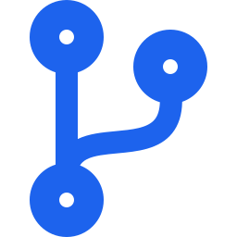




CI/CD & SECURITY
Docker in the Pipeline
Docker's role doesn't stop at your laptop — the same image moves through build, test, and deploy stages, so what you tested is exactly what ships.
Docker Commands in a Pipeline
Security Checklist
docker login
Use official / verified base images
Authenticate the CI runner with the registry
Avoid unknown images that may carry vulnerabilities or malware.
docker build -t app:$TAG .
Build a tagged image for this commit/release
Keep images updated
Rebuild regularly so security patches in the base image reach production.
docker push app:$TAG
Publish the image to the registry
Avoid running as root
docker pull app:$TAG
Set a non-root USER in the Dockerfile to limit damage from a compromised container.
Fetch the exact same image on the deploy server
Scan images before deploy
Use tools like Docker Scout or Trivy to catch known CVEs early.
CI/CD & SECURITY
DOCKER ESSENTIALS
9

Slide 10
CASE STUDY
End-to-End Deployment Example
Taking one app from a local build to a live server in three commands each.
01
02
03
Build
Run Locally
Deploy to Server
docker build -t my-app:1.0 .
docker run -d -p 3000:3000 --name my-app my-app:1.0
docker pull username/my-app:1.0
docker run -d -p 3000:3000 username/my-app:1.0
CASE STUDY
DOCKER ESSENTIALS
10

Slide 11


WHY IT MATTERS
Problems Docker Solves
Four recurring pain points in software delivery, and how containers remove them.
“Works on My Machine”
Dependency Conflicts
Environment drift
Version clashes between apps
The container carries its own OS libraries and config, so behavior doesn't change between machines.
Each container has an isolated filesystem, so two apps can use different, even conflicting, library versions safely.
Portability
Repeatable Deployments
Cloud, on-prem, laptop
Manual, error-prone releases
The same image runs anywhere Docker is installed, no rewriting deployment steps per environment.
Images are versioned artifacts, so CI/CD pipelines can build once and deploy that exact artifact every time.
WHY IT MATTERS
DOCKER ESSENTIALS
11

Slide 12

KEY TAKEAWAYS
Docker in Four Ideas
Build once
Isolate cleanly
A Dockerfile turns source code into a portable, versioned image.
Containers keep apps and their dependencies from colliding with each other.
Connect deliberately
Ship consistently
Port mapping and networks control exactly what a container can reach.
The same image runs unchanged from a laptop to a production server.
Thank you — questions welcome.

