Slide 1
BIG DATA ANALYTICS PROJECT
Real-Time Distributed
Chat Application
Using Apache Kafka · PyQt5 · MongoDB · ML Sentiment · Gemini AI
Priyanshu Nerella (160123737159)
Guide: Dr. N. Sudhakar Yadav, Associate Professor – Dept. of IT, CBIT
E.(IT) VI-Sem | 2025-26 | Submission: 03-05-2026

Slide 2
Agenda
01
Introduction & Motivation
05
Implementation Details
02
Software & Technologies Used
06
Results & Output Screenshots
03
System Architecture
07
Performance Summary
04
Architecture Diagram
08
Discussion & Conclusion

Slide 3
Introduction & Abstract
Project Overview
A real-time distributed chat application built on Apache Kafka as the messaging backbone, PyQt5 for the desktop GUI, and MongoDB for persistent storage. The system supports multiple chat rooms, ML-based sentiment analysis, and AI-powered chat summarization via the Gemini API.
Problem:
Traditional socket-based chat apps lack durability & scalability required for production. This project explores Kafka's streaming capabilities in a desktop chat environment.
Goal:
Build a multi-room chat app where messages are reliably produced/consumed via Kafka, persisted in MongoDB, and displayed in a responsive GUI with analytics.
Impact:
Demonstrates event-driven distributed messaging powering interactive desktop apps with sub-second latency, ML analytics, and LLM summarization.

Slide 4
Objectives
1
Design a Kafka-based publish-subscribe chat system supporting multiple rooms
2
Build a responsive PyQt5 desktop GUI with threaded Kafka I/O to prevent UI blocking
3
Persist all chat messages to MongoDB with room-based retrieval
4
Implement ML-based sentiment classification using a Naive Bayes model
5
Integrate the Gemini API to generate abstractive chat summaries
6
Provide a real-time analytics panel showing user activity and room mood

Slide 5
Software & Technologies Used
Apache Kafka
PyQt5
MongoDB
v kafka-python 2.3.1
v 5.15.11
v PyMongo (latest)
Distributed messaging backbone — pub/sub topics per chat room, durable log storage
Cross-platform desktop GUI with QThread for non-blocking Kafka I/O & signal-slot communication
Document-oriented NoSQL persistence for chat messages with room-based retrieval
scikit-learn
Google Gemini API
Python + python-dotenv
v Latest
v google-generativeai
v 3.x
Multinomial Naive Bayes classifier + CountVectorizer for real-time sentiment analysis
LLM-powered abstractive summarization of chat room conversation history
Core language; dotenv for secure API key management via environment variables

Slide 6
System Architecture – Layered Design
Presentation Layer
PyQt5 main window (gui.py) · Login dialog (login.py) · Chat bubbles · Room selector · Analytics panel
Messaging Layer
Kafka Producer (producer.py) · Kafka Consumer (consumer.py) · KafkaWorker QThread (worker.py) · Topic hot-swap
Persistence Layer
MongoDB via PyMongo (db.py) · kafka_chat database · messages collection · save_message() & load_messages()
Analytics Layer
ML Sentiment Classifier (ml_sentiment.py) · Analytics engine (analytics.py) · Gemini Summarizer (summarizer.py)
Each layer communicates through well-defined interfaces, ensuring separation of concerns and modularity.

Slide 7
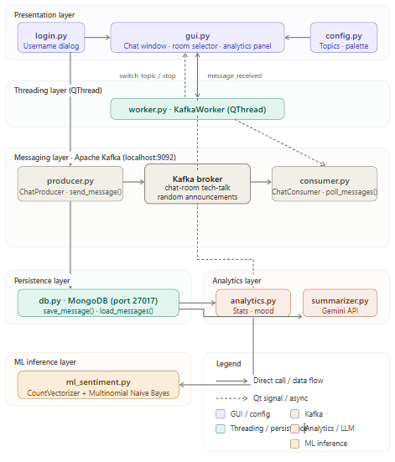
System Architecture Diagram
Presentation Layer: UI built with login.py and gui.py for chat, topic selection, and analytics display.
Threading Layer: worker.py handles background Kafka operations to keep the UI responsive.
Messaging Layer (Kafka): producer.py sends messages, Kafka broker manages topics, and consumer.py receives messages.
Persistence & Analytics: MongoDB (db.py) stores chats, while analytics.py and summarizer.py generate insights.
ML Layer: ml_sentiment.py performs sentiment analysis to detect user mood.

Slide 8
Message Flow & Threading Model
Message Flow
1
User types a message in the PyQt5 GUI
2
GUI calls ChatProducer.send_message() — serializes payload as JSON
3
Message published to the Kafka topic for the selected chat room
4
Message persisted to MongoDB (db.save_message())
5
KafkaWorker (QThread) polls consumer in background — receives message
6
Worker emits message_received Qt signal → GUI slot renders chat bubble
Threading Model:
Kafka I/O is isolated in KafkaWorker (QThread subclass). Signals use queued connections so Kafka polling never blocks the UI event loop.

Slide 9
Module Overview
config.py
Central constants: Kafka servers, topic names, UI colour palette
login.py
Username entry dialog shown at startup
producer.py
Wraps KafkaProducer; serialises & publishes messages; invokes MongoDB save
db.py
MongoDB interface: save_message() and load_messages()
consumer.py
Wraps KafkaConsumer; polls messages; supports topic hot-swap
analytics.py
Per-user stats, peak hour, ML sentiment aggregation
worker.py
QThread driving consumer loop; emits Qt signals to GUI
ml_sentiment.py
Trains and exposes Naive Bayes sentiment classifier
gui.py
Main window: chat bubbles, room selector, analytics panel
summarizer.py
Calls Gemini API for abstractive chat summaries

Slide 10
ML-Based Sentiment Analysis
Naive Bayes Sentiment Classifier (ml_sentiment.py)
Trained at import time on a curated dataset. CountVectorizer converts text to bag-of-words feature vectors. Real-time inference with negligible latency.
Positive 😊
Example phrases: I love this · this is great · awesome work · very good · cool app
Negative 😞
Example phrases: I hate this · this is bad · worst experience · very angry · problem here
Neutral 😐
Example phrases: okay · fine · normal · nothing special · it works
Output: predict_sentiment(message) → 'Positive' | 'Negative' | 'Neutral' | Aggregated to determine overall room mood.

Slide 11
AI-Powered Chat Summarization (Gemini)
Step 1
Load Messages
All messages for a room are retrieved from MongoDB and concatenated into a single text block.
Step 2
Prompt Gemini
A prompt instructs the Gemini Flash model to produce a 2–3 sentence abstractive summary of the conversation.
Step 3
Display Result
The generated summary is rendered in the analytics panel below per-user statistics.
Key Considerations
• Abstractive (not extractive) — novel sentences capture key points
• Depends on Gemini Flash API availability and network round-trip latency
• Complements the ML analytics panel for a complete chat intelligence dashboard

Slide 12
Data Model & Kafka Topic Design
MongoDB Message Schema
Field | Type | Description
_id | ObjectId | Auto-generated MongoDB document identifier
room | String | Kafka topic / chat room name (e.g., 'tech-talk')
username | String | Display name of the sender
message | String | Plain text message content
timestamp | Float | Unix epoch time (seconds) at message creation
Kafka Topic Design
Each chat room maps to a dedicated Kafka topic with a single partition (default config)
Consumer uses auto_offset_reset='earliest' — retrieves messages from start of log on first connect
Consumer group ID randomised per instance (uuid.uuid4()) — all windows receive all messages independently
change_topic() enables hot-swapping without stopping/restarting the KafkaWorker thread

Slide 13
Results & Output Screenshots
Section 6 – Visual outputs from the running application

Slide 14
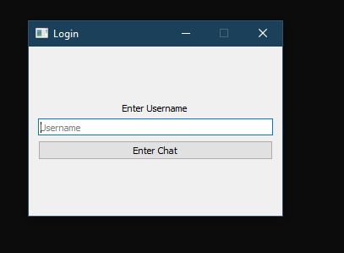
Result 1: Login Screen
[ Place Login Screen
Screenshot Here ]
Login Screen
Minimal dialog presented on application launch
User enters a display username before entering the chat
No password validation in current scope (future: OAuth / JWT)
Implemented in login.py as a standalone QDialog
Fig 6.1 – login.py: Username entry dialog

Slide 15
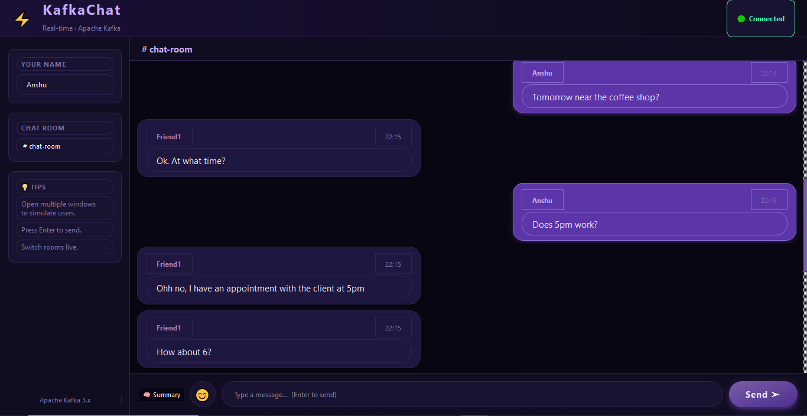
Result 2: Main Chat Window
Chat Window Features
Dark purple theme defined in config.py
Sent messages: right-aligned purple bubbles
Received messages: left-aligned contrasting bubbles
QScrollArea for infinite message history
Room selector dropdown at top for live topic switching
Analytics button opens the statistics panel
Fig 6.2 – gui.py: Chat bubble UI

Slide 16
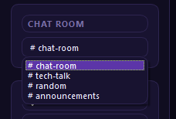
Result 3: Multi-Room Chat
[ Place Room Selector
Screenshot Here ]
Multi-Room Support
Each room = a dedicated Kafka topic
Switching rooms calls change_topic() — no restart needed
Chat area refreshes with messages from the new room
Adding a new room = one line in config.py
Consumer unsubscribes from old topic & re-subscribes instantly
Fig 6.3 – Room selector: topic hot-swap at runtime

Slide 17
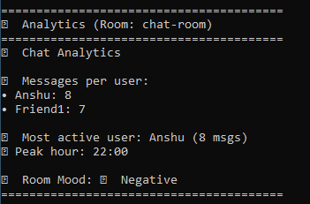
Result 4: Analytics Panel
[ Place Analytics Panel
Screenshot Here ]
Analytics Features
Per-user message counts (Counter)
Most active user identification
Peak activity hour (timestamp bucketing)
Room mood via Naive Bayes aggregate
Loaded on demand via analytics button
Fig 6.4 – analytics.py: per-user stats, peak hour, room mood

Slide 18
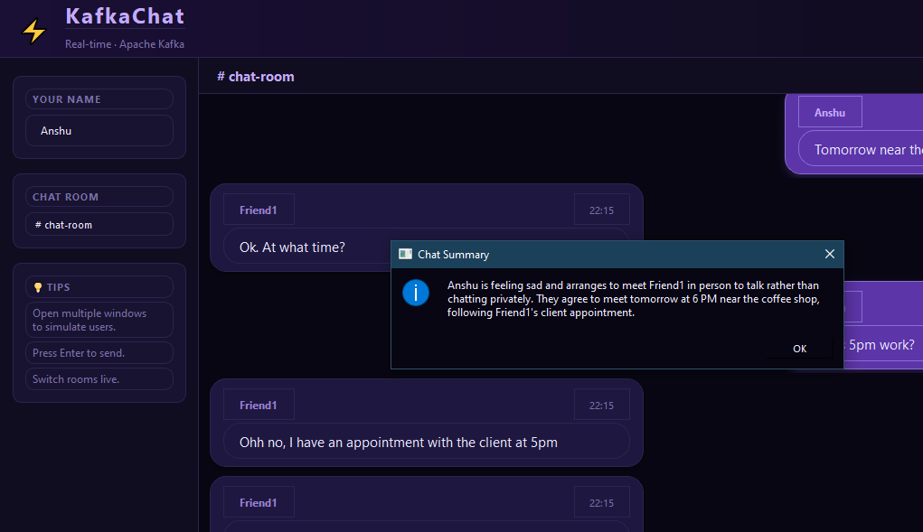
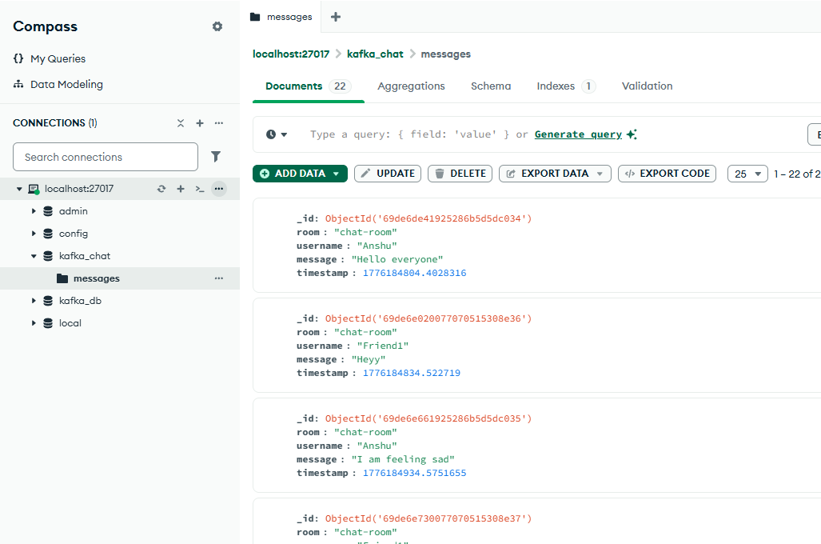
Result 5 & 6: AI Summary & MongoDB Storage
[ Gemini Summary
Screenshot ]
[ MongoDB Storage
Screenshot ]
Fig 6.5 – AI-generated abstractive summary (Gemini Flash)
Fig 6.6 – MongoDB persistence: stored documents (db.py)
AI Summary: Gemini Flash produces a 2–3 sentence abstract of the full room chat history. Network-dependent response time. MongoDB: All messages written to kafka_chat.messages collection with room, username, message, and timestamp fields.

Slide 19
Performance Summary
Metric | Result | Notes
End-to-end message latency (mean) | Sub-second | Producer send → consumer receipt under normal local load
End-to-end message latency (95th pct) | Sub-second | Under normal load on single-machine deployment
Analytics computation time | Fast | Up to 1,000 messages; excludes Gemini API call
Gemini API response time | Network-dependent | External API; round-trip latency varies by connectivity
MongoDB insert time | Fast | Single document insert — PyMongo insert_one()
Sentiment inference time/message | Negligible | Naive Bayes + bag-of-words on CPU, no GPU required
Key Insight: Real-time message delivery achieved with sub-second latency under local conditions. ML inference adds no perceptible delay.

Slide 20
Discussion: Strengths & Limitations
✓ Strengths
✗ Limitations
Clean separation of concerns — each module has a single responsibility
Username-only auth — no password validation or session management
Non-blocking GUI via QThread + Qt signal-slot mechanism
Sentiment classifier trained on only 15 samples; limited real-world accuracy
Sub-second latency message delivery under local conditions
No TLS encryption; Kafka accessed without SASL auth
Extensible room system: new room = one topic name in config.py
Gemini API summarization depends on external availability
Dual analytics: ML sentiment + Gemini abstractive summarization
Single-partition Kafka topic limits horizontal throughput scalability

Slide 21
Future Work
🔐
Authentication
🧠
Better ML Models
🔒
Security
Implement OAuth or JWT-based user authentication with a user management service
Expand sentiment dataset; evaluate transformer-based models (e.g., DistilBERT) for improved accuracy
Add TLS encryption for Kafka connections and enforce SASL authentication
🖼️
Media Messages
🐳
Docker Deployment
🔔
Notifications
Support images and files via Kafka message headers and object storage integration
Deploy with Docker Compose for reproducible multi-node Kafka and MongoDB environments
Introduce notification system using Kafka Streams to alert users of mentions or keywords

Slide 22
Conclusion
Demonstrated feasibility of building a real-time distributed chat app using Kafka as the messaging backbone
QThread + Qt signals effectively decouple Kafka I/O from UI — responsive, non-blocking user experience
Modular architecture with a central config file makes the system readily extensible for production use
Analytics module delivers actionable insights into conversation patterns and sentiment in real time
AI-powered Gemini summarizer enables users to grasp lengthy chat histories at a glance
Future iterations: stronger auth, richer ML models, TLS encryption, and cloud/Docker deployment

Slide 23
References
[1] Apache Kafka Documentation — kafka.apache.org/documentation
[2] kafka-python Library — kafka-python.readthedocs.io
[3] PyQt5 Documentation — riverbankcomputing.com/software/pyqt
[4] PyMongo Documentation — pymongo.readthedocs.io
[5] scikit-learn: Machine Learning in Python — Pedregosa et al., JMLR 12, 2011
[6] Google Generative AI Python SDK — ai.google.dev
[7] MongoDB Documentation — mongodb.com/docs
[8] Kreps, Narkhede & Rao (2011). Kafka: A distributed messaging system for log processing. NetDB Workshop.

