Slide 1
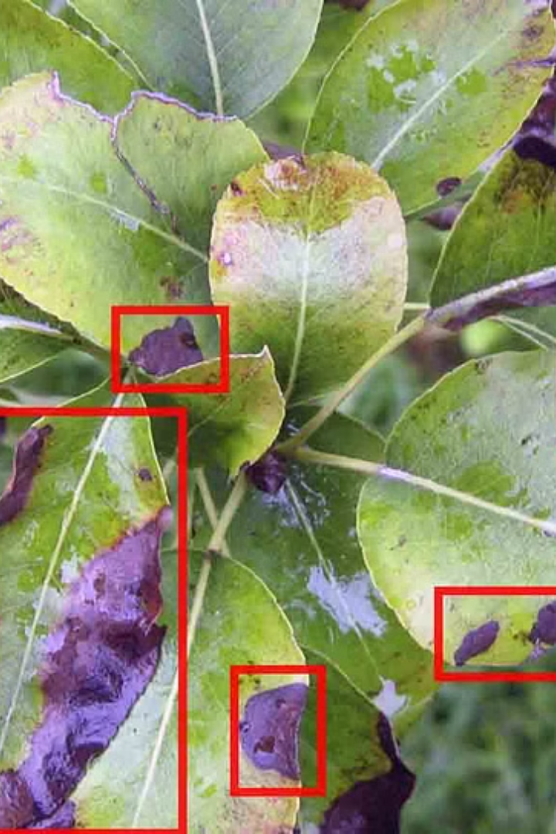
Image-based Disease Detection for Plants
Research Questions:
How accurately can the sequential model and decision tree model identify plant diseases based on visual symptoms in the given dataset?
How well does the model generalize to different plant species?
What are the strengths and limitations of using a Sequential model for plant disease detection in comparison to Decision Tree?

Slide 2
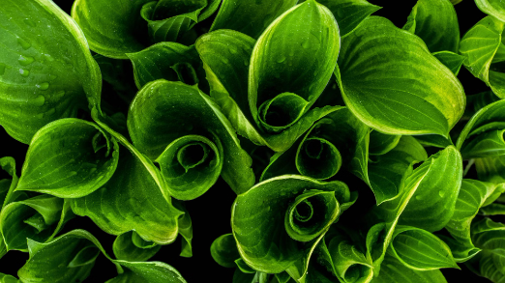
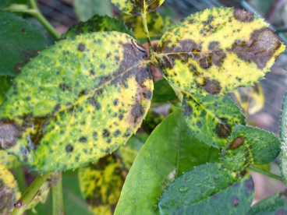
Dataset Information
Plant Images
Disease Categories
The dataset comprises images of various plant species, and each image is associated with metadata such as plant type, environmental conditions, and disease status. The dataset includes a total of 54,305 labelled images of leaves. We split these images into two datasets:
Each image in the dataset is labeled with the corresponding disease category. This allows the dataset to be used for training and evaluation of plant disease detection models.
80% : Training dataset(43,456 images)
20% : Validation dataset(10,849 images)
For more information, please visit the Kaggle dataset page.

Slide 3
Model Design
Data Flow from Directory:
Generate data flow from directories containing training and validation images.
Specify target image size, batch size, and class mode for categorical classification.
Data Loading and Labeling:
Load bottleneck features and class labels for training data.
Convert class labels to categorical format using one-hot encoding.
Flatten the bottleneck features to create a feature matrix compatible with the decision tree model.
Model Implementation:
Build a Sequential model with layers for flattening, dense, dropout, and output.
Configure layer parameters such as input shape, activation functions, and dropout rate.

Slide 4
Data Preparation
Pre-Trained Model: VGG16
Utilize the VGG16 model pre-trained on ImageNet for feature extraction.
The pre-trained model serves as a feature extractor, capturing high-level representations from input images.
Image Data Generation:
Use an ImageDataGenerator to preprocess and augment image data.
Rescale pixel values to ensure they lie in the range [0, 1] for normalization.
Extracting Features:
Extract bottleneck features from the pre-trained VGG16 model.
Predict features for both training and validation data using the model.
Saving Features:
Save the extracted bottleneck features as numpy arrays for later use.(bottleneck_fc_model.weights.h5)
Bottleneck features serve as input to subsequent models for training and prediction.

Slide 5
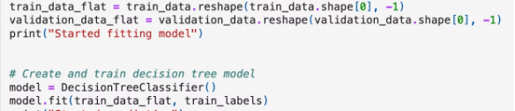
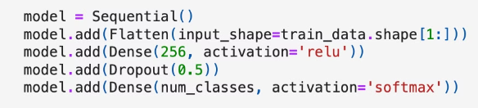
Model Implementation
Sequential Model
Decision Tree
A Sequential model is initialized.
Create a Decision Tree model using DecisionTreeClassifier.
Convolutional layers are added to extract features from input images.
Train the decision tree model on the flattened training data (train_data_flat) and labels (train_labels).
MaxPooling layers are added to downsample the feature maps.
Flattening layer converts the 2D feature maps into a 1D feature vector.
Dense layers are added for classification, followed by dropout for regularization.
The output layer produces class probabilities using softmax activation.

Slide 6
Model Evaluation
Sequential Model
1
Processes images sequentially, making a single classification at the end. Calculated loss and accuracy over 50 epochs and plotted its performance over epochs. We then computed confusion matrices and classification reports and printed weighted precision and F1 score.
2
Decision Tree
Splits the input space hierarchically, making multiple decisions along the way.
We computed confusion matrices and classification reports and printed weighted precision and F1 score.
Weighted Precision: 0.8973363169584712
Weighted F1 Score: 0.8882779978378684
This model is less accurate than the sequential model, with an F1 score of only 52.5%.
Weighted Precision: 0.5278935495901659
Weighted F1 Score: 0.525778046019582

