Slide 1
P2P E-Learning Platform using Cloud Computing
Submitted in the partial fulfillment for the award of the degree of
BACHELOR OF ENGINEERING
IN
Computer Science
Submitted by:
Name | UID
Ramandeep | 21BCS6844
Priyanshu Srivastava | 21BCS6911
Anurag Kumar | 21BCS6940
Akshat Choudhary | 22BCC80003
Under the Supervision of:
Mrs. Sarita Simaiya
DISCOVER . LEARN . EMPOWER
Department of AIT-CSE

Slide 2

Outline
Introduction to Project
What we learnt from
previous project evaluation
What is P2P LMS
Objectives of the work

Slide 3

Introduction to Project
What is an Edu-Tech Learning Platform ?
It is a platform
That delivers educational content online
That provides a virtual learning environment
That is flexible, scalable, cost-effective , and can be accessed from anywhere using internet.

Slide 4





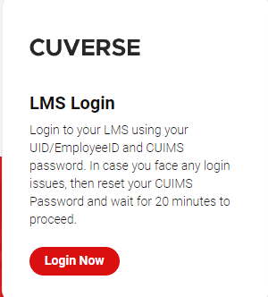
Examples of many existing E-learning Platforms

Slide 5
What is P2P LMS
P2P LMS stands for Peer-to-Peer Learning Management System. It is a type of online learning management system that facilitates learning through interactions between learners, without relying solely on an instructor or central authority.
Here you can create course and be a instructor as well as be a student and consume course content.
Example of a rough idea – Imagine having a e-learning platform , focused on CU students and learners. Here each and every student from college seniors to juniors can share there knowledge by creating courses. Discussing problems and doubts in discussion forums and improving their skills.

Slide 6
Objectives of the Work
Building e-learning website with admin and user logins with their respective managing consoles
Deploying the platform to cloud to ensure its scalability , accessibility and cost effectiveness.
Offering flexibility in terms of content delivery allowing instructors and administrators to provide best learning experience to meet the needs of learners.
Overall, creating an e-learning website using cloud computing can help improve the quality of education

Slide 7
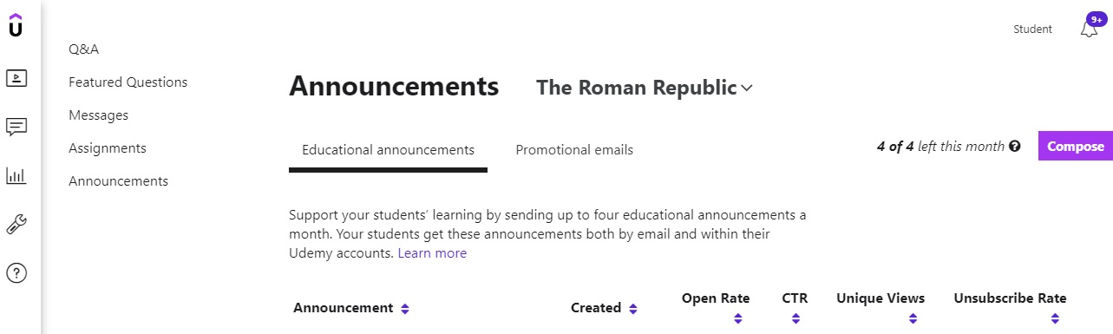

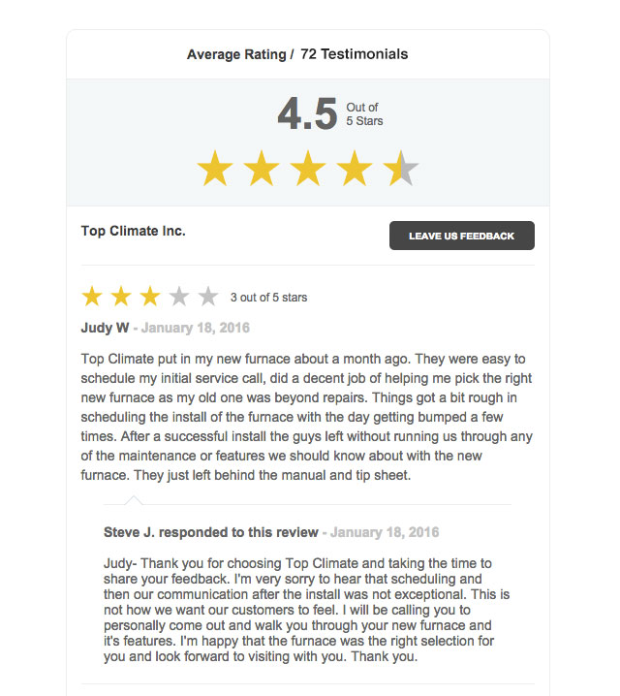
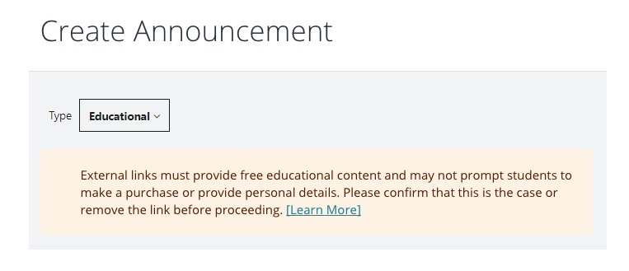
Deciding on features

Slide 8
Constrain Identification
While working on this project some constrains came up in the way-
Technical Constrain
Time Constrain
Security
Language Constrain

Slide 9
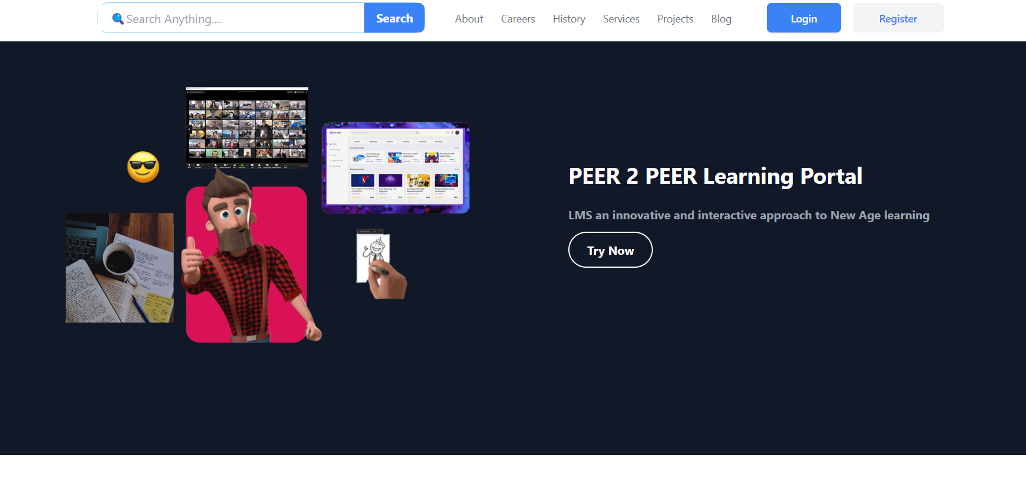
Design Selection
Work in progress–
Home Page

Slide 10
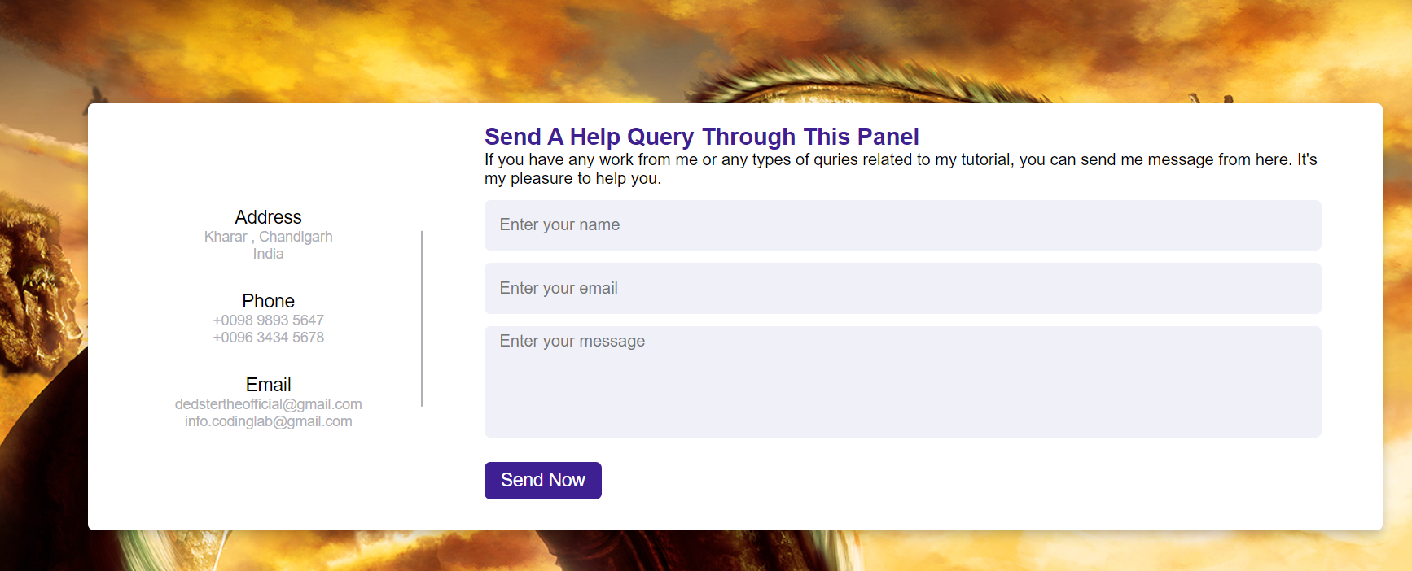
About us & Contact US

Slide 11


Setting up backend
We have currently decided to go with sanity.io which is a third party tech to handle content management system which will contain user generated content.
We have kept are tech stack open and technologies will be decided and used as per requirement

Slide 12
Deciding on features

Slide 13
Thank You

