Slide 1

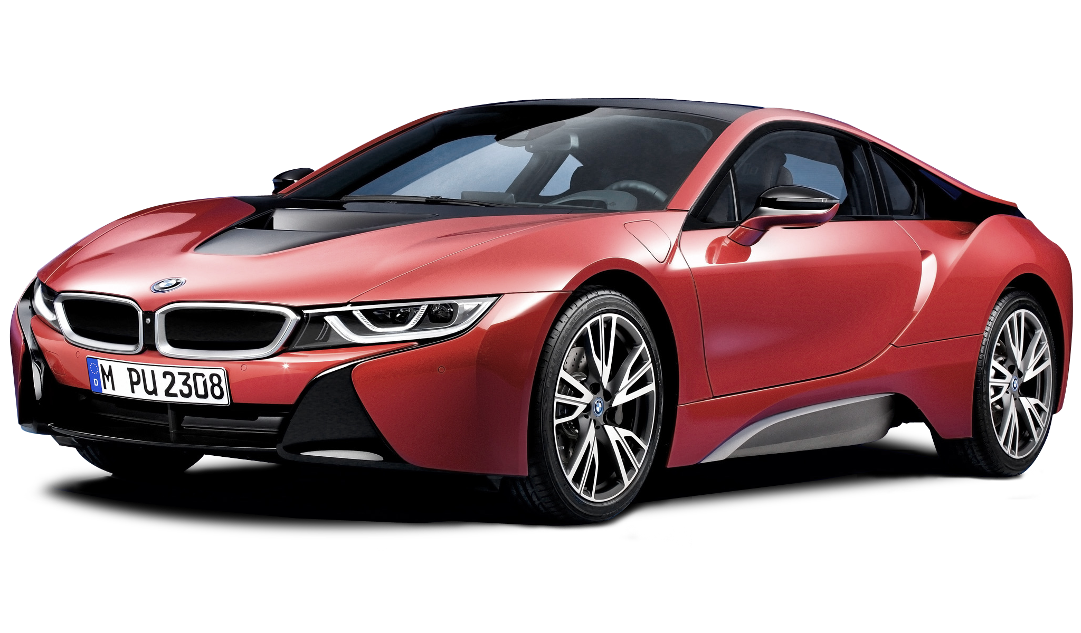
BMW 8
BMW

Slide 2
BMW
BMW 8
The BMW Group and its brands enable moving
Moments – individual and unique. BMW creates driving
Pleasure from the perfect combination of dynamics,
Sporty performance, ground- breaking innovations and
Breath – talking design.
DETAILS:
5.2 seconds
250 kmph
Petrol
Acceleration
Top Speed
Fuel Type

Slide 3
BMW
BMW 8
Freedom of
Design has a
Name.
The BMW Group and its brands enable moving
Moments – individual and unique. BMW creates driving
Pleasure from the perfect combination of dynamics,
Sporty performance, ground- breaking innovations and
Breath – talking design.
BMW 8 Series is a 4 seater Coupe
With a mileage of 11.3 Kmph
Depending upto it’s transmission and
Fuel type. 8 Series’s6 cylinder , 2998
cc. Twin Power Turbo Engine can
Generate 500 Nm @ 1600-4500 rpm
Torque. It has a fuel tank capacity of
68 Litres L.
DETAILS:
5.2 seconds
Acceleration
250 kmph
Top Speed
Petrol
Fuel Type

Slide 4
BMW
BMW individual is the exclusive
Range of individualized features to
Give your car its own special
Charisma – and the same time the
Maximum expression of your
personality

Slide 5
BMW
BMW 8
DETAILS:
The BMW Group and its brands enable moving
Moments – individual and unique. BMW creates driving
Pleasure from the perfect combination of dynamics,
Sporty performance, ground- breaking innovations and
Breath – talking design.
5.2 seconds
Acceleration
250 kmph
Top Speed
Petrol
Fuel Type

