Slide 1


Cosmique: A Modern Watch Website Design Journey
This presentation outlines the design process for a modern watch website, exploring key aspects like technology, design principles, and user experience.
PROJECT BY-
PRIYANSHU PATEL - 23002170510029

Slide 2
Web Technologies: HTML, CSS, JavaScript, Bootstrap, and Tailwind
HTML
CSS
JavaScript
Bootstrap
Structure and content layout.
Styling and visual design.
Dynamic elements.
Designing

Slide 3




Interactive Features and User Experience Enhancement
Product Videos
Customer Reviews
Personalized Recommendations
Interactive product demonstrations.
User feedback and product insights.
Tailored product suggestions.

Slide 4
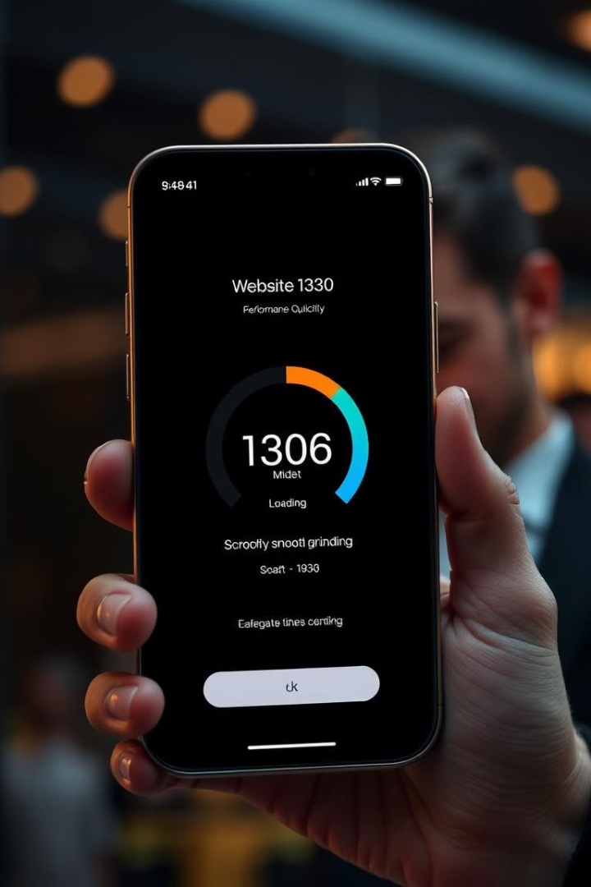
Performance Optimization and Mobile Compatibility
1
Minify HTML, CSS, and JavaScript.
2
Optimize images for web format and size.

Slide 5
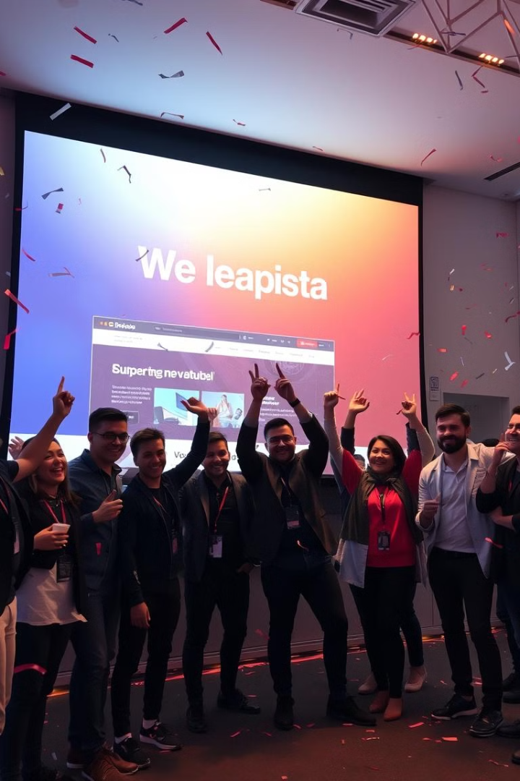
Deployment, Future Improvements, and Launch Strategy
Deployment
Deploying the website on a secure server.
Marketing Campaign
Promoting the website through various channels.
User Feedback
Gathering user insights for continuous improvement.
Future Enhancements
Expanding features and make it more user friendly.

Slide 6
THANK YOU

