Slide 1
Real-Time Crypto
Portfolio Tracker with
On-Chain Data
Submitted By: - Submitted To: -
Priyanshu Tonk Mr.Aauysh

Slide 2
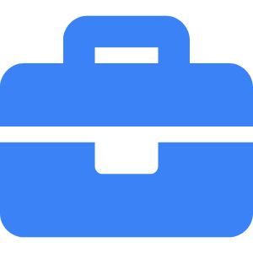
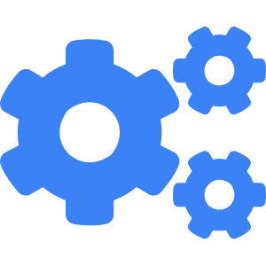
Blockchain Internship Project
Internship Project
A blockchain-based portfolio tracker leveraging on-chain data for real-time visibility.
Full-Stack Development
Built using React, Flask, Web3.py, and decentralized price feeds for seamless integration.
Notes:
Welcome to my presentation on the Real-Time Crypto Portfolio Tracker built during my Blockchain Internship. This project aims to solve the growing need for transparent, decentralized, and real-time monitoring of crypto assets.
At its core, the solution pulls live data directly from blockchains using Web3 tools, eliminating the dependency on centralized APIs that often lag or become unavailable. Through a custom frontend and backend integration, users can visualize their entire crypto portfolio, track price changes, and receive alerts—all from one decentralized dashboard.
This internship was an opportunity to deep dive into full-stack DApp development, on-chain data retrieval, and real-world DeFi usability. Let's now explore the motivations and problems this project set out to solve.

Slide 3
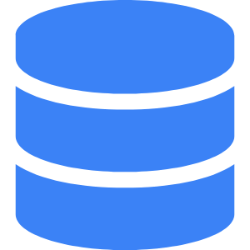
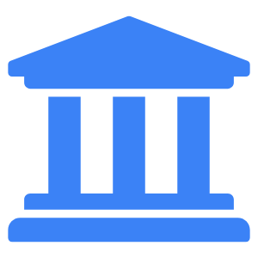
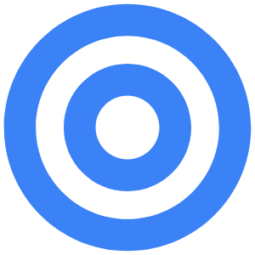
Introduction: Blockchain, DeFi & Internship Goals
Understanding the foundation of decentralized asset management
Blockchain Primer
Blockchain is a decentralized ledger enabling secure, transparent, immutable transactions.
DeFi Significance
DeFi allows users to interact with financial tools without intermediaries using smart contracts.
Internship Objectives
Learn on-chain data integration, build a DApp, and enhance full-stack blockchain development skills.
Notes:
Before diving into the specifics of the project, it’s essential to frame the broader context. Blockchain technology underpins all decentralized finance applications by offering an immutable and transparent ledger. This decentralized infrastructure eliminates the need for trust in intermediaries, which makes it ideal for financial transactions and asset tracking.
DeFi, or decentralized finance, expands this by allowing users to lend, borrow, trade, and manage assets entirely on-chain. Unlike traditional platforms, DeFi applications use smart contracts for logic enforcement, reducing operational risk and increasing transparency.
The goal of my internship was not only to understand these foundational principles but also to implement them in a practical, full-stack decentralized application. The primary learning objectives included handling blockchain data, creating dynamic UI elements for finance data, and integrating decentralized data feeds in a real-world scenario.

Slide 4
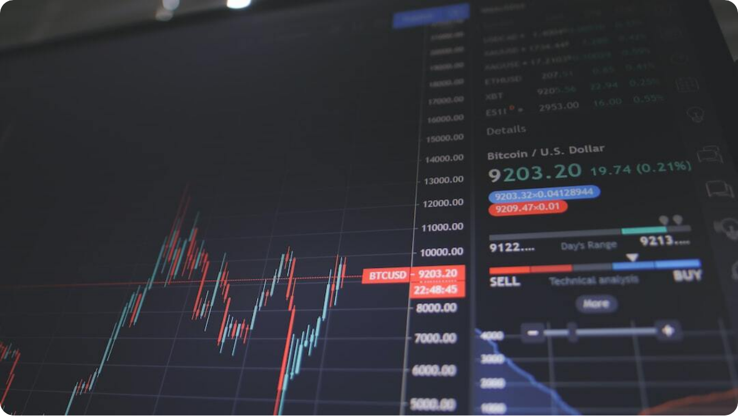
Problem Statements: Gaps in Crypto Portfolio Management
Challenges addressed by our DApp solution
Fragmented Wallets: Users face difficulty in consolidating and tracking assets across multiple wallets and blockchains.
  Centralized Dependence: Existing tools rely heavily on centralized APIs, prone to downtime, rate limits, and latency.
  Lack of Transparency: Users lack on-chain visibility and configurable alerts for real-time portfolio changes.
Notes:
Let’s examine the key issues that inspired this project. First, many users today manage assets across several wallets and blockchain networks. There’s no unified platform to view consolidated holdings in real time.
Second, most existing portfolio trackers pull data from centralized APIs. These APIs, though easy to integrate, introduce vulnerabilities—such as data delays, outages, or even restricted access when rate limits are breached. This creates reliability risks for active traders and DeFi users.
Third, users lack access to raw on-chain data. Without customizable alerts and full transparency into their wallet activity, they remain dependent on opaque systems. This project directly targets these three pain points to enable a fully decentralized, transparent solution.

Slide 5
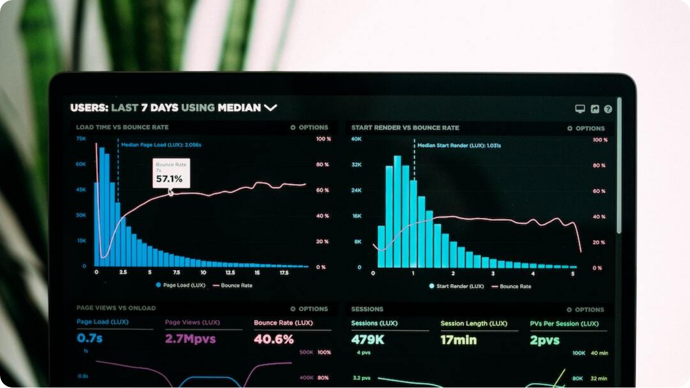
Proposed Solutions: Real-Time & On-Chain Crypto Tracking
How our system bridges transparency, decentralization, and usability
On-Chain Integration: Pulls live token balances and transaction history directly using Web3.py, bypassing centralized APIs.
  Decentralized Price Feeds: Integrates Chainlink and fallback Coingecko APIs to ensure data integrity and redundancy.
  Dynamic Portfolio UI: Visual dashboards, alerts, and analytics empower users to manage their assets independently.
Notes:
To address the core problems, we designed a portfolio tracker that directly interfaces with blockchain nodes. Using Web3.py, we fetch real-time token balances and wallet activities without relying on intermediaries. This ensures the data is always transparent and verifiable on-chain.
For pricing data, we implemented decentralized price feeds like Chainlink. In cases where Chainlink might not provide data for certain tokens, we have a Coingecko API fallback. This hybrid approach offers both decentralization and reliability.
Most importantly, we’ve built a highly visual and user-centric frontend. The dashboard presents asset distribution, value trends, and sends customizable alerts. By combining deep on-chain access with an intuitive UI, users gain full autonomy over their crypto asset monitoring.

Slide 6

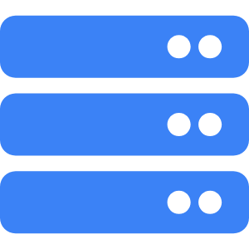
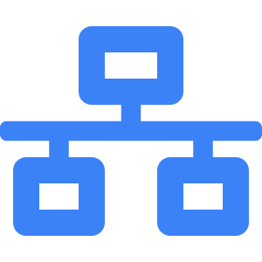
System Architecture: Full-Stack Blockchain Integration
Modular setup with Flask backend, React frontend, and Web3 interface
Frontend (React.js)
User-facing dashboard built in React with TailwindCSS for responsive design.
Backend (Flask)
REST API service in Python handles wallet queries, price data, and data caching.
Blockchain & APIs
Web3.py connects to Ethereum RPC (Infura), with Chainlink/Coingecko for pricing feeds.
Notes:
Our system follows a clear, modular architecture designed for scalability and flexibility. The frontend is developed in React.js using TailwindCSS, ensuring a responsive and intuitive UI. Users interact with the portfolio tracker through this dashboard, which fetches and displays blockchain-based data in real time.
The backend is powered by Python's Flask framework. It functions as a REST API server, managing calls to Web3.py for blockchain data and Chainlink/Coingecko for pricing information. We’ve optimized it with data caching strategies to ensure performance efficiency.
On the blockchain integration front, the app uses Infura nodes via Web3.py to query Ethereum data. This layer also connects to decentralized oracles like Chainlink and fallback APIs. The architecture ensures that all core logic—wallet scanning, price fetching, and alerting—is decentralized and resilient.

Slide 7
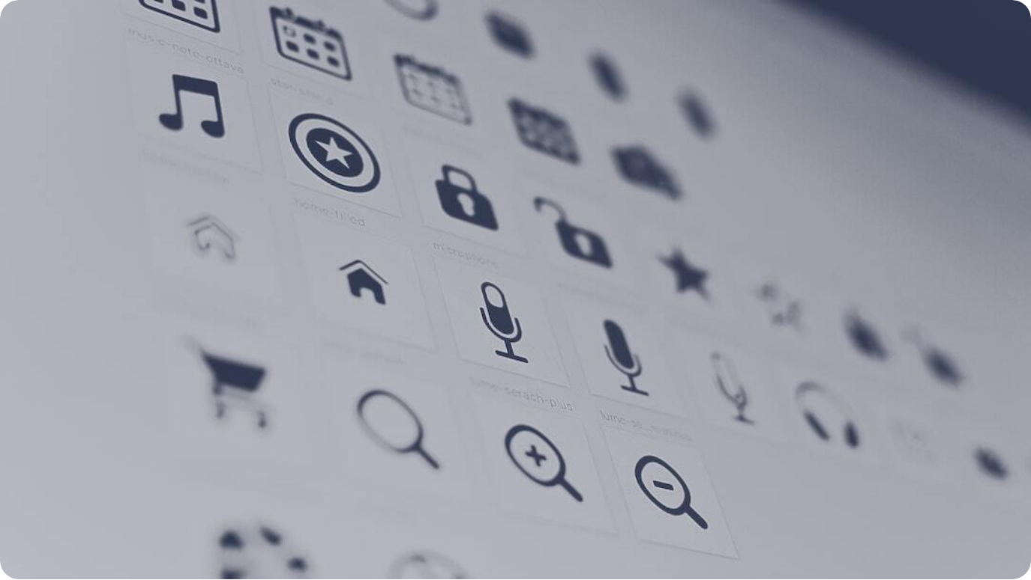
Tech Stack Overview
Tools and technologies powering the DApp
Frontend: React + Tailwind: Developed a responsive UI using React.js and TailwindCSS for dynamic charts and wallet inputs.
  Backend: Flask + Python: Implemented Flask routes and business logic in Python to serve portfolio data and alerts.
  Blockchain: Web3.py + Infura: Used Web3.py to fetch token balances and tx history from Ethereum via Infura endpoints.
Notes:
This project was built with a lean but powerful technology stack designed for decentralization and real-time data processing. On the frontend, we used React.js, a popular JavaScript framework, combined with TailwindCSS to design a modern and responsive dashboard. This allowed us to integrate real-time charts, alerts, and wallet views smoothly.
The backend is developed in Python using the Flask microframework. Flask handles API routing, pricing logic, and data caching. It acts as the bridge between the blockchain and the frontend UI.
For blockchain connectivity, we used Web3.py, a Python library that enables interaction with Ethereum nodes. To access the Ethereum blockchain without hosting our own full node, we integrated Infura endpoints. This architecture ensured quick deployment, scalability, and robust blockchain interactions.

Slide 8
Key Features of the Crypto Portfolio Tracker
User-focused tools for real-time insights and alerts
Live Wallet Tracking: Track real-time token balances from multiple chains like ETH and BSC.
  Performance Analytics: Visualize token trends over 7-day and 30-day intervals with charts.
  Diversification Insights: Generate pie charts showing token allocations and asset spread.
  Custom Watchlist: Let users follow selected tokens with personalized tracking.
  Alert System: Notify users of significant price moves and transactions via WebSocket or polling.
Notes:
This DApp is not just about monitoring balances—it’s packed with features tailored for serious crypto users. Firstly, live wallet tracking allows users to view real-time token balances across Ethereum and Binance Smart Chain wallets. This eliminates the need to log into multiple platforms.
Second, performance analytics use historical data to create meaningful visualizations. Users can assess token trends over time, which is crucial for investment decisions. We also provide diversification insights with pie charts that show how users' assets are distributed.
The application supports a custom watchlist, allowing users to track specific tokens of interest. Lastly, the alert system—built using WebSockets or polling—keeps users informed about key price movements or transactions, empowering them with timely insights.

Slide 9
UI walkthrough of dashboard and live blockchain interaction
Dashboard Interface: Interactive homepage showing wallet stats, token values, and alerts.
  Real-Time Fetch: Wallet balances are fetched dynamically using public blockchain RPC.
  Responsive Design: Built to adapt seamlessly across mobile and desktop views.
Notes:
This slide showcases the visual side of the project. The main dashboard gives users a centralized view of all wallet activities and token values. Built with a clean and modular layout, it ensures that vital stats are always accessible.
A standout feature is real-time balance fetching. When a user inputs a wallet address, the backend immediately queries the blockchain, processes the data, and sends it to the frontend for rendering. No need for logins or custodial setups.
The interface also supports responsive behavior, allowing users to access the platform from desktops, tablets, or smartphones with the same seamless experience. These design choices ensure both technical robustness and practical usability for everyday crypto tracking.

Slide 10
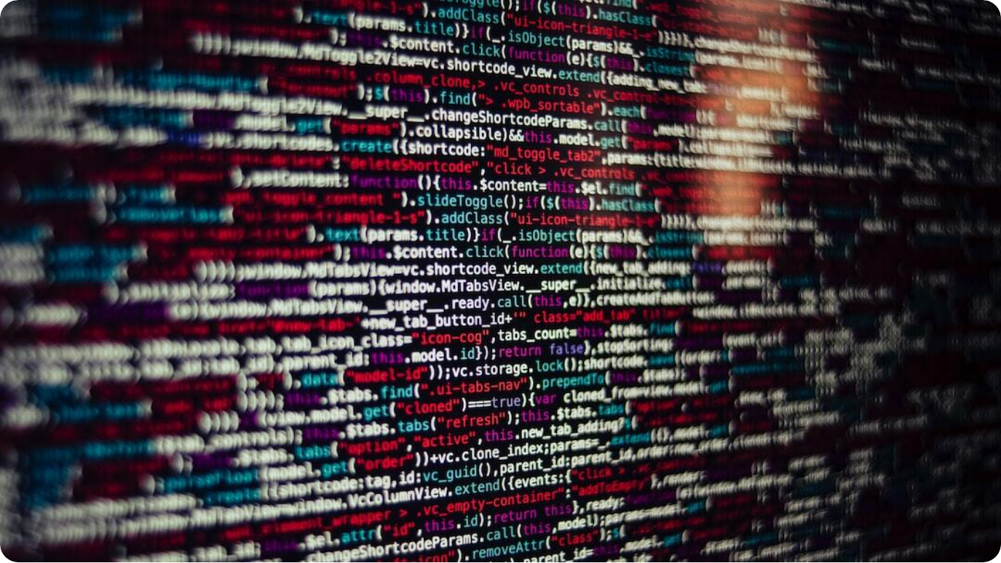
Challenges & Learnings
Technical and conceptual hurdles overcome during development
Blockchain Sync Issues: Managing latency and RPC failures while syncing data from live nodes.
  Token Metadata Parsing: Decoding ERC-20 contract formats and handling edge cases across tokens.
  Privacy & Multi-Chain Support: Resolving wallet identity fragmentation and multi-network standardization.
Notes:
Every meaningful project has its share of challenges—and this one was no exception. First, syncing blockchain data in real time introduced several hurdles. Node rate limits, delayed transaction indexing, and inconsistent RPC responses required extensive error handling and retry logic.
Another major challenge involved token metadata parsing. ERC-20 tokens, while standardized, often diverge slightly in their implementations. Handling these discrepancies while ensuring accurate token balances and names became a critical backend task.
Additionally, wallet privacy and cross-chain compatibility posed unique difficulties. Since users operate across multiple blockchains and addresses, aligning their data under a unified view demanded careful planning. The experience has been an excellent dive into edge-case debugging and decentralized system design.

Slide 11
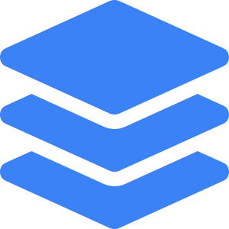

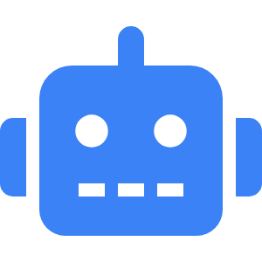
Impact & Future Scope
Where the project goes from here
Scalable Design
Architecture supports future integration with NFTs and DeFi LPs.
Personalized Dashboards
Add login with wallet connect for user-specific portfolio views.
AI-Powered Suggestions
Use ML models to recommend asset allocations and alerts.
Notes:
The potential for this project extends far beyond simple asset tracking. Its modular architecture can be extended to support non-fungible tokens (NFTs), decentralized finance liquidity pools (DeFi LPs), and other on-chain asset types. With the right adapters, any asset class recorded on-chain can be monitored.
One exciting direction is to implement wallet-based logins using WalletConnect or MetaMask. This would allow users to store preferences, build custom dashboards, and track their portfolios across sessions—all while maintaining self-custody.
Another area for growth is artificial intelligence. With machine learning, we can analyze historical wallet behavior and market trends to suggest asset allocations or trigger intelligent alerts. This would transform the DApp from a reactive tracker into a proactive advisor.

Slide 12
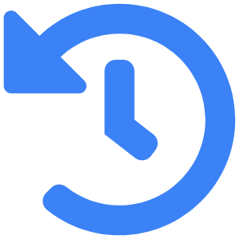

Conclusion
Summarizing key takeaways and appreciation
Project Recap
Built a decentralized, real-time crypto tracker using Flask, React, and Web3.
Key Learnings
Deep dive into DApp architecture, on-chain data processing, and DeFi design.
Notes:
In conclusion, this project has not only achieved its original goals but opened doors for future innovation. From a technical standpoint, we’ve demonstrated how real-time blockchain data can be used to empower end users in managing their digital assets.
Personally, I’ve gained invaluable experience in decentralized app architecture, full-stack development, and the nuances of DeFi systems. This journey involved problem-solving at every level—from parsing smart contract metadata to building responsive, user-friendly interfaces.
A heartfelt thank you to my mentors, peers, and the open-source developers whose tools and guidance made this work possible. I look forward to expanding this project and contributing further to the blockchain ecosystem.

Slide 13
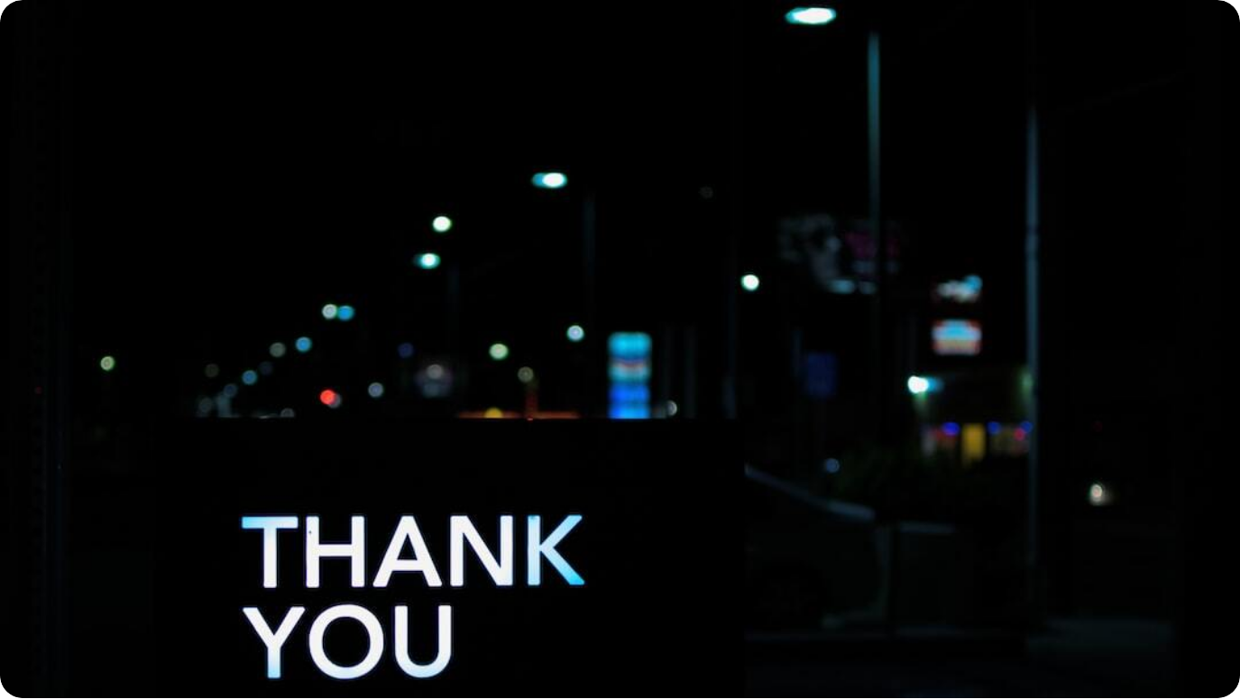
Thank You!
Appreciation for your time and attention
Notes:
Thank you once again for your time, engagement, and valuable feedback. This journey into decentralized technology has been both challenging and rewarding, and I am truly grateful for the guidance and encouragement received along the way.
I extend my thanks to all mentors, colleagues, and blockchain developers who contributed either directly or indirectly to this project. The open-source community, in particular, has been a cornerstone of learning and inspiration.
Please feel free to explore the codebase and connect with me on GitHub. I'm looking forward to continuing this journey and contributing more to the world of decentralized applications.

