Slide 1
The American Express Campus Challenge 2025
Raju Gupta , Priyanshu Kumar , Mridul Singh
Indian Institute of Technology (ISM) Dhanbad
RPM
Notes:
1

Slide 2
Summary of the Final Solution
Feature Engineering
Sampling
Modeling Technique
Any other Dimension?
A temporal sampling technique was used based on the event timestamp (id4). The dataset was chronologically sorted, and a 90:10 split was performed:
First 90% → Training
Last 10% → Validation
Reason :
This approach mimics real-world scenarios, prevents data leakage, and ensures better generalization to future customer behavior.
<Performed the following major feature engineering steps:
Created time-based features (time_since_last_event, time_until_next_event, etc.)
Derived offer interaction metrics (offer_ctr, offer_total_interactions)
Engineered session-level behavior features
✅ Dropped high-null columns (>90%) ✅ Removed leaky features (high ROC AUC with target) ✅ Post-feature pruning to retain only impactful features for MAP@7
Reviewed the following modeling techniques to tackle the binary classification problem of predicting customer click behavior on an offer. Given the high-dimensional feature space (366 features) and the need for robust handling of sparsity, missing values, and ranking patterns, gradient boosting models were deemed appropriate.
XGBoost()
LightGBM()
XGBRanker()
XGBRanker was selected as the final solution based on superior performance on the custom evaluation metric (MAP@7), which better aligned with the problem's business objective of ranking offers by click likelihood.
<
Integration of additional datasets – Use the 3 three additional datasets to provide more context and enrich feature space.
Data fusion strategies – Develop techniques to merge multi-source data effectively, preserving temporal and user-linkage consistency.
>

Slide 3
Feature Engineering & Selection
The following features were created/engineered …
S.No | Feature Description
1. | time_until_next_event :-time remaining until the customer’s next recorded interaction or scheduled event.
2. | time_since_last_event :-Time elapsed since the customer’s most recent recorded interaction or event.
3. | time_since_session_start :-Duration since the beginning of the current customer session.
4. | offer_ctr :- Click-through rate of the offer, calculated as positives divided by total interactions.
5. | offer_total_interactions:- Total number of interactions made with a specific offer by all users.
6. | offer_total_positives:- Count of positive responses (clicks) received for a particular offer.

Slide 4
Top 10 Features in the Final Solution
Mention about any feature selection that was used
✅ High Null Columns Dropped
->Removed features with more than 90% missing values to
reduce noise and prevent overfitting.
✅ Dropped Leaky Features (High ROC AUC with y)
->Removed features showing unusually high individual ROC
AUC scores with the target variable.
->These features likely contained leakage, which could lead to
overfitting and poor generalization.
✅ Post-Feature Engineering Pruning
->After engineering new features (like time-based and session
features), we evaluated their importance and retained only
those contributing meaningfully to MAP@7 performance
Rank | Features | Imp (by gain)%
1. | time_until_next_event | 5.83
2. | time_since_last_event | 3.63
3. | f210 | 2.37
4. | offer_ctr | 2.10
5. | f206 | 1.05
6. | f314 | 0.98
7. | f207 | 0.97
8. | f209 | 0.95
9. | f358 | 0.91
10. | f127 | 0.76

Slide 5
Sampling Technique Used
Detailed overview of the Sampling Technique
✅ Sampling Technique Used
We employed a temporal sampling strategy based on the id4 column, which is event timestamp:
The dataset was sorted chronologically using id4.
A 90:10 split was performed:
First 90% → Used as Training Set
Last 10% → Used as Validation Set
✅ Why this Sampling Strategy?
Mimics real-world deployment where future events are predicted using past data.
Prevents data leakage, as validation events occur after training events.
Better reflects model generalization to unseen (future) customer behavior patterns.
✅ Impact of Sampling
Metric | Before Sampling | After Sampling(Train) | Validation
Row Count | 770164 | 693147 | 77017
Event Rate (CTR) | 4.81% | 4.85% | 4.50%

Slide 6
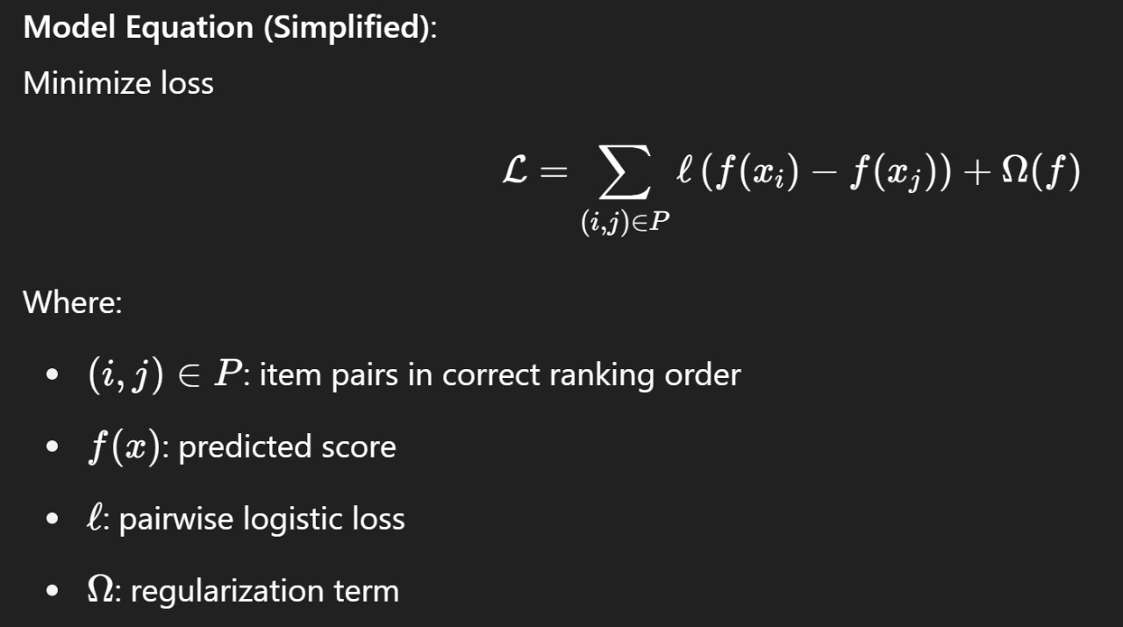
Model Technique/Algorithm Details
XGBRanker gave best out of sample MAP score and was used as final modeling technique
Detailed overview of the Modeling Technique
✅ Final Modeling Technique: XGBRanker :
XGBRanker gave the best out-of-sample MAP@7 score and was chosen as the final model.
Inner Workings of the Technique :
XGBRanker is a learning-to-rank algorithm based on XGBoost, optimized for ranking tasks.
It uses gradient boosting of decision trees and supports pairwise ranking loss like rank:pairwise.
Learns to rank offers per customer-date by minimizing errors in predicted relevance ordering.

Slide 7
✅ Number of Final Variables Used :
Final model used total 339 features, including:
Temporal activity patterns (sessions, gaps, time_since_last_event)
Offer level features( like offer_ctr, offer_total_interactions)
✅ Real-world Usage
Learning-to-rank models like XGBRanker are widely used in:
Search engines (Google, Bing)
E-commerce recommendations (Amazon, Flipkart)
Ad CTR ranking (similar to this use case)
Known for strong performance, especially with structured tabular data
✅ Academic & Industry References :
XGBoost: Chen & Guestrin, 2016 [Paper Link]
Learning to Rank (LTR): Liu, 2009 [Paper Link]

Slide 8
Model Performance – All Iterations
The largest jump in MAP score came from adding temporal sampling, boosting performance from 62.14% to 80.09%. Feature engineering also significantly improved results compared to the XGBoost baseline.
MAP score
[Out of Sample/Validation Results]
*Output from a out of sample/validation data that they created from the training data

Slide 9
More Potential to Improve
Model Ensembling :- Combine multiple models (XGBoost, LightGBM , Catboost) to leverage their strengths and reduce variance.
1
ML Enhancements
1.Integration of additional datasets – Use the 3 three additional datasets to provide more context and enrich feature space.
2.Data fusion strategies – Develop techniques to merge multi-source data effectively, preserving temporal and user-linkage consistency.
2
Any other dimensions

