Slide 1
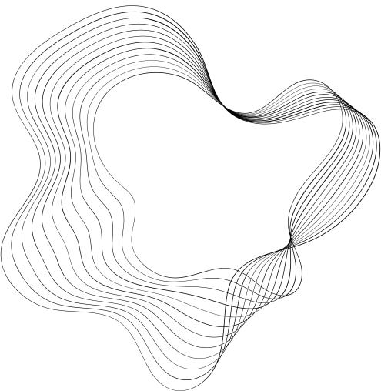


GLAU
TIME TABLE
GENERATOR

Slide 2

CONTENT
01
INTRODUCTION
02
METHODOLOGY
03
RESULTS
04
NEXT FUNCTIONALITY
05
TEAM

Slide 3




INTRODUCTION
The title of the project is “TIME-TABLE GENERATOR”. Automatic Time-Table management is defined as an Web Application.
The system aims to automate timetable generation, addressing challenges like resource optimization, conflict resolution, preference management, and dynamic updates.

Slide 4





METHODOLOGY
Frontend Development with HTML, CSS, and JavaScript:
Backend Development with PHP
Requirement Analysis
The first step is to understand the requirements of the time table generator. This includes determining the type of schedule to be generated (daily), the number of subjects, the available time slots, any constraints (like teacher availability), and user interface preferences.
HTML: Used for creating the structure of the web page
CSS: Provides styling to make the interface visually appealing and user-friendly.
JavaScript: Handles client-side validation of user inputs, dynamic updates of the interface based on user selections
PHP is used to receive the user inputs from the frontend, validate them, and process them.
PHP implements the core logic of the time table generation algorithm, considering constraints such as subject prerequisites, teacher availability, and classroom capacity.

Slide 5

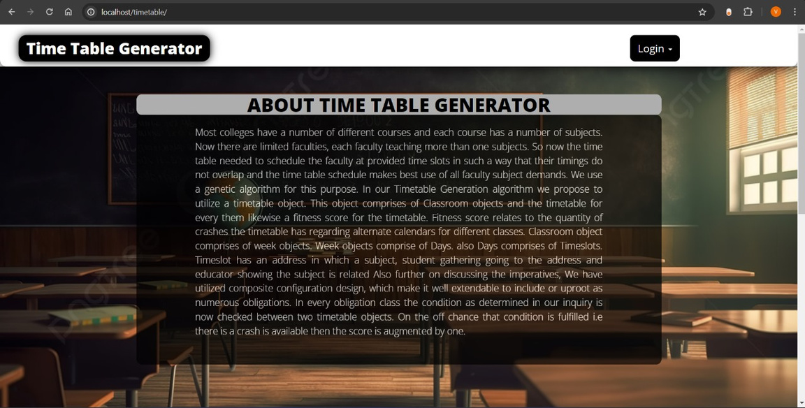
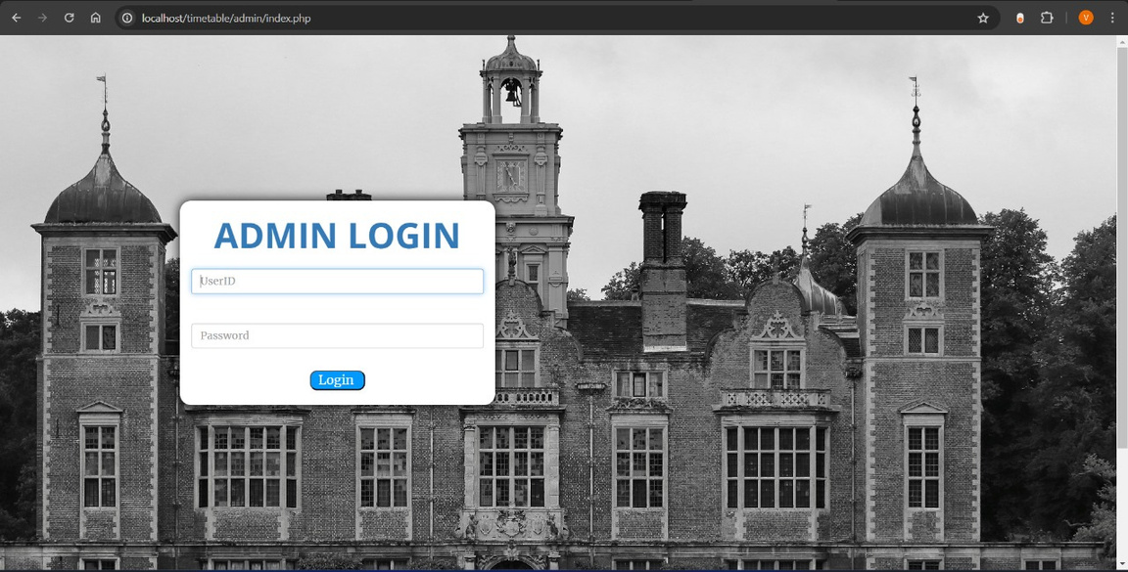
RESULTS

Slide 6
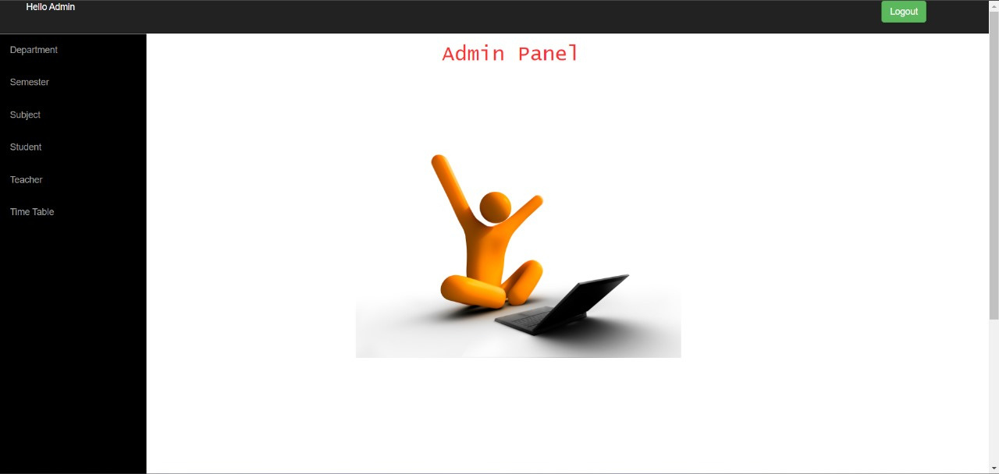
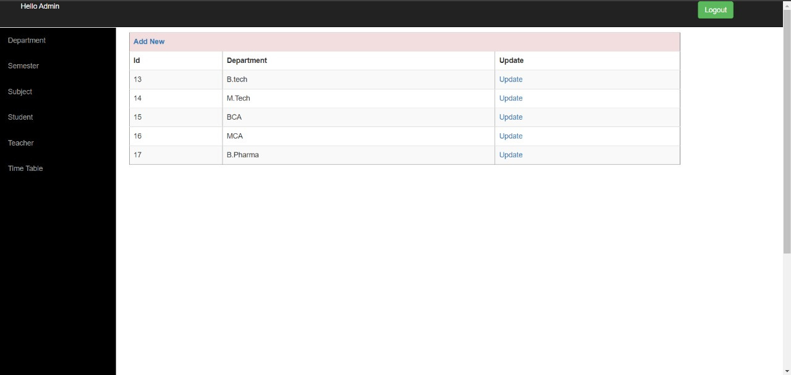
RESULTS

Slide 7
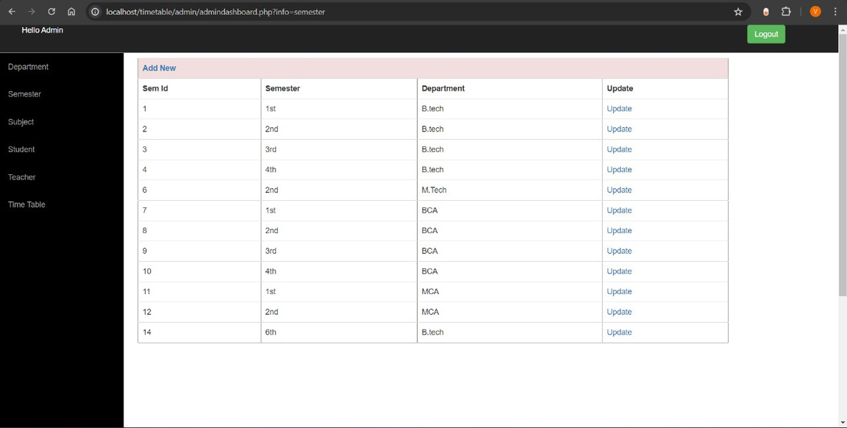
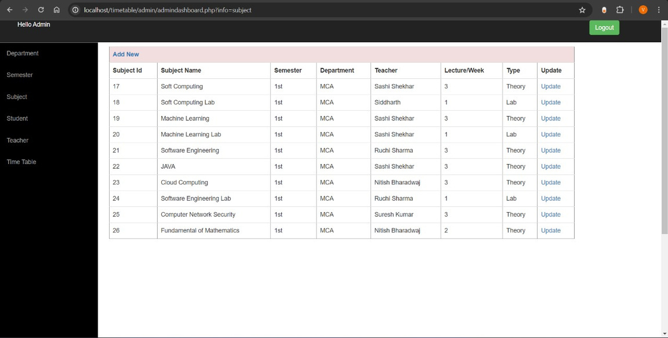
RESULTS

Slide 8
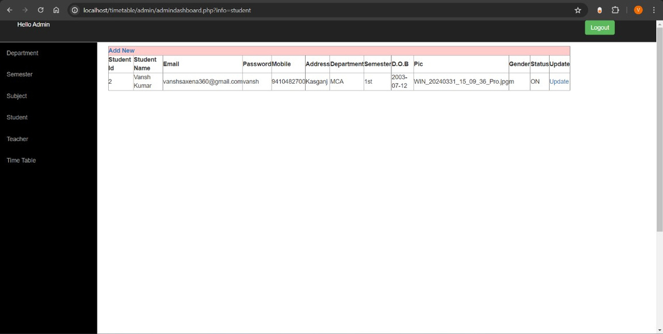
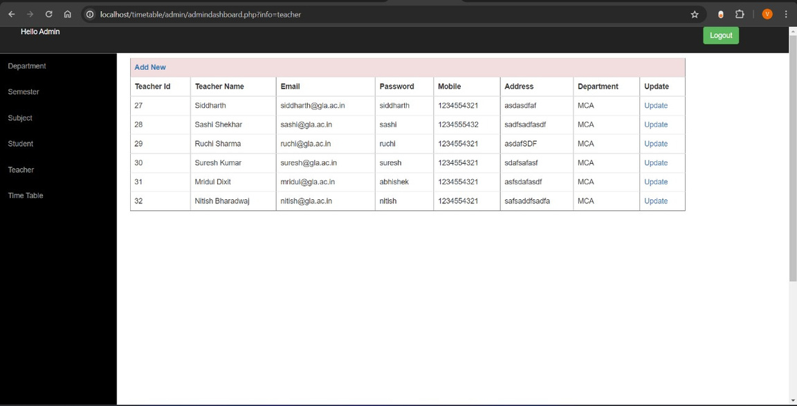
RESULTS

Slide 9
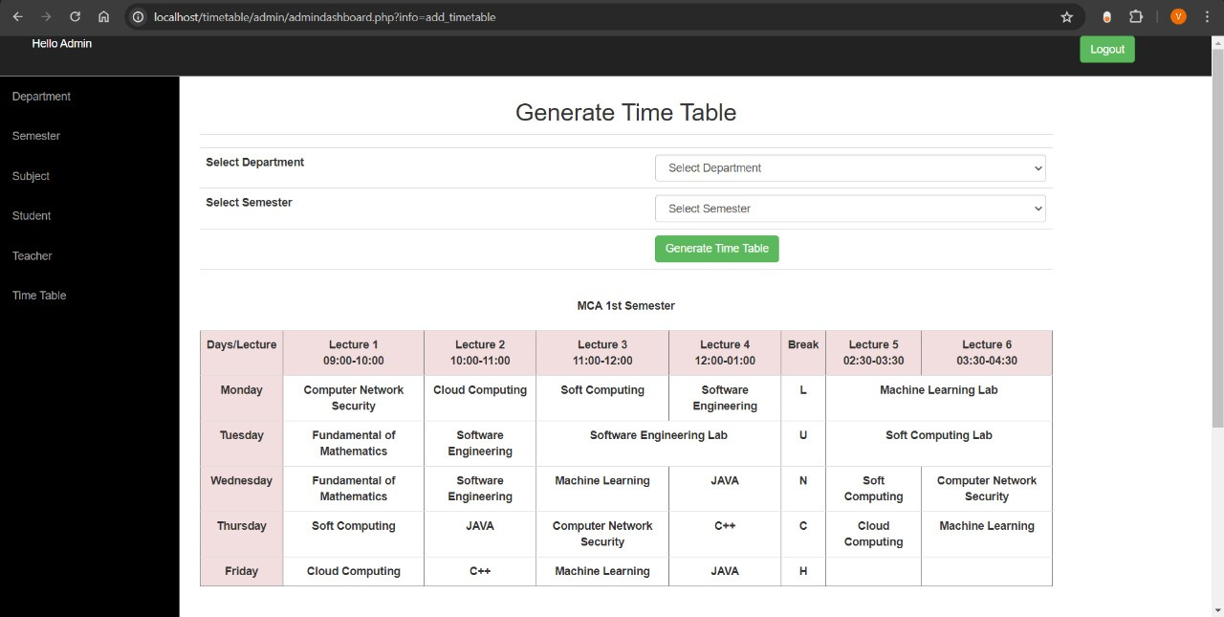
RESULTS

Slide 10
OUR TEAM
-MENTOR-
Umakant Ahirwar
(Asst. Professor)
Department of CEA
GLA University, Mathura
-PRESENTED BY-
Vansh Kumar
Rajul Mishra
RISHABH PANDEY
Yogendra Sisodiya
Priyanshu

