Slide 1
PRIORITY-BASED TASK SCHEDULER
DAA PROJECT

Slide 2

INTRODUCTION
PRIORITIZE YOUR TASKS
A Priority-Based Task Scheduler using a Binary Heap Priority Queue efficiently manages tasks by assigning priority levels. Tasks are represented as nodes with priority and details. Implemented with a binary heap, the scheduler ensures optimal task execution. The binary heap structure allows quick retrieval and removal of the highest-priority task. This system is essential for scenarios where task order matters. The priority queue's effective management enhances overall system performance, making it a vital component in optimizing task scheduling and execution.

Slide 3
PRIORITY BASED TASK SCHEDULER
BINARY
HEAP
PRIORITY
QUEUE
DAA - DESIGN ANALYSIS
OF ALGORITHMS
DAA, or Design and Analysis of Algorithms, is a field of computer science focused on creating and evaluating efficient algorithms for problem-solving, emphasizing algorithmic design, analysis, and optimization techniques.

Slide 4

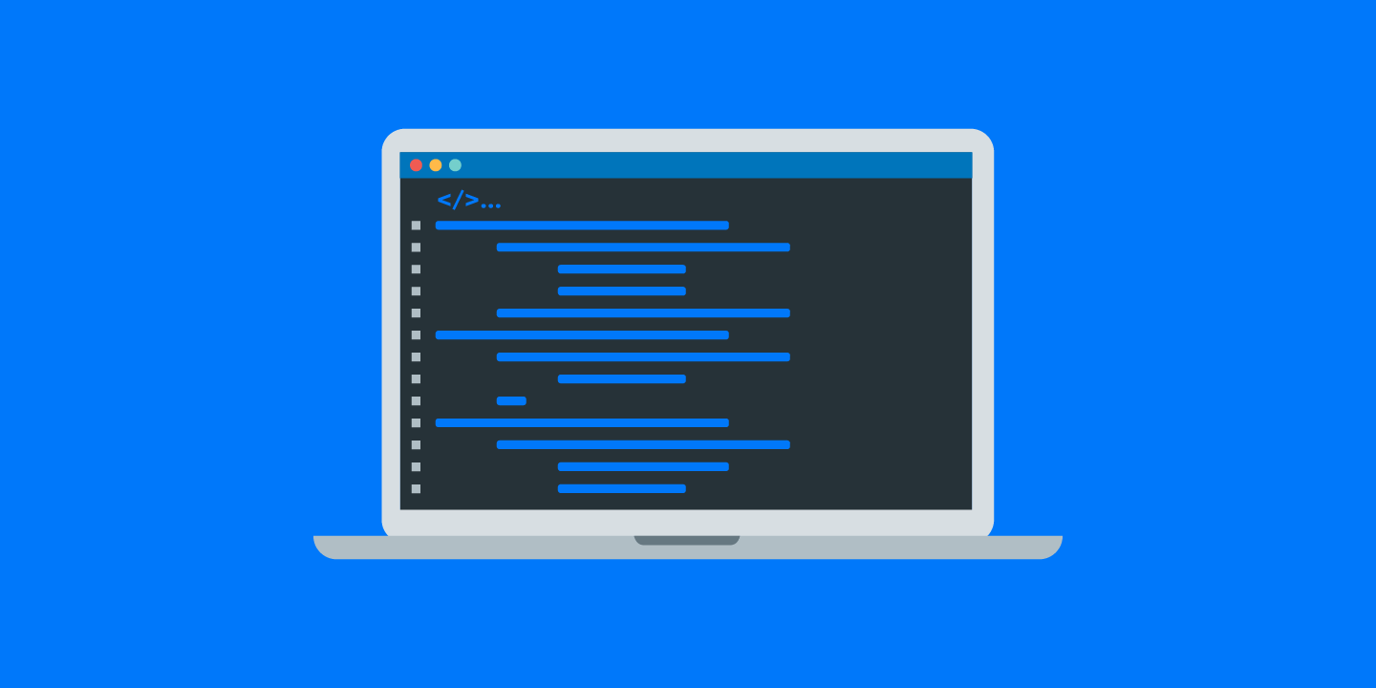
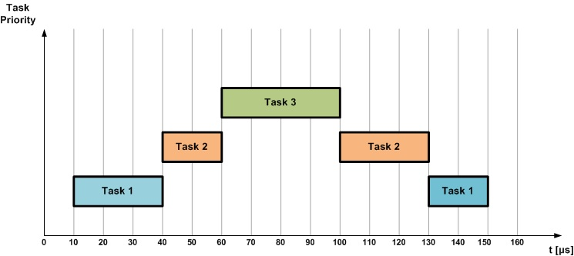
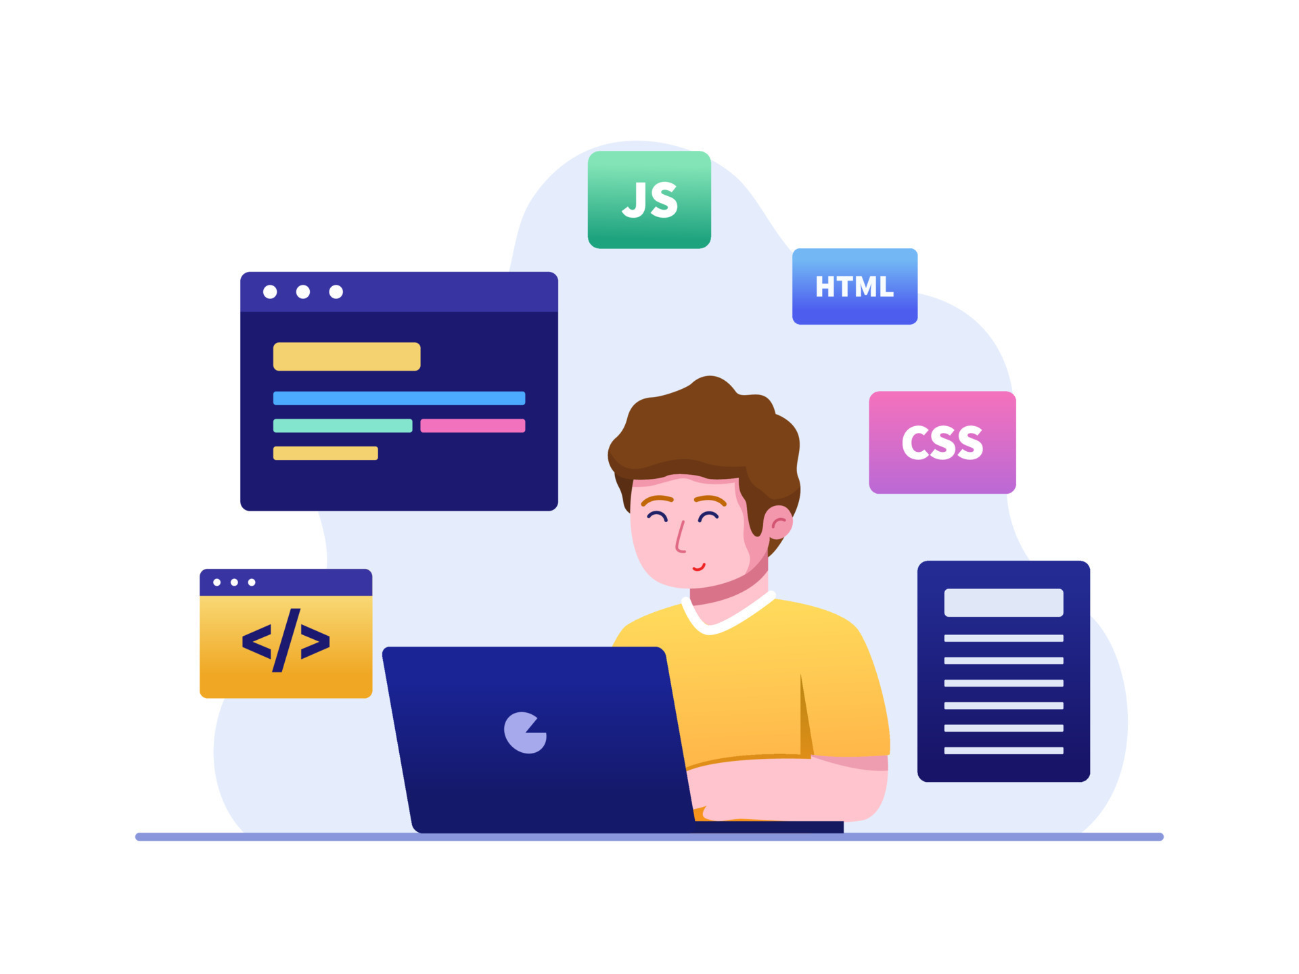
WORKING IDEOLOGY
OF PRIORITY BASED TASK SCHEDULER
A Priority-Based Task Scheduler, employing a Binary Heap Priority Queue, prioritizes tasks based on assigned levels. In this system, each task is represented as a node, containing priority information. The binary heap structure ensures that the task with the highest priority is readily accessible and efficiently managed. Insertion and removal operations are optimized through heap properties, allowing swift task execution. This approach proves indispensable in scenarios where task urgency dictates scheduling. The Priority-Based Task Scheduler, with its binary heap implementation, enhances system efficiency by systematically addressing tasks in order of priority.

Slide 5



HEAP
A heap is a specialized tree-based data structure where each node's key is either greater (max-heap) or lesser (min-heap) than its children's keys. This hierarchical arrangement ensures quick access to the highest or lowest priority element at the root. Heap operations, such as insertion and removal, maintain the heap property, guaranteeing efficient data retrieval. Heaps are pivotal in implementing priority queues and task schedulers, optimizing algorithms and applications by providing a reliable and swift means of managing and accessing prioritized elements in various computing scenarios.
SPECIALIZED TREE
PRIORITY
(MAX. OR MIN)
QUEUES, HEAP SORT, AND GRAPH ALGORITHMS LIKE DIJKSTRA’S

Slide 6
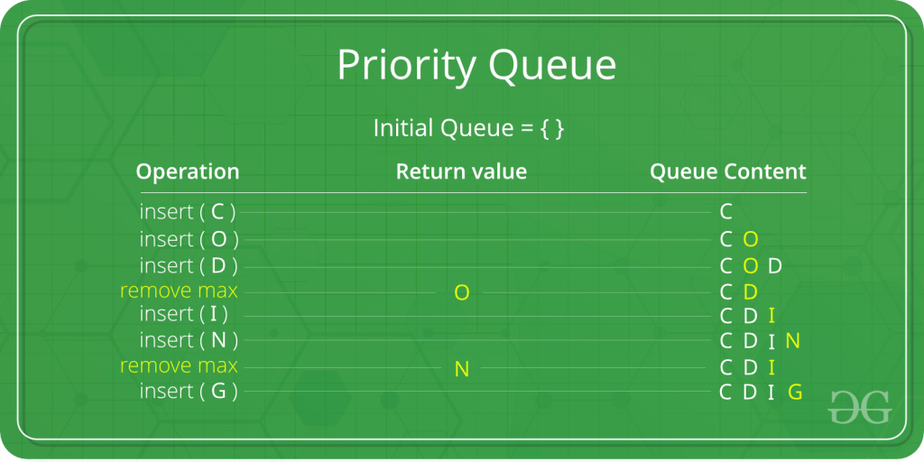

PRIORITY QUEUE
A Priority Queue is a data structure that manages elements with associated priorities. It guarantees that the element with the highest or lowest priority is swiftly accessible. Operations like insertion and extraction maintain order based on priority, making it vital for applications demanding efficient task scheduling. Whether implemented as a binary heap or another structure, a Priority Queue optimizes algorithms, enabling quick access and manipulation of high-priority elements, contributing to the streamlined execution of tasks in diverse computing contexts.
PRIORITY QUEUE
FOR OPTIMIZATION

Slide 7
#include<time.h>
CLOCK()
In C programming, “#include<time.h>” is a library providing time-related functions. The “clock()” function, part of this library, measures CPU time consumed by a program. It returns the processor time elapsed since the program's initiation. Useful for performance analysis, “clock()” aids in benchmarking and optimizing code by measuring processing efficiency. Integration of “<time.h>” enhances programs with time-related functionalities, crucial in scenarios requiring accurate timekeeping or execution timing for various operations within the C programming language.
#include <time.h>
C LIBRARY
<time.h>
ACCURATE TIMEKEEPING
clock()
MESAURING CPU TIME

Slide 8
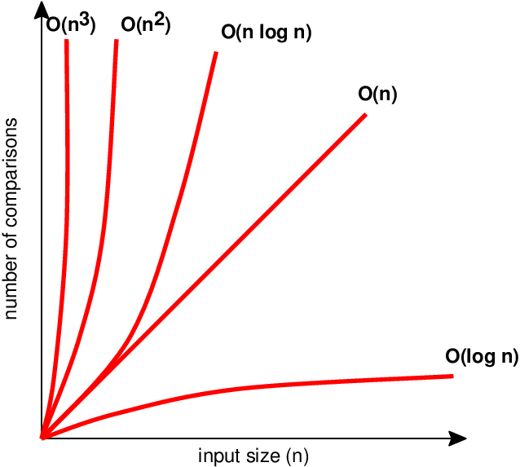
TIME COMPLEXITY
Time complexity measures the amount of computational time an algorithm requires concerning its input size. It characterizes the algorithm's efficiency and scalability in solving problems
O(n log n)
O(log n)
O(log n)
PRIORITY BASED TASK SCHEDUKER
MIN. HEAPIFY
PRIORITY QUEUE

Slide 9
FUCTIONS USED
createPriorityQueue()
swap()
minHeapify()
extractMin()
insertTask()
clock()

Slide 10
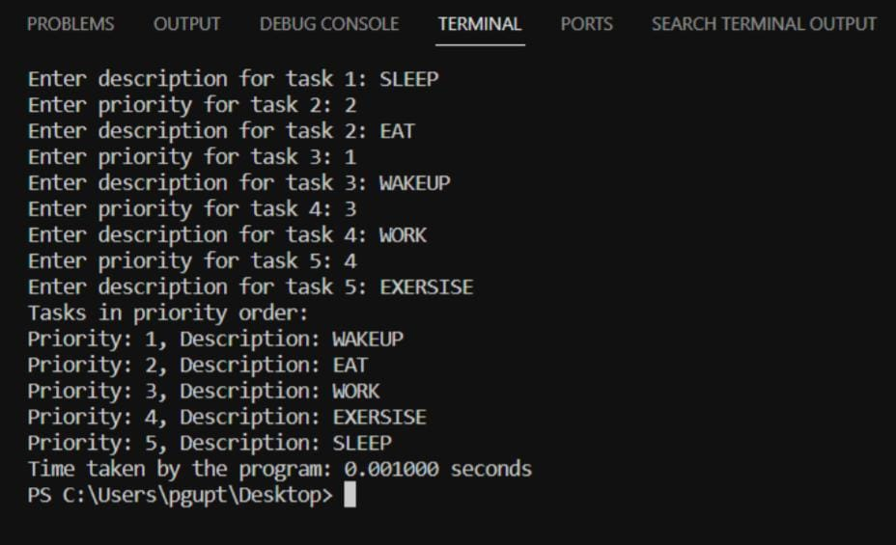
OUTPUT
WAKEUP- EAT- WORK- EXERCISE- SLEEP Make Your Life Easier

Slide 11
REAL LIFE USE
“
Priority-based task schedulers are used in operating systems to manage and execute processes with different priorities. High-priority tasks, such as system-critical processes, are scheduled and executed before lower-priority tasks.
“
Priority-based task schedulers can be applied in network routers or switches.High-priority packets, such as voice or video data, are processed with higher precedence, ensuring timely and efficient communication.
”
”
2. Networking and Packet
Processing
1. Operating System
“
In real-time systems, priority-based scheduling is crucial to meet strict timing requirements.Tasks with higher priority, such as control tasks in industrial automation or avionics systems, are scheduled promptly to maintain system responsiveness.
“
In cloud computing environments, priority-based task scheduling ensures efficient allocation of resources.Higher-priority jobs, like critical computations or time-sensitive processes, are given precedence in resource allocation to meet performance goals and service level agreements.
”
”
3. Real-Time Systems
4. Job Scheduling in Cloud

Slide 12
CONCLUSION
In conclusion, this project has successfully implemented a priority queue using a binary heap to manage tasks with varying priorities. The program efficiently inserts tasks, maintains the min-heap property, and extracts tasks in priority order. With applications in real-time systems, operating systems, and cloud computing, the project showcases the significance of priority-based task scheduling. The use of a clock function measures the execution time, providing insights into the program's efficiency. The implemented algorithm is versatile and applicable in scenarios where task prioritization is crucial, demonstrating the relevance of algorithm design and analysis in optimizing computational processes for diverse real-world applications.

Slide 13



REFERENCES
EVERYONE NEEDS HELP
GEEKSFORGEEKS
CODECHEF
GOOGLE

Slide 14
THANK YOU
KUNAL KISHORE
PRIYANSHU GUPTA
21051060
2105393
SPARSH CHAUDHARY
SARTHAK GHOSH
2105412
21052528

