Slide 1


HACKWAVE 2024
Smart Grid Optimization: Integrating Renewable Energy for Sustainable Power Systems
A.P Shah Institute of Technology
Team Member 1 (Leader) : Priyanshu Agarkar
Team Member 2 : Anushree Salunke
Team Member 3 : Mrunal Misale
Team Member 4 : Suyash Bagwe

Slide 2
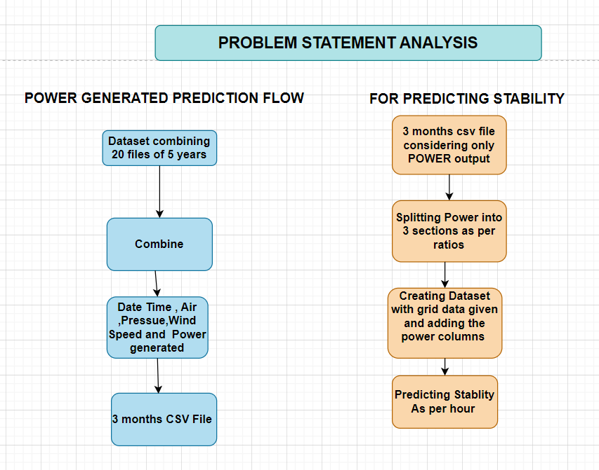

Slide 3
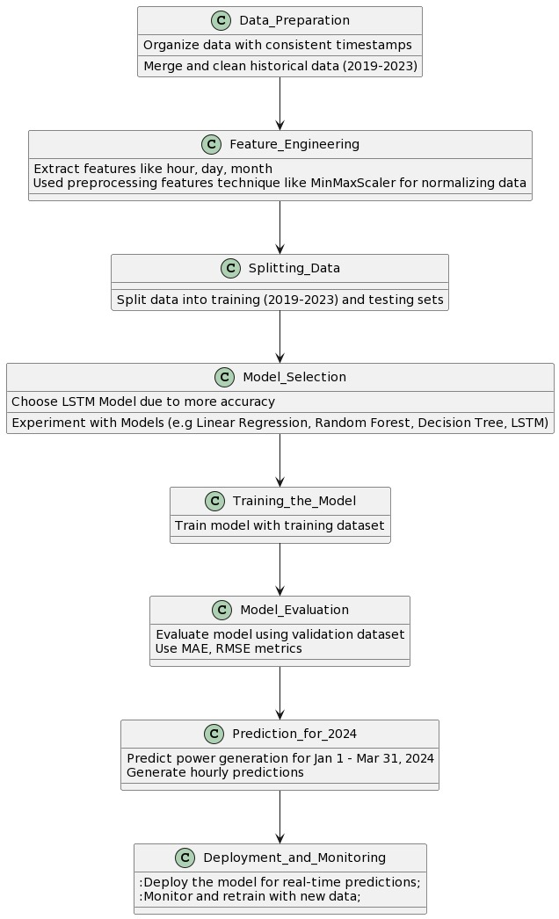
OUR APPROACHES
PART1
PART2

Slide 4
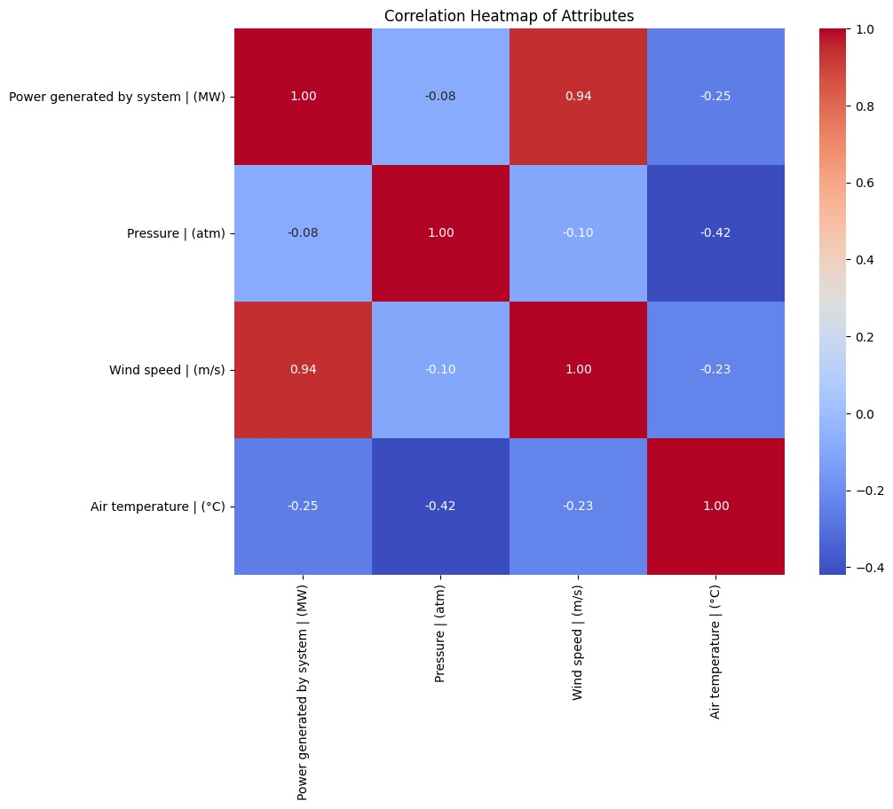
EXPLORATORY DATA ANALYSIS

Slide 5

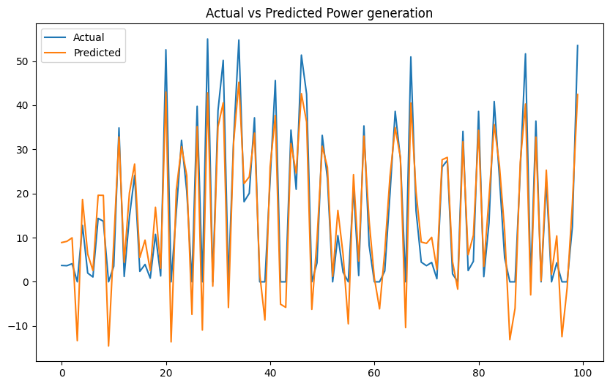
COMPARATIVE STUDY OF MODELS
Linear Regression Graph.

Slide 6
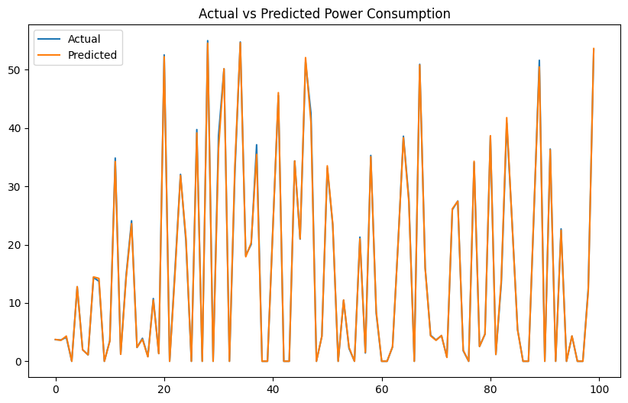
COMPARATIVE STUDY OF MODELS
Decision Tree Graph

Slide 7
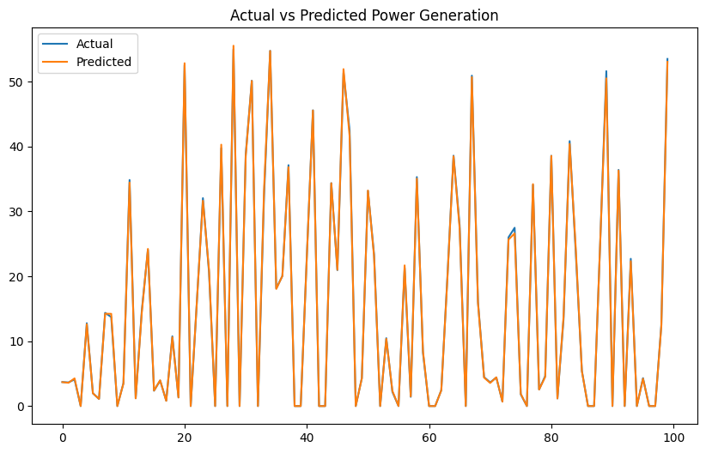
COMPARATIVE STUDY OF MODELS
Random Forest Regressor Graph .

Slide 8

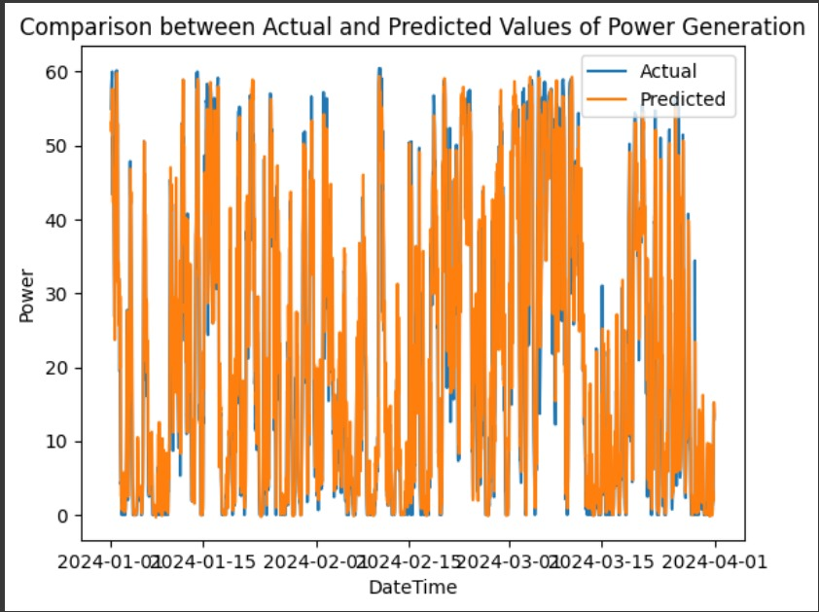
COMPARATIVE STUDY OF MODELS
LSTM Graph.

Slide 9
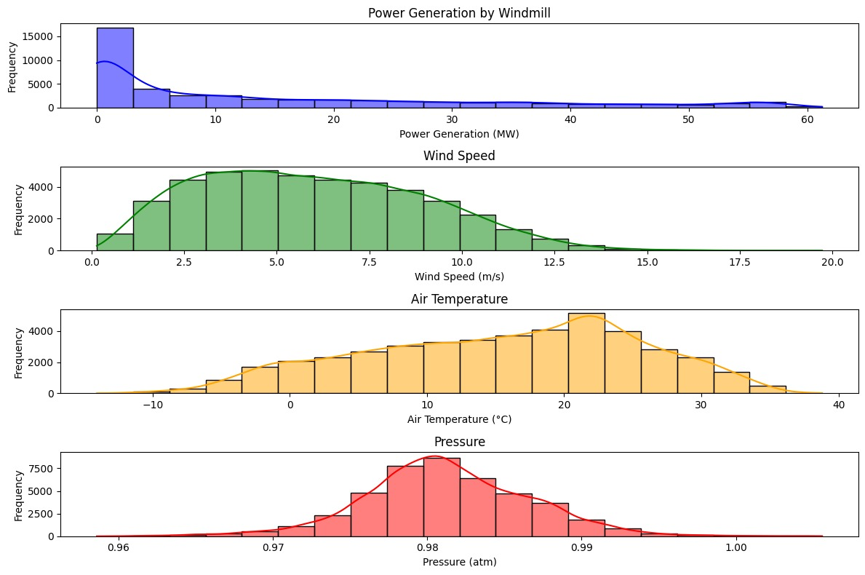

Slide 10
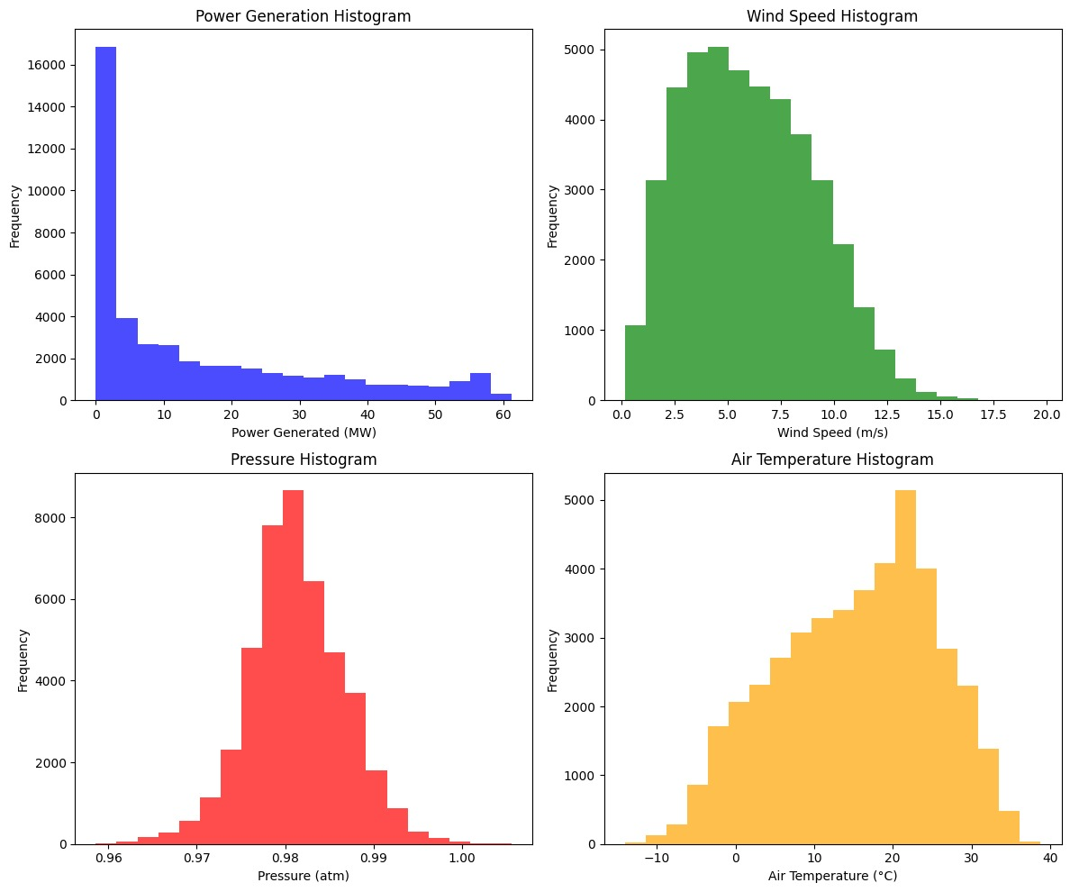

Slide 11
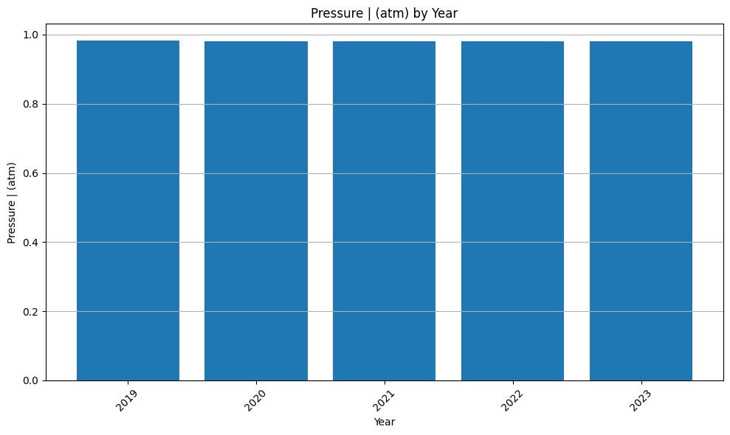
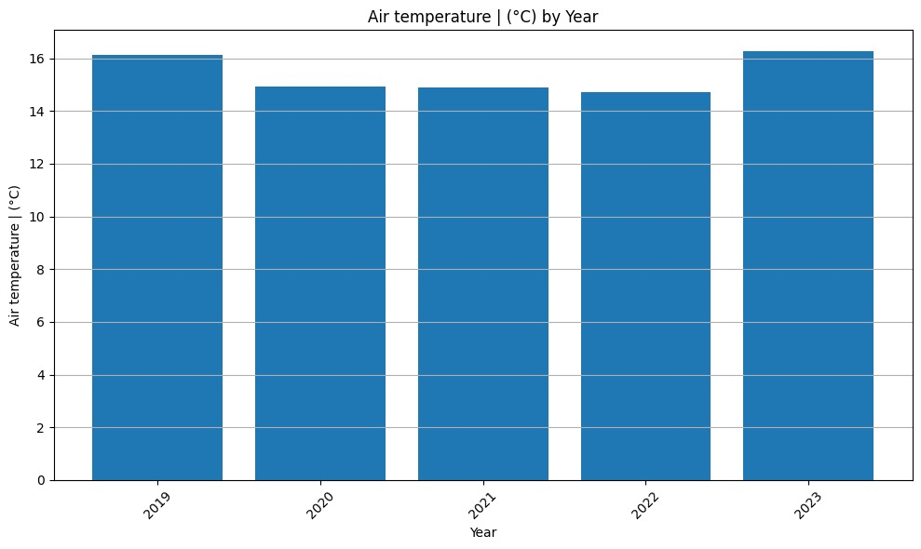
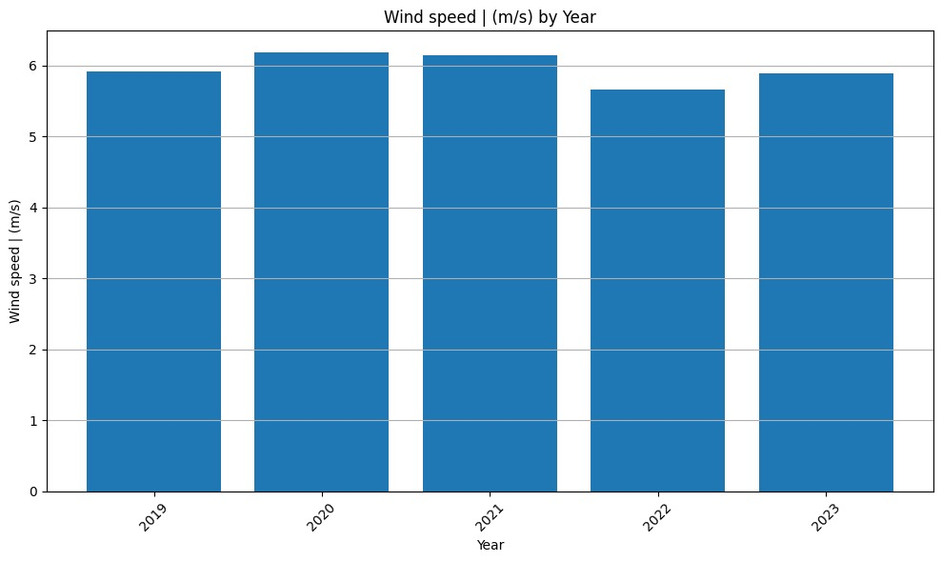
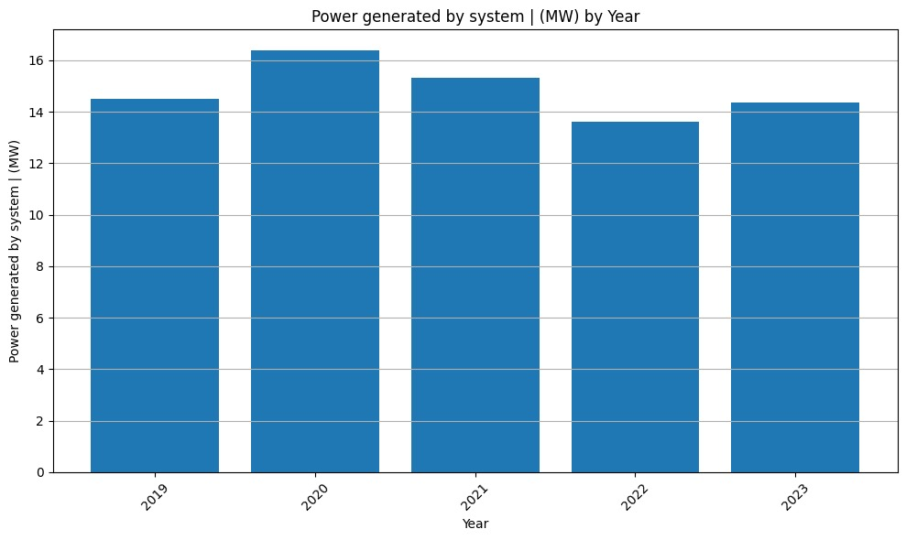

Slide 12
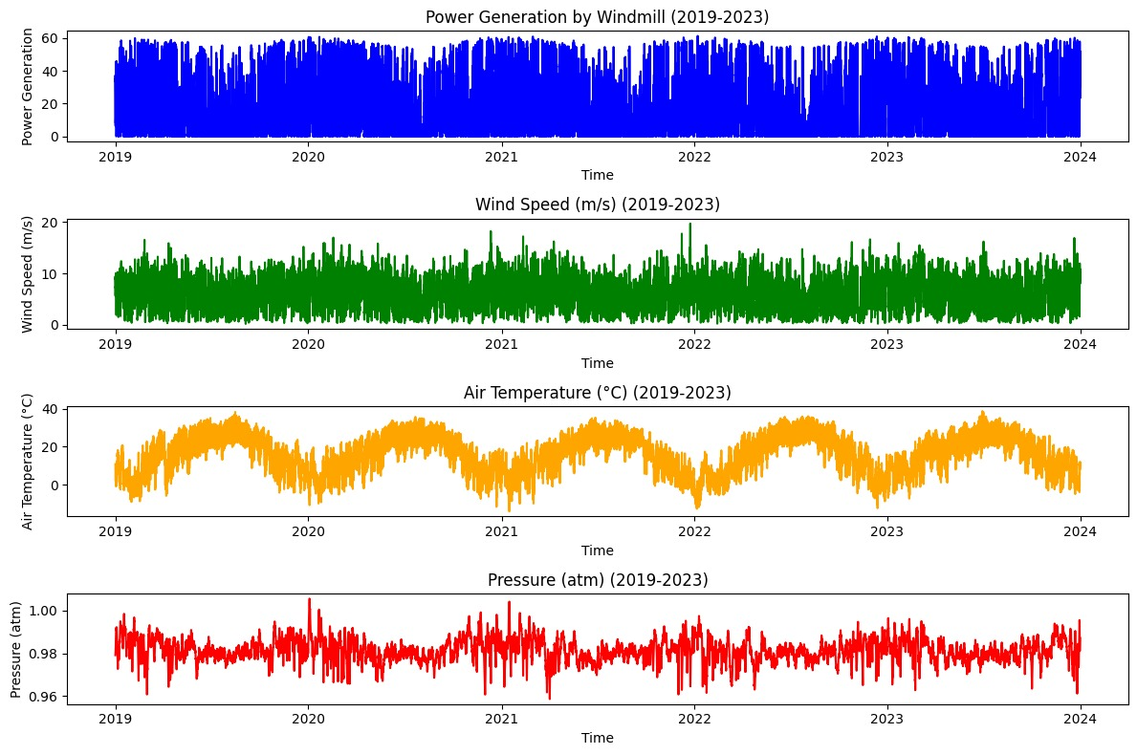

Slide 13

THANKYOU !

