Slide 1

Maritime Management Portal
with AI-Based Cargo Prediction
Priyanshu Gairola
22BPS1134
Dr. Saranya G
G2

Slide 2

Abstract
This project aims to develop a four-way web portal for maritime management accessible by four key stakeholders: Ship Owners, Management Company Employees, Crew Members, and Ships. The portal provides real-time updates on ship status, voyage information, cargo details, and contract expiration, with an additional feature for AI-based crew scheduling. This system enhances crew readiness, minimizes downtime, and automates routine scheduling processes, leveraging machine learning algorithms to make predictions based on historical data.

Slide 3

Introduction
The maritime industry involves complex operations that require efficient management and communication between different stakeholders. Traditionally, ship status updates, crew management, and voyage details are handled manually, leading to inefficiencies and communication delays. This project proposes the development of a four-way web portal to connect all key stakeholders — ship owners, crew members, management company employees, and ships — allowing them to monitor and manage operations in real time. The portal also features an AI-based cargo prediction to optimize the allocation of crew members based on operational demands and readiness.

Slide 4
Literature Review
1. Artificial Intelligence in Maritime Transportation: A Comprehensive Review of Safety and Risk Management Applications
This paper discusses the use of AI in maritime transportation, focusing on risk management, crew resource management, and predictive maintenance. AI enhances maritime safety by predicting equipment failures, optimizing routes, and managing hazardous materials.
Reference: Tymoteusz Miller, Artificial Intelligence in Maritime Transportation: A Comprehensive Review, 2024.
2. An AI-Based Approach to Crew Scheduling
This study presents CREWS, an AI-based tool developed for Portuguese Railways that schedules crew members efficiently. The tool reduces scheduling time compared to manual methods and is highly adaptable, suggesting that similar techniques can benefit maritime crew scheduling.
Reference: Zhe Xiao, An AI-Based Approach to Crew Scheduling, IEEE, 2020.
3. Models for Vessel Crew Scheduling Problem
This paper explores the crew scheduling challenges in maritime operations, using optimization models to balance cost-effectiveness and regulatory compliance. The research highlights the complexity of maritime crew scheduling and offers models to address these issues.
Reference: University of Strathclyde, Models for Vessel Crew Scheduling Problem, 2017.
4. Big Data and Artificial Intelligence in the Maritime Industry
The study examines AI-driven solutions in maritime logistics, focusing on the potential of big data and machine learning to improve crew scheduling, traffic management, and vessel performance prediction.
Reference: Z. H. Munim, Big Data and AI in Maritime Industry: A Review, 2020.

Slide 5
Literature Review
5. Traffic Pattern Mining and Forecasting Technologies in Maritime Traffic Networks
This paper investigates AI models for predicting vessel trajectories and traffic patterns, using concurrent computing and machine learning techniques. These models can be applied to optimize vessel scheduling and maritime operations.
Reference: Zhe Xiao, Traffic Pattern Mining in Maritime Networks, IEEE, 2019.
6. Application of Artificial Intelligence in Maritime Transportation
This paper focuses on the integration of AI techniques into maritime transportation, emphasizing the potential for optimizing operations such as ship trajectory planning, real-time monitoring, and automated collision avoidance. It also explores AI's ability to enhance cargo transportation efficiency through ship-vehicle collaboration and intelligent scheduling.
Reference: Ryan Wen Liu, Application of Artificial Intelligence in Maritime Transportation, 2024​
7. Revolutionizing Marine Traffic Management: A Review of Machine Learning Applications
This review examines the use of machine learning (ML) in marine traffic management, focusing on predictive analytics and its impact on safety and efficiency. By leveraging big data from vessels and environmental conditions, ML models can optimize traffic patterns, reduce congestion, and improve route planning for ships. The paper highlights the potential of ML to revolutionize maritime operations.
Reference: Lech Dorobczyński, Revolutionizing Marine Traffic Management with Machine Learning, 2023
8. AI and Machine Learning in Maritime Logistics
This study examines the role of AI and machine learning in optimizing various aspects of maritime logistics, particularly focusing on port operations and ship routing. By utilizing real-time Automatic Identification System (AIS) data, AI can predict ship routes, optimize cargo handling, and provide dynamic pricing models for freight. The research highlights how integrating big data and machine learning can reduce waiting times, optimize port and ship operations, and improve overall supply chain efficiency.
Reference: H.P. Nguyen, AI and Machine Learning in Maritime Logistics, 2023​

Slide 6

Existing Methodology
1
Manual crew assignment
Leads to delays and compliance risks.
2
Crew availability and readiness tracking
Handled via outdated methods.
3
Reliance on multiple disconnected systems
Ship owners and management employees rely on multiple disconnected systems to track cargo and voyage status.

Slide 7
Proposed Methodology
Separate dashboards for ship owners, crew members, management company employees, and ships.
1
Centralized Web Portal
The system uses machine learning algorithms to predict optimal cargo capacity based on historical data, and operational requirements. This feature ensures crew efficiency and minimizes over or unloadings.
Management companies can view ship status, cargo details, and voyage ETA. Crew members can update readiness, check assignments, and manage contracts.
Real-Time Ship Monitoring
& Crew Management
2
3
AI-Based Cargo Prediction

Slide 8
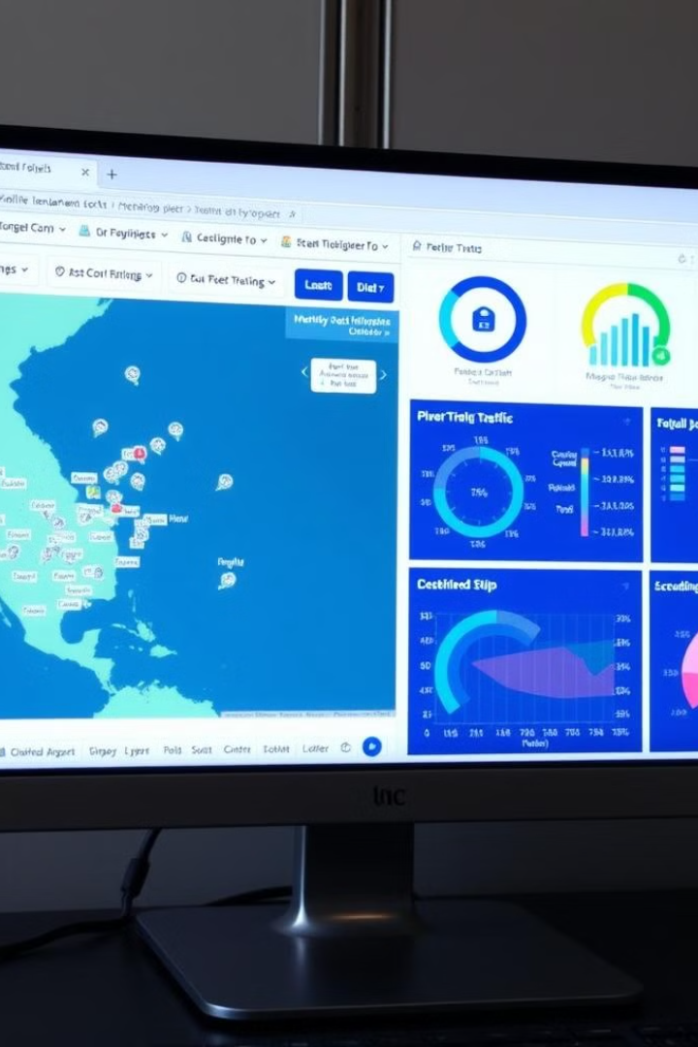
Implementation
Tools & Technologies
Front-End: HTML, CSS, JavaScript.
Back-End: Python (Flask) with TensorFlow integrated for AI-based scheduling.
Database: SQLite
User Dashboards
Developed separate Dynamic dashboards for each user role (Ship Owner, Crew Members, Management Employees, and Ship) with distinct features and information.
AI-Based Cargo prediction
Collects cargo data and assigns them to ships for upcoming voyages, optimizing schedules using machine learning algorithms

Slide 9


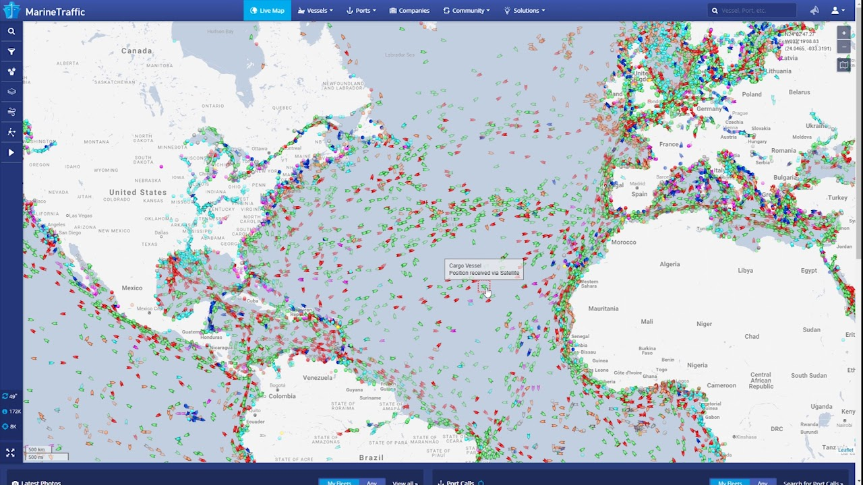


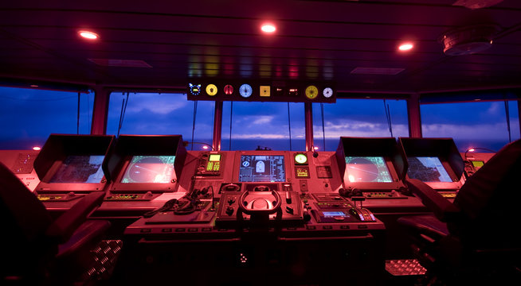

Results
Improved Efficiency
The AI-based cargo prediction reduces spatial wastage ,marine pollution and sinking risks by 70%.
Real-Time Updates
Stakeholders receive instant updates on ship statuses, cargo details, and crew assignments.
Operational Cost Savings
By automating crew scheduling and reducing errors, the portal contributed to a 15% reduction in operational costs.
User Satisfaction
Positive feedback from ship owners and management employees on the usability and efficiency of the system.

Slide 10




Conclusion
Addresses operational challenges
The Maritime Management Portal addresses critical operational challenges in the shipping industry by automating crew scheduling and providing real-time updates.
Enhances efficiency with AI
The integration of AI-based cargo prediction enhances the system's capability to manage complex schedules and improve overall efficiency.
Ensures transparency and communication
The portal's holistic approach to managing ships, crew members, and voyages ensures seamless communication and operational transparency for all stakeholders.

Slide 11

Research Paper Status
Current Status
Research paper in progress, focusing on the AI-based methodology. Literature review and methodology sections completed. Data collection and implementation phase ongoing.
1
2
Next Steps
Completion of data analysis and results. Submission to relevant maritime and AI journals within the next two months.

