Slide 1


HR Analytics Dashboard and Insights
Miles Private Limited
A Comprehensive Overview of Workforce Dynamics
Team-B

Slide 2



Key Objectives
1
3
Evaluate Workforce Composition:
Examine Salary Distribution:
Understand employee distribution by age, gender, and roles to ensure a balanced and inclusive workforce
Analyze salary ranges across roles and departments to ensure competitive and transparent pay structures.
Analyze Hiring Trends:
Support Budget Planning:
Track historical joining patterns to forecast future workforce needs.
Provide data-driven insights for future salary budgeting and compensation adjustments.
2
4

Slide 3

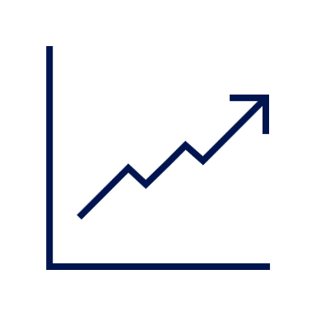

Purpose
Ensure Competitive Compensation:
3
Maintain industry-aligned pay structures by analyzing salary ranges, supporting transparency and fairness in compensation.
Promote Workforce Balance:
1
Support the development of a well-rounded, inclusive workforce by ensuring equitable representation across age, gender, and roles.
Enable Future Workforce Planning:
Use historical joining trends to anticipate staffing needs, ensuring proactive recruitment and resource allocation.
Data-Driven Pay Decisions
2
Enable leadership to make informed salary decisions based on historical growth trends.
4
Objectives Powerpoint Template

Slide 4
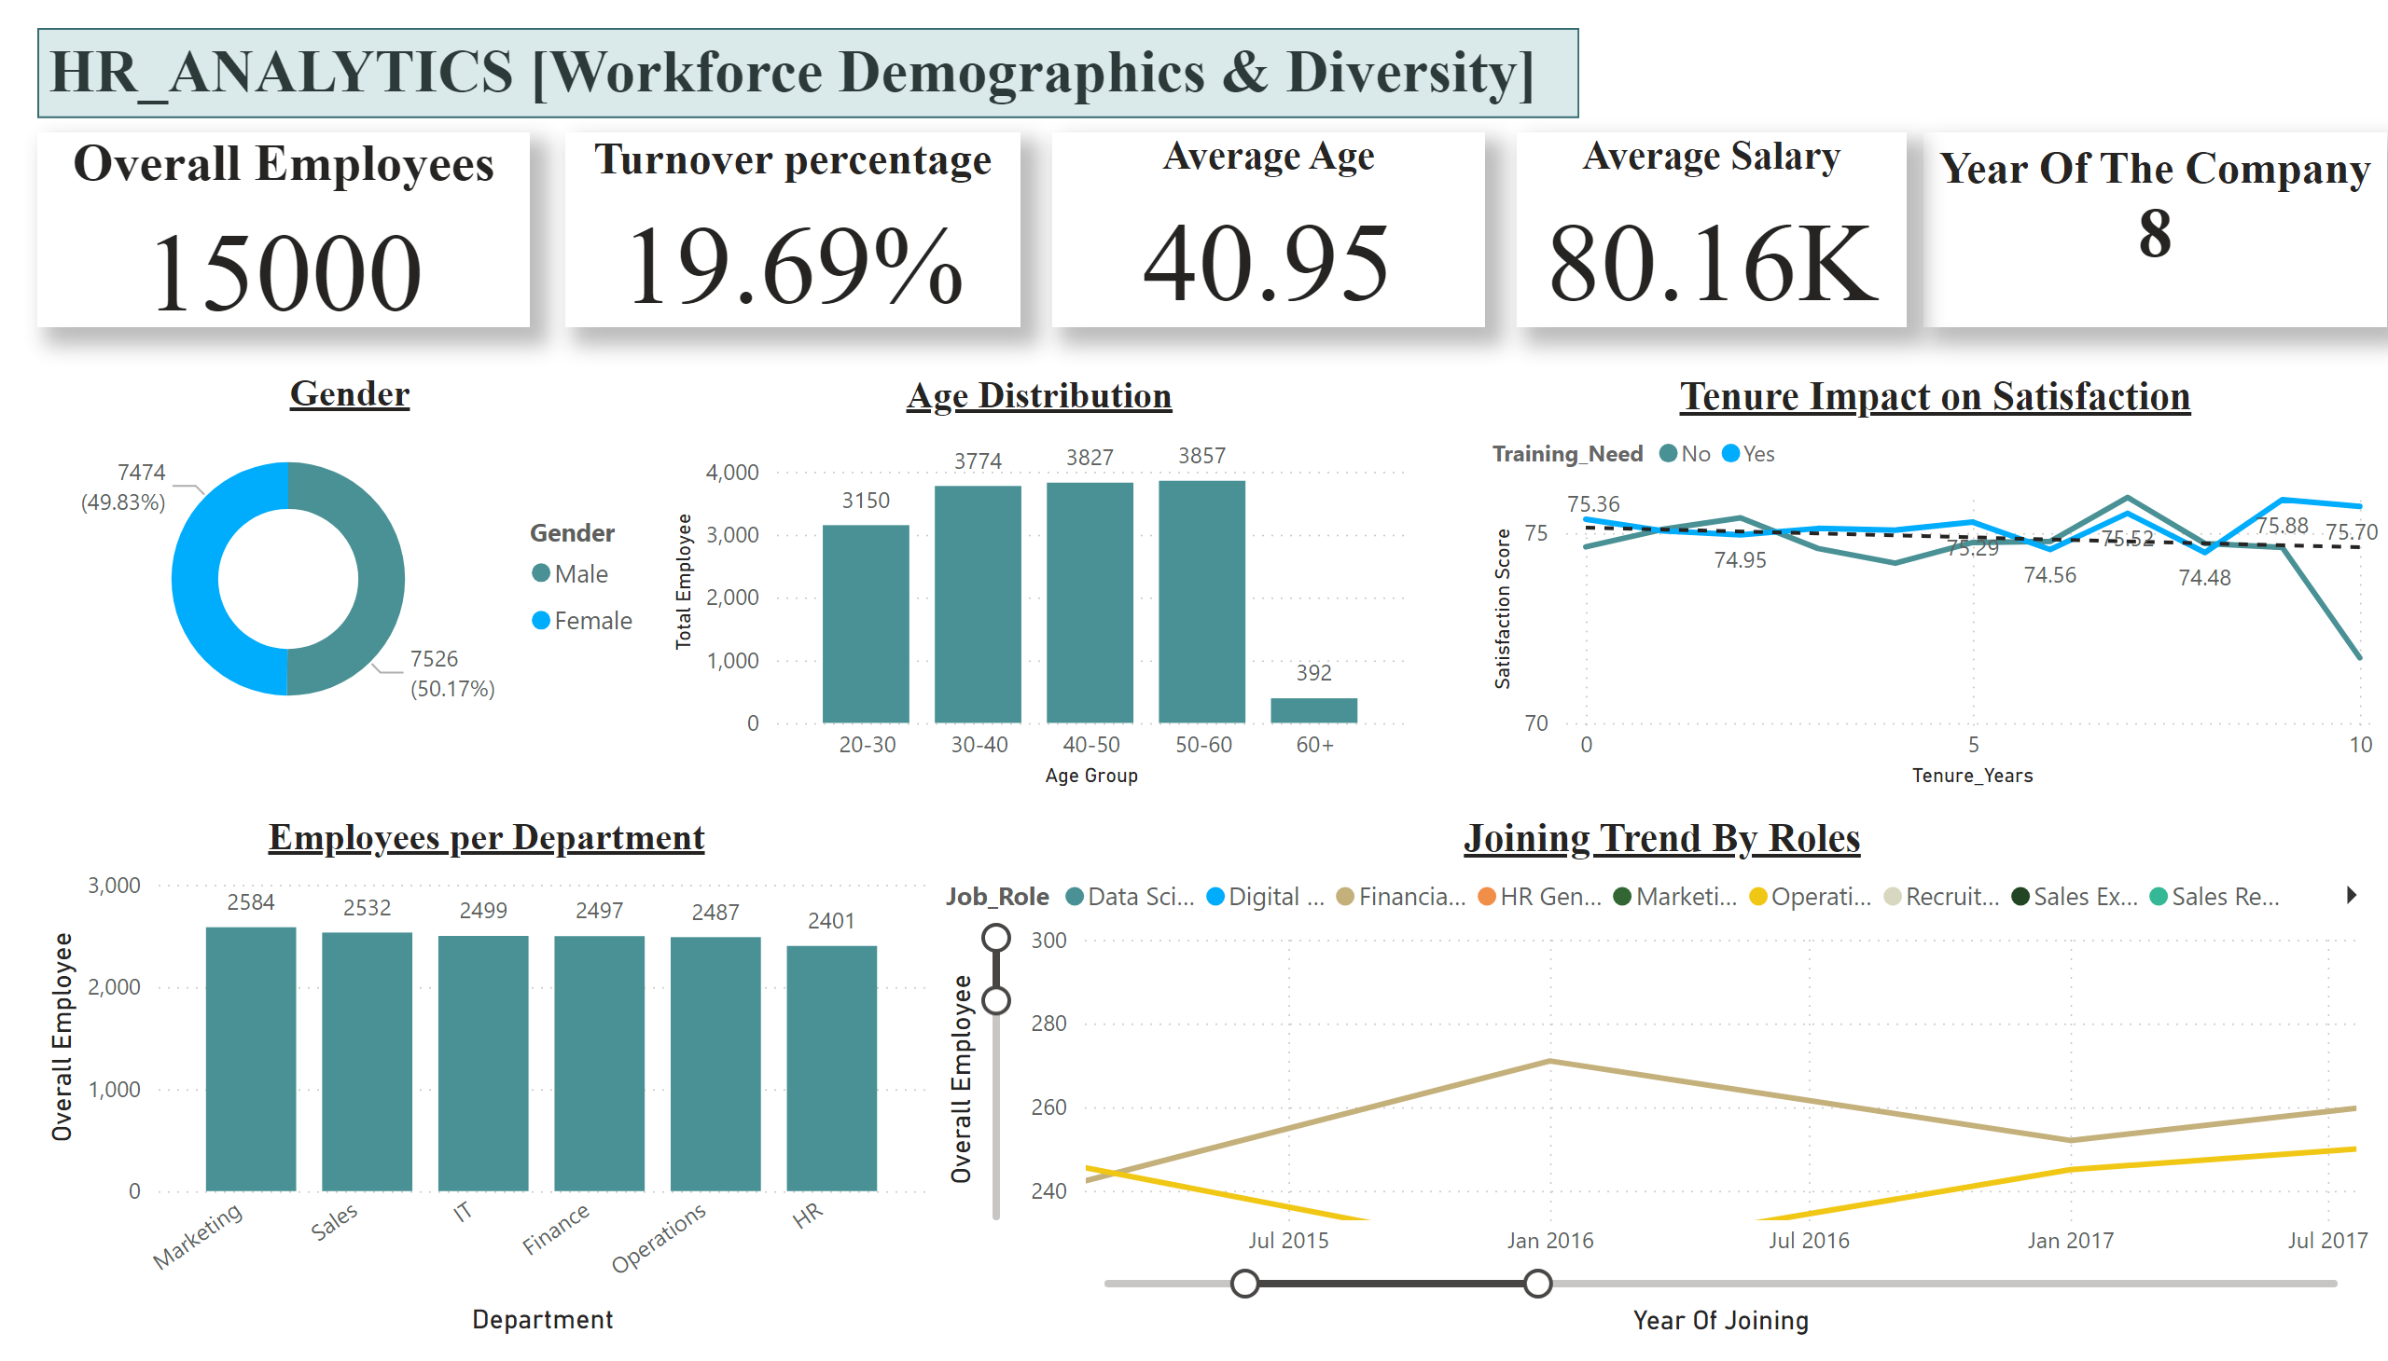
Workforce Demographics & Diversity
Notes:
Age Distribution
No alt text provided
Gender
No alt text provided
Overall Employees
No alt text provided
textbox
No alt text provided
Employees per Department
No alt text provided
Turnover percentage
No alt text provided
textbox
No alt text provided
Average Age
No alt text provided
Average Salary
No alt text provided
Joining Trend By Roles
No alt text provided
shape
No alt text provided
Tenure Impact on Satisfaction
No alt text provided

Slide 5
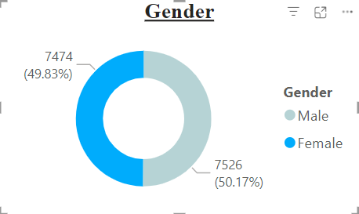
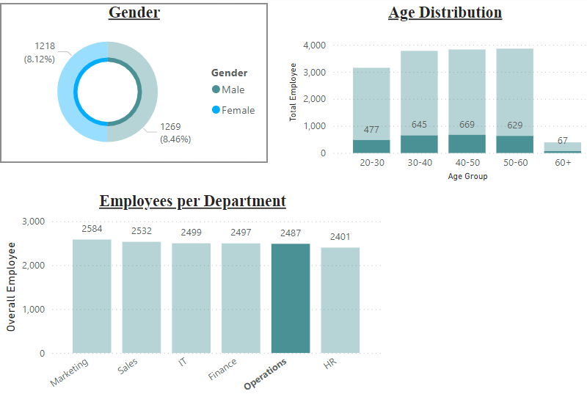
50.17% male vs. 49.83% female - indicates a well-balanced workforce, reflecting strong gender diversity at the organizational level.
This balance promotes an inclusive work environment, reducing potential biases in leadership, collaboration, and task allocation.
Consistently monitoring such metrics can help sustain equity across all departments.

Slide 6
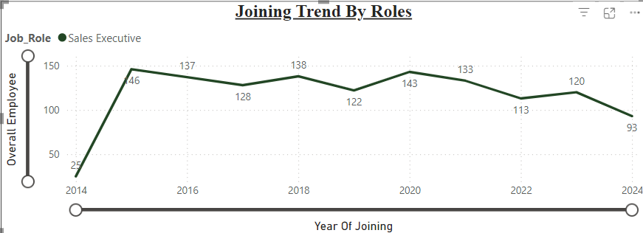

Growth Phase (2014-2020):
Hiring surged from 25 in 2014 to 143 in 2020, reflecting business expansion or increased sales targets. This consistent rise suggests a strong focus on sales growth during this period
Decline Phase (2022-2024):
The decline from 113 hires in 2022 to 93 in 2024 signals a potential strategic shift.
Market Saturation
Reduced need for sales staff due to digital sales
Economic Adjustments

Slide 7
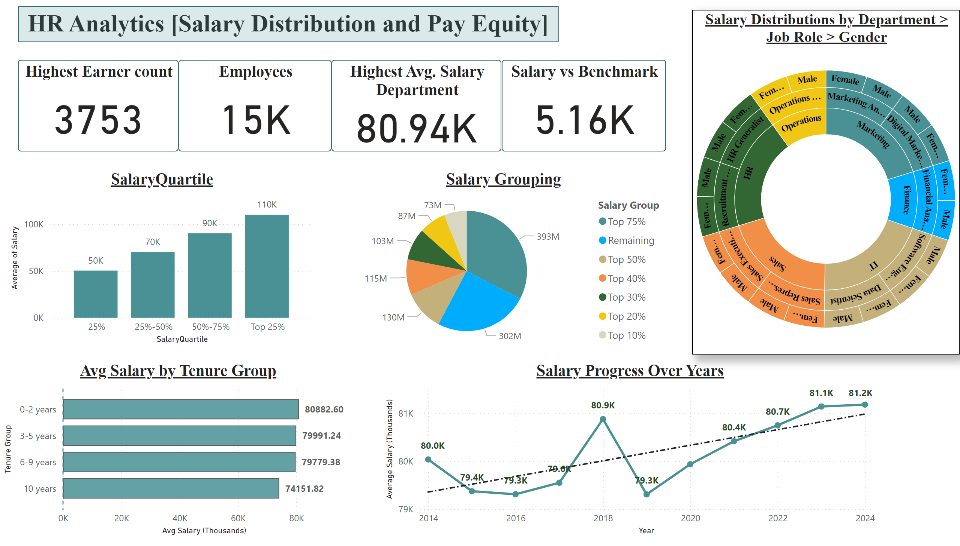
Compensation and Pay Equity
Notes:
textbox
No alt text provided
Employees
No alt text provided
Highest Avg. Salary Department
No alt text provided
Highest Earner count
No alt text provided
Salary vs Benchmark
No alt text provided
SalaryQuartile
No alt text provided
Salary Grouping
No alt text provided
Avg Salary by Tenure Group
No alt text provided
Salary Progress Over Years
No alt text provided
Salary Distributions by Department > Job Role > Gender
No alt text provided
shape
No alt text provided

Slide 8
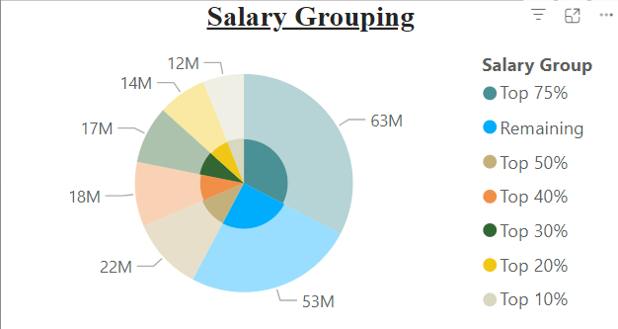
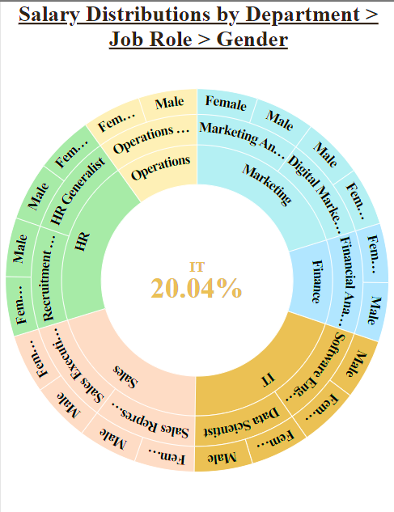
IT holds the highest salary distribution at 20.04%, indicating a concentration of high-paying roles
Top Salary Group Analysis:
Top 75% Salary Group: Collectively holds 63 million, reflecting how a large portion of total salary is concentrated among top earners.
Next Tier (50%-75%): The segment below the top 75% holds 22 million, showing a steep salary drop-off after top earners.

Slide 9
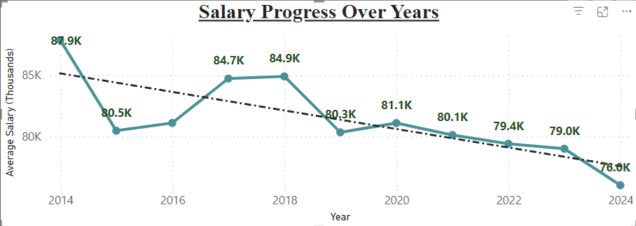

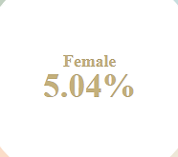
The average salary for female software engineers in IT dropped is the lowest from $87.9K in 2014 to $76.0K in 2024, indicating a steady decline.
The total salary decrease over the decade is 13.54%, signaling a significant downward trend.
The decline suggests limited salary progression for female employees in this role, which could be :
lack of promotions
market adjustments
evolving tech industry standards

Slide 10
Recommendation
Objective | Insights | Recommendation
Evaluate Workforce Composition | Gender ratio is nearly equal (50.17% male, 49.83% female) across departments and Age Distribution | Maintain gender balance through inclusive hiring practices and career development programs.
Analyze Hiring Trends | In sales Executive Hiring peaked in 2020, followed by a steady decline, possibly due to market shifts or cost-cutting measures. | Evaluate recruitment strategies and adjust based on current business needs and market demand.
Examine Salary Distribution | While IT dominates salary distribution, Steep salary accumulation within the top percentiles might indicate the need for broader pay equity policies. | Implement pay equity reviews and adjust salary structures to reduce income disparity.
Support Budget Planning | indicate industry-specific pay adjustments, budget constraints, or shifting skill demand for IT roles. | Conduct regular market benchmarking and adjust salaries to attract and retain top talent.

