Slide 1



final_hr
View in Power BI
Last data refresh:
11/26/2024 5:34:42 AM UTC
Downloaded at:
12/5/2024 7:36:42 AM UTC

Slide 2

HR Analytics Dashboard and Insights
Miles Private Limited
A Comprehensive Overview of Workforce Dynamics
Team Members
Priyanshu Ghosh
Nandini
Srusthi
Sai Raghu

Slide 3
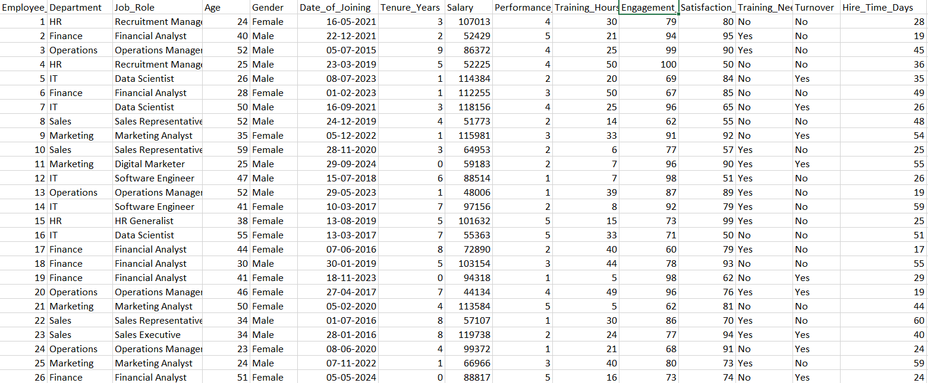
Dataset and Highlights
Dataset Contains 15 columns and 15000 rows
Tool Used : Power Bi
employee dataset
Employee_ID: A unique identifier for each employee, ensuring we can track individual data points.
Department and Job_Role: These columns help us understand workforce distribution across teams and specific roles.
Age, Gender, and Tenure_Years: Critical demographic details that allow us to analyze diversity, experience, and retention trends.
Date_of_Joining: This helps us identify hiring patterns over time.
Salary and Performance_Rating: These metrics provide insights into compensation and individual contributions.
Training_Hours and Training_Need: These reflect skill development efforts and areas where additional training might be required.
Engagement_Score and Satisfaction_Score: Two essential measures of employee morale and productivity.
Turnover: This indicates whether an employee has left the company, a key metric for analyzing retention.

Slide 4
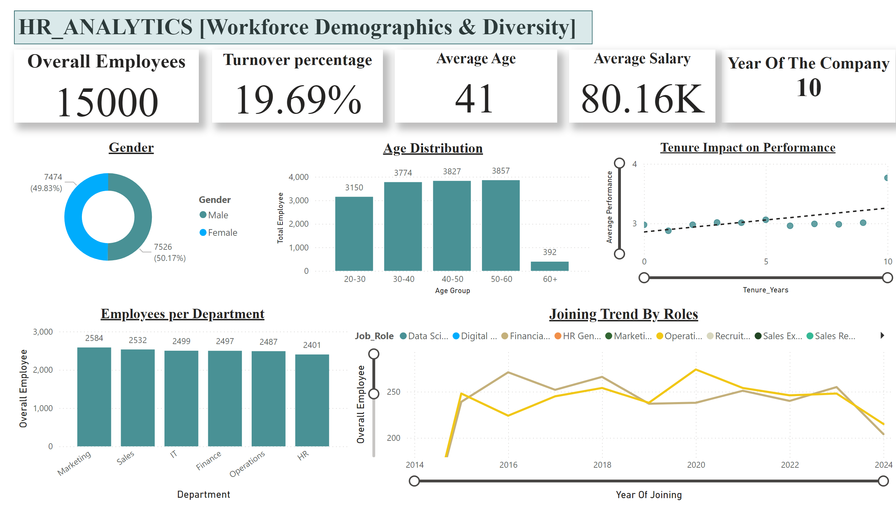
Workforce Demographics & Diversity
Notes:
Age Distribution
No alt text provided
Gender
No alt text provided
Overall Employees
No alt text provided
textbox
No alt text provided
Employees per Department
No alt text provided
Turnover percentage
No alt text provided
textbox
No alt text provided
Average Age
No alt text provided
Average Salary
No alt text provided
Joining Trend By Roles
No alt text provided
Tenure Impact on Performance
No alt text provided
shape
No alt text provided

Slide 5
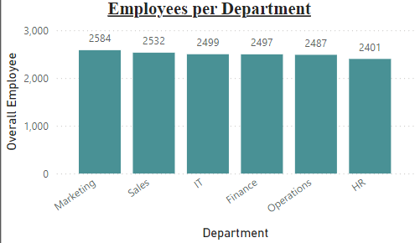
Insights And Analysis [Workforce demographics and diversity]
10 years of building a diverse and dynamic workforce
There is a total of 15000 Employee.
Average Age is 41
Correlation Between Tenure and Performance: The plot reveals how employee performance ratings vary with tenure, highlighting whether longer tenure correlates with higher or stable performance levels
Generational and Experience Dynamics:For instance, mid-career employees might show the highest performance due to a balance of experience and motivation, whereas early-career or late-career employees could display more variability based on learning curves or retirement approaches.
Hiring Patterns Across Roles: revealing trends like increased demand for specific roles due to organizational growth or shifts in business priorities.
Performance Peaks at Certain Career Stages: older employees with longer tenure could either demonstrate consistent high performance or experience burnout or disengagement.
DAX Measures Used : Turnover Percent

Slide 6
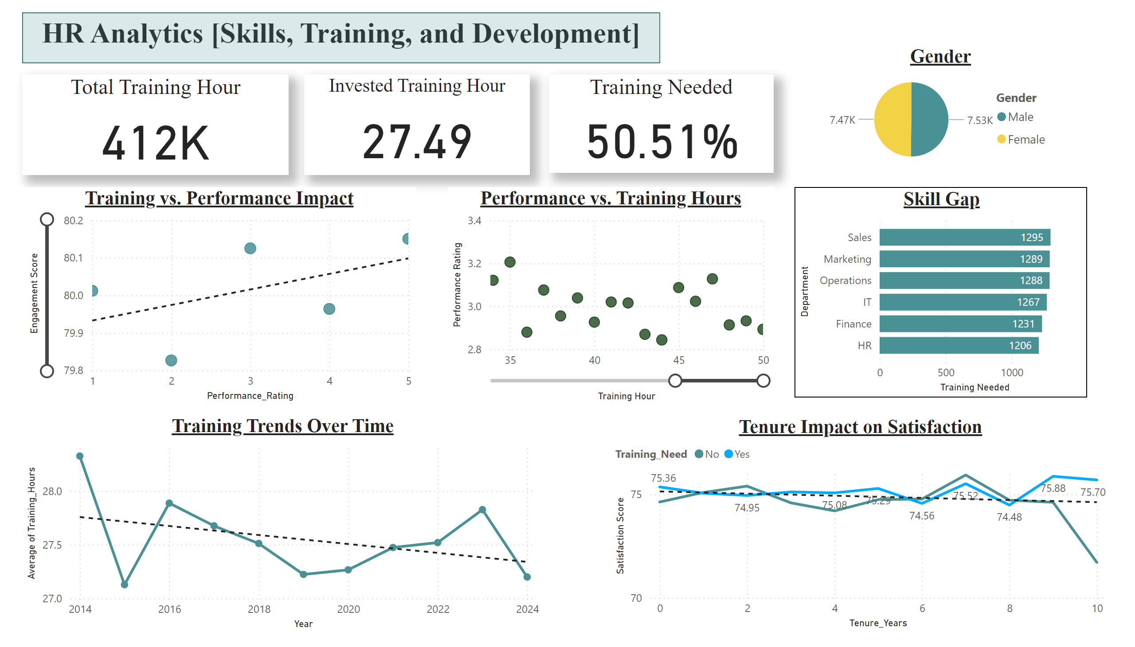
Skills, Training, and Development
Notes:
textbox
No alt text provided
Invested Training Hour
No alt text provided
Training Needed
No alt text provided
Total Training Hour
No alt text provided
Training vs. Performance Impact
No alt text provided
Skill Gap
No alt text provided
Training Trends Over Time
No alt text provided
shape
No alt text provided
Gender
No alt text provided
Tenure Impact on Satisfaction
No alt text provided
Performance vs. Training Hours
No alt text provided

Slide 7
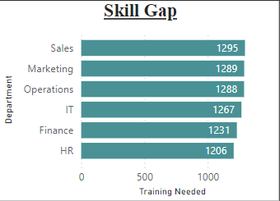
Insights And Analysis [Skills, Training, and Development]
Around 50% Employee need the training
Total training hours provided by the Company is 412K
27+ hrs of average training per person
Training Hours vs. Performance Impact: Employees with higher training hours tend to have better performance ratings. Focus training efforts on employees with low performance scores to uplift overall productivity
performance vs training in the highest training shows low performance rating
Training Effectiveness Issues: The training content or methods may not be adequately addressing the employees
Overtraining Fatigue: Excessive training hours could lead to burnout or diminished productivity
high skill gap but increase in training trends
The organization recognizes the skill gap and is actively addressing it through increased training efforts
Increased Satisfaction with Training Needs: Employees who are identified as needing training show higher satisfaction scores over time, possibly because the organization invests in their development, making them feel valued
Invest in Career Development Pathways: Develop programs that cater to long-term career growth, such as leadership development
DAX Measures Used : Training Percentage
Training needed

Slide 8
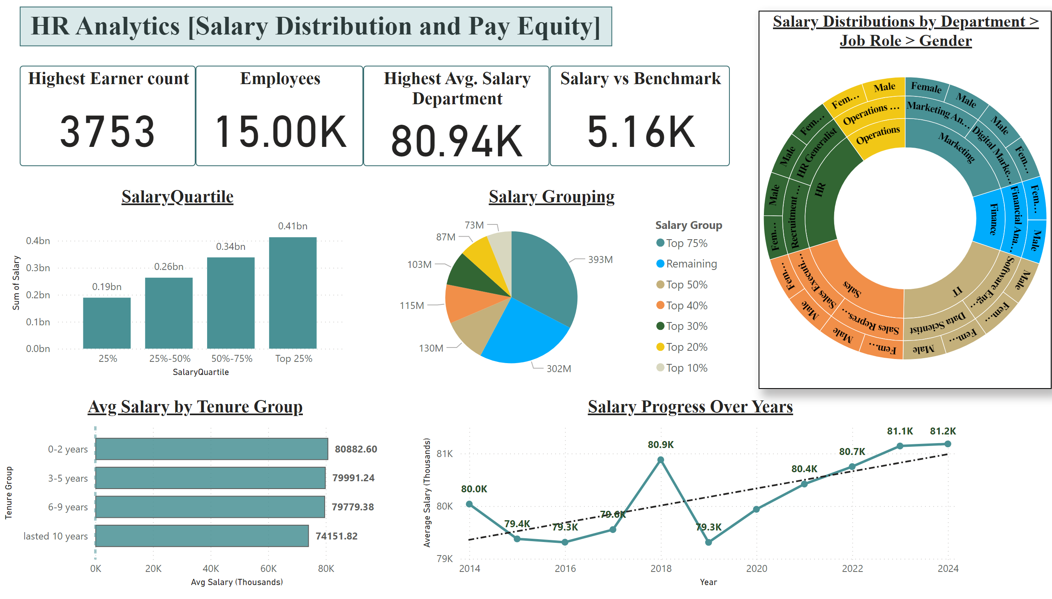
Compensation and Pay Equity
Notes:
textbox
No alt text provided
Employees
No alt text provided
Highest Avg. Salary Department
No alt text provided
Highest Earner count
No alt text provided
Salary vs Benchmark
No alt text provided
SalaryQuartile
No alt text provided
Salary Grouping
No alt text provided
Avg Salary by Tenure Group
No alt text provided
Salary Progress Over Years
No alt text provided
Salary Distributions by Department > Job Role > Gender
No alt text provided
shape
No alt text provided

Slide 9
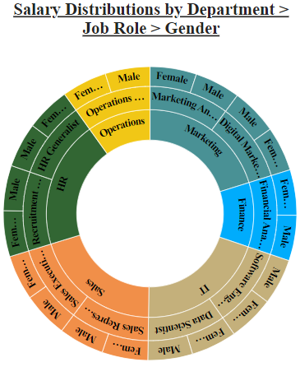
Insights And Analysis [salary distribution and pay equity]
3753 earn above 1 lakh
Highest average salary per department is 80k
Salary is 5.16 above the benchmark
Income Disparity: The low contribution of the first quartile to total salary expense suggests a steep pay disparity between the lowest and highest earners. Introduce policies to ensure a more equitable distribution of salaries
The lower average salary for the 10+ year group may indicate salary stagnation for long-tenured employees. A smaller cohort of 17 employees suggests limited progression opportunities or attrition within this group
Employees in these roles may perceive limited career advancement, risking turnover. Addressing stagnation.
Can show which percentiles (e.g., 75%) contribute the most to total salary.
Sunburst diagram
Using Sunburst visualization here I can filter every aspect of the salary ratio or salary over tenure or Hike on salary based on department, Job, roles and Gender
DAX Measures Used : Highest Earner count
Salary vs Benchmark Avg. salary by Tenure group
Avg. salary by year

Slide 10
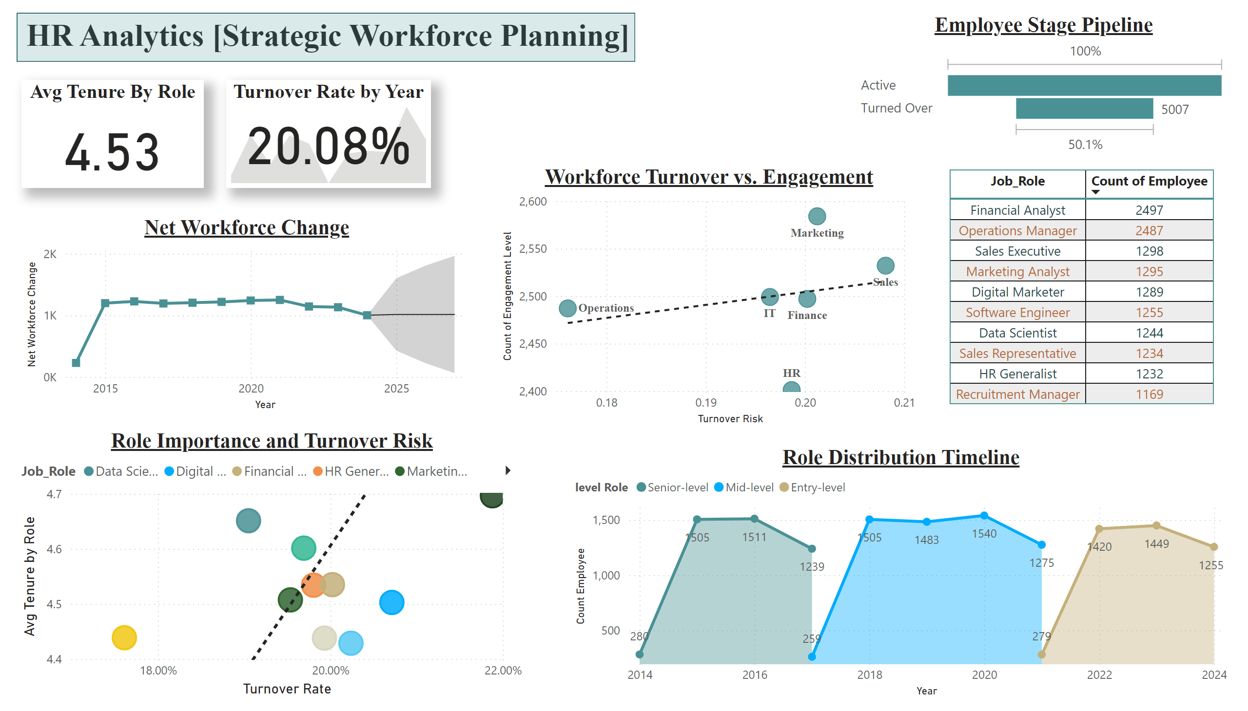
Strategic Workforce Planning
Notes:
textbox
No alt text provided
Avg Tenure By Role
No alt text provided
tableEx
No alt text provided
Employee Stage Pipeline
No alt text provided
Role Importance and Turnover Risk
No alt text provided
Role Distribution Timeline
No alt text provided
Net Workforce Change
No alt text provided
kpi
No alt text provided
Workforce Turnover vs. Engagement
No alt text provided
shape
No alt text provided

Slide 11
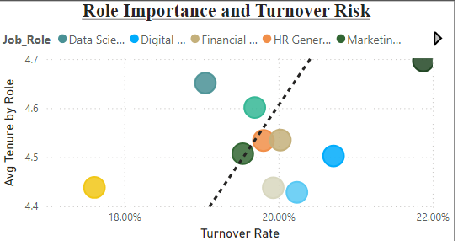
Investing in retention strategies such as competitive compensation, upskilling, and career development for these roles can mitigate business risks.
Insights And Analysis [Strategic Workforce Planning]
Average Tenure by role is 4.5 years
Turnover rate by year is 20.08%
The Turnover Pipeline Simulation shows that the highest turnover occurs among employees within their Job roles in a department
The Role Importance and Turnover Risk Scatter Plot reveals that key technical roles have high turnover risk but are also critical to business operations.
Investing in retention strategies such as competitive compensation, upskilling, and career development for these roles can mitigate business risks.
The Future Workforce Forecast predicts a declining headcount in the department due to higher turnover and slower hiring rates compared to other departments. Analysis: A targeted hiring campaign or improved retention strategies can help sustain operational efficiency and avoid skill gaps.
Financial Analysts exhibit the highest turnover rate compared to other roles in the organization. Financial Analyst roles often involve high-pressure tasks, deadlines, and long hours, which may lead to burnout and higher turnover
The net workforce change has remained relatively stable over the past few years, indicating a balance between hiring and turnover.
DAX Measures Used : Net Workforce Change
Turnover risk
Average tenure by role

Slide 12
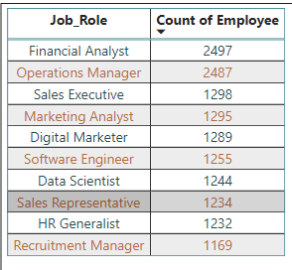
Key Takeaways and Conclusion
The organization shows a balanced age distribution but faces gaps in generational diversity in certain roles.
Departments with lower diversity indices highlight areas for inclusion-focused recruitment and retention efforts.
Training programs demonstrate varied impacts, with high training hours not always correlating with higher performance, signaling a need for more targeted skill development.
Departments with significant skill gaps but improving training trends indicate potential future improvements in productivity and satisfaction.
Employees requiring training report higher satisfaction, showcasing the positive psychological impact of organizational investment.
Salary disparities are evident, with the first quartile contributing only 15% of the total salary pool, highlighting potential income inequality.
Employees with over 10 years of tenure show relatively lower average salaries despite long service, which could indicate stagnation or underappreciation.
Roles with high turnover, such as Financial Analysts, require immediate retention strategies, possibly through enhanced engagement and compensation packages.
Stable workforce trends indicate consistent hiring practices but may mask underlying turnover risks in critical roles.
Engagement scores strongly correlate with retention,

