Slide 1
Team members
1. Priyanshu Yadav, 210050125
2. Pulkit Goyal, 210050126
3. Nikhil Nandigama, 210050105

Slide 2
MEMORY/CACHE optimisation for sat
CS 230 PROJECT

Slide 3
CACHE HIERARCHY POLICIES
We are using three cache hierarchy policies. They are inclusive, exclusive and non-inclusive-non-exclusive (NINE) hierarchies.
Champsim implements NINE by default.
We have implemented inclusive and exclusive policies for the purpose of comparison.
Next, we will briefly explain about the implementation of these policies.

Slide 4
INCLUSION POLICY
We have made changes at two places in the cache.cc to implement inclusion policy.
First change is made in “handle_fill” function in cache.cc. In this, before we evict from a cache, we make sure that this block be evicted from upper level caches as well, if it is present in them.
Second change is made in “handle_writeback” function. In this also, we evict the cache block from upper caches if it is being evicted in current cache.
We do this to maintain inclusivity in caches. These steps are sufficient to implement inclusive cache policy.

Slide 5
EXCLUSION POLICY
For exclusion policy, we have made changes at three places in cache.cc.
In handle_fill(), we don’t write into lower level caches if the entry’s fill level corresponds to higher level cache, i.e. we bypass them in this case. Also, whenever we evict a block, we copy it to lower level cache. Note that this is the only way L2 and LLC caches are filled.
In handle_write(), again whenver we evict a block, we fill it in lower cache.
In handle_read(), whenever we send return data to higher level cache, we invalidate it in current cache to maintain exclusivity.
These changes suffices to make exclusive cache policy.

Slide 6
NON-INCLUSIVE POLICY
This is the default policy in ChampSim.
It will be referred to as NINE, Non-inclusive non-exclusive.

Slide 7
REPLACEMENT POLICIES
The replacement policies used are as follows:
LFU
LRU
LRU-K
Prob-lru-lfu
LinearComb-lru-lfu
SSRIP
MRU
FIFO
FILO

Slide 8
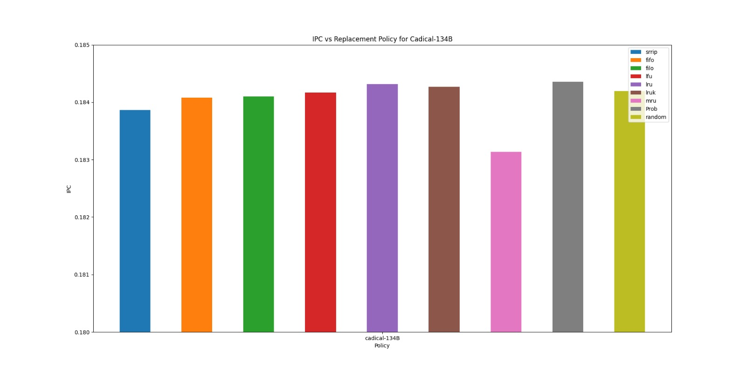
Replacement policies for cadical-134

Slide 9
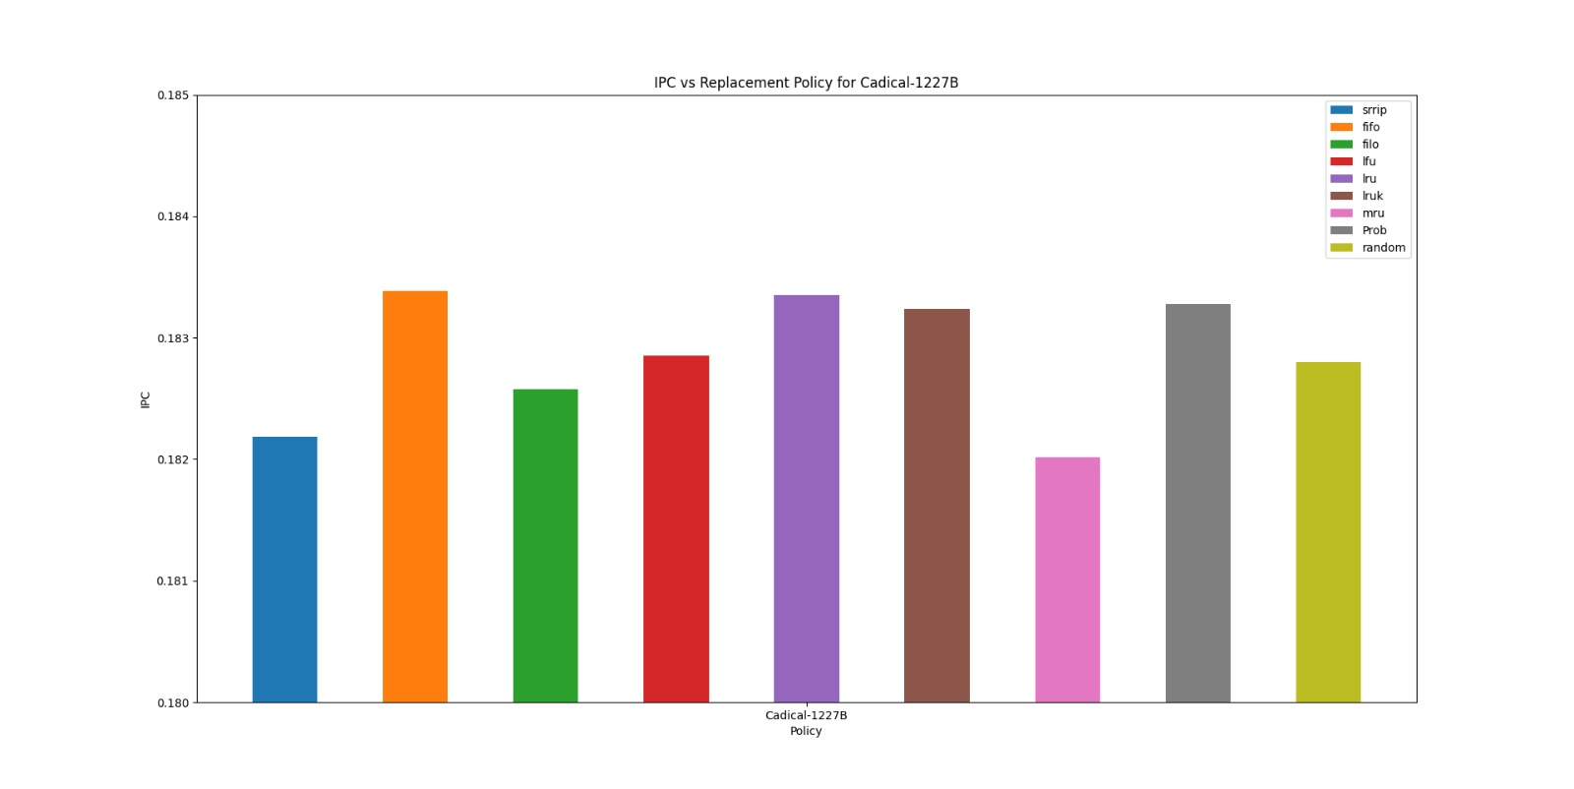
Replacement policies for cadical-1227

Slide 10
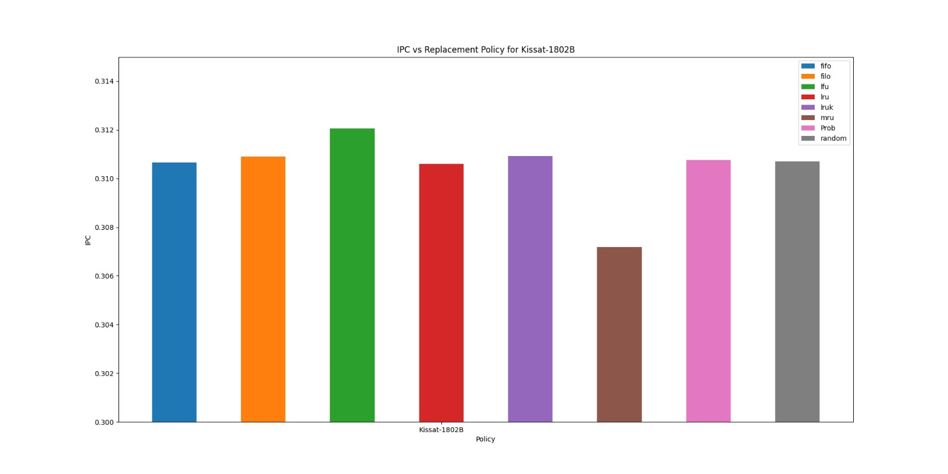
Replacement policies for KISSAT

Slide 11
Conclusion for replacement policies for different traces
According to the graphs above, it is clear that for the first two traces lru is one suitable option for cache replacement policy while in the kissat trace, lfu dominates. Also the difference between lru and lfu is very minimal in the first two traces, while it is somewhat significant in the third trace. Seeing these traces, the best cache replacement policy is lfu when needed without knowing which trace to act on.

Slide 12
Prob-lru-lfu, linearcomb-lru-lfu
In Prob-lru-lfu, to find victim, we chose lru or lfu with 50 % probablity each.
In LinearComb-lru-lfu, to find victim, we chose that entry for which a*lfu + b*lru gives the highest value, i.e. a linear combination of lru and lfu values. This combines the good properties of both lru and lfu.

Slide 13
Lru-k
This Policy is similar to LRU
Here the victim should have frequency less than k and it should be least recently used one
If all the blocks have frequency more than k then we choose the least recently used block among them.

Slide 14
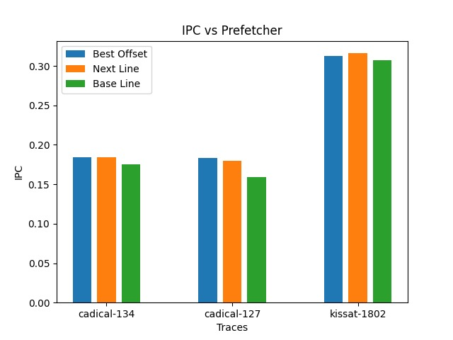
Prefetchers ...
Among next-line prefetcher and Best-offset prefetcher, BO prefetcher is better(theoretically, while competing with the next line prefetcher as shown below). Therefore, we have used BO prefetcher for all our activity.

Slide 15
SIZE VARIATION WITH AND WITHOUT EFFECT OF LATENCY FOR EACH CACHE

Slide 16
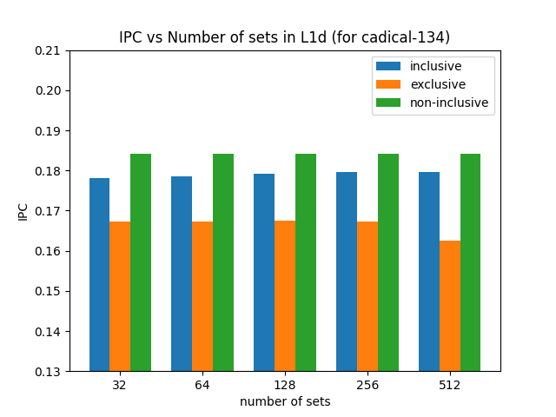
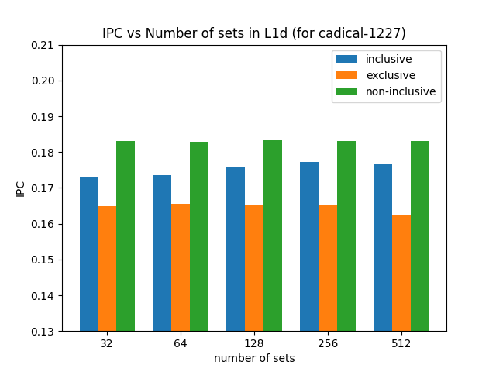
L1D

Slide 17
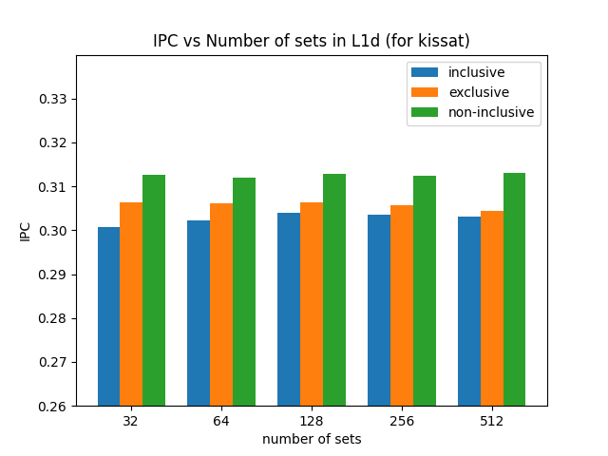
L1d
Changing number of sets in L1d without changing the latency slightly improves the IPC for the given range of values. But the change is negligible. For much more higher values, it is expected that the IPC will increase. That’s natural for the simulator to show, but in the real world, the latency effects, cost of technology etc. make it impractical to increase L1d above a certain value.

Slide 18
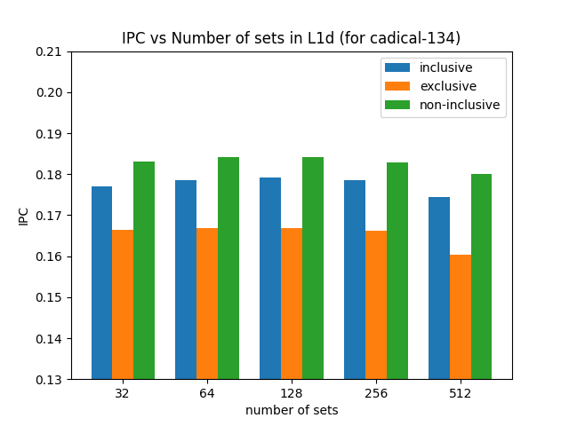
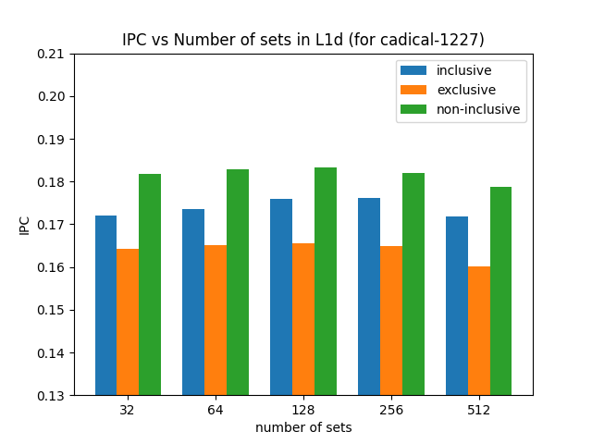
L1D (with latency)

Slide 19
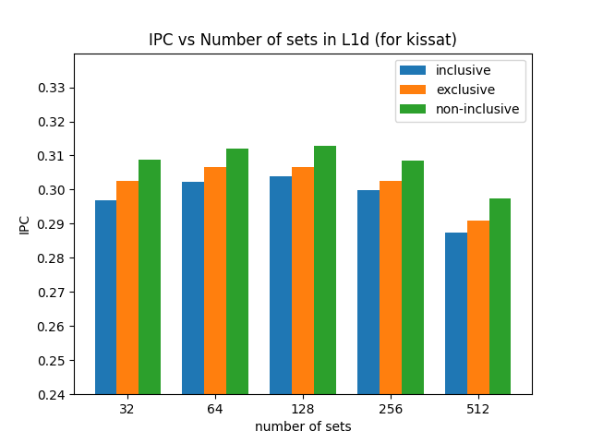
L1D (With latency)
In L1d cache, increasing number of sets with increasing latency first increases IPC, then it remains almost constant and then it decreases. This behaviour is justified, since we face a trade-off between latency and cache size. Latency increase outweighs the IPC increase due to size at larger size values.

Slide 20
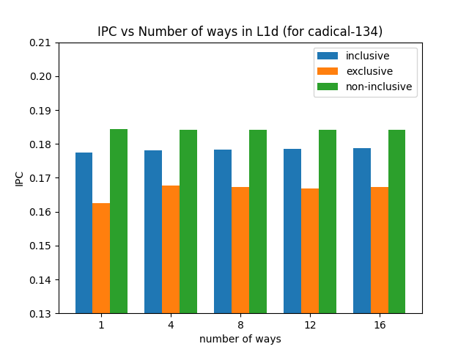
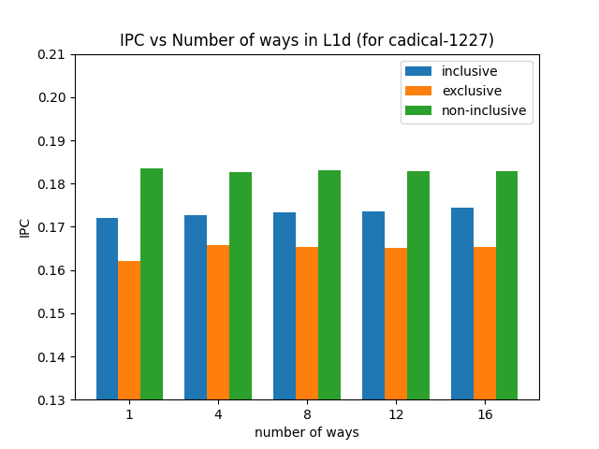
L1d (ways)

Slide 21
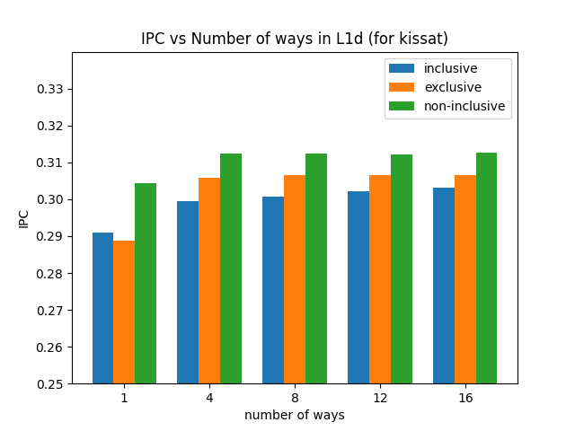
L1d (ways)
Increasing Ways have an effect of increasing IPC till a saturation point beyond which IPC won’t increase and mostly remains constant or may even decrease.

Slide 22
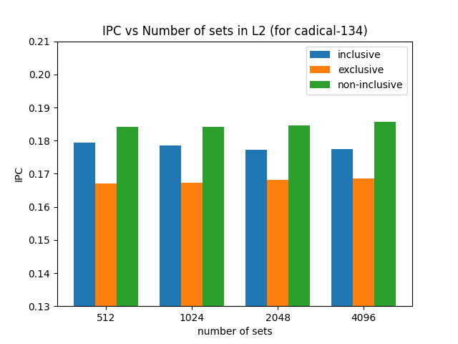
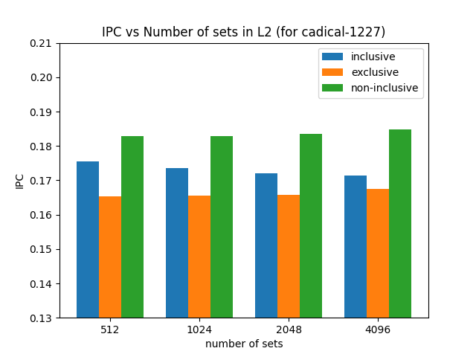
L2

Slide 23
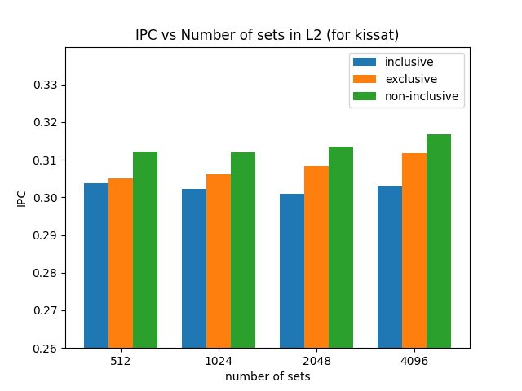
L2
Increasing number of sets in L2 cache without any change in latency slightly increases the IPC.

Slide 24
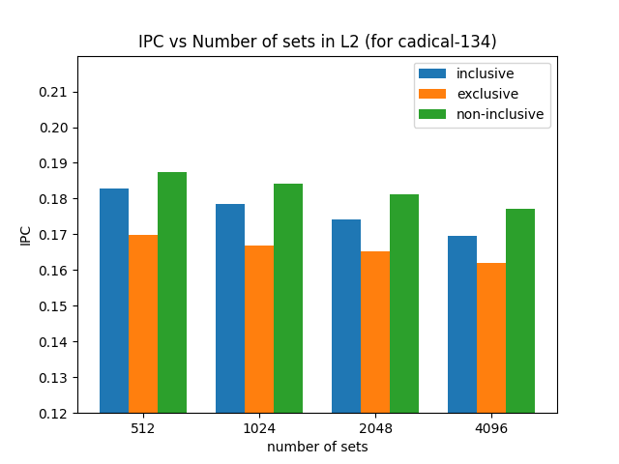
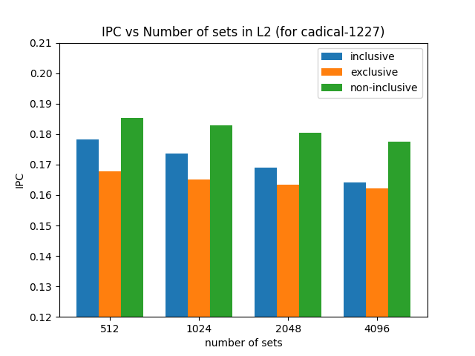
L2 (with latency)

Slide 25
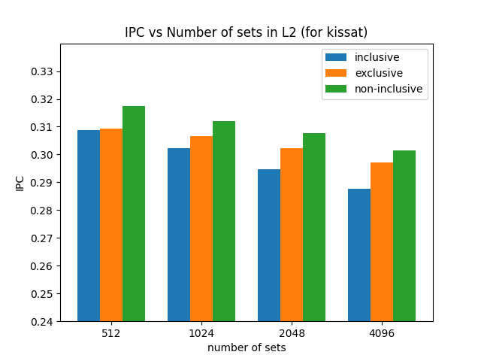
L2 (with latency)
Increasing number of sets while increasing latency decreases the IPC. The latency increase due to the function chosen has a more profound impact in decreasing IPC as compared to increase in IPC due to change in size(number of sets).

Slide 26
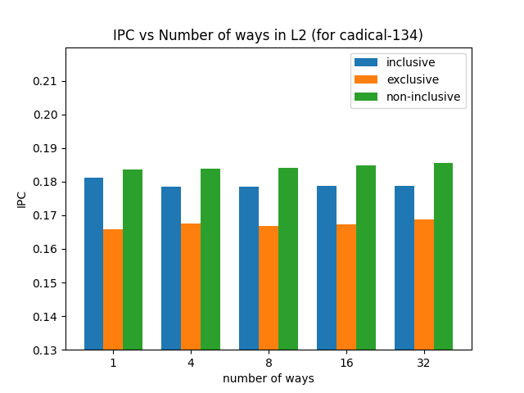
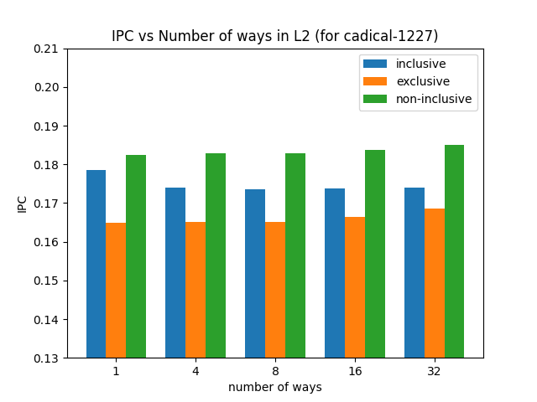
L2 (ways)

Slide 27
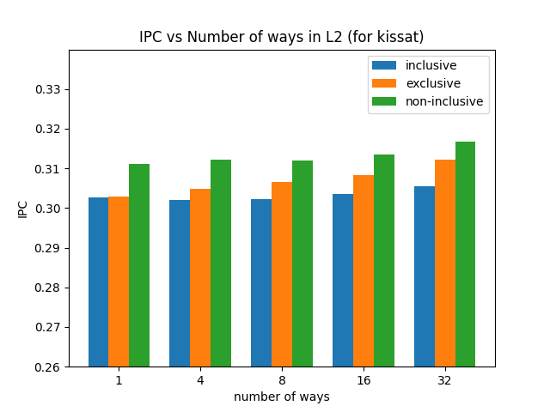
L2 (ways)
Increasing number of ways increases the IPC till a saturation point where IPC doesn’t change and then IPC starts decreasing slightly.

Slide 28
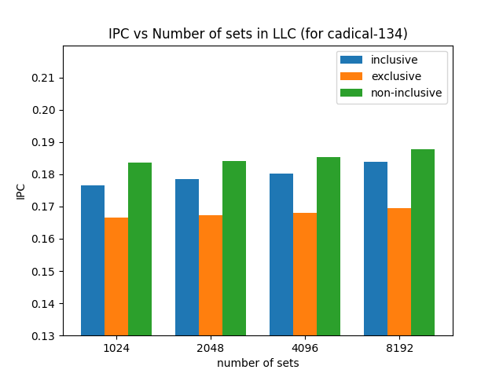
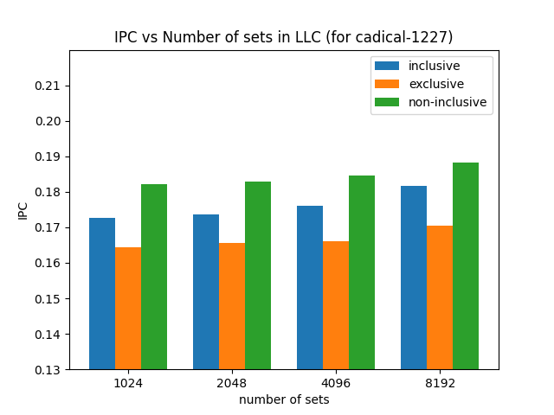
LLC

Slide 29
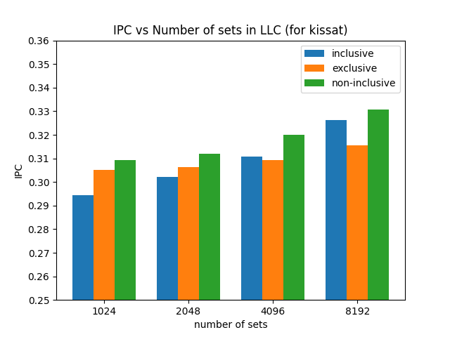
LLC
Increasing number of sets in LLC without changing latency increases the IPC.

Slide 30
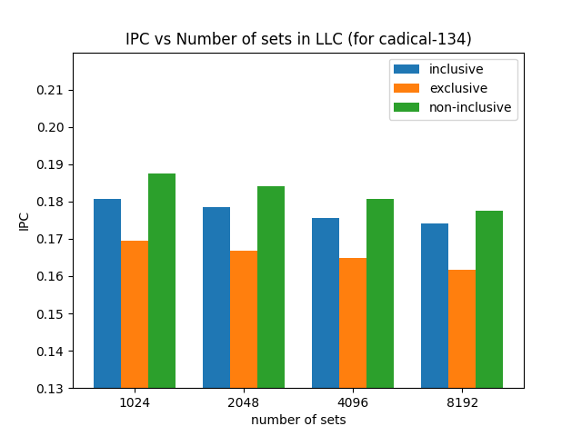
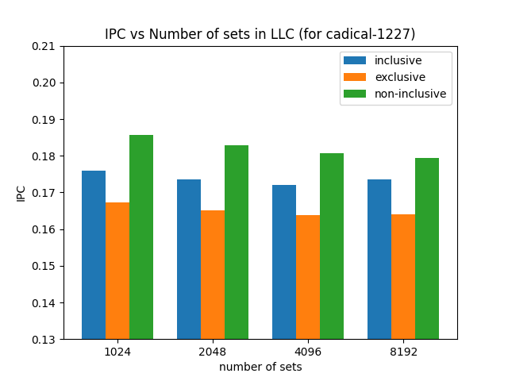
LLC (With Latency)

Slide 31
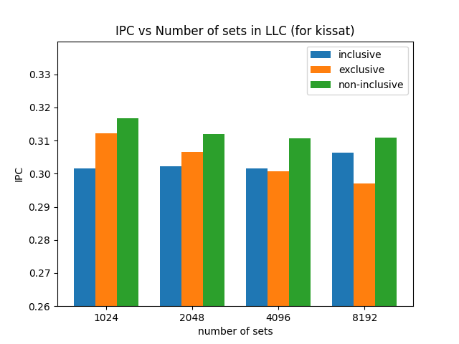
LLC (with latency)
Increasing LLC number of sets while changing latency clearly brings a negative impact on the IPC recorded. It decreases on increasing size which is because of increasing latency.

Slide 32
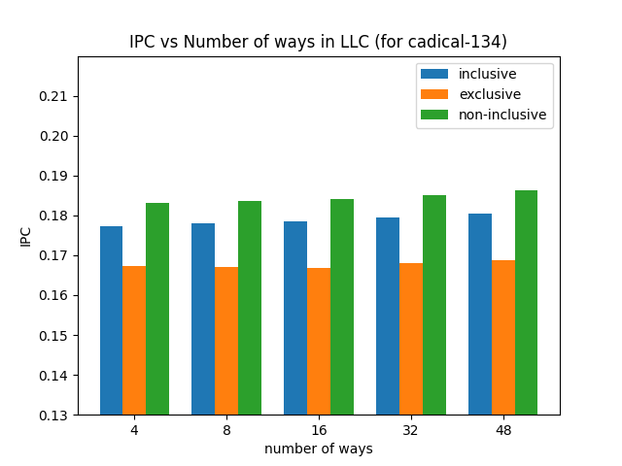
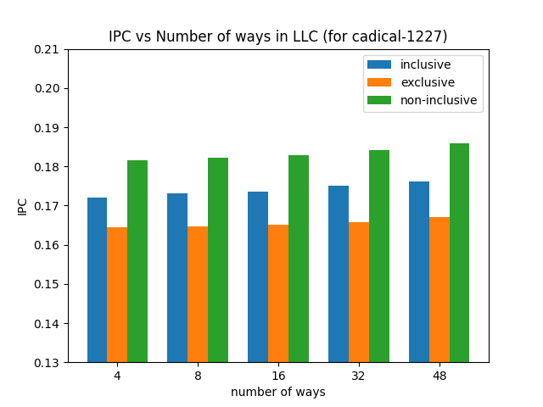
Llc (ways)

Slide 33
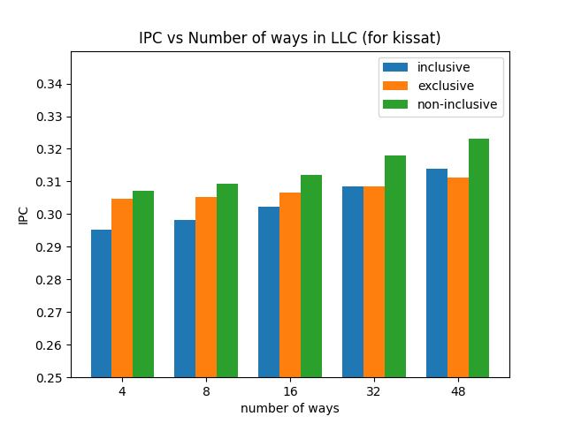
Llc (ways)
Increasing number of ways in LLC increases IPC. But increasing too much will cause a stable value or a slightly decreasing IPC value.

Slide 34
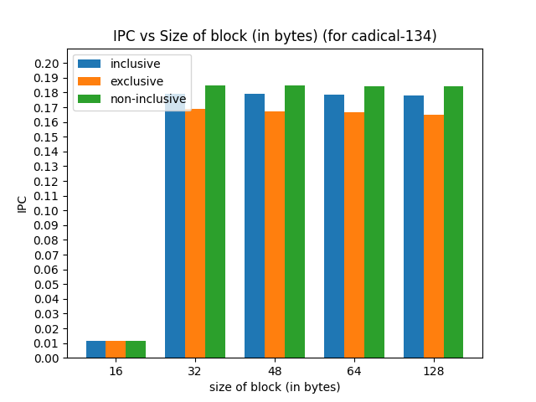
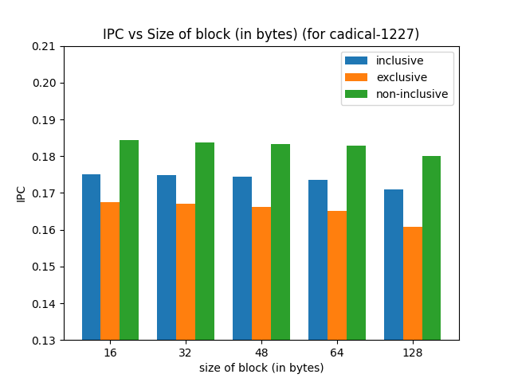
Block size variation

Slide 35
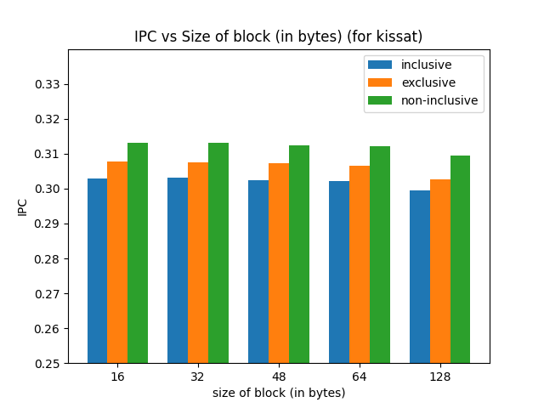
Block size variation
Increasing block size first increases IPC, then keeps it constant for a while before decreasing it slightly. This is due to the fact that too lower block size decreases the benefits of the block while too large just increases the baggage carried with each block which results in lowering of IPC.

Slide 36
Latency variation with size
We had three points for (size,latency), from the hardcoded values in ChampSim. For L1D cache, we have size = 64 sets*12 ways = 768 and latency = 5 cycles.
Similarily, for L2 cache, we have size = 1024*8 = 8192 and latency of 10 cycles.
For LLC, we have size = 2048*16 = 32768 and latency of 20 cycles.
Size values vary much more compared to latency values, therefore we took log of size with base 10 to get following three points : (2.88, 5), (3.91, 10) and (4.51, 20).
We made the hypothesis that y varies parabolically with x for these 3 points.
We found the parabola that contains these three points.

Slide 37
The parabola is : y = 7.21*(logx)^2 - 44.16*(logx) + 72.38, where x is the size of the cache, i.e. sets * ways. y is the latency in number of cycles.
We used this function to find the latency of the cache when we change its size.
This function is based on our hypothesis that latency varies as parabolic function of log(size). We have demonstrated the results we got from using this function under the latency sections.

Slide 38
REPLACEMENT POLICY CHANGE WITH SIZE OF CACHES

Slide 39
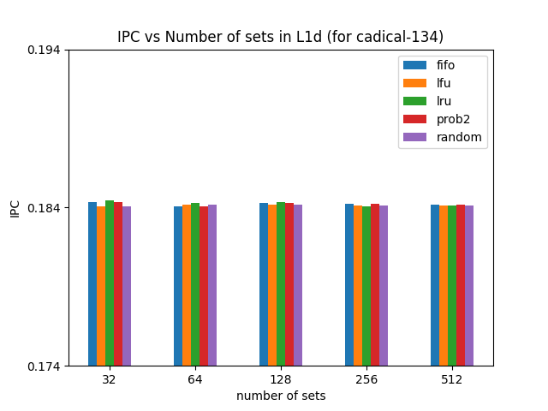
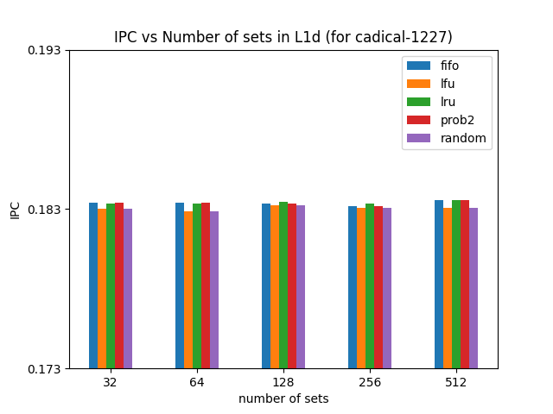
L1d

Slide 40
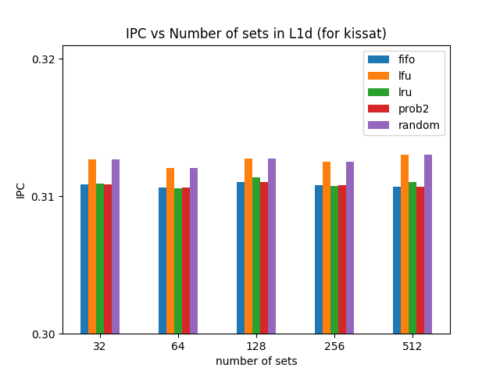
l1d
Changing the L1D cache size(number of sets), we notice that there isn’t much difference in IPC that specifically makes one cache replacement policy too good at certain cache size as compared to other sizes. Also the trend of all caches is similar to the general template of IPC vs Increasing number of sets.

Slide 41
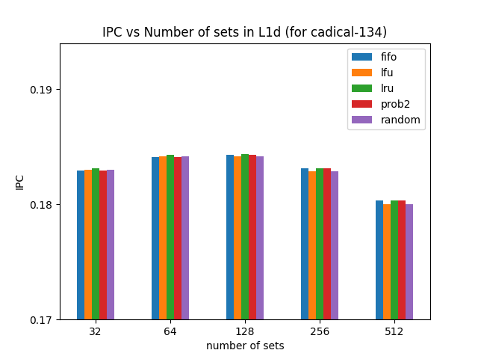
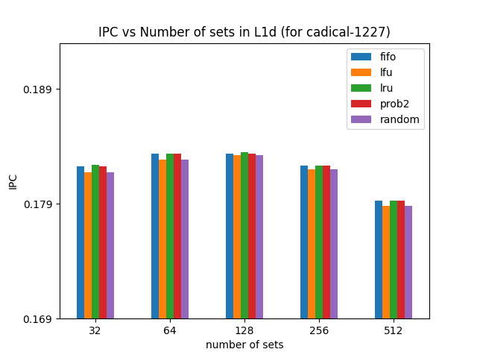
L1d (latency)

Slide 42
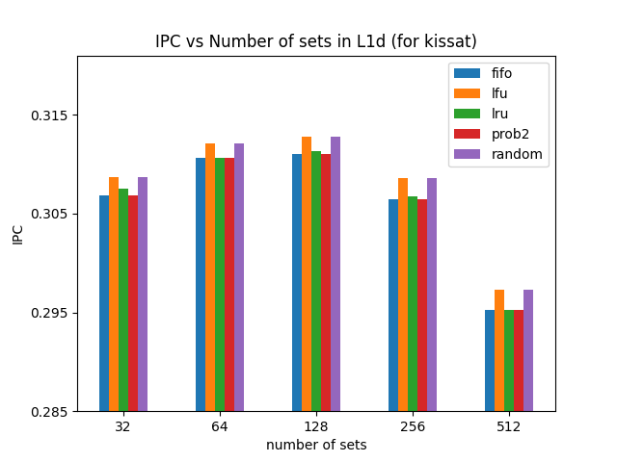
L1d (latency)
Changing number of sets with corresponding change in the latency first increases then decreases the IPC. All Cache replacement policies follow the above stated trend as well.

Slide 43
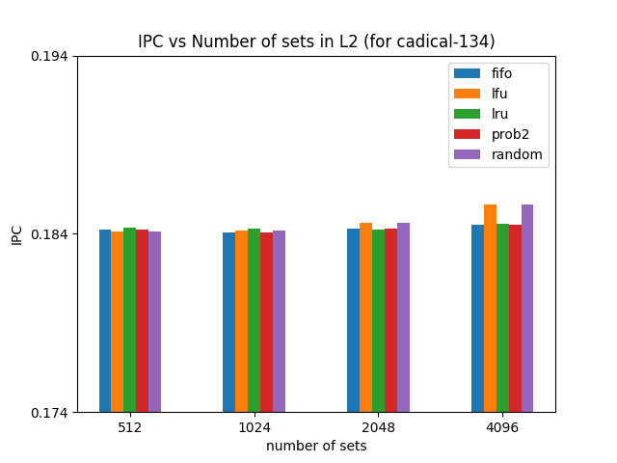
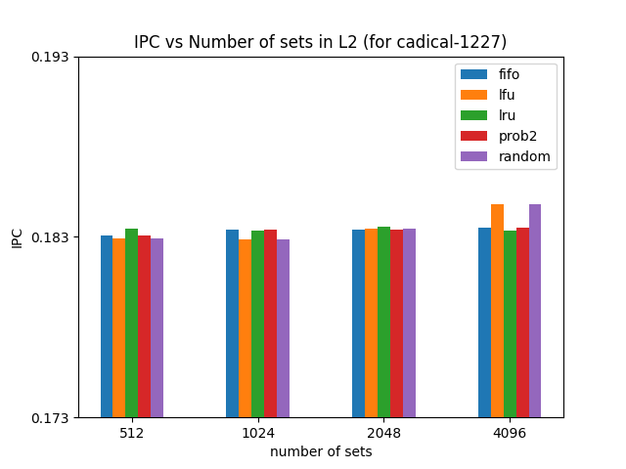
l2

Slide 44
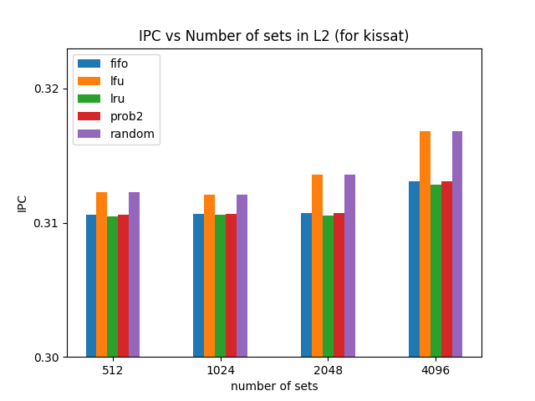
l2

Slide 45
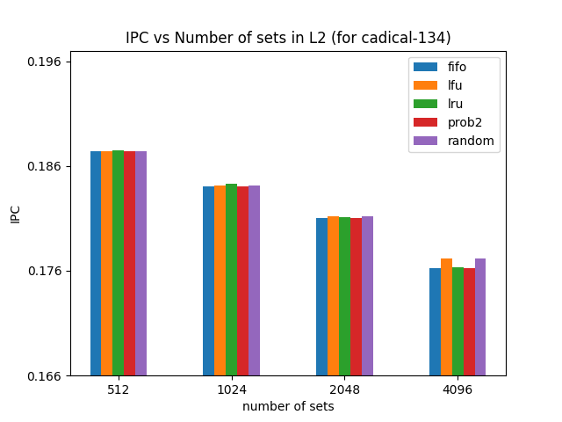
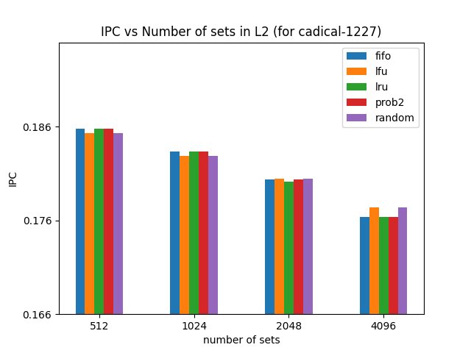
L2 (latency)

Slide 46
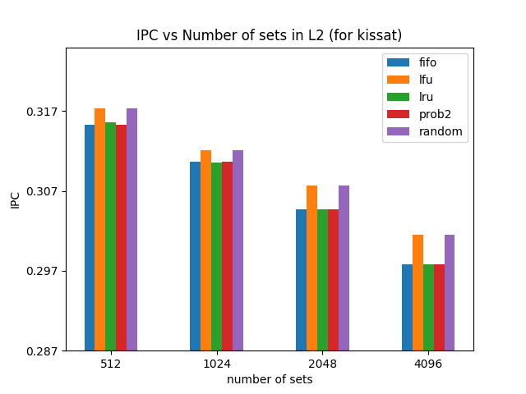
L2 (latency)

Slide 47
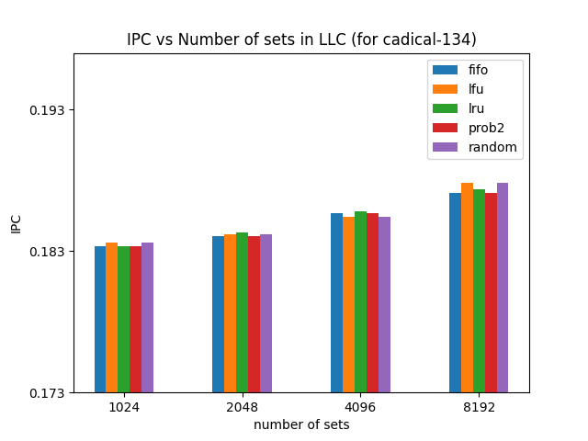
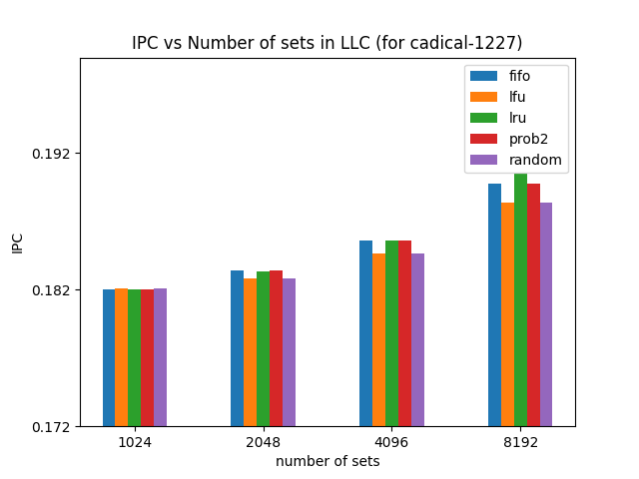
llc

Slide 48
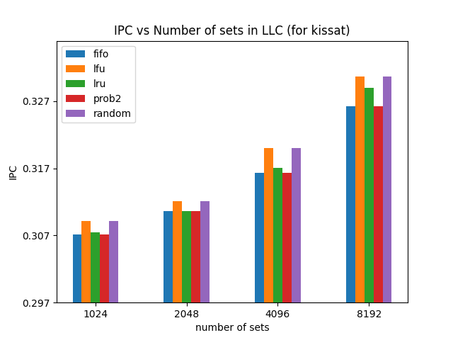
llc

Slide 49
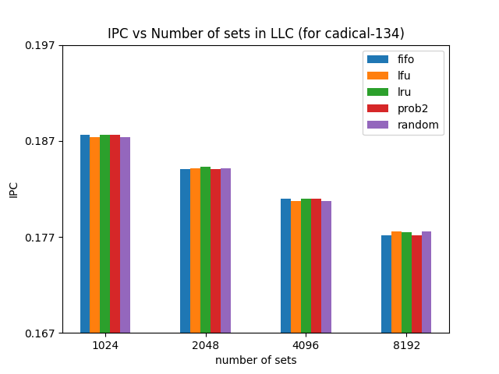

Llc (with latency)

Slide 50

Llc (with latency)

Slide 51

Comparison of BEST Possible optimizations vs. Baseline implementation

Slide 52
Comparison of BEST Possible optimizations vs. Baseline implementation
We have changed the size of caches to accommodate the best possible theoretical plus practical sizes. L1D numsets = 128 and numways = 12, L2 numsets = 1024, numways = 16, LLC numsets = 2048, numways = 32.
Block size is kept at 64.
We use lfu as our first priority cache replacement policy.
NINE(Non Inclusive and Non Exclusive) cache policy is best, followed by Inclusive cache policy which is then followed by Exclusive cache policy. So NINE is used.
We get an improvement of 1% each in cadical traces, while 3% improvement in kissat trace.

Slide 53
CONCLUSION
We saw how the size of the cache affects the perfomance.
We looked at different cache replacement policies and evaluated their performance.
We implemented cache hierarchy policies and analysed them in different scenarios.
We made a hypothesis about variation of cache latency with size of cache and analysed its behaviour, gaining useful insights.

