Slide 1
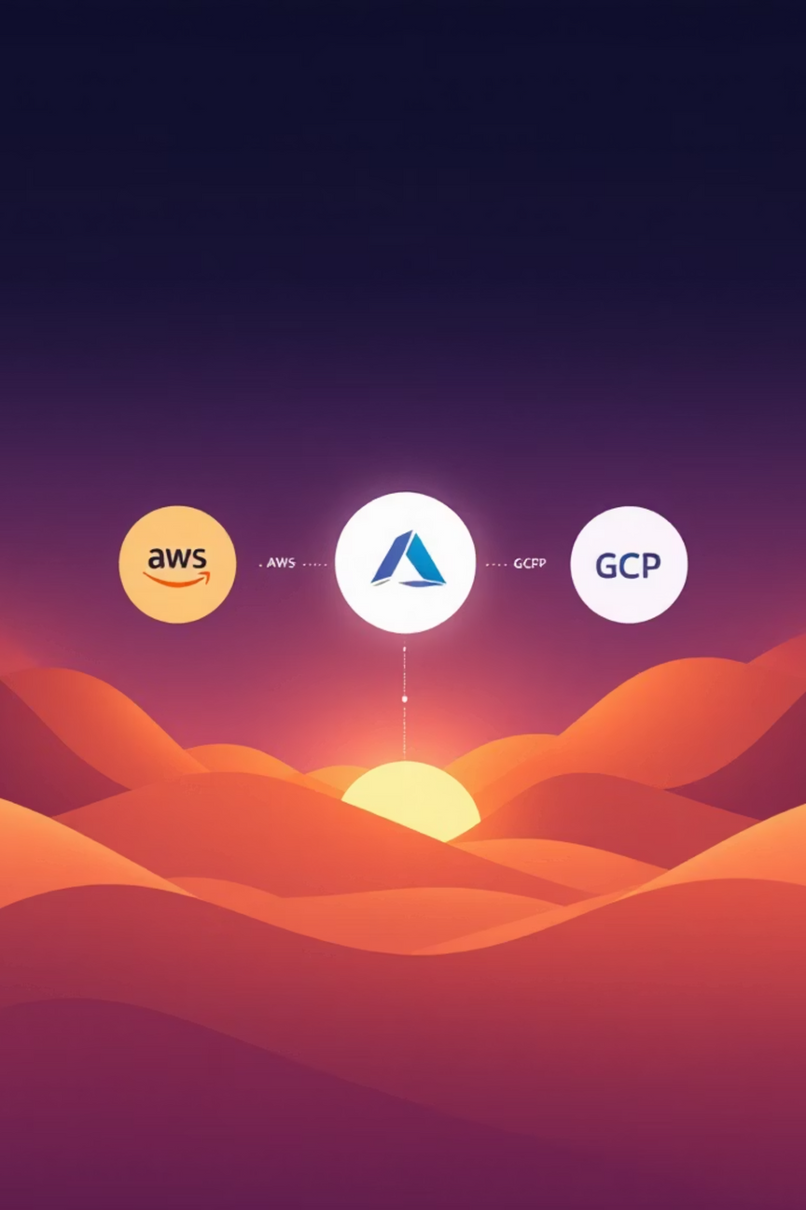

Cloud Simplify: The Unified Multi-Cloud Platform
Stop juggling cloud tools. Start building with one.
Your team will love to manage infrastructure.
TEAM NAME: CLOUDINEERS
Notes:
1

Slide 2
The Problem: The Complexity of Multi-Cloud
Too Many Tools
Inconsistent Workflows
Developers and teams must learn and manage a separate set of APIs and CLI tools for AWS, Azure, GCP, and other providers. This leads to fragmented knowledge and slow operations.
Provisioning a database on AWS is a different process from provisioning one on Azure, leading to inefficiency, manual errors, and a higher risk of misconfigurations across environments.
High Learning Curve
Configuration Drift
Onboarding new team members is slow and costly due to the steep learning curve required to master each individual cloud ecosystem and its specific tooling.
Manually managing infrastructure across various cloud providers inevitably leads to inconsistencies and discrepancies between development, staging, and production environments.
Notes:
2

Slide 3
Our Solution: A Unified Provisioning Platform
  Introducing a web-based platform that acts as a user-friendly abstraction layer over native cloud APIs, simplifying infrastructure management.
  We use Terraform as the powerful, standardized engine to provision and manage infrastructure reliably and consistently behind the scenes.
  Users interact with a simple UI, while we handle the complex configuration generation and execution, eliminating the need for deep cloud-specific knowledge.
Notes:
3

Slide 4



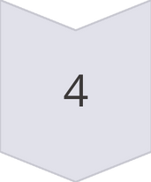

Core Components of Cloud Simplify
User Interface (UI)
A clean, intuitive dashboard where users can easily select cloud services and configure parameters without writing complex code.
API Gateway
A secure and robust backend translating user requests from the UI into a standardized format for seamless integration with our automation engine.
Terraform Automation Engine
The core of the platform: dynamically generates Terraform files, manages and securely stores .tfstate files, and executes all necessary Terraform commands.
Cloud Provider Integrations
Securely connects to AWS, Azure, and GCP via established service accounts and API keys, ensuring reliable and authorized resource provisioning.
Monitoring & Logging
Provides real-time feedback and detailed logs on all provisioning jobs, offering transparency and enabling quick troubleshooting.
Notes:
4

Slide 5

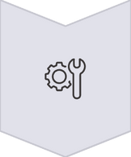



How It Works: A Simple Workflow
1. Request
A user logs in and requests a specific service (e.g., a virtual machine) through the intuitive UI.
2. Configuration
Our engine instantly generates the corresponding Terraform configuration file based on the user's selections.
3. Execution
The automation engine executes the terraform apply command using securely stored credentials.
4. Provisioning
Terraform communicates directly with the chosen cloud provider's API to provision the requested resource.
5. Completion
The dashboard updates in real-time, providing the user with immediate access details (e.g., public IP, connection string).
Notes:
5

Slide 6





Value Proposition: Why This Matters
Consistency
Simplicity
Enforces standardized configurations, eliminating human error and ensuring that all environments remain identical and stable.
Abstracts away the complex underlying infrastructure, enabling anyone, regardless of cloud expertise, to provision resources effortlessly.
2
1
Speed
3
Reduces provisioning time from hours to mere minutes, accelerating development cycles and deployment speeds.
5
Cost Efficiency
Minimizes manual mistakes, optimizes resource utilization, and helps prevent over-provisioning, leading to significant cost savings.
4
Reduced Learning Curve
New team members can be productive on day one, as extensive training on multiple cloud ecosystems is no longer required.
Notes:
6

Slide 7
Target Audience: Who Benefits Most?
Developers & Startups
DevOps Engineers
Small to Medium Businesses (SMBs)
For those who need to quickly spin up infrastructure without the overhead of a dedicated DevOps team. Focus on coding, not cloud configuration.
Empowers experienced professionals to streamline their workflows, automate repetitive tasks, and focus on higher-value strategic initiatives.
Offers a simple, cost-effective, and centralized way to manage their multi-cloud presence without needing extensive in-house cloud expertise.
Notes:
7

Slide 8


Future Roadmap: What's Next for Cloud Simplify
Expanded Cloud Support
Service Catalog
Adding support for additional major cloud providers including Oracle Cloud (OCI), Alibaba Cloud, and DigitalOcean to broaden our reach.
Introducing a comprehensive library of pre-configured templates for common stacks like LAMP, Kubernetes clusters, and more, for rapid deployment.
Cost Management
Code-Based Provisioning
Integrating robust cost monitoring and optimization features directly into the platform to help users better track and control their cloud spend.
Allowing advanced users the flexibility to upload and manage their own custom Terraform configurations directly through the platform.
Notes:
8

Slide 9

Q&A
Thank You
Notes:
9

