Slide 1

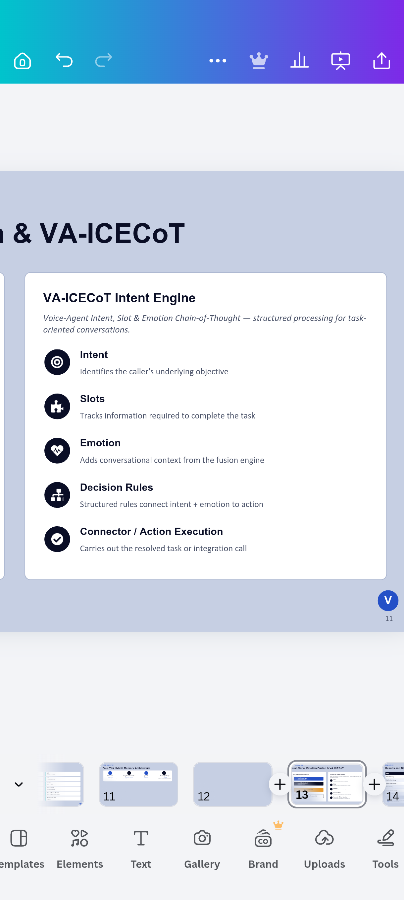

Presentation
On
VoCall — The memory augmented voice calling agent
with emotional awareness
Group Number : 5
Department of Artificial Intelligence & Data Science (AI&DS)
GNIOT Greater Noida, India)
Presented by
Abhishek Kr. Singh (2301321630002)
Adarsh Pandey (2301321630005)
Ananya Gupta (2301321630007)
Priyanshu Kumar (2301321630027)
Under the Supervision
Dr Shivkant
(Assistant Professor)
Notes:
1

Slide 2



INTRODUCTION
Problem Statement & Motivation
Problem Statement
Motivation
Existing voice-agent platforms rarely provide one integrated architecture that simultaneously delivers low-latency interaction, acoustic-and-textual emotion fusion, persistent caller-specific memory, Hindi–English code-switched interaction, and browser-based testing without physical telephony infrastructure.
VoCall's problem, therefore, is designing a unified architecture where real-time voice processing, persistent memory, emotion intelligence, intent reasoning, language-aware processing and developer configuration operate together.
Reduce repetition using persistent memory that recalls prior caller context
Add emotional context so responses reflect how a caller is communicating
Combine emotion with intent & slot data for richer conversation management
Enable task-oriented use cases: support, sales qualification, appointments, healthcare triage
Notes:
4

Slide 3






LITERATURE REVIEW
Problems in Existing Approaches
Traditional voice systems rely on rigid, predefined dialogue flows or isolated sessions; LLM-based systems are more flexible but do not, by themselves, provide persistent memory, emotion processing, multilingual routing or structured task execution.
Contextual Amnesia
Limited Emotional Awareness
Code-Switching Difficulty
Information is lost once a session ends
Responses miss caller frustration or distress
Poor handling of Hindi–English speech
Latency Constraints
Fragmented Memory
Complex Testing Workflows
Delays break natural conversational flow
No unified, multi-tier memory representation
Often depend on physical telephony setups
Notes:
6

Slide 4
RESEARCH OBJECTIVES
What This Project Sets Out to Achieve
Design a layered architecture separating client, API, storage, real-time voice and asynchronous processing
Support English and Hindi–English code-switched voice interaction
1
5
Implement a four-tier hybrid memory architecture: short-term, semantic, episodic and knowledge-graph
Provide a browser-based Web Call environment for agent testing
2
6
Design a dual-signal emotion fusion mechanism combining acoustic and textual signals
Provide an Agent Studio for configuration, memory, voice, integrations and analytics
3
7
Implement structured intent & slot reasoning through the VA-ICECoT architecture
4
Notes:
7

Slide 5
PROPOSED SYSTEM
VoCall — Major Contributions
VoCall combines real-time voice interaction with persistent memory, emotion intelligence, intent reasoning, Hinglish support and developer-oriented configuration in one modular architecture.
Contribution | Challenge Addressed | VoCall Approach
Persistent Memory | Context loss | Four-tier hybrid memory
Emotion Intelligence | Limited emotional awareness | Acoustic + textual emotion fusion
Intent Reasoning | Basic intent classification | Intent, slot & emotion reasoning (VA-ICECoT)
Hinglish Processing | Monolingual limitations | Language-aware STT/TTS routing
Real-Time Interaction | Conversational latency | Streaming voice pipeline (Pipecat + LiveKit)
Browser Testing | Telephony dependency | Web Call testing studio
Notes:
8

Slide 6





SYSTEM ARCHITECTURE
Layered, Modular Platform Design
Client Layer
Dashboard, Agent Studio, Web Call
▼
API Layer
FastAPI services (auth, agents, calls, memory)
▼
Memory, Emotion & Intent
Four-tier memory, emotion fusion, VA-ICECoT
▼
Real-Time Voice Pipeline
Pipecat orchestration + LiveKit WebRTC
▼
External AI Services
LLM, STT, TTS, Emotion providers
▼
Async Post-Call Processing
Trigger.dev — summarization, memory updates
Time-sensitive voice operations stay decoupled from slower post-call activities such as summarization and memory consolidation.
Notes:
9

Slide 7
SYSTEM ARCHITECTURE
Technology Stack
Frontend
STT
Next.js, React, TypeScript
Whisper / Sarvam AI
Styling
TTS
Tailwind CSS
Cartesia / Sarvam AI
Backend
Emotion
Python, FastAPI
Hume AI / NLP
Voice Orchestration
Relational DB
Pipecat
Supabase PostgreSQL
WebRTC
Vector + Graph Memory
LiveKit
pgvector, Upstash Redis, FalkorDB
LLM
Background Jobs
Groq LLaMA
Trigger.dev
Notes:
10

Slide 8


CORE INNOVATION
Four-Tier Hybrid Memory Architecture
Short-Term
Long-Term Semantic
Episodic
Knowledge Graph
Entities & relationships between them
Live conversational state for the active call
PostgreSQL + pgvector
PostgreSQL
FalkorDB
Upstash Redis
Semantic facts & retrieval across sessions
Historical call summaries over time
Dual-Signal Emotion Fusion & VA-ICECoT
Dual-Signal Emotion Fusion
VA-ICECoT Intent Engine
Voice-Agent Intent, Slot & Emotion Chain-of-Thought — structured processing for task-oriented conversations.
Textual Emotion Signal
from transcribed speech
  INTENT: Identifies the caller's underlying objective
  SLOTS:
  EMOTIONS:
  DECISION RULE:
  CONNECTOR/ACTION EXECUTION:
Acoustic Emotion Signal
from prosody / voice
Acoustic Emotion Signal
from prosody / voice
Tracks information required to complete the task
Dual-Signal Fusion
Adds conversational context from the fusion engine
Structured rules connect intent + emotion to action
Overall Conversational Emotion State
Carries out the resolved
task or integration call
Notes:
11

Slide 9
EVALUATION
Results and Discussion — Proposed Metrics
Metric | Evaluation Method | Target | Status
End-to-End Latency | Pipeline instrumentation | < 500 ms | To Be Evaluated
Voice First-Byte Latency | TTS latency measurement | < 100 ms | To Be Evaluated
Emotion Fusion Accuracy | Comparison with human ratings | > 90% correlation | To Be Evaluated
Intent Accuracy | Labelled test scenarios | > 95% | To Be Evaluated
Memory Retrieval Precision | Relevant-context precision | > 92% | To Be Evaluated
Task Completion Rate | Automated scenario completion | > 85% | To Be Evaluated
These values are proposed evaluation targets, not achieved results. The architecture and major components are implemented; formal, statistically validated evaluation is part of the final project phase.
Notes:
13

Slide 10
CONCLUSION
Conclusion & Future Work
Key Contributions
Future Scope
Four-tier hybrid memory unifies short-term, semantic, episodic & graph context
Support for additional Indian languages
Dual-signal emotion fusion estimates caller state from text and voice together
Emotion models calibrated for Indian accents & code-switching
Stronger long-term memory consolidation across calls
VA-ICECoT structures intent, slot and emotion reasoning for task completion
Deeper knowledge-graph reasoning
Real-time Pipecat + LiveKit pipeline with language-aware Hinglish support
Additional telephony integrations & privacy-preserving inference
Real-time interaction is decoupled from async post-call processing
Larger-scale empirical evaluation against proposed metrics
Notes:
14

Slide 11
REFERENCES
References
[1]
X. Zhang, W. Wang, and Q. Jin, “IntentionESC: An Intention-Centered Framework for Enhancing Emotional Support in Dialogue Systems,” in Findings of ACL 2025, Vienna, Austria, 2025, pp. 26494–26516.
[2]
Y. Yin, E. Hwang, and G. Carenini, “SWI: Speaking with Intent in Large Language Models,” in Proc. 18th Int. Natural Language Generation Conf., 2025, pp. 684–698.
[3]
Y. Huang et al., “JX4MEI: Multimodal Semantically-Enhanced LLM for Joint Multimodal Emotion-Intent Explanation and Classification,” in Findings of ACL 2026, 2026, pp. 20242–20261.
[4]
R. Liu, H. Zuo, Z. Lian, X. Xing, B. W. Schuller, and H. Li, “Emotion and Intent Joint Understanding in Multimodal Conversation: A Benchmarking Dataset,” arXiv:2407.02751, 2024.
[5]
L. Yu et al., “Affective Multimodal Agents with Proactive Knowledge Grounding for Emotionally Aligned Marketing Dialogue,” arXiv:2511.21728, 2025.
[6]
VoCall Engineering Team, “VoCall — Product Requirements Document,” Internal Project Specification, v2.0, 2026.
[7]
VoCall Architecture Team, “VoCall — System Architecture Document,” Internal Project Specification, v2.0, 2026.
[8]
P. Kumar, “VoCall — Design Document (Pages & Tabs Reference),” Internal Project Specification, v1.0, 2026.
Notes:
15

