Slide 1
AS4545 | Undergraduate Research Project
Self-Sensing GFRP / CNT Composites under Flexural Loading
Failure Forecasting from Electrical Resistance
Priyanshu Kumar (AE22B048) Guide: Prof. David Kumar Department of Aerospace Engineering, IIT Madras
Code and report: github.com/PriyanshuKumar9798/self-sensing-gfrp-cnt

Slide 2
Motivation
Composites carry load in critical structures such as aircraft panels and wind-turbine blades.Failure usually begins inside the material, as micro-cracks, where it is invisible.Finding it means taking the structure out of service for inspection, which is slow and costly.A self-sensing material would report its own condition electrically, while still in use.
“Damage starts where you cannot see it. We want the material to tell us before it breaks.”
2

Slide 3
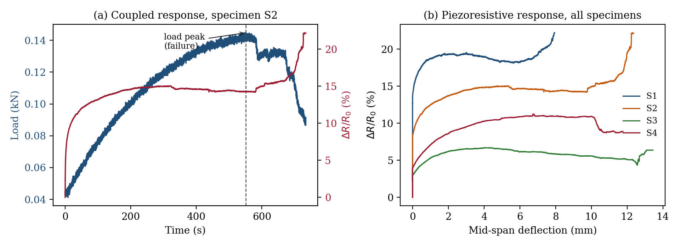
Sensing mechanism
The glass fibres do not conduct; the carbon nanotubes (CNTs) form a conducting network in the matrix.Strain widens nanometre tunnelling gaps and micro-cracks sever paths, so resistance rises.The rise is exponentially sensitive, so even tiny early damage can show up.The signal therefore reports on the matrix, exactly where damage starts.
3

Slide 4
Objective
Predict, from the resistance signal alone, how close a bar is to breaking, and raise an early-warning alarm, on bars the model has never seen.
Forecast
Warn
Generalise
Estimate remaining deflection to failure
Trigger a calibrated alarm before failure
to a new, unseen bar
4

Slide 5
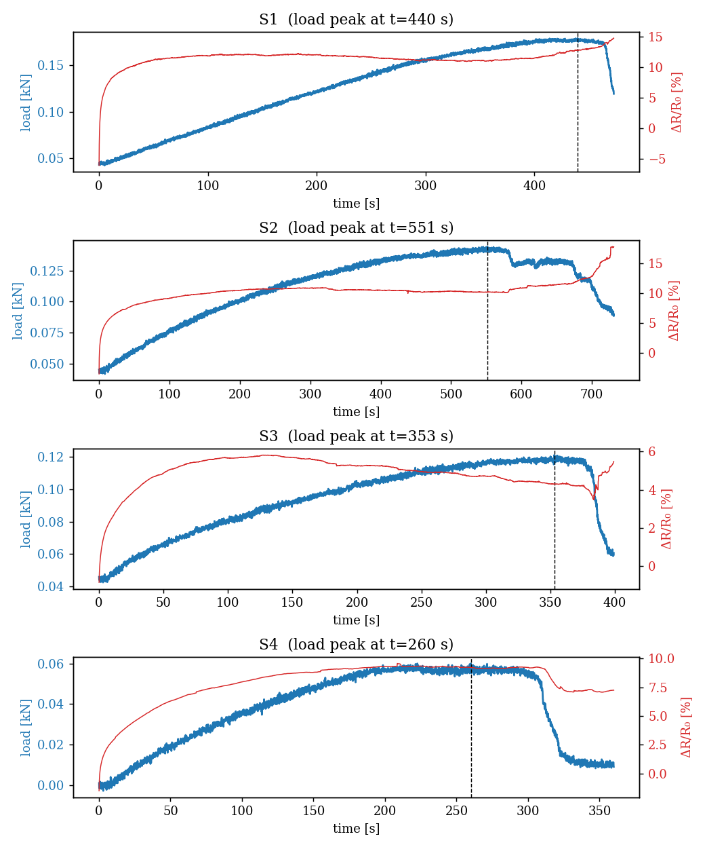
Experimental setup and data
Four nominally identical bars (S1 to S4) bent to failure in three-point bending.A universal testing machine recorded load and deflection; a Keithley source-meter recorded resistance.Both sampled at about 12 Hz and aligned on a common time base.Resistance is used as the fractional change ΔR/R₀.
Bar | R₀ (MΩ) | Peak load (kN) | D_peak (mm) | Rate (mm/s)
S1 | 52.4 | 0.180 | 7.36 | 0.017
S2 | 61.8 | 0.144 | 9.26 | 0.017
S3 | 11.1 | 0.121 | 11.55 | 0.033
S4 | 6.8 | 0.060 | 8.44 | 0.033
5

Slide 6
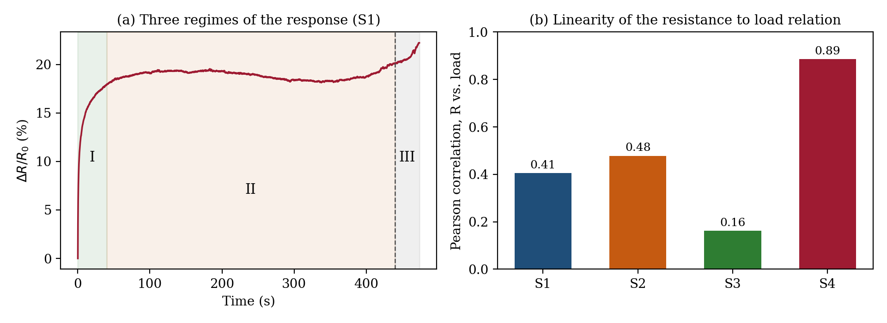
Resistance response: three regimes
I Steep early rise: most of the change in the first 10 to 20 percent of the test.II Saturation: a plateau through the middle while load keeps climbing.III Features near failure: clear steps and jumps around the load peak.Resistance-to-load correlation varies 0.16 to 0.89 between bars: no fixed mapping holds.
6

Slide 7
Challenges and mitigations
Only four bars, so models overfit
→
Leave-one-bar-out testing, simple models first, and heavy data augmentation
Loading rate and baseline resistance differ between bars
→
Used a rate-invariant target (deflection to failure) and worked in ΔR/R₀
Prediction intervals were over-confident (90% band covered only 61%)
→
Applied a conformal correction to restore valid coverage
7

Slide 8
Methodology
1. Signal
→
2. Features
→
3. Model
→
4. Alarm
ΔR/R₀ on a 12 Hz grid
14 causal features (past only)
trained on 3 bars, tested on the 4th
bound on the remaining deflection
Deflection to failure (the target): how much further the bar can bend before it breaks; it does not depend on the loading speed, so it is comparable across bars. Leave-one-specimen-out (the test): train on three bars, test on the fourth the model has never seen, then rotate. This is the honest measure of accuracy on a new bar.
8

Slide 9
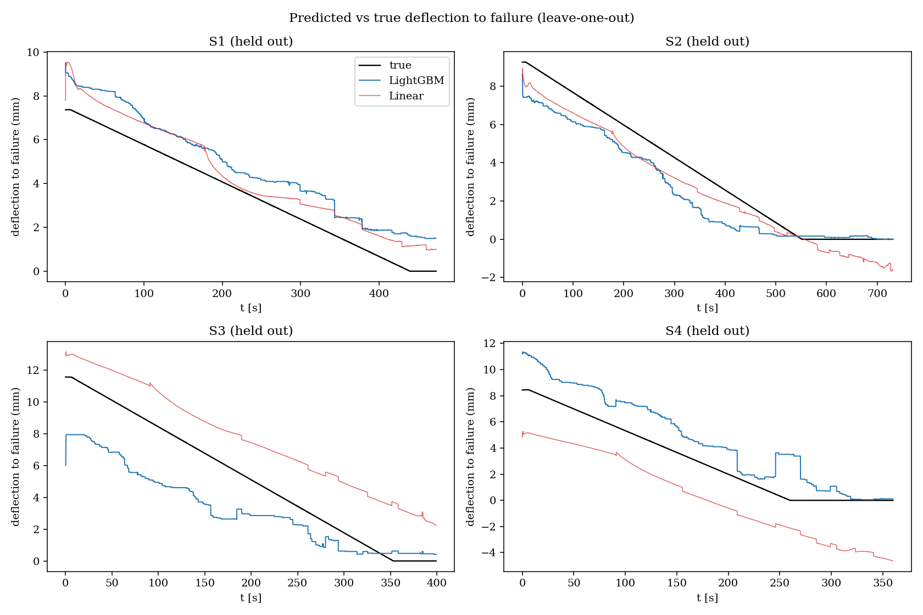
Results: classical baselines
Gradient-boosted trees (LightGBM) with a linear-regression floor.Tuned and tested entirely under leave-one-specimen-out.Predictions track the falling line to failure on every held-out bar.
1.51 mm
mean deflection-to-failure error (LightGBM)
9

Slide 10
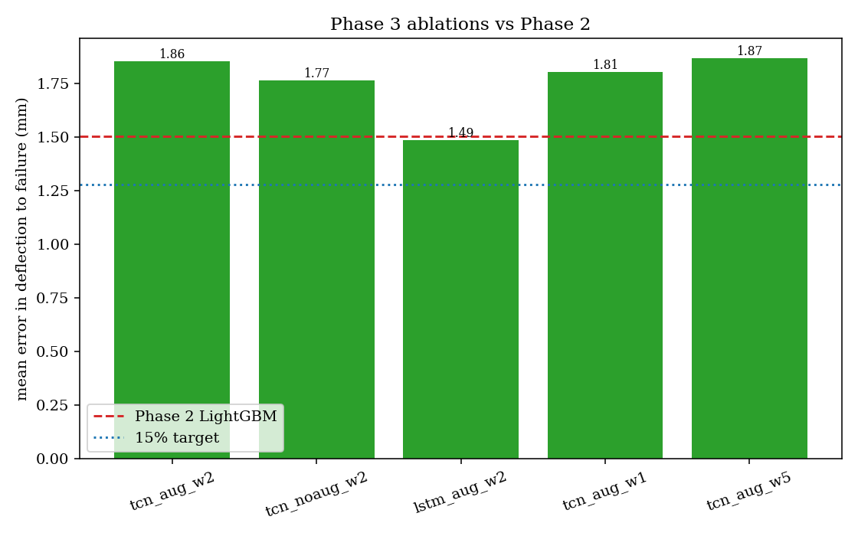
Results: sequence models
Small TCN and LSTM networks with five physics-aware augmentations.Best sequence model: LSTM at 1.49 mm, essentially level with the baseline.No model reached the 15 percent improvement target.With four bars, gradient-boosted trees remain competitive, as expected.
10

Slide 11
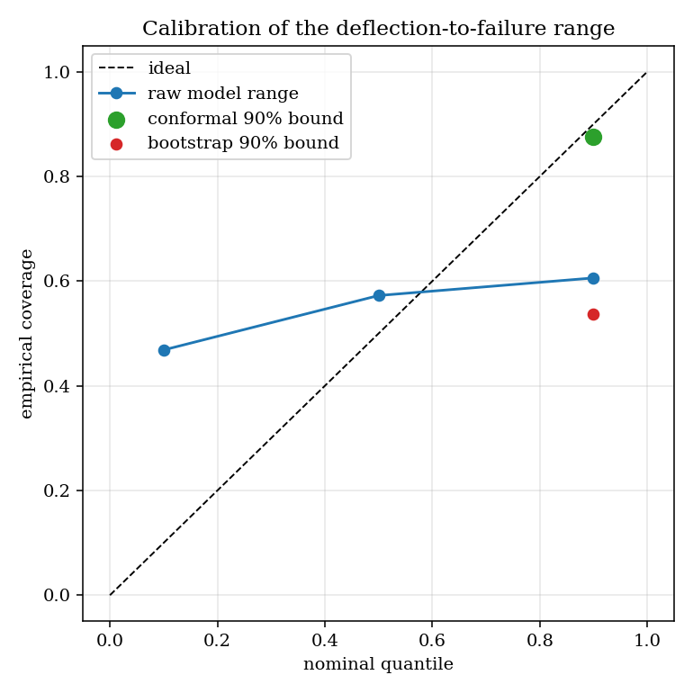
Results: uncertainty calibration
The model predicts a range (10th to 90th percentile), not a single number.Within one bar the deflection to failure is almost fixed, so the raw range came out too narrow and over-confident.A conformal correction widens the bound until its stated 90% coverage actually holds.
0.61 → 0.88
coverage of the 90% bound, before and after calibration
11

Slide 12
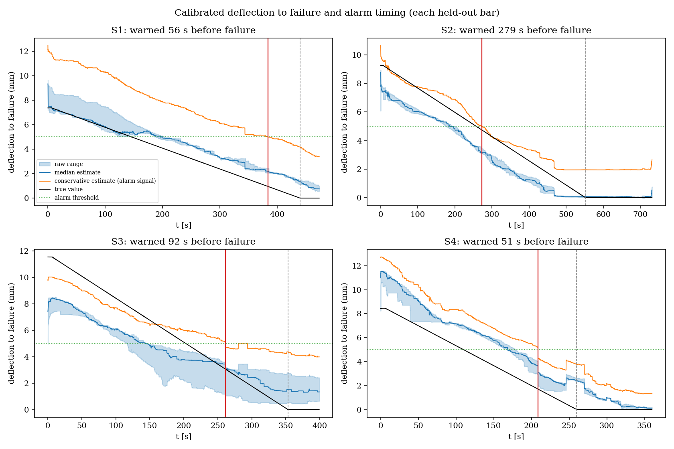
Results: early-warning alarm
On every held-out bar, the alarm fires before failure, with no false alarms.
1.00
1.00
74 s
precision
recall
median warning
Operating point: raise the alarm when the conservative deflection-to-failure bound stays below 5 mm for 3 samples in a row.

Slide 13
Deployment and validation
Predicting on a new bar, in real time
Live signal:
resistance + deflection
→
Causal features
(past only)
→
Trained model
→
Deflection to failure,
then warning in seconds
It uses only the past, so it can run while the bar is still being loaded.
Checking the accuracy
Load a new bar to failure: its load peak fixes the true remaining deflection at every instant.Compare the prediction against that truth, giving the average error in mm, exactly as measured on the four bars.Each additional bar is one more independent test; today's honest estimate is the leave-one-out error of about 1.5 mm.
Run it on a new bar: make predict UTM=newbar.xls SM=newbar.csv
13

Slide 14
Limitations
Only four bars, so every reported number has a wide confidence band.Two loading rates and an eightfold baseline-resistance spread remain real confounds.A two-wire measurement includes contact resistance.One material and one geometry: the results do not yet generalise further.
14

Slide 15
Conclusions and future work
A model that reads the resistance signal predicts the deflection to failure of an unseen bar to about 1.5 mm.A conformally-calibrated alarm warns before failure on every held-out bar, about 74 seconds ahead, with no false alarms.Sequence models did not beat the simpler trees, an honest reflection of having only four bars.
Next step. Test more bars, ideally with a four-wire measurement, to tighten every estimate and give the sequence models a fair chance.
15

Slide 16
Thank you
Questions and discussion
Priyanshu Kumar | AE22B048 | Department of Aerospace Engineering, IIT Madras
Code and report: github.com/PriyanshuKumar9798/self-sensing-gfrp-cnt

