Slide 1
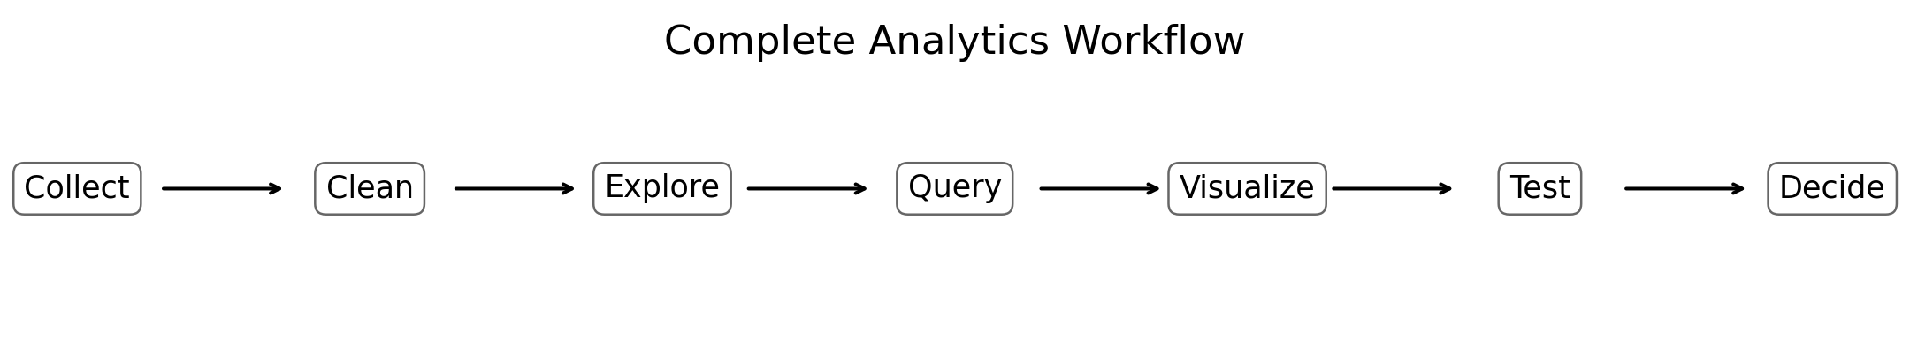
Growfinix Data Analytics Internship
Final Submission Package
Project Development • Learning Progress • Final Presentation • Additional Work • Blog
Priyanshu Raj
Data Analytics / Data Science Track
01

Slide 2
Internship Objective
Growfinix Data Analytics Internship
Turn raw data into cleaned, analysed and decision-ready outputs.
Build practical analytics projects with Python, SQL and visualization tools.
Document the full learning journey and progress clearly.
Create a final presentation that explains implementation and results.
Add extra technical work to strengthen the portfolio.
Publish a blog explaining the end-to-end analytics lifecycle.
Portal Structure Followed
Task 1: Project
Task 2: Progress
Task 3: Presentation
Task 4: Additional Work
Task 5: Blog
02

Slide 3
Technology Stack
Growfinix Data Analytics Internship
Tools used across the internship projects.
Data Analysis
Python, Pandas
Visualization
Matplotlib, Seaborn, Plotly
Dashboard
Streamlit
Extraction
Requests, BeautifulSoup
Database
SQL, SQLite
Statistics
SciPy, Statsmodels
03

Slide 4
Complete Analytics Workflow
Growfinix Data Analytics Internship
The portfolio connects five skills into one practical process.
Data is collected from CSV files, HTML listings and SQL databases.
Raw records are cleaned, validated and transformed before analysis.
Visualizations and dashboards convert analysis into business communication.
Statistical tests protect decisions from false conclusions.
04

Slide 5
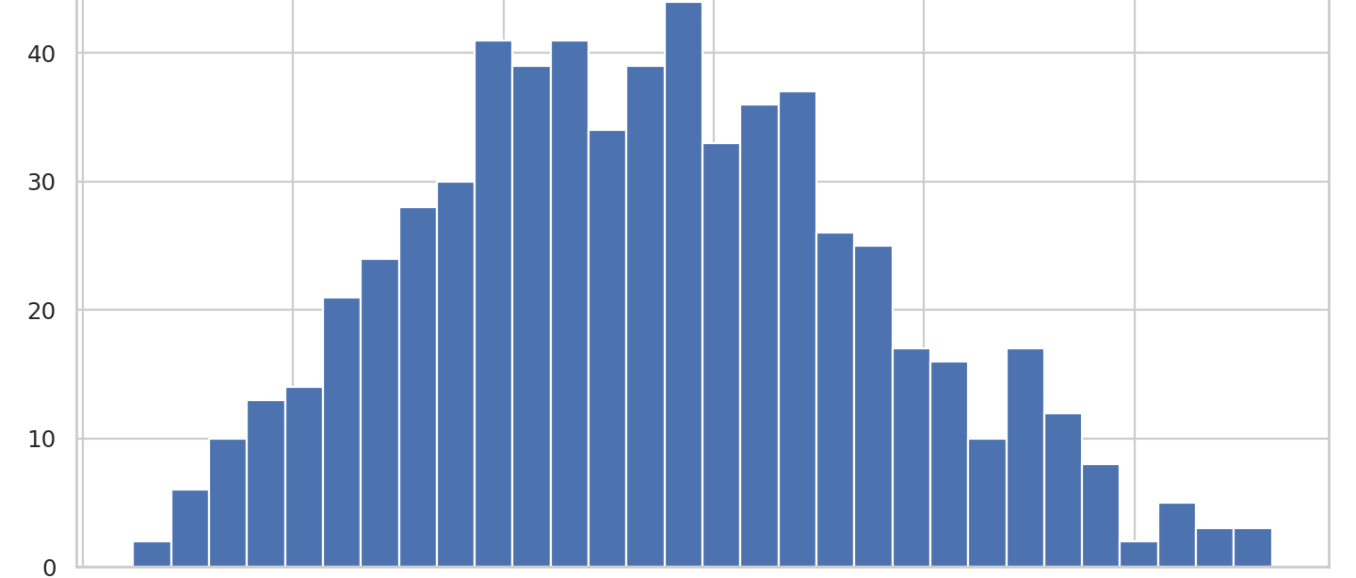
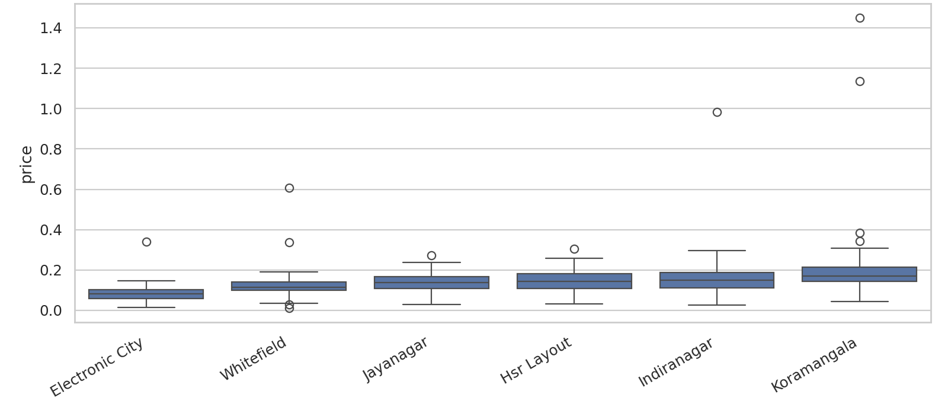
Project 1: Real Estate EDA
Growfinix Data Analytics Internship
Cleaning messy property data and finding pricing patterns.
Handled missing values, duplicate rows and inconsistent records.
Used IQR logic to flag outliers.
Created price per square foot for better comparison.
Analysed price distribution by neighbourhood and property size.
05

Slide 6
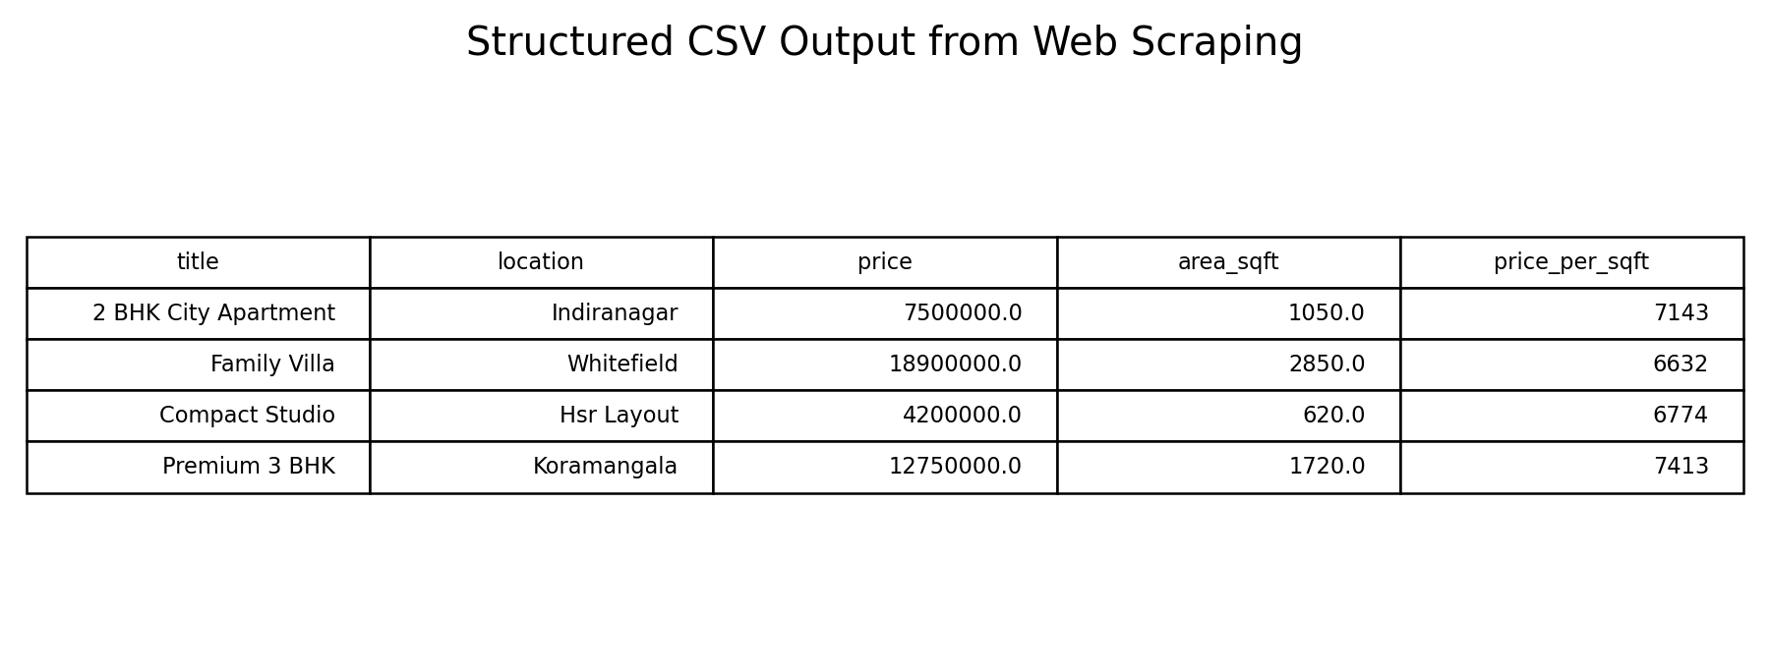
Project 2: Automated Data Extraction
Growfinix Data Analytics Internship
Converting listing HTML into a structured CSV dataset.
Used BeautifulSoup selectors to parse property title, location, price and size.
Converted unstructured listing text into clean Pandas columns.
Exported structured CSV output for downstream analytics.
Kept scraping logic conservative and did not bypass site restrictions.
06

Slide 7
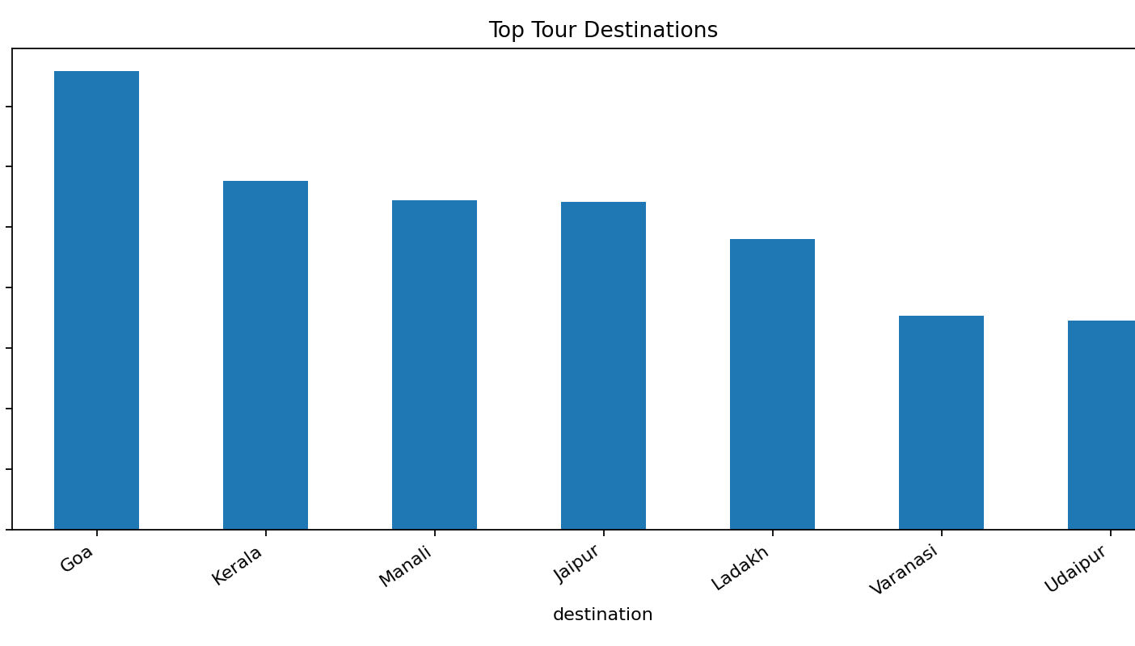
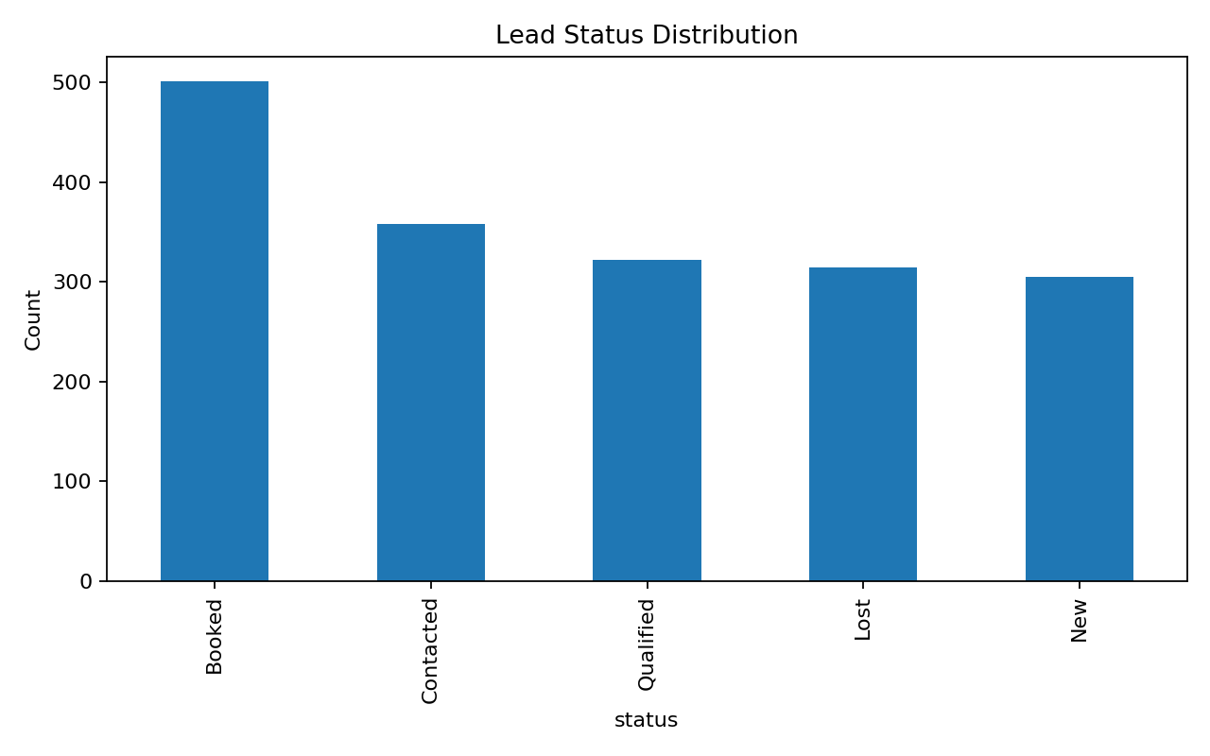
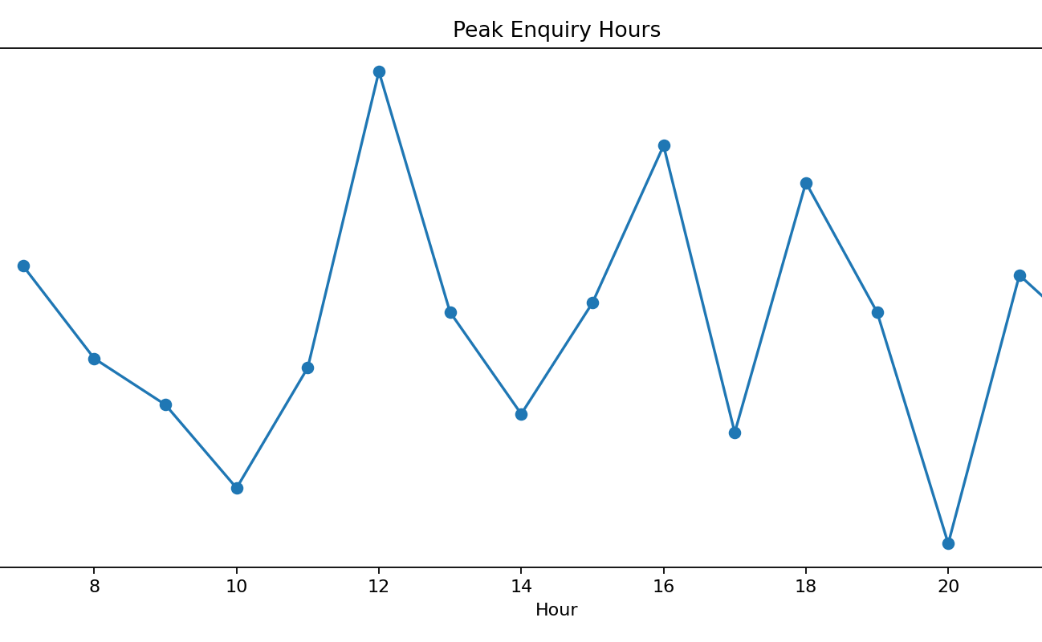
Project 3: Tour Enquiry Dashboard
Growfinix Data Analytics Internship
Interactive business dashboard for enquiry and booking analysis.
Dashboard KPIs: enquiries, bookings, conversion rate and median budget.
Interactive filters help analyse destinations, sources and lead statuses.
Business use: plan sales capacity around peak enquiry hours.
07

Slide 8
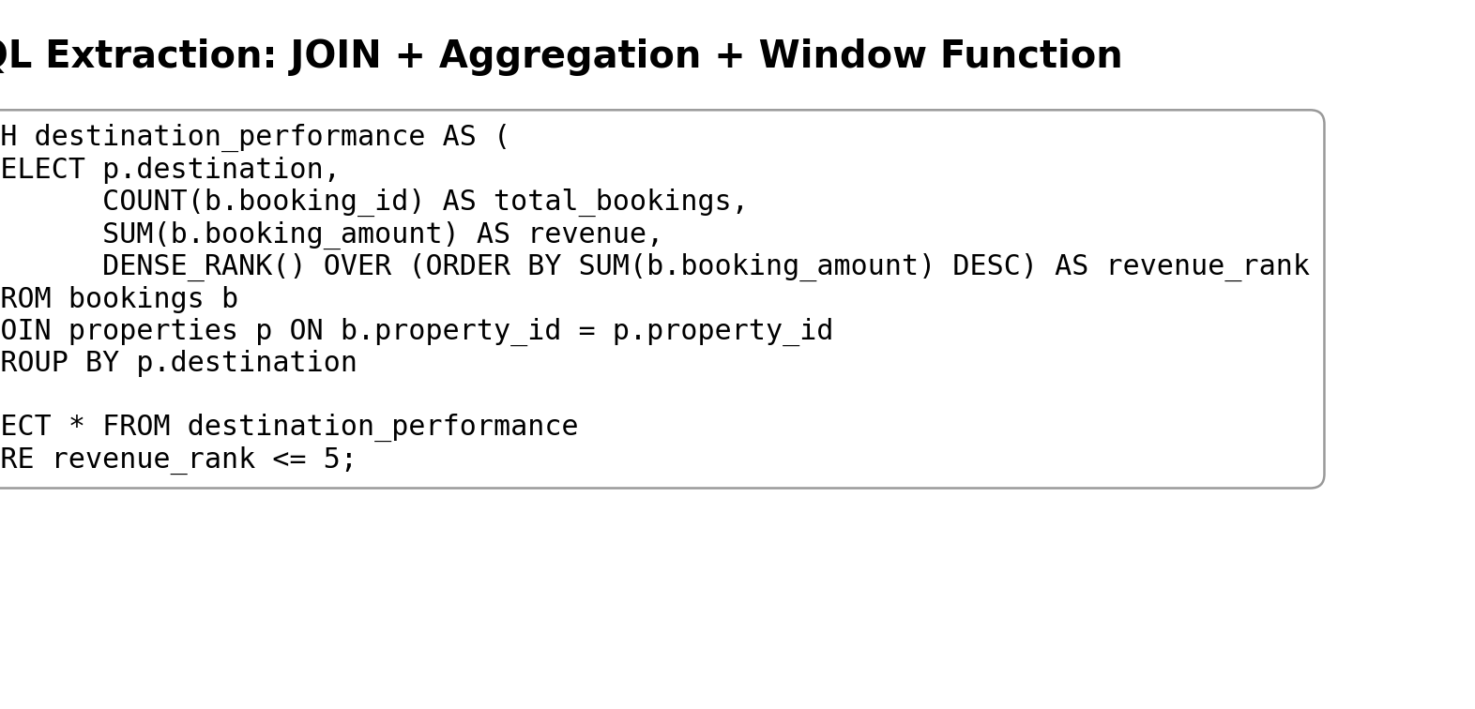
Project 4: SQL Database Integration
Growfinix Data Analytics Internship
Extracting analytical datasets from a relational database.
Used JOINs to connect users, properties and bookings.
Applied GROUP BY, HAVING, CTEs and window functions.
Loaded SQL outputs directly into Pandas DataFrames.
Generated booking and destination-performance datasets.
08

Slide 9
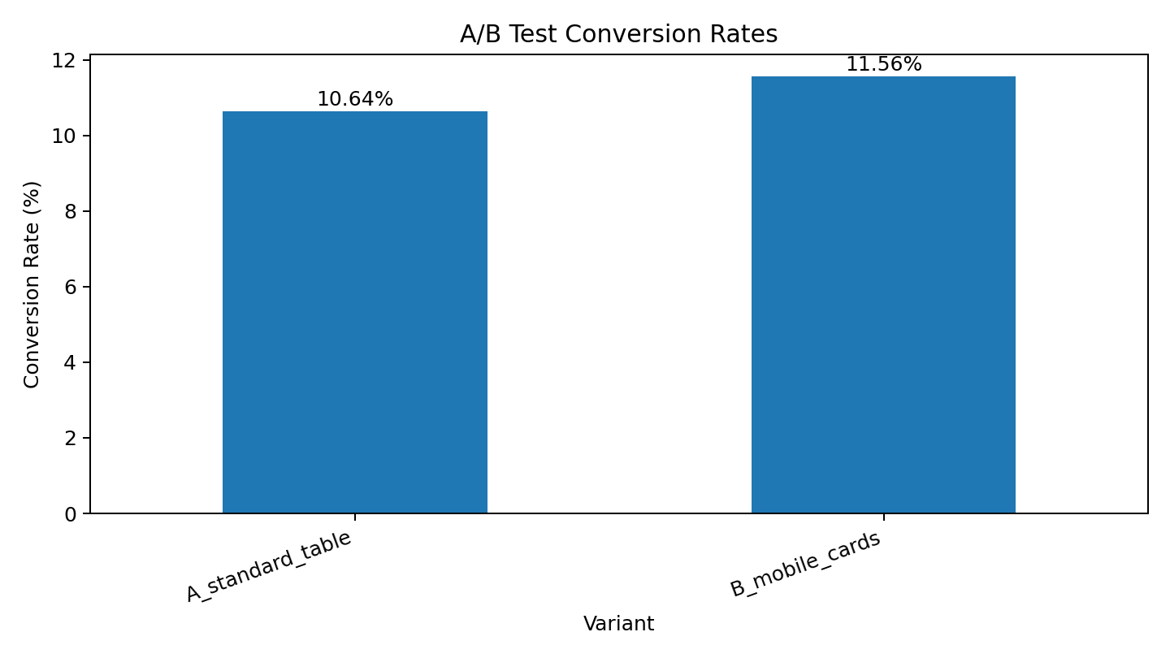
Project 5: A/B Testing Analysis
Growfinix Data Analytics Internship
Using statistics to avoid unreliable business decisions.
Compared standard table layout against mobile-responsive card layout.
Calculated conversion rates, lift, p-value and confidence interval.
Result: Variant B was numerically higher, but not statistically significant at alpha = 0.05.
Decision: do not ship only because one percentage looks higher.
09

Slide 10
Challenges and Solutions
Growfinix Data Analytics Internship
Important implementation problems solved during the internship.
Messy data
Used Pandas checks for nulls, duplicates, invalid types and outliers.
Unstructured web data
Parsed HTML with selectors and cleaned extracted fields before export.
Dashboard usability
Built filters, KPIs and business-focused charts rather than static plots.
Multi-table data
Used SQL joins, CTEs and Pandas integration.
Experiment decisions
Used statistical significance instead of simple percentage comparison.
10

Slide 11
Key Learning Outcomes
Growfinix Data Analytics Internship
What the internship portfolio demonstrates.
Practical understanding of the full data analytics lifecycle.
Ability to clean, transform and analyse imperfect datasets.
Ability to build interactive dashboards for business users.
Ability to use SQL and Python together for analytics workflows.
Ability to interpret statistical results before recommending decisions.
Final Portfolio Proof
Code
Datasets
Outputs
Screenshots
Documentation
Presentation
Blog
11

Slide 12
Final Submission Map
Growfinix Data Analytics Internship
How the repository maps to the Growfinix portal.
Task 1
Project Development & Documentation
Tour Enquiry Dashboard
Task 2
Learning Documentation & Progress Tracking
Weekly progress + skills docs
Task 3
Final Presentation & Summary
PPTX/PDF + summary
Task 4
Additional Project Work
EDA + SQL projects
Task 5
Research Paper or Blog
Analytics journey blog
Repository name suggestion: Growfinix-Data-Analytics-Internship
12

