Slide 1
Front End Engineering-I Project
Team Details:
Priyanshu Bindal 2210990686
Priyanshu Gupta 2210990687
Priyanshu Saini 2210990688
Punal 2210990690
Faculty Coordinator: Dr. Mandeep Kaur
:
Chitkara University Institute of Engineering and Technology,
Chitkara University, Punjab

Slide 2
Table of Contents
Introduction
Problem Statement
Technical Details
Key Features
Project Highlights
Bonus Feature(optional)
Conclusion

Slide 3
Introduction
PROJECT NAME : EXIT THE PLUGIN
Team Members:
Priyanshu Bindal
Priyanshu Gupta
Priyanshu Saini
Punal
This JavaScript-based project uses JavaScript as a an advertising tool that uses HTML and CSS to showcase their ads and reach to a greater public while surfing the internet.

Slide 4
Problem Statement
Exit Popup enables you to display a jQuery modal window, which can include text, images, videos, forms, maps and so on, before a visitor leaves your website.
Exit Popup intelligently detects mouse behaviors and then pops up a modal window when your visitors are about to close the current web page, helping you increase your landing page conversion rates, newsletter subscribers, and so on.
From experience, you can expect a 7% to 12% conversion rate increase – depending on your audience, traffic quality, and offer.

Slide 5
Technical Details
1.Front-end development: The user interface (UI) of pop up window and the base window will be evolved the usage of HTML, CSS, and JavaScript. The UI must be responsive and intuitive to apply, and must permit the person to pick, enter or go out the present window.
2 .Tools: The app should provide quite a number organized notes with customizable labels. Set time and vicinity-primarily based reminders. Loose and properly-included with the Google tech atmosphere.

Slide 6
Key Features
There are several key features that are essential to consider while creating the pop up ads :-
Display almost anything you could display on a normal web page using HTML
Word Press short code can be used in popup content + WPML compatibility
Control the Height and Width of your Popup window
Control how often your visitors see the popup
Overall, these key features will help you create a robust and user-friendly pop ups that will provide a great experience to your users and
reach to a greater audience or to provide them with some information .

Slide 7
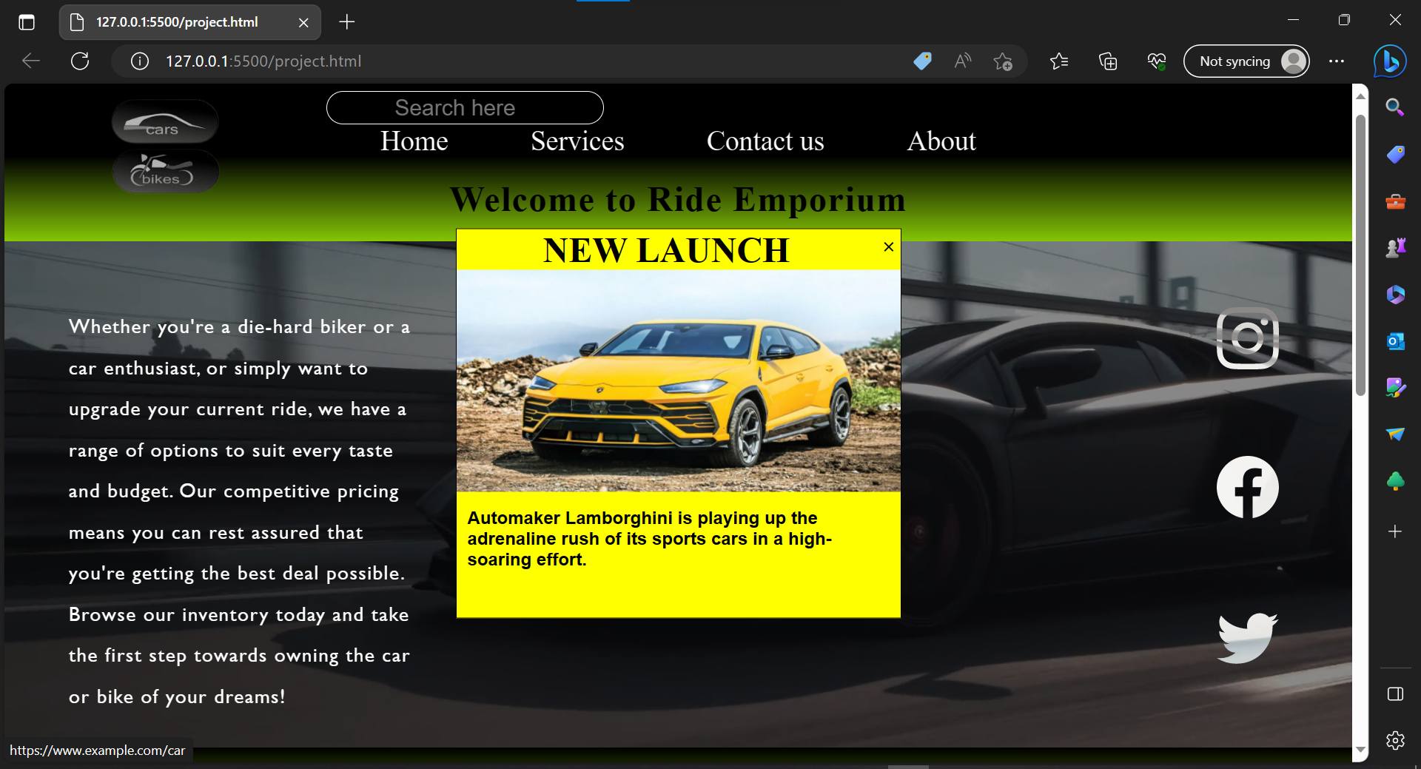
Project Highlights
Base Window
Pop up
Window

Slide 8
Conclusion
The key points of the project for creating exit the plug-in :
“This JavaScript-primarily based challenge makes use of JavaScript as an advertising device that uses HTML and CSS to exhibit their commercials and reach to a more public at the same time as browsing the net.”
The pop ups have a simple and user-friendly interface that uses Bootstrap for styling.. It also has a button to exit the pop ups/ plugins.
2. It is responsive, fast and easy to use. It can handle different types of actions on the existing website.
During the project, the team learned the importance of planning and designing the app thoroughly before starting the development process. The team also gained knowledge of working with JavaScript, HTML, and CSS to create a drawing tool app. Overall, the team's takeaway from the experience was that creating a drawing tool app requires attention to detail, testing, and user feedback to make a successful and user-friendly application.

Slide 9
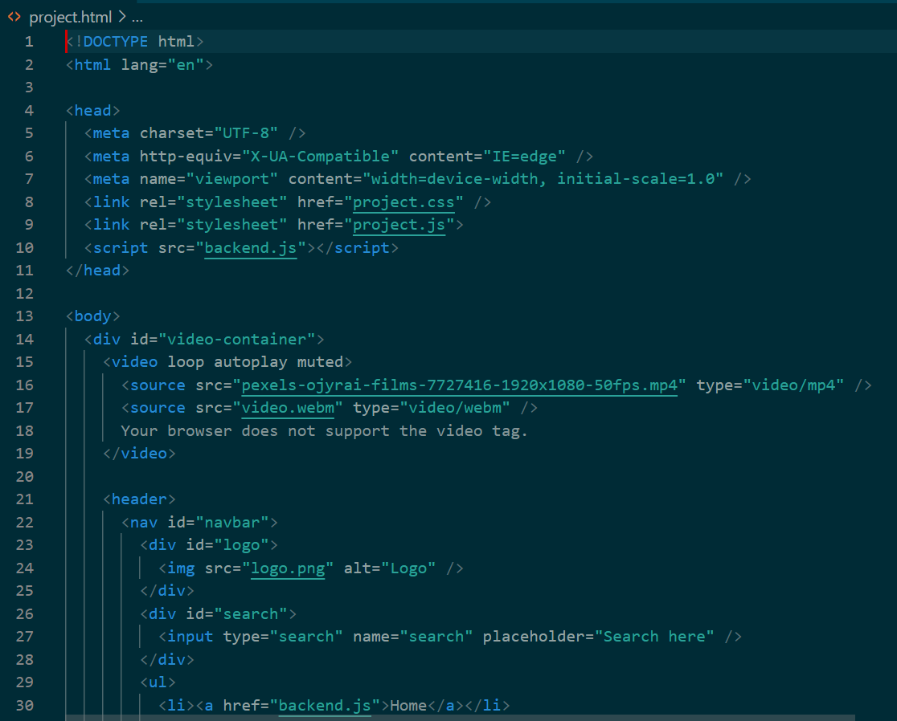
THE CODE

Slide 10
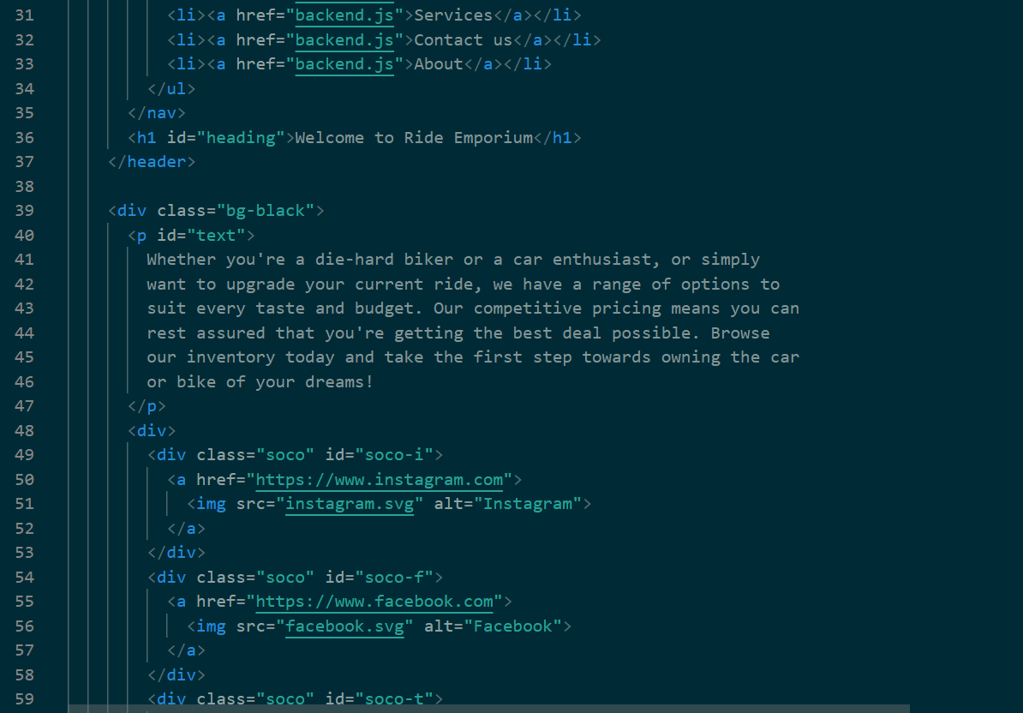
THE CODE

Slide 11
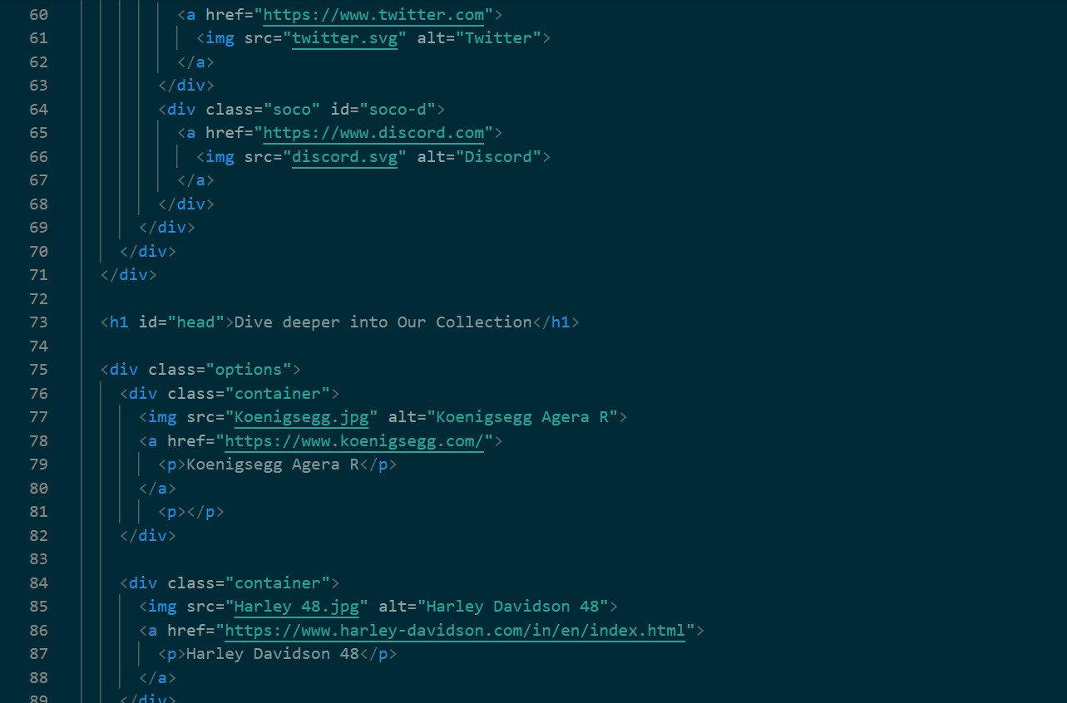
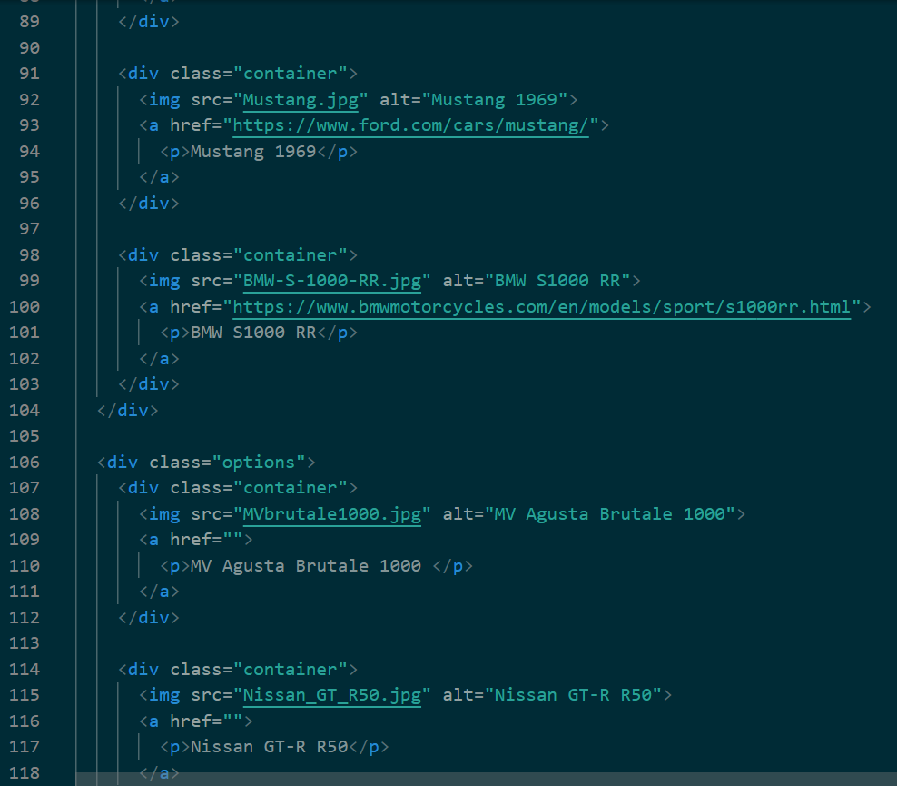
THE CODE

Slide 12
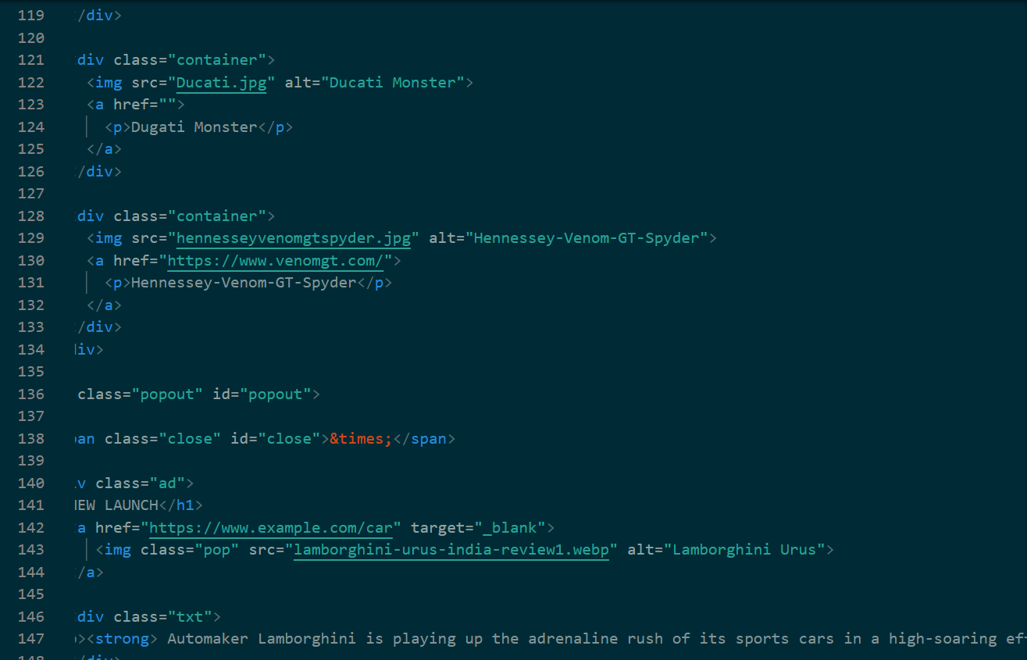
THE CODE

Slide 13


