Slide 1
Walmart SCT Hackathon Round 2
1810Code

Slide 2
Problem Statement
The core challenge was predicting the likelihood of hard disk drive (HDD) failure within a specific time frame. By addressing this, we can proactively maintain or replace at-risk HDDs, minimizing downtime and data loss. This predictive approach is invaluable for businesses that rely on data centers, cloud storage services, or any sector where data integrity and availability are critical

Slide 3
Data Processing
Attributes Used:
SMART (Self-Monitoring, Analysis, and Reporting Technology) attributes from HDDs, which are indicative of drive health and operational status.
Attributes Understanding:
We focused on attributes with direct implications on HDD reliability, avoiding columns with all-null values or irrelevant information to the failure prediction.

Slide 4
Data Processing
Data Challenges:
- Cleaning involved removing all-null columns and rows with insufficient data.
- Pre-Processing entailed selecting HDDs that have failed and calculating their Remaining Useful Life (RUL).
- Handling Imbalanced Data: We faced an imbalance with a smaller proportion of failed drives, which is typical in failure prediction problems.

Slide 5
Data Processing
Data Challenges:
- Cleaning involved removing all-null columns and rows with insufficient data.
- Pre-Processing entailed selecting HDDs that have failed and calculating their Remaining Useful Life (RUL).
- Handling Imbalanced Data: We faced an imbalance with a smaller proportion of failed drives, which is typical in failure prediction problems.

Slide 6
Data Processing
Data Insights:
Analyzing SMART attributes revealed certain indicators that are more predictive of failure, such as re-allocated sectors and read error rates.
Train Validation Test Splits:
- The dataset was split into 80% training and 20% test sets to validate the performance of the predictive models.

Slide 7
Feature Engineering
In addition to the SMART attributes, we developed additional features to enhance the model's predictive accuracy:
Remaining Useful Life (RUL): A calculated feature representing the number of days until the HDD is expected to fail, which provides a time-sensitive target for our predictions.
Binary Failure Indicator: We created a binary label indicating whether an HDD is expected to fail within a 15-day prediction window. This transforms the problem into a binary classification task, simplifying the model's output for practical use

Slide 8
Model Building
Model Selection: Random Forest and Gradient Boosting classifiers.
Rationale: These models handle the nonlinear relationships and are robust to unbalanced datasets typical in failure prediction.
Explored Alternatives: Considered SVM and logistic regression but rejected due to poor performance with imbalanced datasets.

Slide 9
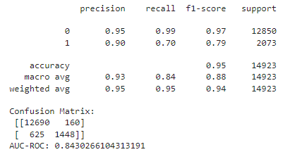
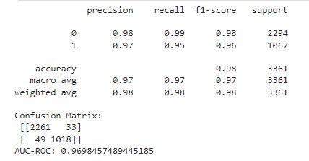
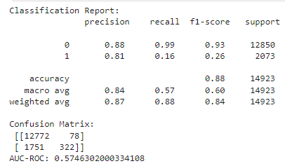
Model Building
Accuracy Definition: The ability of the model to correctly predict imminent hard drive failures.
Forecast Window: 15 days before failure.
Metrics:
Random Forest (2013 Data) AUC-ROC: 0.84
Random Forest (2017 Data) AUC-ROC: 0.97
Gradient Boosting (2013 Data) AUC-ROC: 0.57
Random forest (2013 Data)
Random forest (2017 Data)
Gradient Boosting(2013 Data)

Slide 10
Model Evaluation
Random Forest Evaluation (2017 Data)
Accuracy Metrics:
Precision: Very high precision for both classes (0.98 for negative, 0.97 for positive).
Recall: Excellent recall for both classes (0.99 for negative, 0.95 for positive).
F1-Score: High F1-score for both classes, indicating balanced precision and recall (0.98 for negative, 0.96 for positive).
Confusion Matrix Analysis:
True Negatives (TN): 2261; almost perfect at predicting non-failure cases.
False Positives (FP): 33; a minimal number of incorrect failure predictions.
True Positives (TP): 49; highly effective at identifying failures.
False Negatives (FN): 18; very few missed failure detections.
AUC-ROC: 0.969, showing an exceptional model performance with a great ability to differentiate between the classes.

Slide 11
Model Evaluation
Random Forest Evaluation (2013 Data)
Accuracy Metrics:
Precision: Very high precision for both classes (0.95 for negative, 0.90 for positive).
Recall: Excellent recall for the negative class and good for the positive class (0.99 for negative, 0.70 for positive).
F1-Score: High F1-score for the negative class and a good score for the positive class, indicating balanced precision and recall (0.97 for negative, 0.79 for positive).
Confusion Matrix Analysis:
True Negatives (TN): 12690; the model is exceptional at predicting non-failure cases.
False Positives (FP): 160; a small number of non-failure cases incorrectly predicted as failures.
True Positives (TP): 1448; effective at identifying failures.
False Negatives (FN): 625; a larger number of failures were not detected.
AUC-ROC: 0.843, showing a very good model performance with a strong ability to differentiate between the classes.

Slide 12
Model Evaluation
Gradient Boosting Evaluation (2013 Data)
Accuracy Metrics:
Precision: High precision for both classes (0.88 for negative, 0.81 for positive).
Recall: Excellent recall for the negative class but very low for the positive class (0.99 for negative, 0.16 for positive).
F1-Score: Good F1-score for the negative class and low for the positive class, suggesting an imbalance (0.93 for negative, 0.26 for positive).
Confusion Matrix Analysis:
True Negatives (TN): 12772; the model is extremely accurate at predicting non-failure cases.
False Positives (FP): 78; a small number of false alarms in failure predictions.
True Positives (TP): 322; limited success at identifying failures.
False Negatives (FN): 1751; a significant number of failures went undetected.
AUC-ROC: 0.5746, indicating moderate performance with limited ability to differentiate between the classes.

Slide 13
Conclusion
Opportunities for Improvement:
Advanced resampling methods and anomaly detection algorithms could be explored to further enhance the model's sensitivity to failure patterns.
Temporal features capturing trends over time, such as the rate of change in SMART attributes, could be developed to provide a more dynamic prediction model.
Unimplemented Ideas:
Due to time constraints, we did not deploy deep learning architectures, which could potentially uncover deeper insights from the complex relationships within the data.
Final Thoughts:
Our ensemble-based models have demonstrated a promising capability in predicting HDD failures. These insights pave the way for more reliable data storage solutions.

