Slide 1

NetSage AI: Intelligent Network Troubleshooting Assistant
Student: Priyanshu Yadav
Roll Number: 2410031648
Batch: 2024–2028
Internship: Cisco Virtual Internship Program
College: IILM University, Greater Noida
Faculty Mentor: Dr. Swati Vashisht

Slide 2
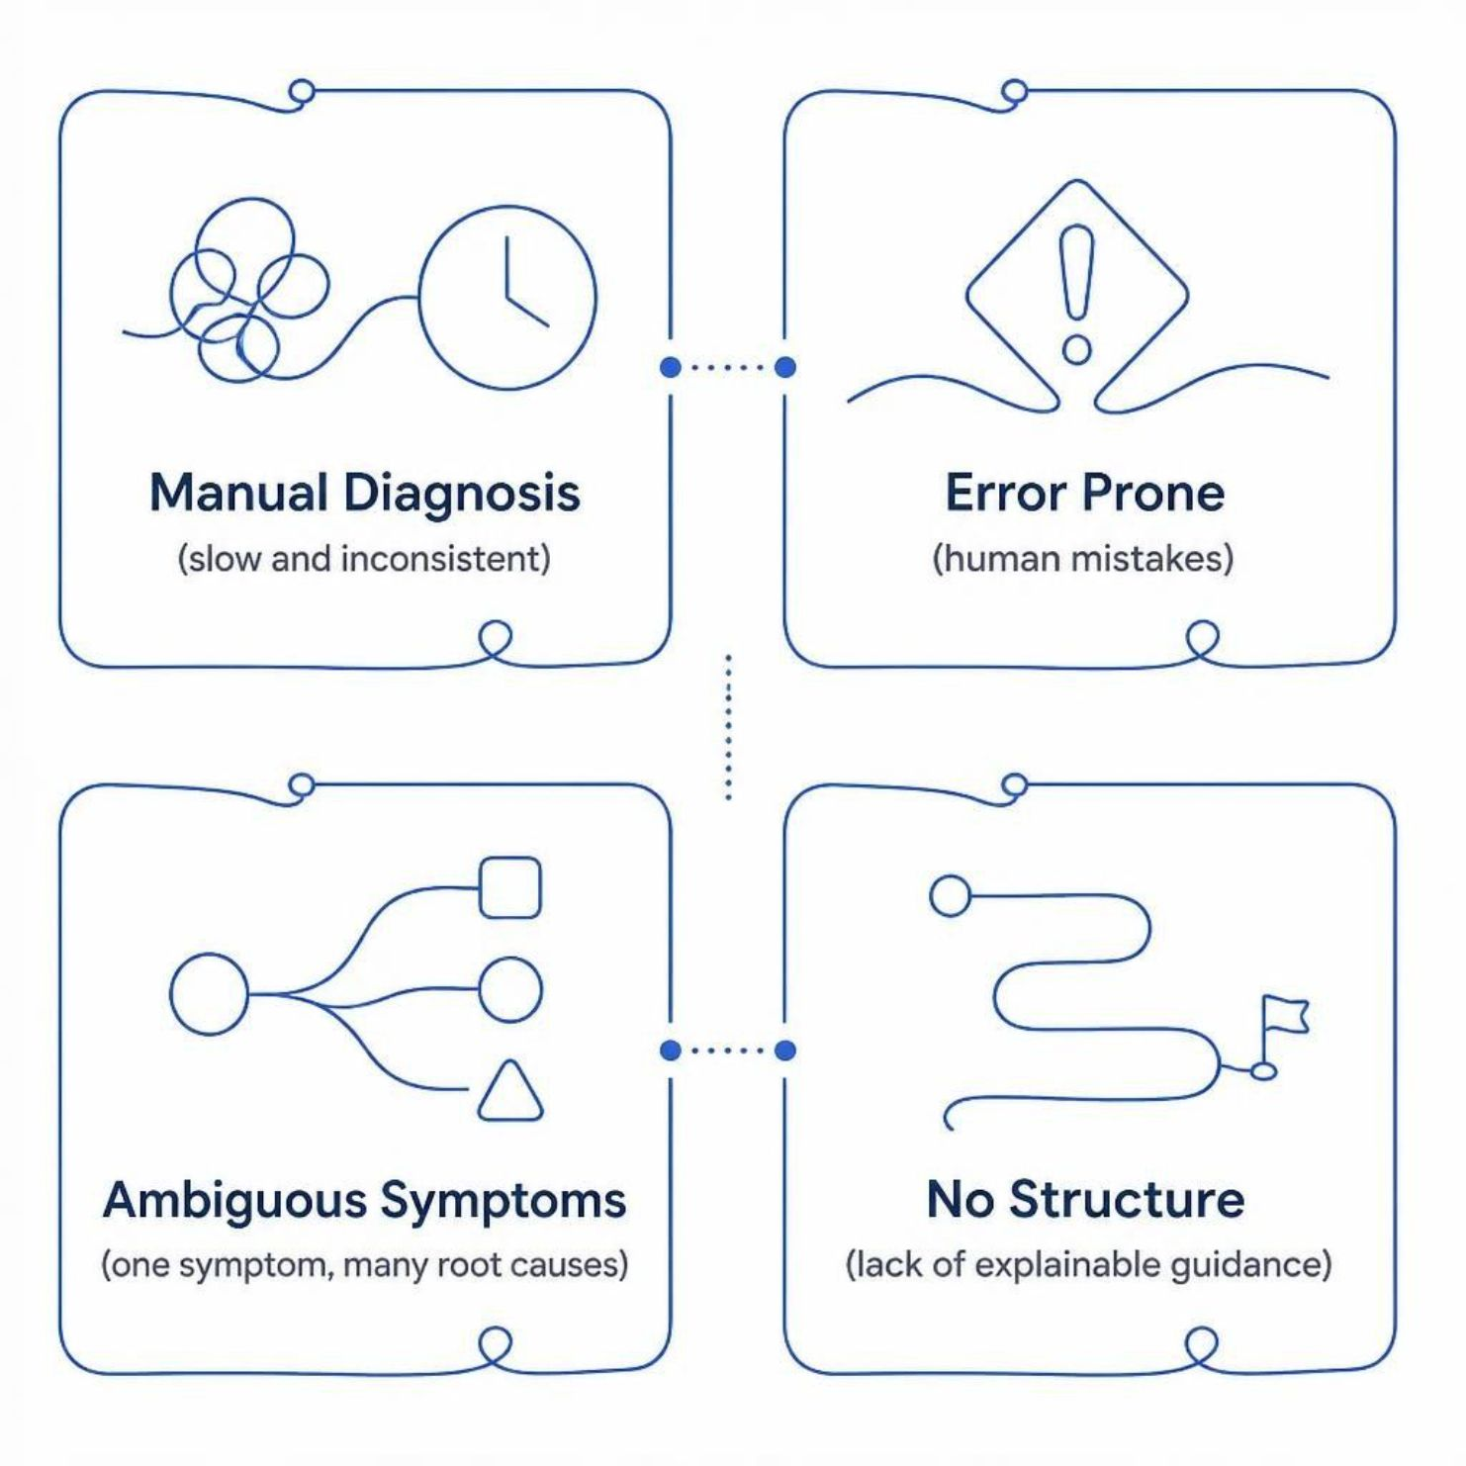
PROBLEM STATEMENT
Industry Problem Statement
Network faults require manual, time-consuming diagnosis — IP conflicts, VLAN errors, routing issues, DHCP, DNS, ACL, NAT, and wireless failures
Diagnosis is error-prone and inconsistent across engineers
Junior engineers struggle when the same symptom has multiple root causes
Urgent need for structured, explainable troubleshooting guidance

Slide 3

PROPOSED SOLUTION
NetSage AI
Web-Based Assistant
Hybrid Intelligence
Accessible troubleshooting platform built with Streamlit — no local installation required
Deterministic Python rules combined with AI-assisted diagnosis for accuracy and depth
Structured Fixes
Human in Control
Every case yields a structured diagnosis with specific, recommended remediation steps
No automatic configuration changes — human reviewer retains final authority

Slide 4
OBJECTIVES
Project Objectives
1
Build a 30+ case troubleshooting dataset
2
Detect common network configuration faults
3
Generate structured diagnosis and recommended fixes
4
Provide an interactive Streamlit dashboard
5
Keep human reviewer in control at every step

Slide 5
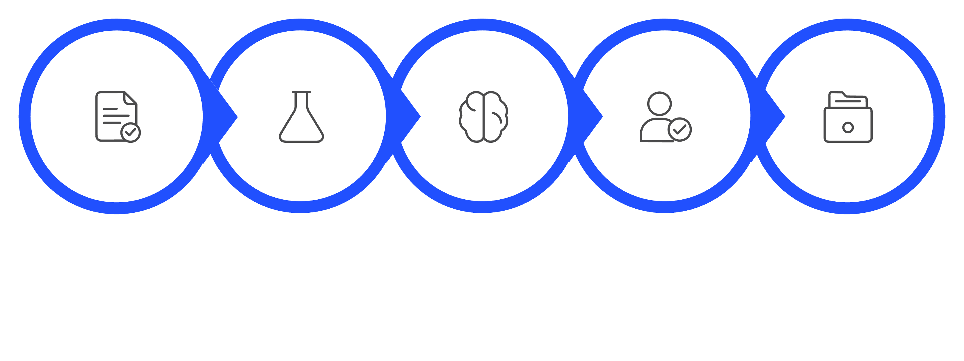

ARCHITECTURE
System Workflow
Case Input
Rule Checker
AI Diagnosis
Human Review
Diagnosis Log
The system does not automatically change any network configurations — human authority is preserved throughout.

Slide 6

CORE ENGINE
Deterministic Rule Checker
A Python-based rule engine scans device output and configuration data to flag known fault patterns — before AI is ever consulted.
IP & Subnet
Interface & VLAN
Duplicate IPs · Wrong subnet masks · Gateway mismatch
Interface down · Missing VLAN · Port misconfiguration
Rules are deterministic, transparent, and fully auditable.
Routing & Services
Missing routes · DHCP · DNS · ACL · NAT · Wireless failures

Slide 7
AI LAYER
AI Diagnosis and Responsible AI
Every AI Output Includes
Human Review Options
Probable root cause
Evidence cited from the case
Recommended fix
Confidence level
Verification steps
All recommendations are explainable, traceable, and subject to human final authority.
✓ Accept
✎ Edit
✗ Reject

Slide 8
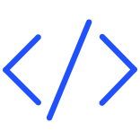



TECH STACK
Technologies Used
Core Stack
Data Storage
Python · Streamlit · Pandas
CSV and JSON for structured case and log storage
AI Engine
Testing & DevOps
OpenAI API for natural-language diagnosis generation
unittest · GitHub version control · Streamlit Community Cloud deployment

Slide 9
RESULTS
Results and Deployment
32
23
100%
Troubleshooting Cases
Automated Tests Passed
Human Review Logged
In the curated dataset
Full unittest coverage
All diagnoses tracked
Interactive dashboard with charts and case analytics
Live deployment on Streamlit Community Cloud
[Insert NetSage AI dashboard screenshot here]

Slide 10
CONCLUSION
Conclusion and Future Scope
What NetSage AI Delivers
Future Scope
Network troubleshooting that is more structured, explainable, and beginner-friendly — bridging the gap between junior engineers and complex fault diagnosis.
Persistent review database
Packet Tracer and real-lab integrations
AI-human agreement scoring
Additional network fault categories
Thank You
Priyanshu Yadav · IILM University · 2410031648

