Slide 1
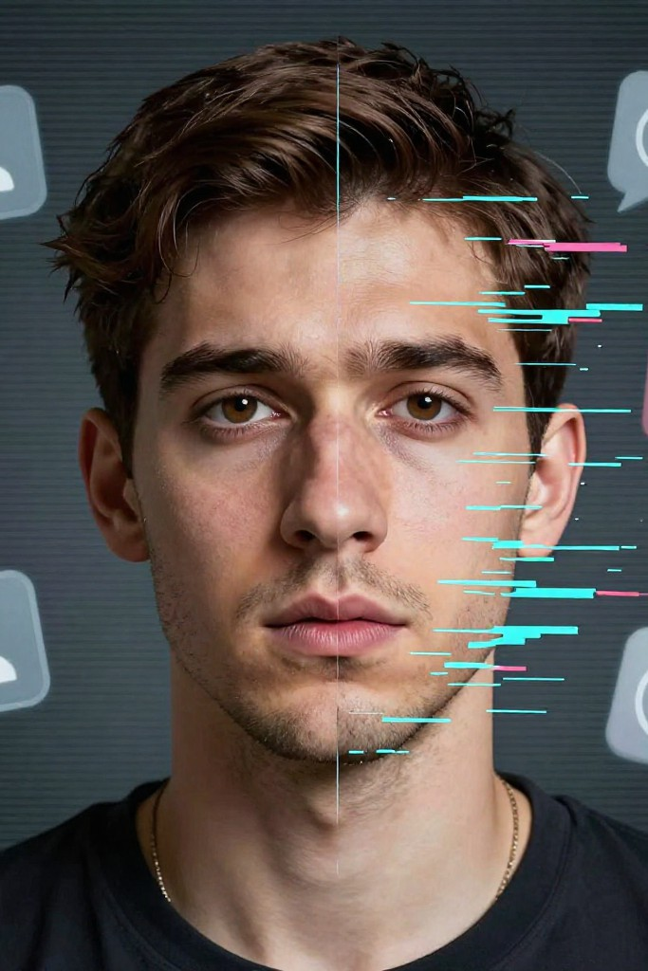
DeepFake Technology and the collapse of digital trust
Exploring the impact of AI-generated misinformation and strategies for a more secure digital future.

Slide 2
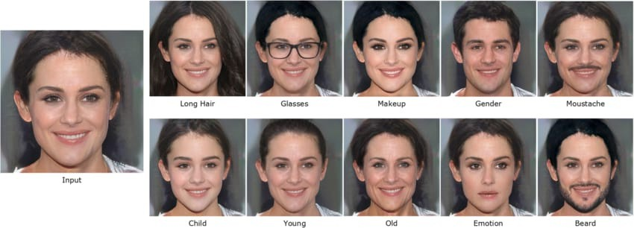
WHAT ARE DEEPFAKES?
The AI-Powered Illusion
Deepfakes are AI-generated images, videos, or audio created using deep learning models that can imitate real people with high realism.
They are mainly built using neural networks like GANs (Generative Adversarial Networks), where one model generates fake content and another tries to detect it.
As AI models improve, deepfakes are becoming more realistic and harder to identify with the human eye.
Why Deepfakes Are a Serious Problem
The biggest issue with deepfakes is that they break digital trust.
We can no longer fully trust what we see or hear online.
Fake videos can damage reputations, spread misinformation, and manipulate public opinion.
This creates confusion, fear, and loss of confidence in digital media.

Slide 3
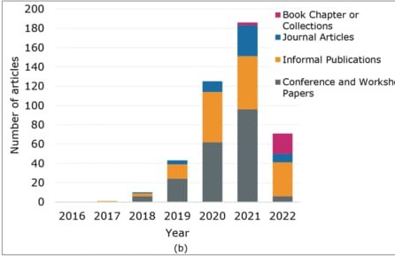
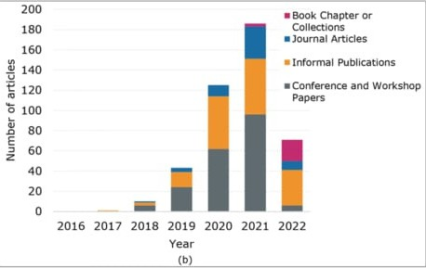
Why Deepfakes Threaten Our Digital World
Main Technical Problem
Deepfake generation models are improving faster than detection systems. Creating a deepfake today requires very little skill because open-source tools and pre-trained models are freely available.
However, detecting these deepfakes accurately in real-world conditions is still a major technical challenge.
What Research Shows
Recent research reports show that the number of deepfake videos online has
grown exponentially in the last few years.
Studies also show that many detection models fail when deepfakes are compressed, resized, or shared on social media platforms.
This proves that current systems are not robust enough for real-world use.
Basic Direction to Solve This
To address this problem, researchers are working on:
AI-based detection models trained on large and diverse datasets Media authentication techniques like digital watermarking Awareness and ethical use of AI technology
Solving this problem requires both technical solutions and responsible AI usage.

Slide 4
Research Background of Deepfakes
The Evolution: How it Started
Early Days (2014)
It started in research labs using a concept called
1
GANs (Generative Adversarial Networks). Back then, you needed a supercomputer and a PhD to make one.
The Explosion
Around 2017, the tech became "open source." This means anyone with a decent laptop could download a program and swap faces.
2
Today
We have moved from low-quality face-swapping to Real-Time deepfakes, where someone can change their face and voice instantly during a live video call.
3

Slide 5
2. Accuracy: Why they look so real now
3. The Challenge: Why detection is getting harder
It is a "cat and mouse" game between creators and detectors.
The reason we can’t tell the difference anymore is due to three main improvements:
Better Training: AI models used to "learn" from 100 photos; now they learn from thousands of high-definition video frames.
Focus on Small Details: Older deepfakes didn't blink or had weird shadows. Modern AI perfectly copies skin texture, reflections in the eyes, and how light hits the face.
Seamless Blending: The "seam" where the fake face meets the real head is now digitally smoothed out, making it look like one single skin surface.
Fixing Flaws: Every time a scientist finds a way to spot a deepfake (like "they don't blink"), the AI developers simply update the code to make them blink.
Social Media "Noise": When a video is uploaded to Instagram or WhatsApp, the quality is compressed. This "blurriness" actually hides the tiny digital errors that detection software looks for.
Speed of Creation: New versions of deepfake software are released every month, meaning detection tools are often outdated by the time they are finished.

Slide 6
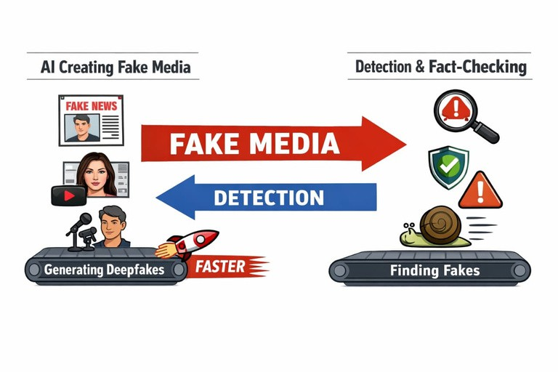
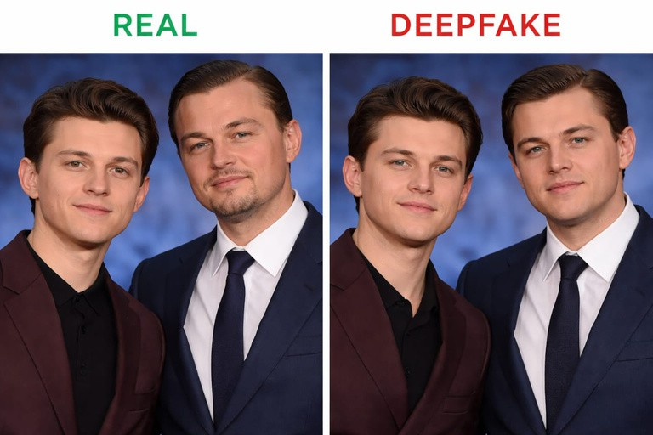
Deepfakes and Misuse of AI
Deepfakes are synthetic media created using artificial intelligence techniques such as deep learning to manipulate or generate realistic images, videos, or audio of people. While the technology has legitimate uses in entertainment, education, and accessibility, it is increasingly misused for harmful purposes. Common abuses include creating non-consensual explicit content, spreading political misinformation, committing fraud, and enabling identity theft. The growing accessibility of deepfake tools—through open-source software and pre-trained models—has lowered the technical barrier, allowing even non-experts to produce convincing fake content. This rapid proliferation raises serious ethical, social, and legal concerns, as deepfakes undermine trust in digital media, damage reputations, and outpace current detection methods and regulatory frameworks.
How Deepfakes Are Created
AI models like GANs (Generative Adversarial Networks) and Autoencoders are used to create deepfakes. The process begins with data collection of large sets of target images or videos. During model training, the generator creates synthetic content while the discriminator evaluates its authenticity, refining the results. In mapping and blending, facial expressions, movements, and textures are transferred and adjusted for realism. Advanced techniques can reproduce fine details like skin texture and eye reflections, making the synthetic media hard to distinguish from real footage. These methods can also be applied to voice cloning, full-body reenactments, and style transfers, demonstrating both the power and potential misuse of AI-generated content.

Slide 7
Threats to Society and Individuals
Accessibility of Deepfake Tools
The accessibility of deepfake tools has made creating realistic synthetic media easier than ever. Open-source software like DeepFaceLab and FaceSwap, along with browser-based apps, allow users to generate deepfakes with minimal technical knowledge. Pre-trained models further reduce the skills required, and research shows that even novices can produce convincing deepfakes quickly.
These low barriers to entry have led to rapid proliferation, increasing the potential for misuse and raising concerns about privacy, security, and misinformation.
Problem: Misuse of AI Models
The misuse of AI models, particularly for creating deepfakes, has led to serious ethical and legal concerns. Applications range from non-consensual explicit content to political misinformation and fraud or identity theft. These issues are compounded by challenges such as difficult attribution, slow legislation, and delays in detection, making it hard to hold perpetrators accountable or prevent harm.

Slide 8

Political & Democratic Problems Election Manipulation & Fake Speeches
1. Election Manipulation
Vote buying and bribery of voters
Misuse of government resources during campaigns Spread of misinformation to influence voter decisions Social media bots and targeted political ads Allegations of EVM tampering in some regions Impact on Democracy:
Reduces fairness and transparency Weakens public trust in elections Distorts the true will of the people
2. Fake Speeches & Political Misinformation
Deepfake videos of political leaders Edited or out-of-context speech clips False campaign promises
Viral fake news on WhatsApp & social media Consequences:
Misleads voters
Creates social and political division
Influences voting behavior emotionally rather than rationally

Slide 9
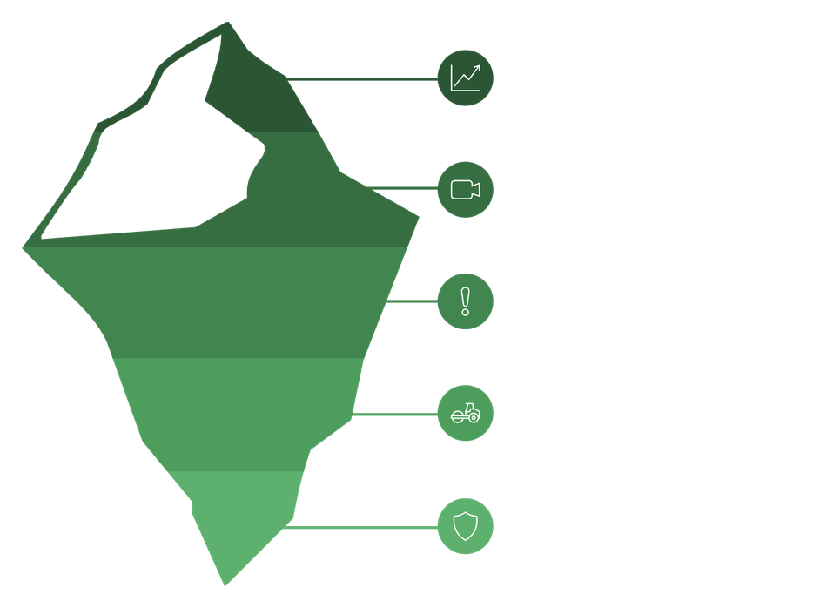
RESEARCH INSIGHTS
Digital Misinformation in Elections
During major elections globally, fake news spread widely through social media Targeted ads were used to influence specific voter groups
Deepfake technology created confusion among voters
Young voters were highly influenced by online political content Key Findings:
Emotional and sensational content spreads faster than factual information Low digital literacy increases belief in fake news
Research-Based Insights
Misinformation reduces voter confidence in democratic systems Algorithm-based platforms amplify extreme political content Strong fact-checking systems can reduce misinformation impact
Electoral reforms and media literacy programs strengthen democracy
Surface Trend
Visible Risk
Model Failures
Compression Vulnerability
System Fragility

Slide 10
Financial Fraud & Identity Theft
Cyber Crime Problems
Financial Fraud
Online banking fraud and phishing attacks Credit/debit card fraud
UPI and OTP scams
Investment and cryptocurrency scams Fake loan and job offer scams Impact:
Financial loss to individuals and businesses Loss of trust in digital payment systems Emotional stress and legal complications
Identity Theft
Stealing personal data (Aadhaar, PAN, bank details) SIM swap fraud
Fake social media profiles
Unauthorized use of personal information for loans or purchases
Consequences:
Financial damage Reputation harm
Long recovery process for victims

Slide 11
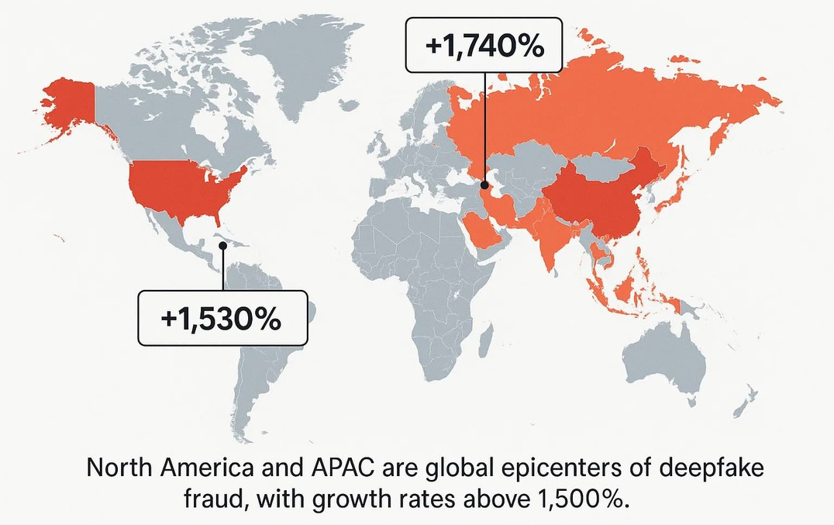
Research Data on Rising Fraud Cases
Global Trends
Rapid growth in digital transactions → rise in cyber fraud cases Increase in phishing and ransomware attacks worldwide Financial fraud is among the top reported cyber crimes
India-Specific Data (Recent Trends) Significant rise in UPI-related fraud cases
Thousands of complaints registered daily on cyber crime portals Major fraud types: OTP scams, fake investment , impersonation fraud Research Insights
Most victims fall for urgency-based scams Lack of cybersecurity awareness increases risk
Strong password practices & 2-factor authentication reduce fraud chances Government cyber awareness campaigns help but need wider reach

Slide 12
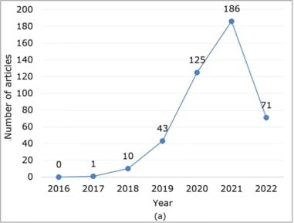
Privacy & Personal Harm
Loss of Personal Identity
Deep learning systems can infer sensitive traits (behavior, preferences, identity)
Data aggregation reduces individual anonymity Privacy Risks
Unauthorized data collection and surveillance
Misuse of facial recognition and biometric data Personal Harm
Data breaches exposing private information
Profiling leading to unfair judgments about individuals

Slide 13

Psychological & Social Consequences
Psychological Impact
Increased anxiety due to constant monitoring Reduced sense of autonomy and self-expression Algorithmic labeling affecting self-esteem
Social Consequences
Bias and discrimination reinforced by trained models Marginalization of certain social groups
Erosion of trust in technology and institutions Research Findings
Studies show algorithmic bias mirrors societal inequalities
Lack of transparency reduces user confidence and accountability

Slide 14

Tackling the deepfake crisis requires a three-pronged approach
Finally, prevention through provenance
Research is shifting from spotting fakes to proving authenticity.
Technologies like cryptographic content labeling and Zero Trust security models allow us to verify what is real at the source, instead of endlessly chasing what is fake.
Second, strong legal frameworks
especially in India. Since AI’s use in the 2019 general elections and recent high-profile misuse cases, the urgency is clear. We need laws that mandate transparency in political communication, criminalize malicious synthetic media, and empower specialized enforcement units for high-tech crimes.
First, AI-based detection
While detection tools exist, experts agree they are the weakest defense. It’s a constant cat-and-mouse game where generation evolves faster than detection, and many systems fail once content is compressed or stripped of metadata.

Slide 15
Technical Challenges
THE ROAD AHEAD
Deepfake detection faces major technical challenges because modern deepfake models (GANs and diffusion models) generate highly realistic images, videos, and audio. These models learn fine-grained facial expressions, lighting, shadows, and lip movements, making fake content visually and acoustically close to real data. Rapid improvements in AI generation outpace detection tools, and deepfakes can be compressed, resized, or re-encoded, which removes detectable artifacts. Another challenge is generalization—detectors trained on one type of deepfake often fail on new or unseen manipulation techniques.
Why Detection Is Difficult
Detection is difficult because deepfakes exploit the same statistical patterns found in real media. Early detection relied on obvious artifacts like unnatural blinking or facial distortion, but modern deepfakes correct these flaws. Adversarial training also allows generators to intentionally fool detectors. Additionally, real-world conditions such as low resolution, poor lighting, background noise, and social media compression further reduce detection accuracy.

Slide 16
THE ROAD AHEAD
Future & Conclusion (Deepfake Technology)
In the future, deepfake technology will become more advanced and realistic It will be difficult for common people to identify real and fake content
Deepfakes can cause serious problems like fake news, cyber fraud, and damage to personal reputation
Misuse of deepfakes can reduce trust in media, social platforms, and digital communication
Responsible engineering and ethical use of AI are very important
Governments should make strong laws to control misuse of deepfake technology AI-based detection tools must be improved to identify fake content early
Public awareness and digital literacy can help people stay safe
Conclusion: Deepfake technology has both benefits and risks, but with proper control, awareness, and responsible use, its negative impact can be reduced

