Slide 1



Department of Computer Science and Design
Session 2025-26
External Seminar(Project Phase-I)
on
AI CLOUD ASSISTIVE PLATFORM:
CLOUD-MAN
Presented By Group No: 07
Guided By
Bhushan U. Bawankar
AI Cloud Assistive Platform-(7)
1

Slide 2



Contents
1. 2. 3. 4. 5. 6. 7. 8. 9.
Abstract
Introduction
Problem Definition
Aim & Objectives
Literature Review
Patent Search
Research Gap
Hardware Software Requirement
Proposed methadology
Experimental Results
Plan of Action
Conclusion and Future Scope
References
10.
11.
12.
13.
AI Cloud Assistive Platform-(7)
2

Slide 3
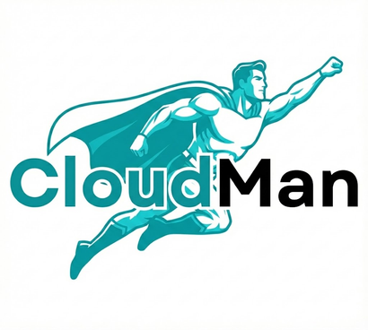










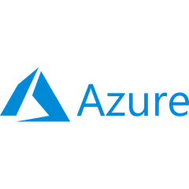
Abstract
The rapid adoption of cloud computing has become a cornerstone of modern IT infrastructure, with over 60% of organizations now utilizing multi-cloud environments. However, prominent platforms such as AWS, Azure, and GCP present significant barriers to entry due to their high complexity, making them difficult for beginners to navigate. Current industry challenges include a steep learning curve due to poor documentation clarity, a lack of centralized management tools which slows troubleshooting, and high operational complexity that necessitates dependency on skilled professionals. Furthermore, manual configuration of networking, security, and Identity and Access Management (IAM) leads to frequent deployment errors, with statistics indicating that 82% of cloud misconfiguration errors are caused by human mistakes. These issues result in a lack of visibility regarding cost and security risks prior to deployment, often leading to resource wastage and security vulnerabilities.
System Architecture & Workflow
AI Layer & NLP Engine
Natural Language
Request
Infrastructure
Planner
Cost
Predictor
Security/Risk
Analyzer
IAC
(Infrastructure as a Code )
Multi-Cloud Deployment
AI Cloud Assistive Platform-(7)
3

Slide 4


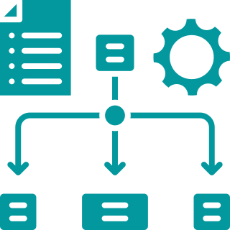





Abstract
To address these critical inefficiencies, this project introduces CloudMan, an AI-assisted, human-in-the-loop multi-cloud deployment and management platform. The primary aim of CloudMan is to democratize cloud infrastructure provisioning by abstracting technical complexities while maintaining transparency. The system utilizes a sophisticated architecture driven by a Natural Language Processor and an AI Layer that includes an Infrastructure Planner, Cost Estimator, and Security/Risk Analyzer. Through a user-friendly web application, users can articulate requirements in natural language, which the system converts into executable Infrastructure as Code (IaC) generations.
CloudMan ensures reliability and control through an Orchestration Layer that enforces a workflow controller and requires user approval before execution, mitigating the risk of automated errors. The platform integrates adapters for AWS, Azure, and GCP, allowing for seamless, centralized management across different providers through a single interface. By providing unified observability including cost tracking, logs, and alerting CloudMan effectively solves the problem of multi-cloud fragmentation. Ultimately, this platform reduces the learning curve for beginners and ensures secure, error free, and cost-optimized cloud deployments.
Unified Governance & Control
Core Benefits & Impact
Unified Observability & Cost Tracking
Reduced Learning
Curve
Workflow Controller
User Approval
Required
Execute
Single Interface
Adapter
Centralized Platform
AI Cloud Assistive Platform-(7)
4

Slide 5






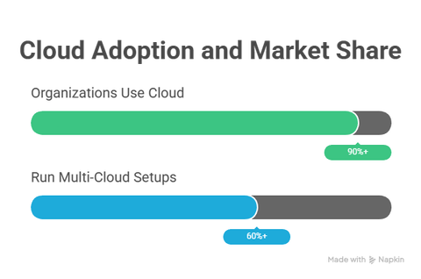
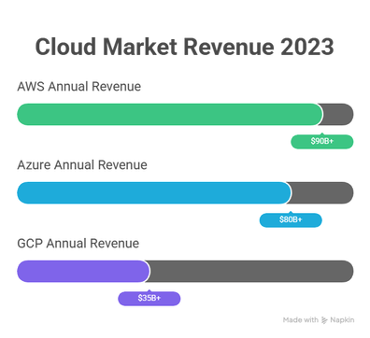
Introduction
What is cloud computing ?
Cloud Service Models
Delivery of servers, storage, databases, and software over the internet.
No physical infrastructure required.
On-demand, scalable, pay-as-you-use.
SAAS (Software as a Service)
PAAS (Platform as a Service)
IAAS (Infrastructure as a Service)
From renting hardware to using finished software.
Cloud
Cloud Providers
AI Cloud Assistive Platform-(7)
5

Slide 6
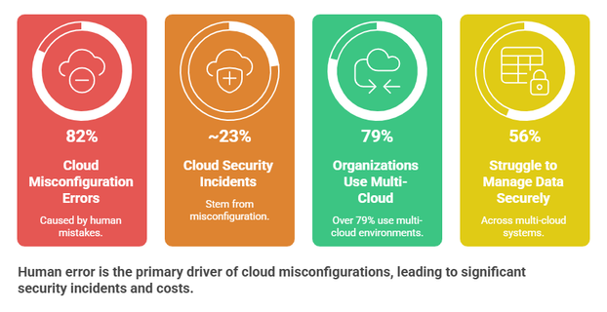
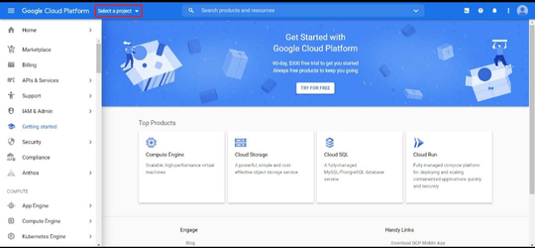
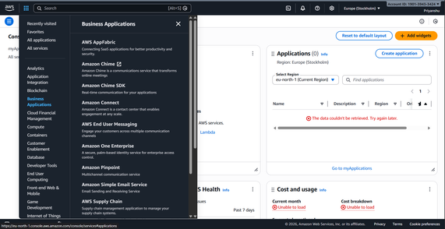
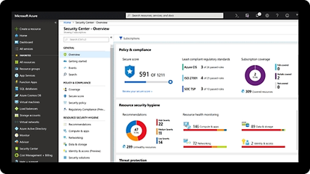
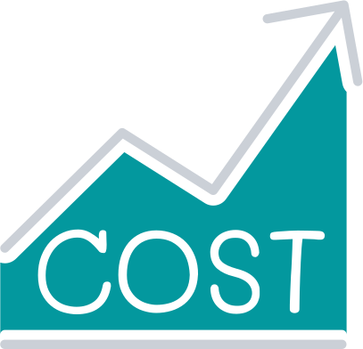


Problem Definition
Problems
Stats
AWS platforms present a steep learning curve and high entry barriers for beginners due to their inherent complexity.
Manual configuration of networking and security leads to frequent mistakes, causing 82% of all cloud misconfigurations.
A lack of natural language interfaces makes it difficult to convert high-level requirements into executable Infrastructure-as-Code.
Users suffer from resource wastage because there is no clear visibility of service costs prior to actual deployment.
Provisioning resources without integrated security validation often results in exposed data and significant security risks.
Fully autonomous systems risk deploying incorrect resources without a mandatory human-in-the-loop approval mechanism.
AI Cloud Assistive Platform-(7)
6

Slide 7
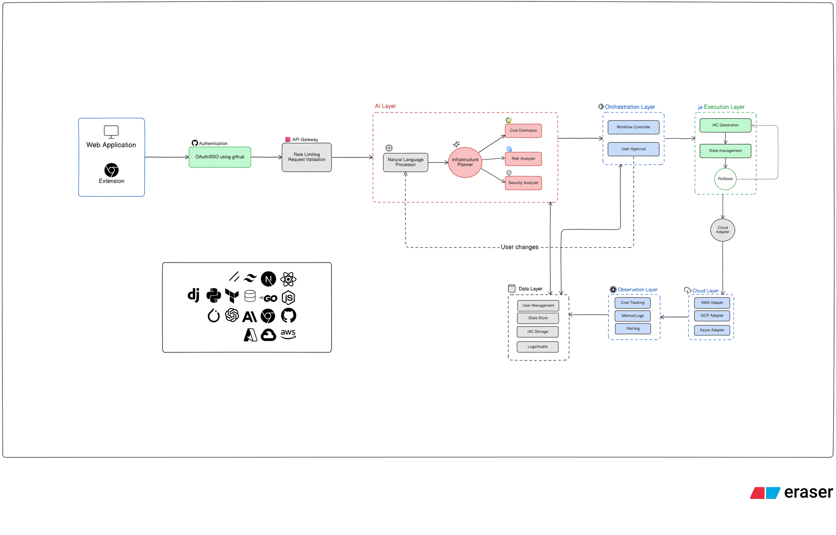
Aim and Objectives
Aim
The aim of Phase 1 of CloudMan is to build an AI-assisted platform that converts natural language cloud requirements into structured deployment plans for selected Amazon Web Services services like Amazon EC2 and Amazon S3, ensuring cost awareness, security checks, and user approval before deployment.
System Architecture
AI Cloud Assistive Platform-(7)
7

Slide 8






Objectives
Objectives
AI-assisted planning
converts user requirements into visual infrasplans.
Natural language input :-
Natural Language Input
AI Planning & Validation
AWS Deployment Planning
allows users to describe cloud needs in simple language.
“Deploy a React App.....”
User describes cloud requirements
Generates deployment plan with cost & security checks
Infrastructure planning for EC2 & S3
AWS integration
supports planning for Amazon Web Services services like Amazon EC2 and Amazon S3.
Cost & security checks
Key Benefits
provides pre-deployment estimation and risk checks.
User approval control
ensures deployment happens only after confirmation.
Simplified provisioning
reduces complexity for users.
Faster AWS Infra. planning
Reduced deployment risk & cost
Secure & controlled provisioning
AI Cloud Assistive Platform-(7)
8

Slide 9
Literature survey
Sr. No.
Title of the paper
Author
Year of Publication/ Publisher
Major observations/findings
Deployability-Centric Infrastructure-as-Code Generation: Fail, Learn, Refine, and Succeed through LLM-Empowered DevOps Simulation.
Tianyi Zhang, Shidong Pan, Zejun Zhang, Zhenchang Xing, and Xiaoyu Sun.
State-of-the-art Large Language Models (LLMs) performed poorly on initial IaC deployability, achieving success rates of only 20.8% to 30.2% on the first attempt.
1
2025; ACM (Proceedings of FSE).
March 2025; International Journal of Engineering Research & Technology (IJERT).
Your Proposes an AI-driven model that integrates FinOps for cost forecasting, AI-driven policy enforcement for compliance, and a self-adapting governance model.
2
AI Driven Hybrid Multi Cloud Governance Strategy.
Sunil Kattikar.
Ai-Powered Cloud Automation: Enhancing Auto-Scaling Mechanisms Through Predictive Analytics And Machine Learning.
Dheerender Thakur.
June 2022; International Journal of Creative Research Thoughts (IJCRT).
Traditional auto-scaling methods are often reactive and inefficient, leading to over-provisioning or resource shortages.
3.
AI Cloud Assistive Platform-(7)
9

Slide 10
Literature survey
Sr. No.
Title of the paper
Author
Year of Publication/ Publisher
Major observations/findings
Yikun Li, Matteo Grella, Daniel Nahmias, Gal Engelberg, Dan Klein, Giancarlo Guizzardi.
2025 (arXiv preprint; rights licensed to ACM)
Base Model Weakness: Current base Large Language Models (LLMs) often lack security awareness when generating Infrastructure-as-Code (IaC), with code-specific models showing particularly poor .
GENSIAC: Toward Security-Aware Infrastructure-as-Code Generation with Large Language Models
4.
Rana Nameer Hussain Khan, Dawood Wasif, Jin-Hee Cho, and Ali Butt xt
Y2025
(arXiv preprint)
Multi-Agent Approach: The paper introduces MACOG, an architecture that replaces monolithic, single-pass generation with specialized agents.
Multi-Agent Code-Orchestrated Generation for Reliable Infrastructure-as-Code
5.
AI Cloud Assistive Platform-(7))
2025; published in the International Journal of Multidisciplinary Research in Science, Engineering and Technology (IJMRSET).
The PromptOps framework achieved over 96% syntactic accuracy and 91.8% semantic correctnesst
PromptOps: Leveraging LLMs for Dynamic Infrastructure as Code Generation and Maintenance
Selva Kumar Ranganathan
6.
10
AI Cloud Assistive Platform-(7)

Slide 11

Patent Search
Sr. No.
Title of the Patent
Author
Year of Publication/ Publisher
Major observations/findings
1
System and Method for Automated Cloud Resource Provisioning
Amazon Technologies Inc.
2016 / USPTO
Introduces automated provisioning of cloud resources, reducing manual configuration errors and deployment time.
2
Microsoft Corporation
2018 / USPTO
Provides centralized management of multiple cloud platforms, improving interoperability and operational efficiency.
Method for Managing Multi-Cloud
Environments
Uses analytics to monitor cloud usage and optimize costs, helping reduce resource wastage.
3
Intelligent Cloud Cost Optimization System
Google LLC
2019 / USPTO
2020 / USPTO
Applies AI to recommend suitable cloud services and configurations, simplifying cloud usage for beginners.
4
AI-Based Cloud Deployment
Recommendation System
IBM Corporation
AI Cloud Assistive Platform-(7)
11

Slide 12
Research Gap
Engagement Rate
Engagement Rate
High Complexity & Steep learning Curve
AI-Driven Abstraction
Due to poor documentation clarity & cluttered UI
AI-driven abstraction via Natural Language Processing (lowers learning curve).
Prone to Human Error
Human-in-the-Loop Validation
Manual configuration prone to frequent human errors (82% misconfiguration rate
Validation before Infrastructure as Code (IaC) execution.
Lack of Pre-Deployment Visibility
Proactive Observability
costs and security risks.
Proactive analysis using integrated Cost Estimator and Security/Risk Analyzer.
Fragmented Management
Unified Single Interface
fragmented management tools across multi-cloud environments.
Interface managing multiple providers (AWS, Azure, GCP).
AI Cloud Assistive Platform-(7)
12

Slide 13
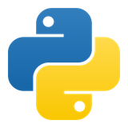



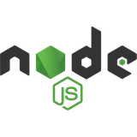
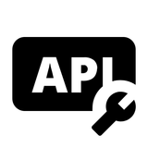


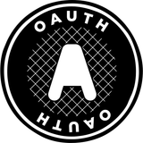










Hardware/Software Requirement
Core Application
Client, Data & Integrations
1.Programming Language
1.Client Side
  JavaScript/Typescript
  Python and Go
  Web Browser & Extension
  Storing API Key
2. Frameworks and Libraries
2. Data, Storage & Auth
  Next.js (Web App Framework)
  Convex (Offline Sync & Data Management)
  PWA (Progressive Web App for Offline Support)
  Redis Storage (Data Caching)
  Tailwind CSS / Shadcn UI (UI Design)
  Postgresql, VectorDB and Redis
  Auth (OAuth 2.0 ): Github OAuth/SSO
3. AI Automation & Devlops
  Cloud Service provider: Active accounts for AWS, Azure & GCP
3. AI Automation & Devlops
  AI/NLP Engine: for natural language processing & Infra planning
  IAC Tool: Terraform for generation
  Containerization Tool: Docker for application viratualiztion.
AI Cloud Assistive Platform-(7)
13

Slide 14
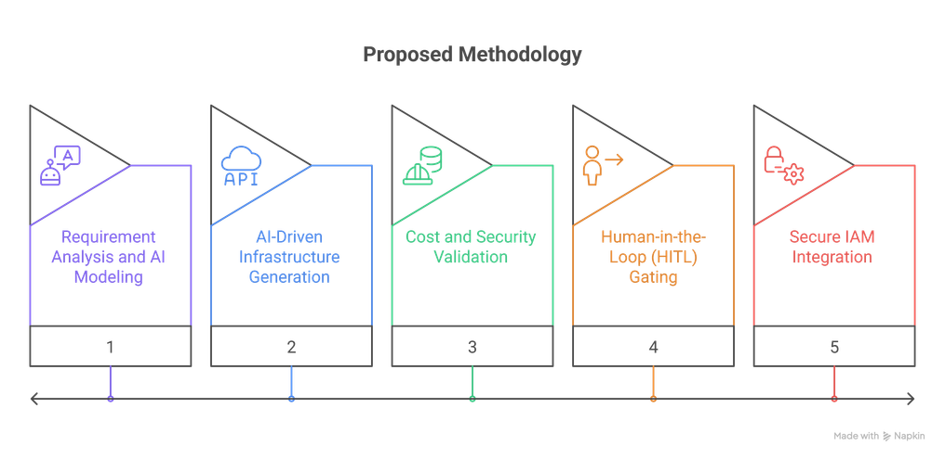
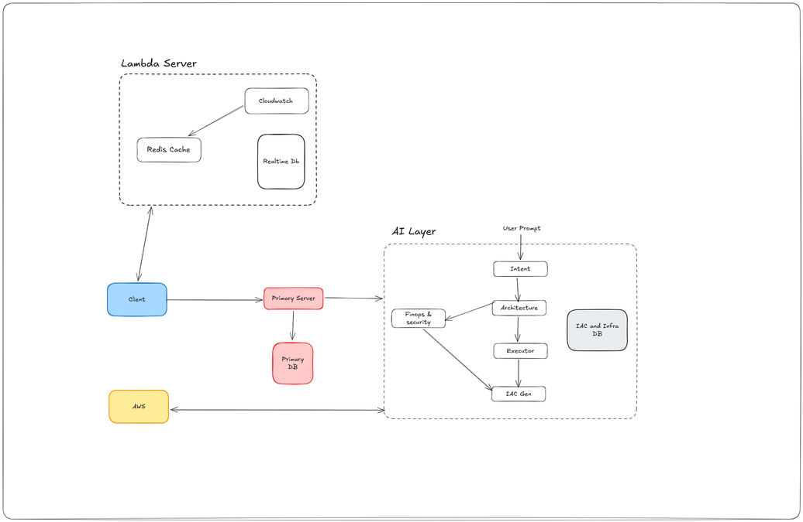
Proposed Methodology
Core Application
1 .Requirement Analysis and AI Modeling
An LLM-based Cloud Architect Agent parses natural language inputs into structured JSON technical specifications.
2.AI-Driven Infrastructure Generation
JSON specifications are converted into Terraform (HCL) code to ensure reproducible and standardized AWS deployments.
3.Cost and Security Validation
The system integrates the AWS Pricing API for real-time cost estimation and utilizes static analysis tools for pre-deployment security scanning.
4.Human-in-the-Loop (HITL) Gating
A mandatory review stage where users must explicitly verify and approve the infrastructure plan before any resources are provisioned.
5.Secure IAM Integration
Uses AWS Security Token Service (STS) to assume temporary roles, eliminating the need for long-term access keys and enhancing security
AI Cloud Assistive Platform-(7)
13

Slide 15
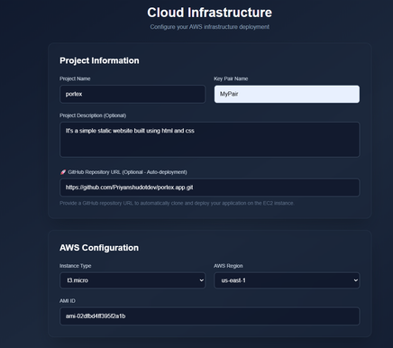
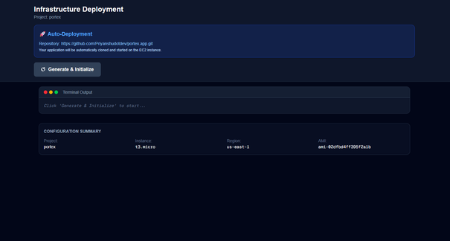
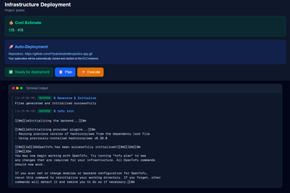
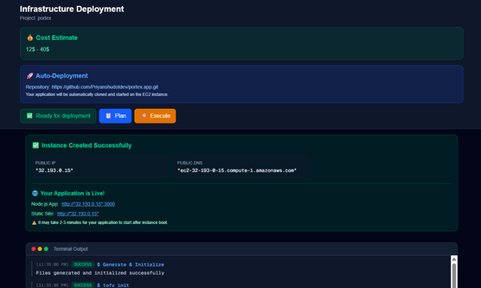
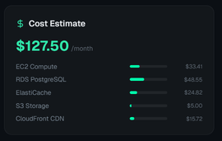
Experimental results/Output/Snapshots
Core Application
Infrastructure Planning
Cost & Risk Assessment
IaC Generation & Execution
AI Cloud Assistive Platform-(7)
13

Slide 16
Conclusion and Future Scope
Core Application
Conclusion
Future Scope
Democratized AWS Access Successfully reduced technical barriers by allowing users to provision infrastructure using natural language instead of complex code.
Full Multi-Cloud Integration Extend platform adapters to include Microsoft Azure and Google Cloud Platform for a unified cross-provider experience.
Eliminated Manual Errors Replaced error-prone manual configurations with standardized Terraform scripts to mitigate the 82% human error rate
Advanced Multi-Agent AITransition to specialized AI agents to improve the accuracy of complex architectural planning and code generation.
Enhanced Transparency Integrated proactive cost estimation and security scanning to provide full visibility before any resources are deployed.
Intelligent FinOps & Governance Deploy AI-driven budget forecasting and automated policy enforcement to optimize long-term cloud spending.
Safety First Architecture Implemented a mandatory human-in-the-loop approval gate to prevent accidental or incorrect AI-driven deployments.
Self-Healing Infrastructure Develop automated monitoring and troubleshooting agents to detect and fix resource health issues autonomously.
Your Secure Credential Handling Established a secure foundation using AWS STS for temporary role-based access, removing the risks of static API keys.aph text
Full CI/CD Integration Incorporate direct pipelines to automate the lifecycle from requirement gathering to final production deployment.
AI Cloud Assistive Platform-(7)
13

Slide 17
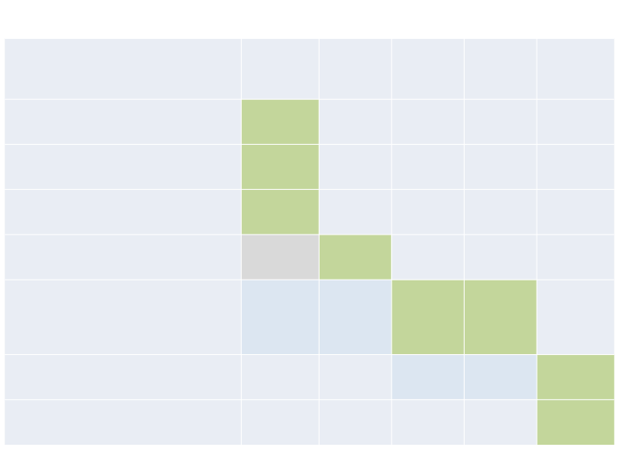
Plan of Action
Activity (2021)
Jan-Feb
Feb-Mar
Mar-April
April-May
May-June
Literature Survey
Analysis of literature data
Conclusions
Preparation
of
Project
Report/
Paper Writing
AI Cloud Assistive Platform-(7)
14

Slide 18
References
  Rackspace. The 2025 state of cloud report, 2025. URL https://www.rackspace.com/blog/2025-state-cloud-report.
  Hashicorp. Hashicorp2023stateof cloudstrategy survey., 2023. URL https://www.hashicorp.com/en/state-of-the-cloud.
  Hashicorp. Terraform versus cloudformation, heat, and other infrastructure as code tools, 2024. URL https://developer. hashicorp.com/terraform/intro/vs/cloudformation.
  AWS. Managing aws resources as a single unit with aws cloudformation stacks, 2025. URL https://docs.aws.amazon. com/AWSCloudFormation/latest/UserGuide/stacks.html.
  aws-cloudformation-templates by AWS Cloudformation : AWS CloudFormation Sample Templates. https://github.com/ aws-cloudformation/aws-cloudformation-templates.
  DeJong Kevin, Myron Pat, van Boven Frank, et al. Aws cloudformation linter, 2025. URL https://github.com/aws cloudformation/cfn-lint.
  Wang, J., & Suresh, P. (2022). Multi-Cloud Infrastructure Automation with Terraform: Case Study. International Journal of Cloud Applications, 15(2), 210-225.
  Microsoft Azure. Architecture strategies for using infrastructure as code, 2023. URL https://learn.microsoft.com/en us/azure/well-architected/operational-excellence/infrastructure-as-code-design.
  Turner, R., & Holland, M. (2021). Terraform in Multi-cloud Environments: Opportunities and Challenges. IEEE Cloud Computing, 8(4), 20-30.
  Jansen, S., & Bloemendal, M. (2020). Terraform State Management in Large Teams. International Journal of DevOps Engineering, 6(2), 45-61.
AI Cloud Assistive Platform-(7)
15

Slide 19

Thank You…….
Title of Project-(Group-No)
15

