Slide 1
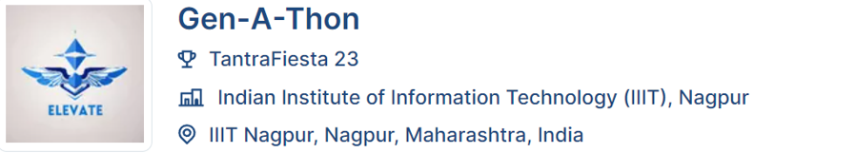
Problem Statement Title: Creating an Educational Chatbot for Juniors: Empowering Students to Navigate Academic and Non-Academic Challenges
Team Name : end_is_peace

Slide 2
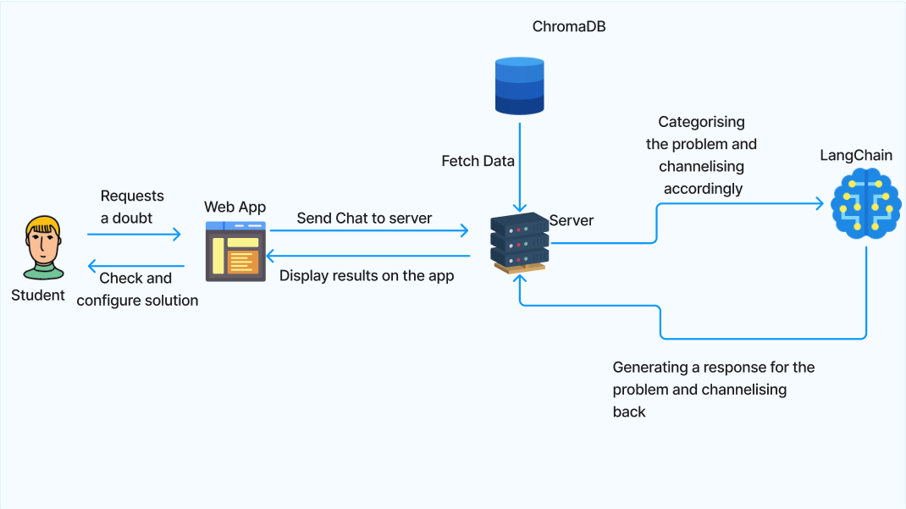

Slide 3
TECH STACK
Front-end: HTML, CSS, JavaScript
Back-end: Flask
Language models: Bard, ChatGPT, LangChain
Database: ChromaDB
Natural Language Processing (NLP):Hugging Face models

Slide 4
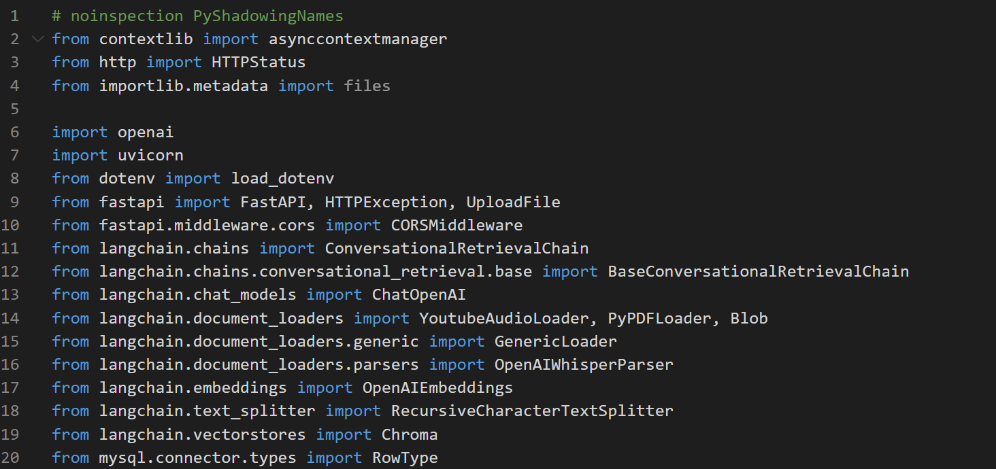
Some important code-snippets of my prototype

Slide 5
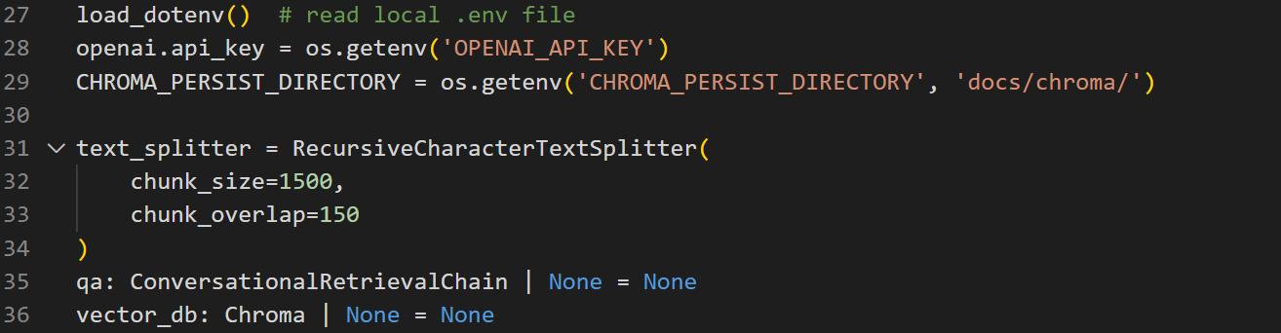

Slide 6
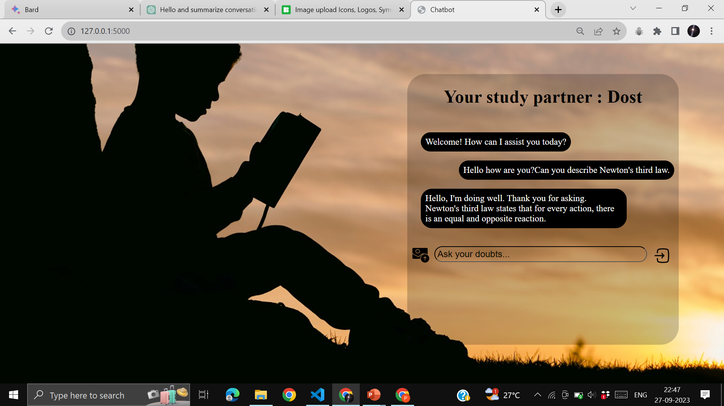
Frontend of My prototype

Slide 7
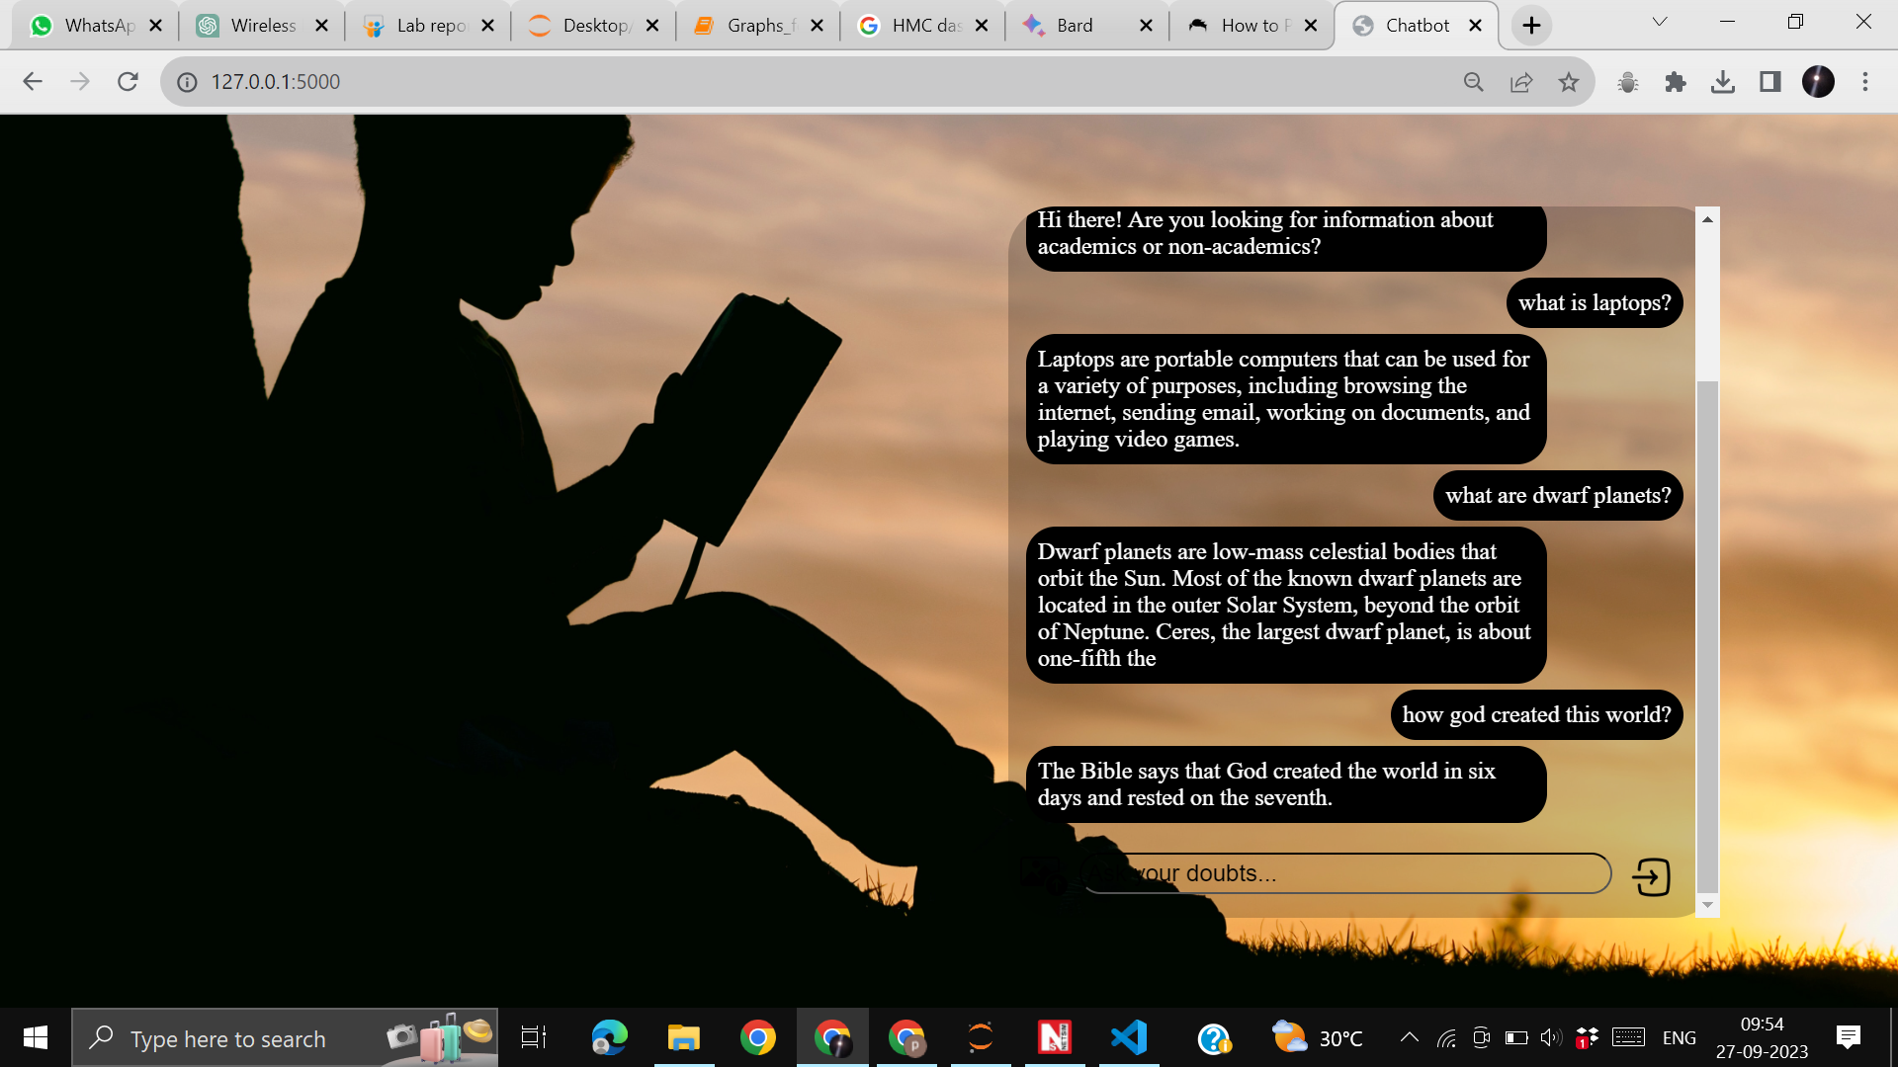

Slide 8
Glossary
GPT - Generative Pretrained Transformer: A cutting-edge language model architecture known for its text generation capabilities.
LLM - Large Language Model: High-capacity AI models designed to understand and generate human-like text.
PaLM - Pathways Language Model: A novel language model designed to provide more focused and coherent text generation.
API - Application Programming Interface: A set of protocols that allows different software applications to communicate and interact with each other.
OpenLLM - Open Large Language Model: A framework for hosting and using large language models, enabling customization and control over AI models.
GenAI - Generative Artificial Intelligence: AI systems that can generate creative content, such as text, images, or music, autonomously.

Slide 9
Use-cases
Use Case 1:
Academic Support (Highest Priority)Description: Provide clear explanations and solutions for academic questions in various subjects, ensuring students have reliable support for their studies. This use case addresses core educational needs.
Use Case 2:
Study Tips and Time Management (Medium Priority)Description: Offer practical advice on effective study techniques, time management, and goal setting. Help students develop better study habits and manage their time efficiently to improve academic performance.
Use Case 3:
Extracurricular Activity Recommendations (Lower Priority)Description: Assist students in discovering suitable extracurricular activities aligned with their interests and goals. Encourage students to explore passions and engage in holistic personal development.

Slide 10
Solution statement/ Proposed approach
Project Objective:
To enhance the capabilities of the educational chatbot for junior students, enabling it to provide comprehensive support for academic and personal development needs.
Approach:
Leverage Language Models (LLMs):
Continue using GPT and BARD for text-based solutions to student doubts. Implement a pipeline using LangChain to integrate multiple LLMs with different strengths and abilities.
Expanded Functionalities:
Implement various functionalities, including:
Visual Question Answering (VQA): Enable the chatbot to answer questions based on visual content, such as images and diagrams.
Document Question Answering (DQA): Allow students to ask questions related to documents and articles.
Question Answering (QA): Provide general question-answering capabilities. These functionalities will provide a holistic learning experience for students.

Slide 11
Image Upload and Description:
Continue allowing students to upload images and receive descriptions.
Extend this functionality to support educational content, where students can upload diagrams or charts and receive explanations.
Integration with ChromaDB:
Utilize ChromaDB, an open-source vector database, to store and manage vector embeddings.
Enhance the chatbot's ability to retrieve relevant content and provide more accurate answers.
Personalization and User Profiles:
Implement user profiles to track student preferences, progress, and areas of interest.
Personalize recommendations and guidance based on individual needs.

Slide 12
Future Scopes
Expand the knowledge base of the chatbot: The chatbot can be trained on a wider range of data, including textbooks, educational articles, and even student essays and projects. This will allow the chatbot to provide more comprehensive and accurate answers to student questions.
Improve the chatbot's ability to understand natural language: The chatbot should be able to understand student questions even if they are poorly phrased or grammatically incorrect. This will make it more accessible to students of all levels.
Personalize the chatbot's responses: The chatbot can take into account the student's individual needs and interests when providing answers. For example, if the student is struggling with a particular subject, the chatbot can provide more targeted support.
Make the chatbot more interactive: The chatbot can be integrated with other tools and resources, such as online learning platforms and educational games. This will create a more engaging and interactive learning experience for students.
Enable the chatbot to provide real-time feedback: The chatbot can give students immediate feedback on their work, such as essays and quizzes. This will help students identify areas where they need to improve.

Slide 13
Provide support for students with disabilities : The chatbot can be adapted to meet the needs of students with different disabilities, such as visual impairments or learning disabilities.
Promote social-emotional learning : The chatbot can help students develop social-emotional skills, such as self-management, social awareness, and relationship skills.
Support student well-being : The chatbot can be used to provide students with resources and support for mental health, stress management, and other well-being concerns.

