Slide 1

Investment Recommendation System Using ESG and Investor Behavior
Group 1
Priyanshu Jain – 2024BTech179.
Aman Pratap Singh – 2024BTech136.
Harshit Mundra – 2024BTech186.

Slide 2
Model 1 – Company Risk Prediction (ESG + Market Data)
Objective: To analyze how ESG performance combined with market behavior influences stock returns and risk.
Key Inputs:
ESG component scores (E, S, G).
Market capitalization and sector.
Derived stock performance indicators (returns, volatility, momentum).
Approach:
ESG and market features are combined into a structured dataset.
Machine learning models learn non-linear relationships between ESG quality and stock behavior.

Slide 3
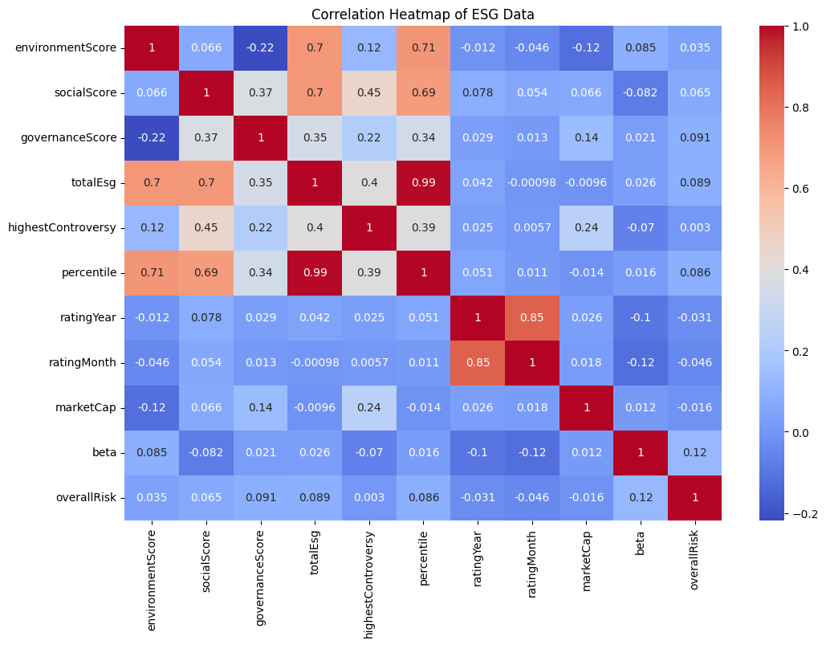
DATA PREPROCESSING
Step 1: Data Cleaning
The Date column in the price dataset was converted into proper datetime format and the data was sorted in chronological order.
The dataset was checked for missing (NULL) values to ensure data quality.
Unnecessary columns were removed from the ESG dataset to reduce noise, including:
Full Name
GICS Sub-Industry
Percentile
ratingYear
ratingMonth
overallRisk

Slide 4
DATA PREPROCESSING
Step 2: Feature Engineering and Data Merging
Daily returns were calculated from stock prices using the formula: Return = (Price_today − Price_yesterday) / Price_yesterday
From daily returns, three new features were created:
avg_return (average daily return)
volatility (standard deviation of returns)
momentum_6m (overall price trend over time)
These market features were then merged with the ESG dataset using the Symbol column, keeping only common companies.

Slide 5
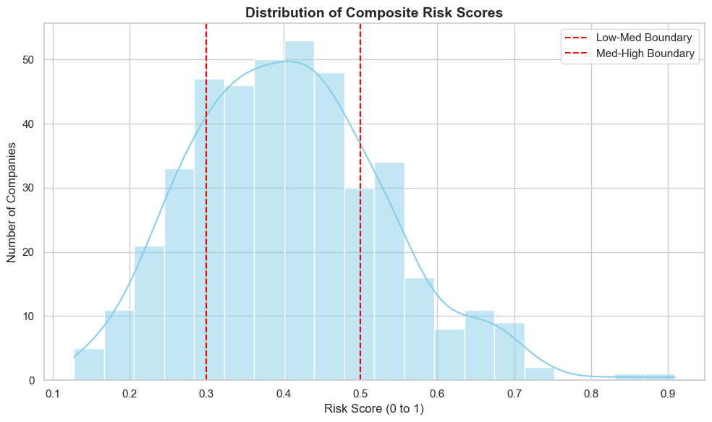
DATA PREPROCESSING
Step 3: Risk Score Creation and Classification
The features volatility and totalEsg were normalized to bring them to the same scale.
A composite risk score was created using the formula: Risk Score = 0.6 × volatility + 0.4 × (1 − ESG)
The risk score was then converted into three categories:
Low Risk
Medium Risk
High Risk

Slide 6
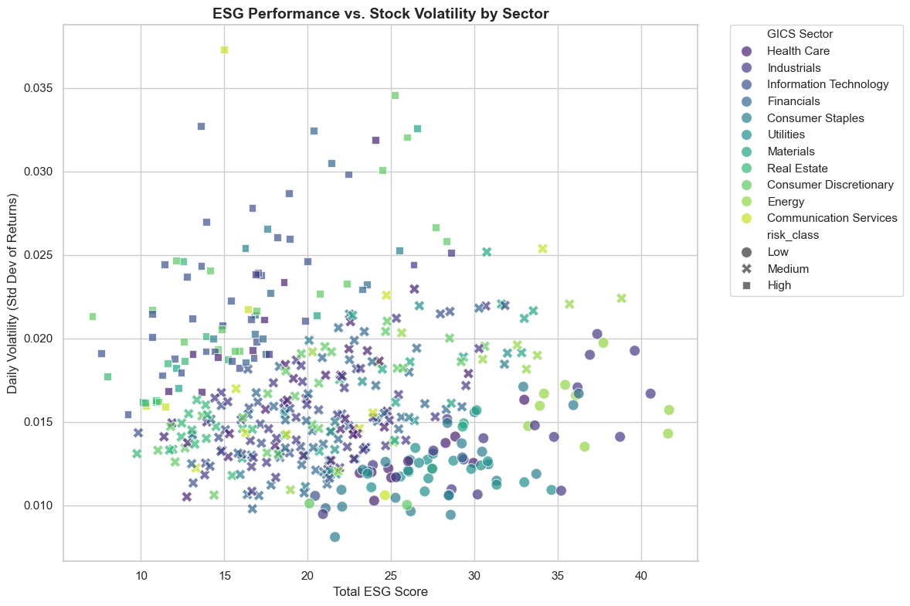
DATA PREPROCESSING
Step 4: Encoding
The categorical column GICS Sector was converted into numerical format using one-hot encoding.
The target variable risk_class was converted into numeric labels using label encoding.
Step 5: Feature Scaling
All input features were scaled using StandardScaler.
This ensures that large values like marketCap do not dominate smaller values like beta.

Slide 7
Feature Transformation: From Raw Data to Final Model Inputs
INITIAL FEATURES (Dataset Columns)
Symbol
Full Name
GICS Sector
GICS Sub-Industry
environmentScore
socialScore
governanceScore
totalEsg
highestControversy
percentile
rating Year
rating Month
marketCap
beta
overallRisk
FINAL FEATURES (Used in Model)
environmentScore
socialScore
governanceScore
highestControversy
marketCap
beta
avg_return (Derived)
momentum_6m (Derived)
GICS Sector (Encoded)
TARGET VARIABLE
risk_class (Created from risk score → Label Encoded)

Slide 8
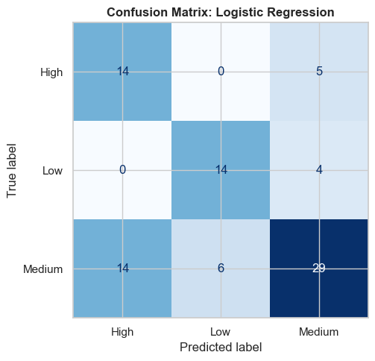
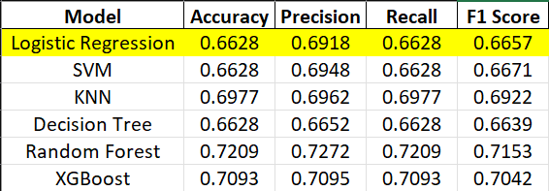
Model: Logistic Regression
Interpretation
The model gives moderate performance.
It is able to classify the data but struggles with separating the three risk classes clearly.
It performs better for Medium risk but makes mistakes in High and Low categories.

Slide 9
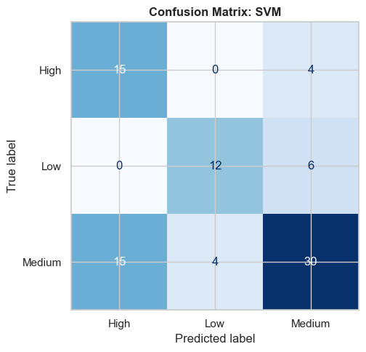
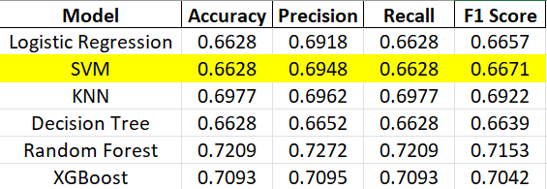
Model: SUPPORT VECTOR MACHINE (SVM)
Interpretation
Performance is similar to Logistic Regression.
Slight improvement in precision shows better class separation.
Still faces difficulty in distinguishing between Medium and other classes.

Slide 10
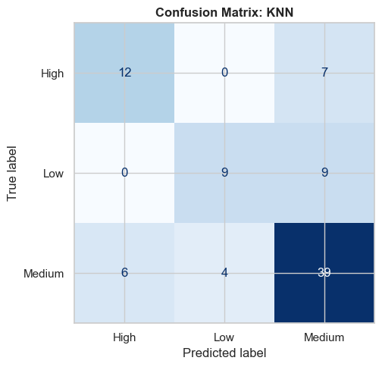
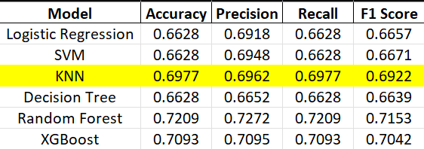
Model: K-NEAREST NEIGHBORS (KNN)
Interpretation
Shows better performance compared to previous models.
Works well because it uses similarity between data points.
Still affected by overlapping between risk classes.

Slide 11
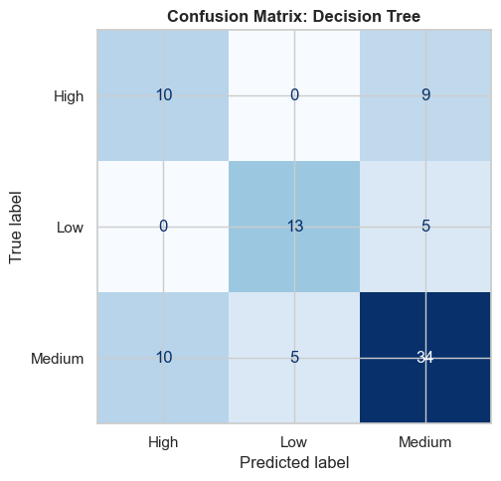
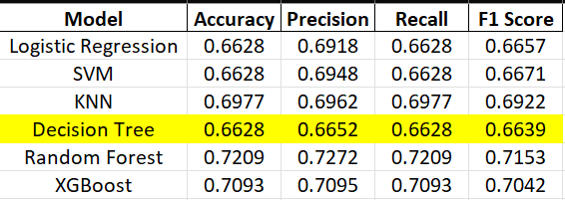
Model: DECISION TREE
Interpretation
Shows better performance compared to previous models.
Works well because it uses similarity between data points.
Still affected by overlapping between risk classes.

Slide 12
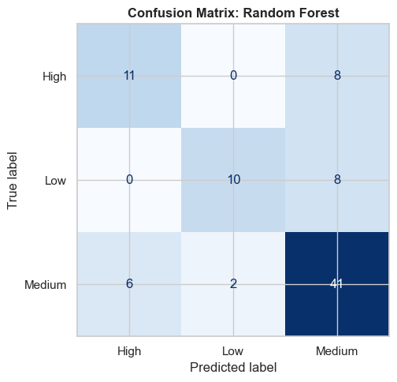
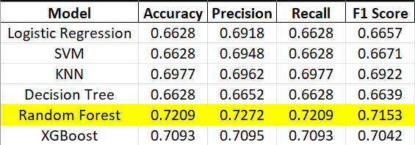
Model: RANDOM FOREST
Interpretation
It combines multiple decision trees, which improves overall performance.
It handles complex patterns better than other models.
Gives balanced performance across all risk classes.

Slide 13
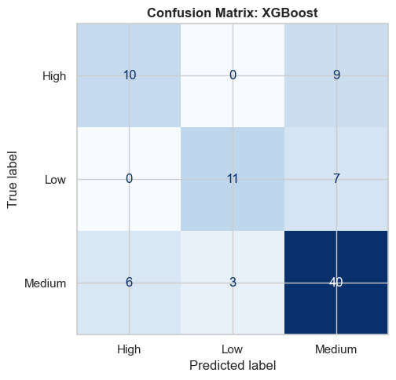
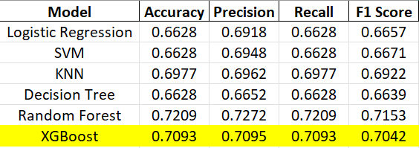
Model: XGBoost
Interpretation
Performance is slightly lower than Random Forest.
It captures patterns well but does not outperform Random Forest in this case.
Still a strong model with good overall results.

Slide 14
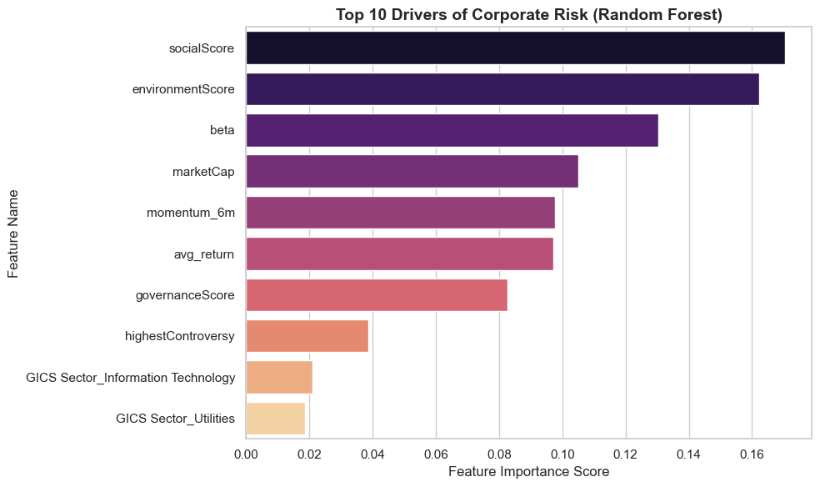
CONCLUSION
Best Model: Random Forest
Achieved highest performance among all models
Accuracy: 0.7209
F1 Score: 0.7153
Key Observations
Models perform moderately due to overlap between risk classes
Medium risk category is predicted better than High and Low
Combining ESG and market features improves prediction
Final Conclusion
The model is able to predict company risk using ESG and market data
Random Forest gives the most reliable results
Risk depends on both ESG scores and market behavior

