Slide 1
CartPilot
The AI Manager Sitting on Top of Your Inventory
Explainable e-commerce coordination with guarded execution
[Student / team names] • [Institution] • [Department] • [Project guide]
CartPilot | deterministic specialists • guarded local/simulated actions 01 / 12
Notes:
Evidence: /Users/priyanshuraj/Projects/cartpilot/PROJECT_REPORT_OUTLINE.md
The AI Manager Sitting on Top of Your Inventory Explainable e-commerce coordination with guarded execution [Student / team names] • [Institution] • [Department] • [Project guide]
Confidence and priority are heuristics. Shopify is mocked/read-only. No measured business uplift is claimed.

Slide 2
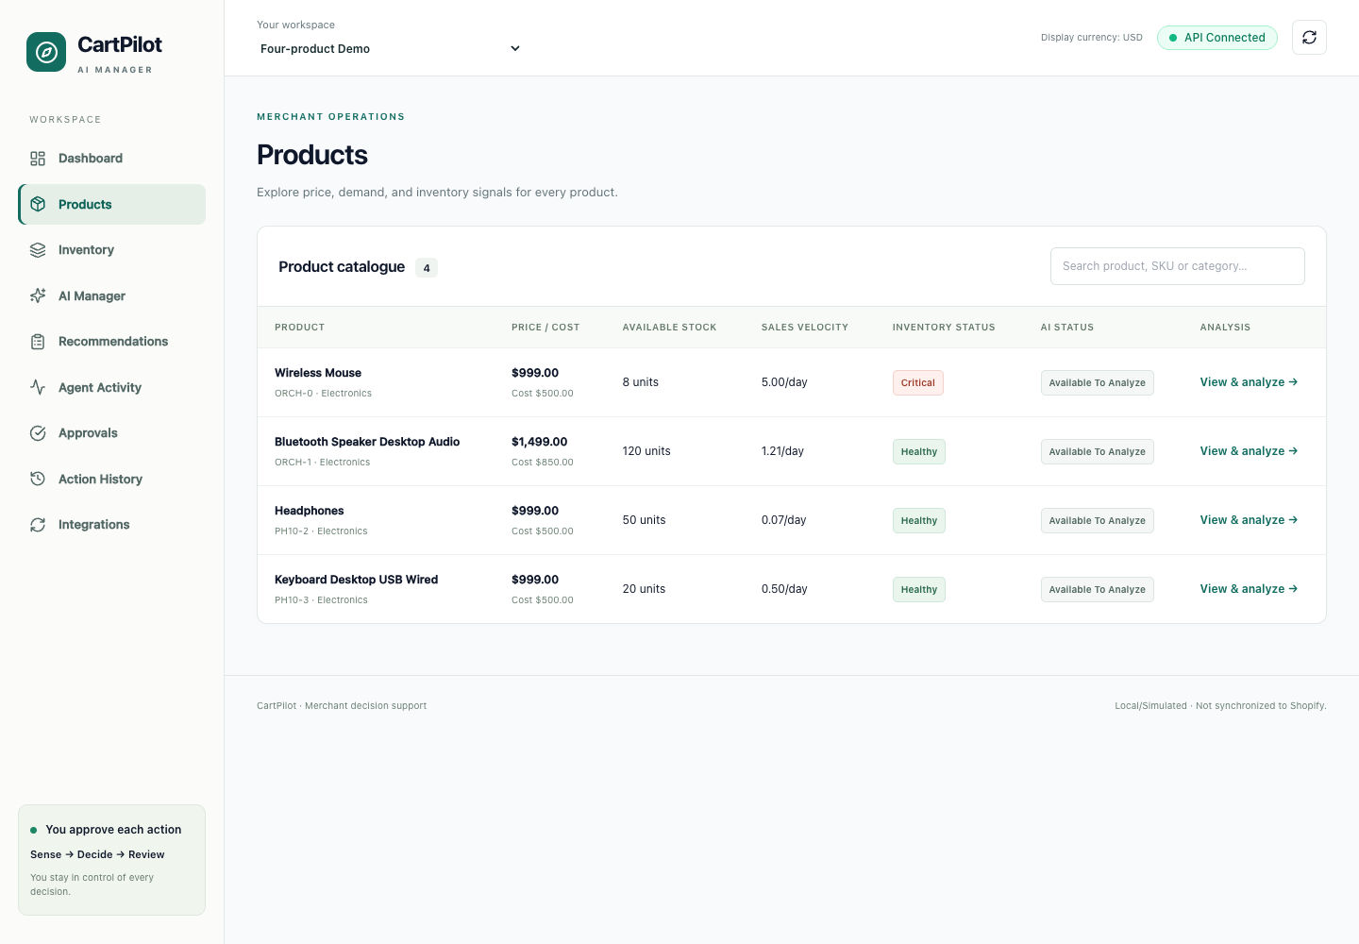
The coordination problem
A discount can conflict with low stock
Weak listing content can resemble weak demand
Independent proposals need a shared operational priority
CartPilot | deterministic specialists • guarded local/simulated actions 02 / 12
Notes:
Evidence: /Users/priyanshuraj/Projects/cartpilot/PROJECT_REPORT_OUTLINE.md
A discount can conflict with low stock Weak listing content can resemble weak demand Independent proposals need a shared operational priority
Confidence and priority are heuristics. Shopify is mocked/read-only. No measured business uplift is claimed.

Slide 3
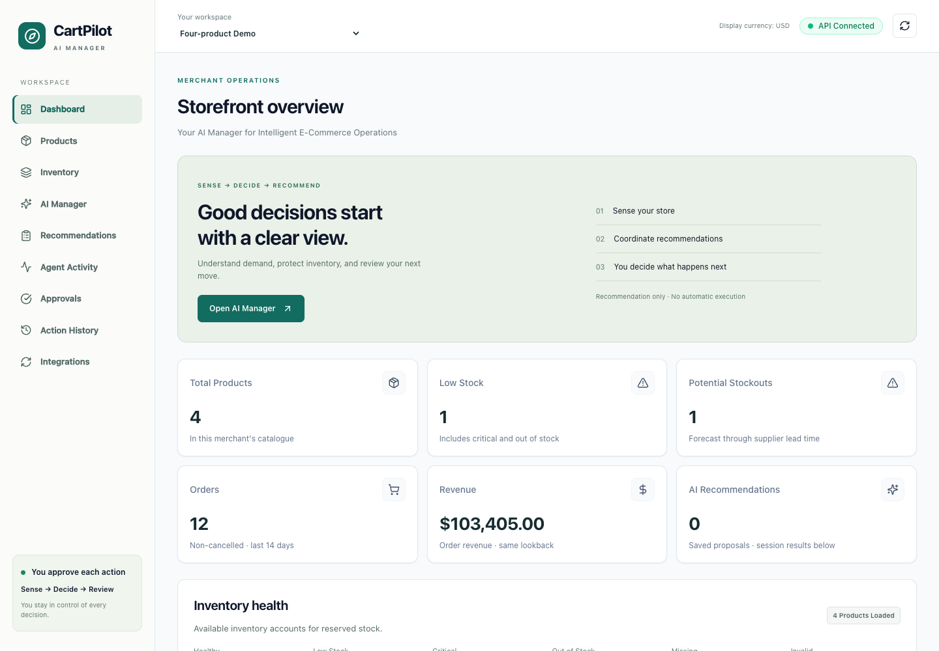
Project objectives
Four typed, explainable specialist recommendations
One merchant-goal priority plan
Policy validation, approval and persistent audit
CartPilot | deterministic specialists • guarded local/simulated actions 03 / 12
Notes:
Evidence: /Users/priyanshuraj/Projects/cartpilot/PROJECT_REPORT_OUTLINE.md
Four typed, explainable specialist recommendations One merchant-goal priority plan Policy validation, approval and persistent audit
Confidence and priority are heuristics. Shopify is mocked/read-only. No measured business uplift is claimed.

Slide 4
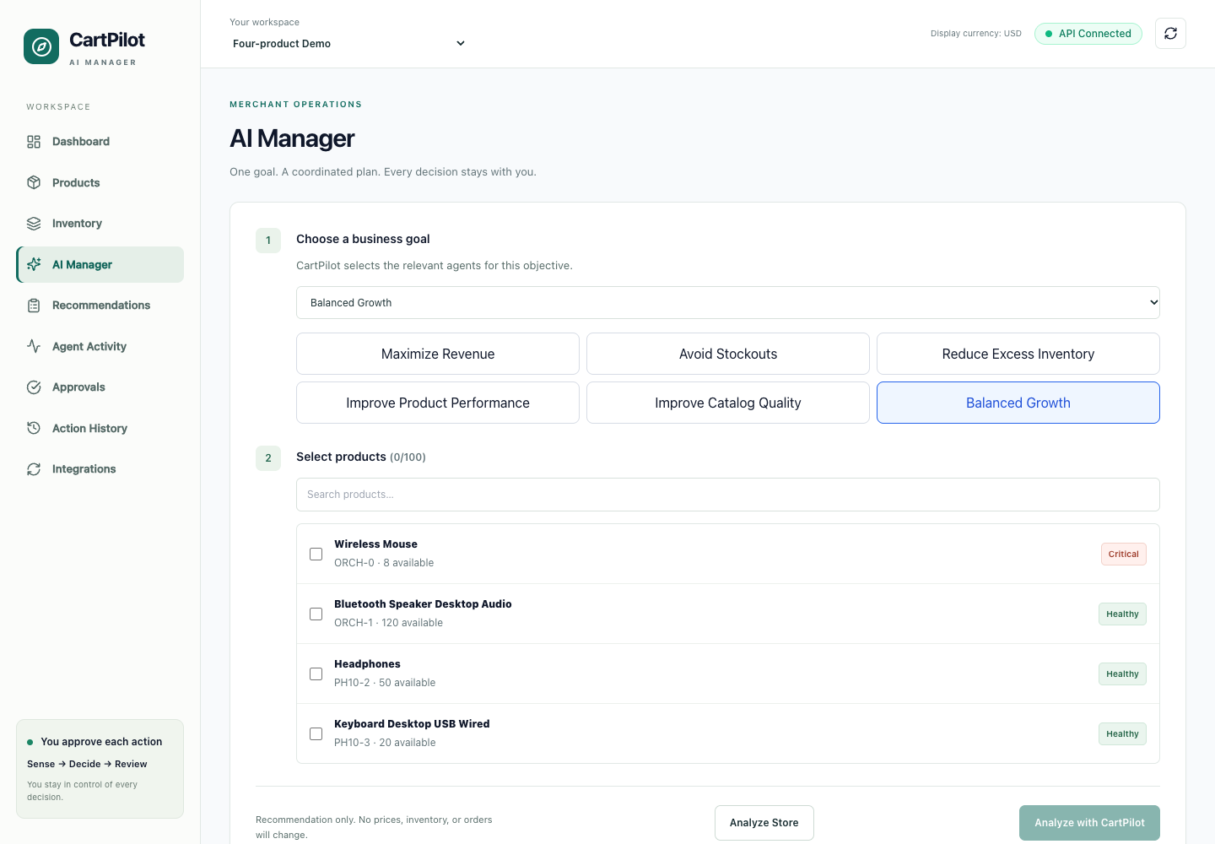
Proposed solution
Scoped store data → shared signals
Specialists → conflict and dependency resolution
Advisory queue → separately reviewed action
CartPilot | deterministic specialists • guarded local/simulated actions 04 / 12
Notes:
Evidence: /Users/priyanshuraj/Projects/cartpilot/PROJECT_REPORT_OUTLINE.md
Scoped store data → shared signals Specialists → conflict and dependency resolution Advisory queue → separately reviewed action
Confidence and priority are heuristics. Shopify is mocked/read-only. No measured business uplift is claimed.

Slide 5
System architecture
React / TypeScript → FastAPI → relational data
Shopify import: read-only; Redis: optional
Local price/listing edits; simulated restock/promotions
CartPilot | deterministic specialists • guarded local/simulated actions 05 / 12
Notes:
Evidence: /Users/priyanshuraj/Projects/cartpilot/PROJECT_REPORT_OUTLINE.md
React / TypeScript → FastAPI → relational data Shopify import: read-only; Redis: optional Local price/listing edits; simulated restock/promotions
Confidence and priority are heuristics. Shopify is mocked/read-only. No measured business uplift is claimed.

Slide 6
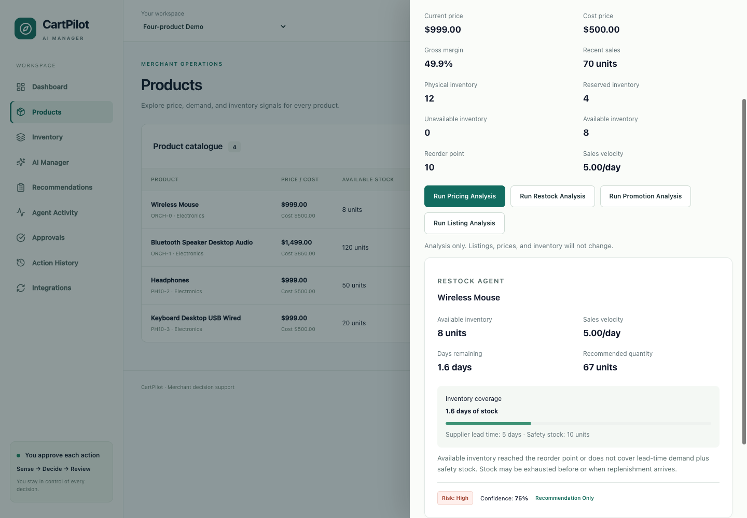
Four specialist agents
Pricing: bounded Decimal price rules
Restock: demand + safety + buffer deficit
Promotion: inventory and margin-safe discounts
Listing: grounded quality checks and suggestions
CartPilot | deterministic specialists • guarded local/simulated actions 06 / 12
Notes:
Evidence: /Users/priyanshuraj/Projects/cartpilot/PROJECT_REPORT_OUTLINE.md
Pricing: bounded Decimal price rules Restock: demand + safety + buffer deficit Promotion: inventory and margin-safe discounts Listing: grounded quality checks and suggestions
Confidence and priority are heuristics. Shopify is mocked/read-only. No measured business uplift is claimed.

Slide 7

Master Orchestrator
Balanced Growth: critical restock first
Listing before inappropriate demand stimulation
Show selected, blocked and omitted work
CartPilot | deterministic specialists • guarded local/simulated actions 07 / 12
Notes:
Evidence: /Users/priyanshuraj/Projects/cartpilot/PROJECT_REPORT_OUTLINE.md
Balanced Growth: critical restock first Listing before inappropriate demand stimulation Show selected, blocked and omitted work
Confidence and priority are heuristics. Shopify is mocked/read-only. No measured business uplift is claimed.

Slide 8
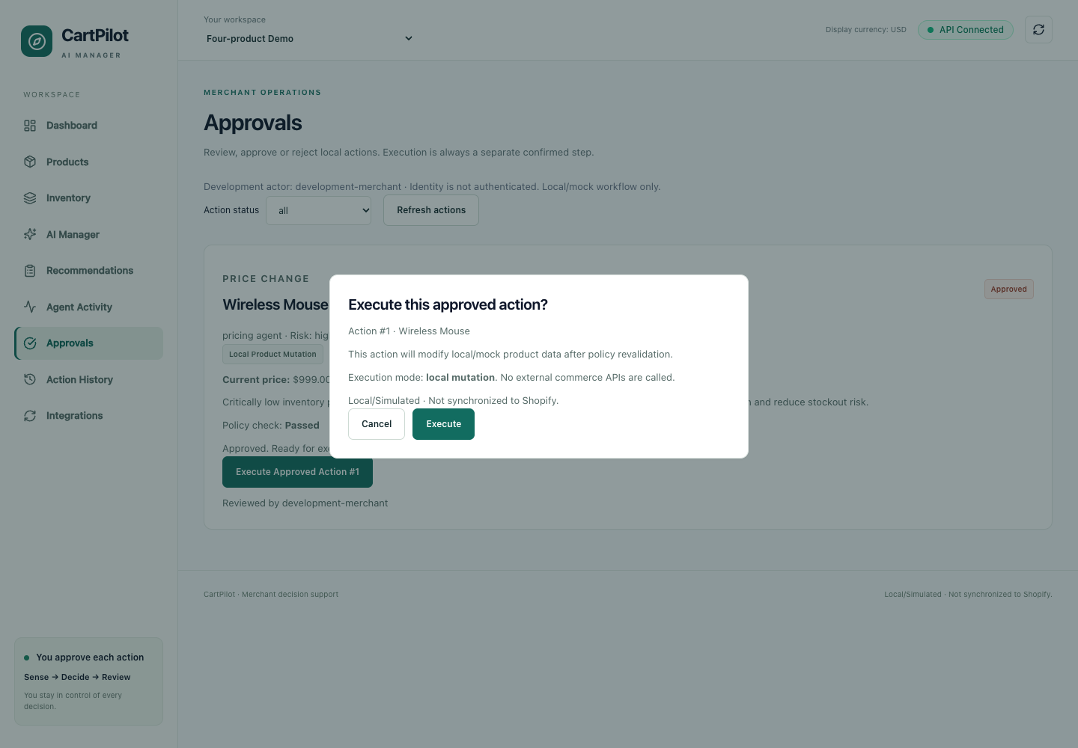
Approval and guardrails
Review and approval do not execute
Separate confirmation + current-state revalidation
50% price movement fails the 10% policy
CartPilot | deterministic specialists • guarded local/simulated actions 08 / 12
Notes:
Evidence: /Users/priyanshuraj/Projects/cartpilot/PROJECT_REPORT_OUTLINE.md
Review and approval do not execute Separate confirmation + current-state revalidation 50% price movement fails the 10% policy
Confidence and priority are heuristics. Shopify is mocked/read-only. No measured business uplift is claimed.

Slide 9
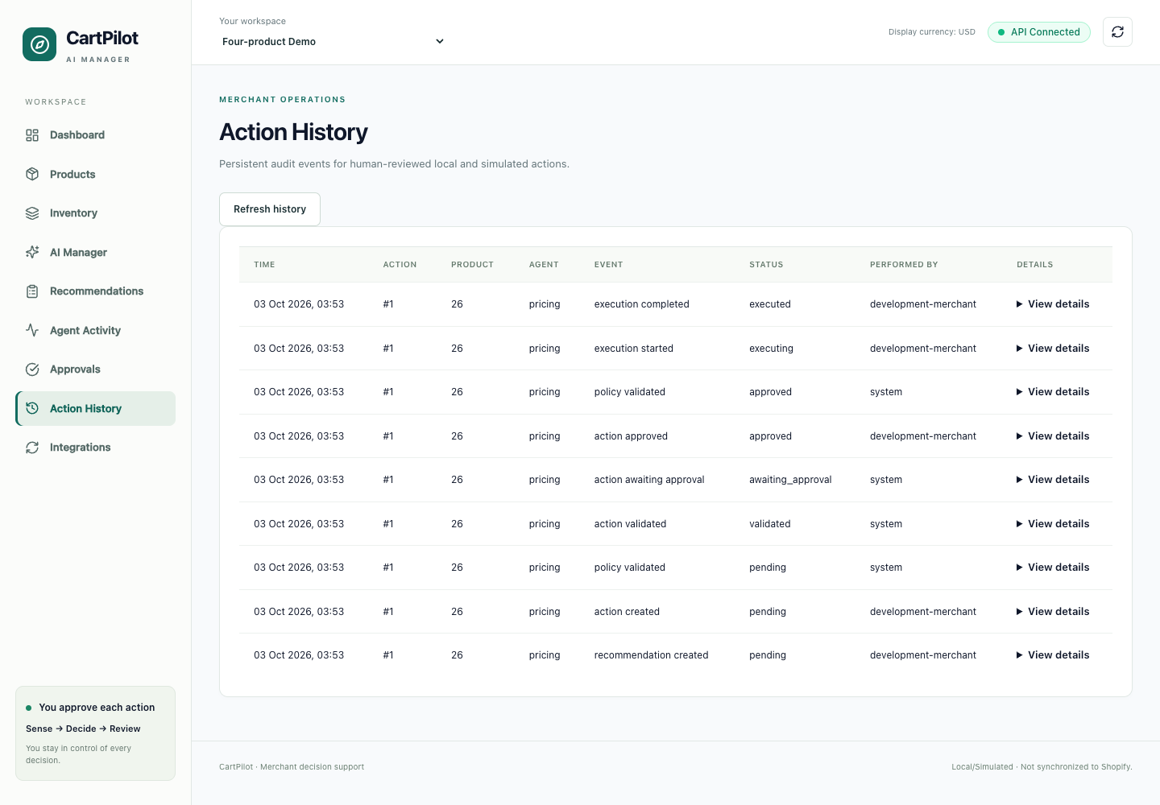
Demonstrated behavior
Mouse: 8 available; 5/day; restock 67
Approved local price: 999 → 1048.95
Persistent execution audit; Shopify import mocked
CartPilot | deterministic specialists • guarded local/simulated actions 09 / 12
Notes:
Evidence: /Users/priyanshuraj/Projects/cartpilot/PROJECT_REPORT_OUTLINE.md
Mouse: 8 available; 5/day; restock 67 Approved local price: 999 → 1048.95 Persistent execution audit; Shopify import mocked
Confidence and priority are heuristics. Shopify is mocked/read-only. No measured business uplift is claimed.

Slide 10
Verification evidence
560 backend tests; 76 frontend tests
TypeScript / Vite build and 9 browser routes passed
Fresh migrations/seed; stale-state and policy blocks
Basic PostgreSQL execution checked; cloud unverified
CartPilot | deterministic specialists • guarded local/simulated actions 10 / 12
Notes:
Evidence: /Users/priyanshuraj/Projects/cartpilot/PROJECT_REPORT_OUTLINE.md
560 backend tests; 76 frontend tests TypeScript / Vite build and 9 browser routes passed Fresh migrations/seed; stale-state and policy blocks Basic PostgreSQL execution checked; cloud unverified
Confidence and priority are heuristics. Shopify is mocked/read-only. No measured business uplift is claimed.

Slide 11
Limits and future work
Deterministic heuristics; no trained forecasting or learning
No production authentication; trusted private access
External actions simulated; Shopify read-only
Future: identity, forecasting and authorized adapters
CartPilot | deterministic specialists • guarded local/simulated actions 11 / 12
Notes:
Evidence: /Users/priyanshuraj/Projects/cartpilot/PROJECT_REPORT_OUTLINE.md
Deterministic heuristics; no trained forecasting or learning No production authentication; trusted private access External actions simulated; Shopify read-only Future: identity, forecasting and authorized adapters
Confidence and priority are heuristics. Shopify is mocked/read-only. No measured business uplift is claimed.

Slide 12
Conclusion and questions
Explainable coordination across four domains
Human control, current-state safety and audit evidence
Trusted academic demo; no business uplift claimed
CartPilot | deterministic specialists • guarded local/simulated actions 12 / 12
Notes:
Evidence: /Users/priyanshuraj/Projects/cartpilot/PROJECT_REPORT_OUTLINE.md
Explainable coordination across four domains Human control, current-state safety and audit evidence Trusted academic demo; no business uplift claimed
Confidence and priority are heuristics. Shopify is mocked/read-only. No measured business uplift is claimed.

