Slide 1

Electric Vehicle Population Analysis
Submitted by: Priyanshu Tanwar
Registration No: 12303519
Programme and Section: Btech Cse and K23SH
Course Code: INT-217

Slide 2
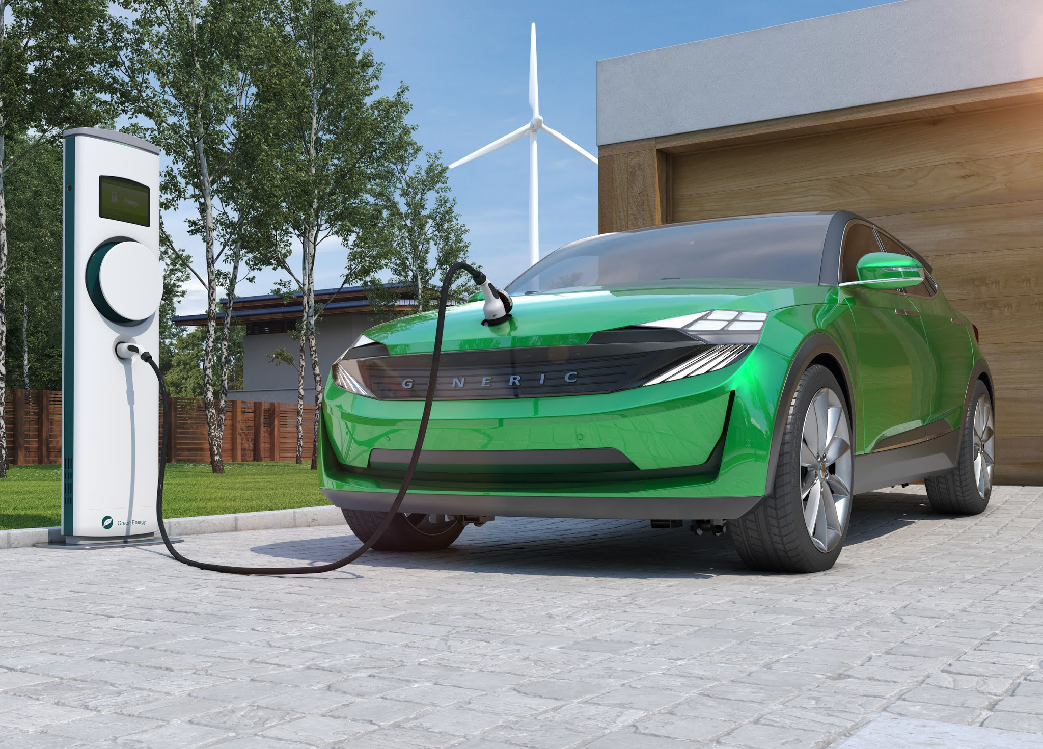
Introduction
Electric vehicles (EVs) are revolutionizing the transportation landscape by offering a sustainable alternative to traditional internal combustion engines. This project explores the electric vehicle population dataset through Excel, leveraging its powerful data analysis and visualization features to uncover key insights and patterns in EV adoption.

Slide 3

Dataset Overview
Source: Official Open Government Dataset on EVs
Scope: Electric vehicle registration and details across various parameters
Attributes Covered:
Vehicle Make and Model
EV Type (Battery Electric/Plug-in Hybrid)
Region & City of Registration
Model Year
Electric Range

Slide 4

Data Preprocessing
Removed unnecessary columns for clarity
Cleaned null and inconsistent entries
Standardized vehicle types and regional names
Converted data types for accurate calculations
Created pivot-friendly formats for analysis

Slide 5

Objectives of the Analysis
Identify the Top EV Manufacturers
Discover the Most Popular EV Models
Analyze the Regional Distribution of EVs
Understand the Breakdown by Vehicle Type
Observe Year-wise Growth and Trends
Build a visually appealing and interactive Excel Dashboard

Slide 6
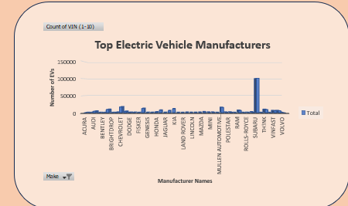
Top EV Manufacturers
General Description: Understanding which manufacturers lead the EV market
Excel Feature Used: Pivot Table + Column Chart
Insights:
Tesla dominates with the highest share
Nissan and Chevrolet are key contributors
Visualization: Horizontal bar chart sorted by registration count

Slide 7
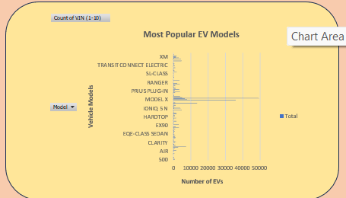
Most Popular Models
General Description: Pinpointing individual vehicle models with high adoption
Excel Tools: Pivot Table + Filtered Model Analysis
Insights:
Tesla Model 3, Nissan Leaf among top models
Certain models spike in popularity post-2020
Visualization: Column chart with color-coded model names

Slide 8
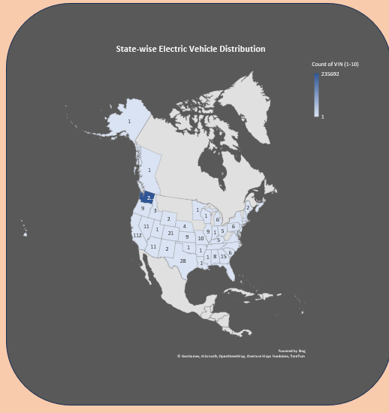
Regional Distribution
Description: Highlighting where EV adoption is highest
Excel Tools: Pivot Chart + Map Chart
Findings:
Urban hubs like Seattle and Bellevue lead adoption
Certain counties show minimal penetration
Visualization: Geo-map with data bars

Slide 9
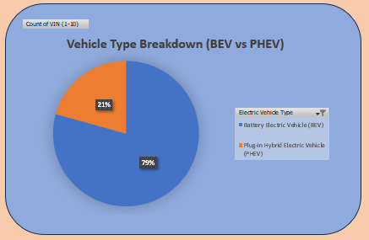
Vehicle Type Distribution
Purpose: Analyze Battery Electric vs Plug-in Hybrid vehicle trends
Method: Pie Chart & Bar Chart from Pivot Tables
Observations:
Battery Electric Vehicles (BEVs) lead the way
Plug-in Hybrids maintain a stable presence

Slide 10
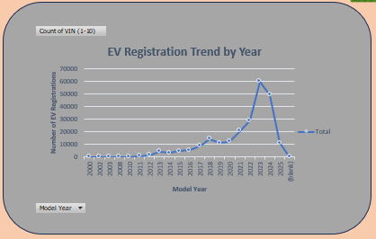
Year-wise Trends
Goal: Track how EV registrations have evolved over time
Excel Tools: Line Chart + Slicers for interactivity
Result:
Steady growth since 2015
Massive uptick post-2019
Visualization: Interactive line chart with slicers for year filtering

Slide 11
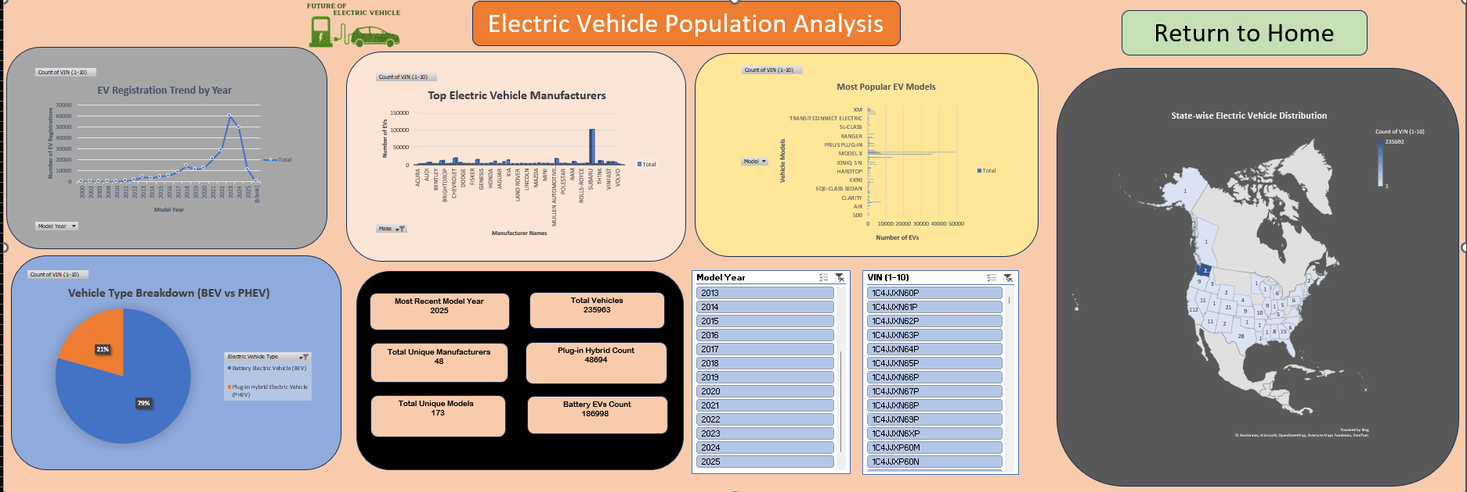
Final Dashboard
Integrated all objectives into a single dashboard
Includes:
Dynamic slicers (Make, Model Year, Region)
Linked charts for interactivity
Clean layout with slicer color-coded buttons
Purpose: Instant insight delivery with filters

Slide 12
Conclusion
The dashboard provides a deep, intuitive look into the electric vehicle landscape. It highlights leading manufacturers, growing trends, and regional disparities. Excel's advanced visualization and pivot capabilities make the insights both accessible and actionable.

Slide 13


