Slide 1

Customer Shopping Behavior Analysis
3,900 purchases — 18 features — goal: spending, segments, preferences, subscriptions

Slide 2
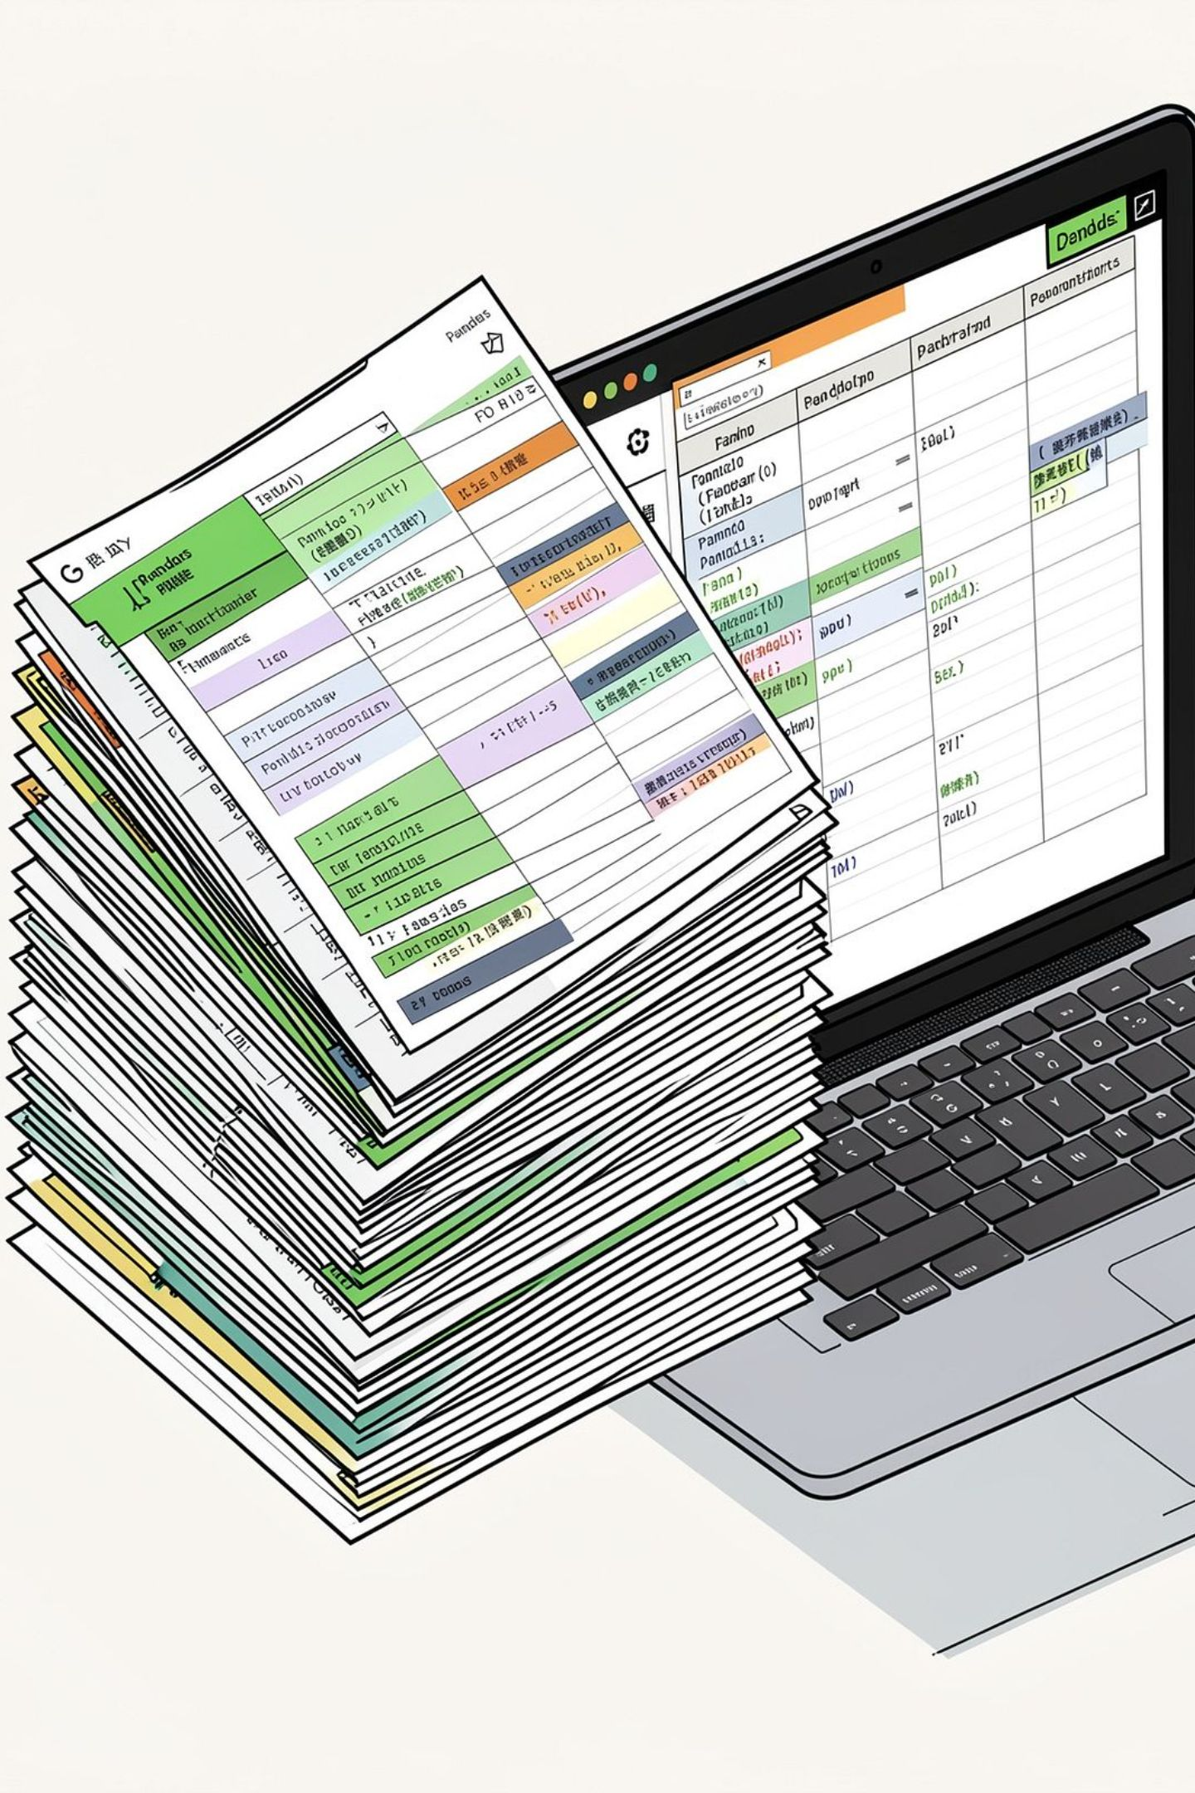
Dataset Summary
Size
Key Features
Rows: 3,900 • Columns: 18
Demographics, Purchase details, Behavior
Missing Data
37 missing values in Review Rating

Slide 3
EDA & Preparation (Python)
01
02
03
Load & Inspect
Clean & Impute
Standardize
pandas: df.info(), describe()
Imputed Review Rating by category median
Renamed columns to snake_case
04
05
Feature Eng.
DB
age_group, purchase_frequency_days
Loaded cleaned DataFrame into MySQL

Slide 4
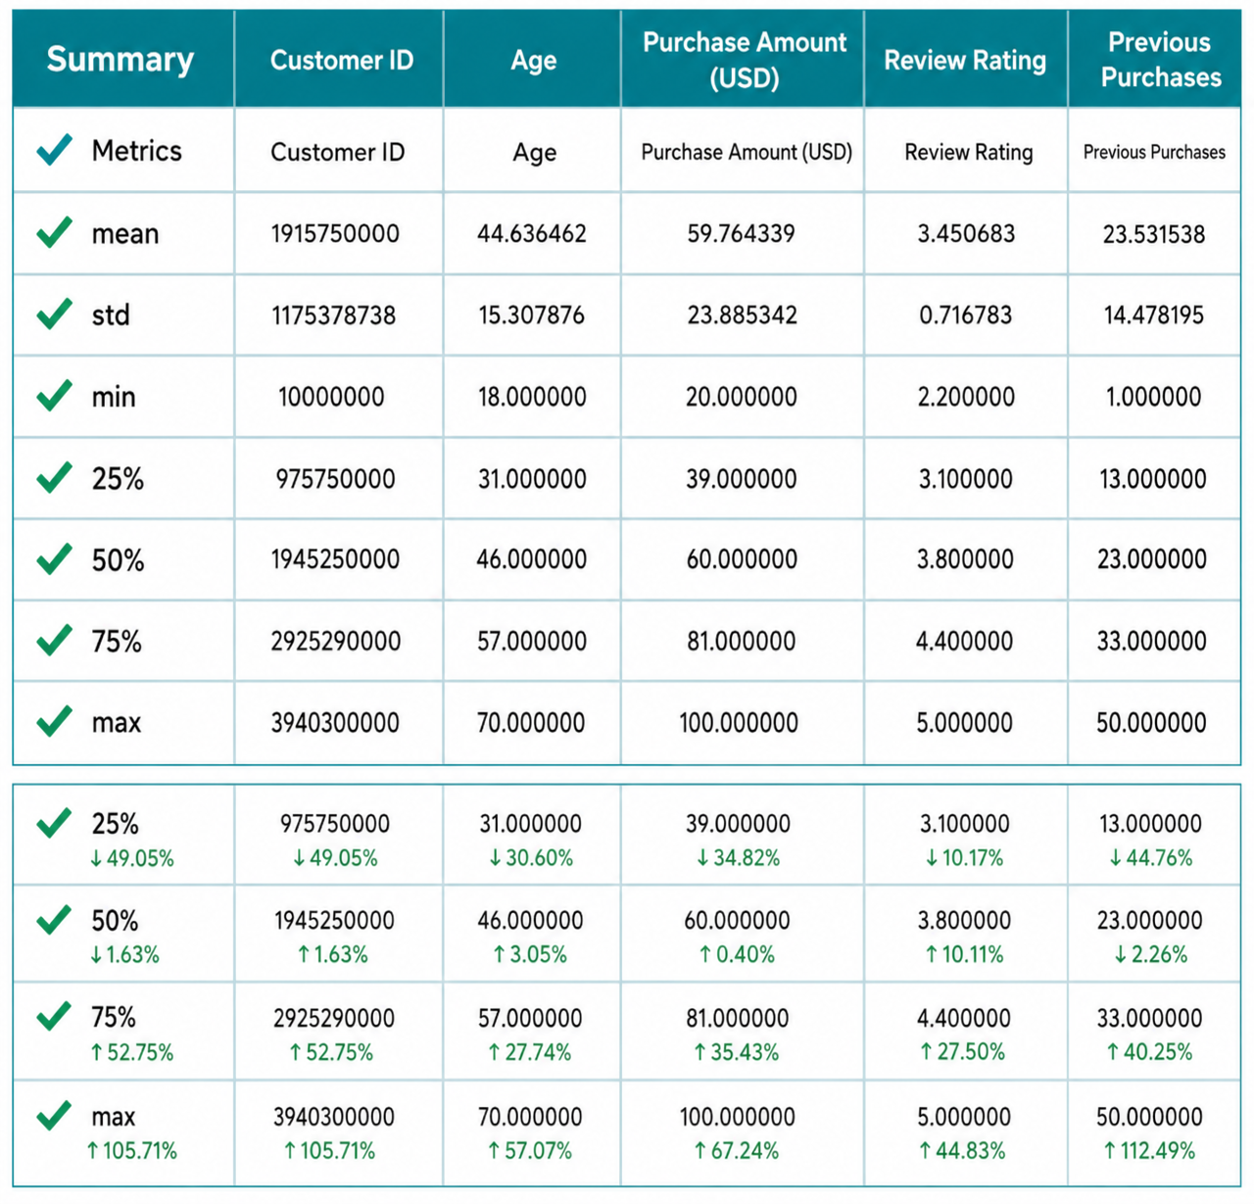
Descriptive Stats Snapshot
Highlights
Mean purchase: $59.76
Avg review rating: 3.75 (37 missing)
Top item frequency: Blouse (171)

Slide 5
SQL Findings — Revenue & Segments
Revenue by Gender
Customer Segments
Repeat Buyers & Subscriptions
Male: 157,890 • Female: 75,191
Loyal: 3,116 • Returning: 701 • New: 83
Repeat buyers more likely to subscribe (958 vs 2,518)

Slide 6





Top Products & Ratings
Gloves
Sandals
Boots
Hat
Avg rating: 3.86
Avg rating: 3.84
Avg rating: 3.82
Avg rating: 3.80
Skirt
Avg rating: 3.78

Slide 7
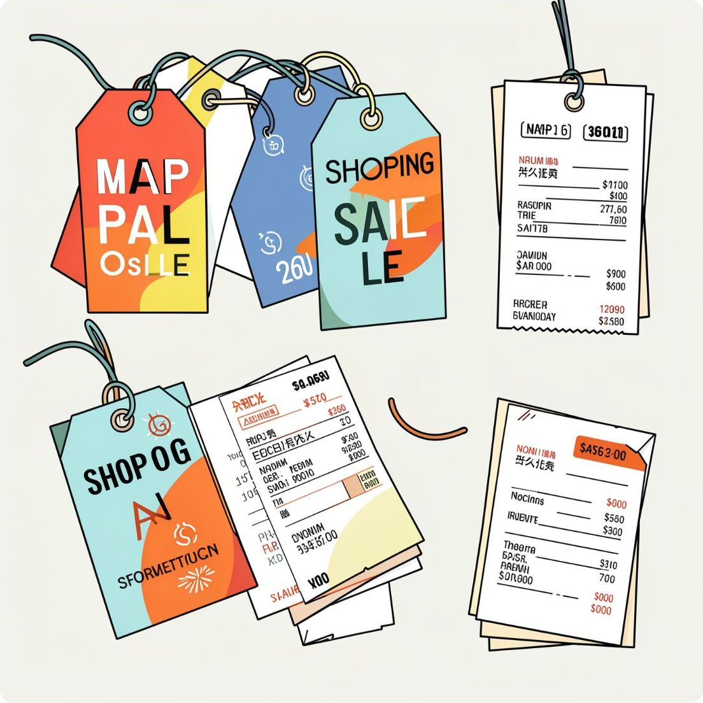
Discounts & High-Spenders
Discount-Dependent Items
High-Spending with Discounts
Top: Hat 50% • Sneakers 49.66% • Coat 49.07% • Sweater 48.17% • Pants 47.37%
Examples: customer_id 3 ($73), 4 ($90), 29 ($94) — spent above average despite discounts

Slide 8
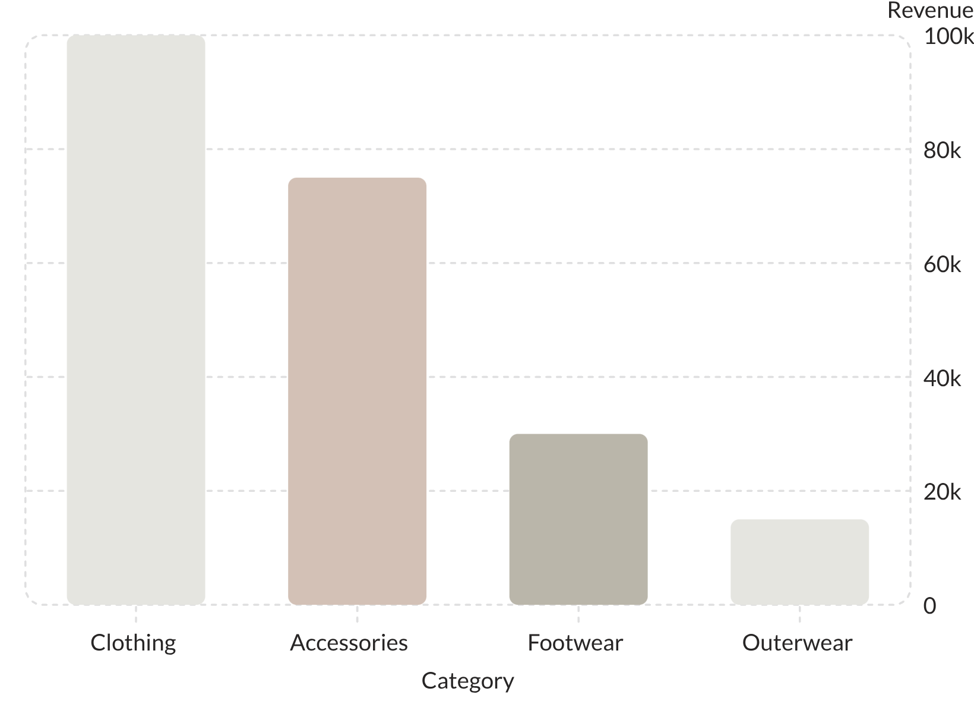
Revenue & Shipping Insights
Shipping Comparison
Express avg: $60 • Standard avg: $58
Age Group Revenue
Young Adult: 62,143 • Middle-aged: 59,197 • Adult: 55,978 • Senior: 55,763

Slide 9
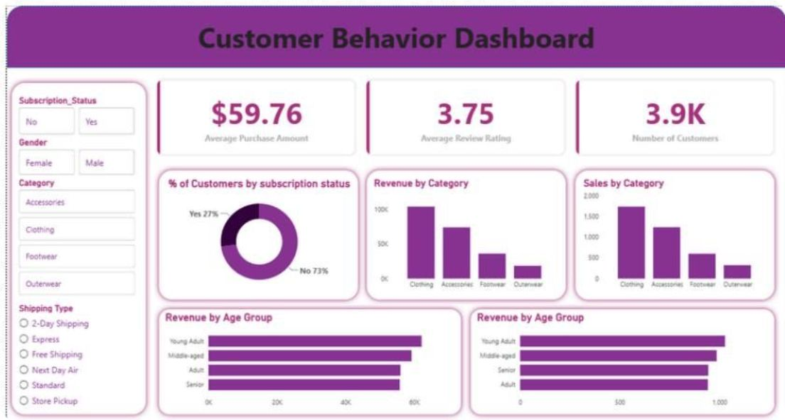
Dashboard Preview
Key Metrics
Avg purchase $59.76 • Avg rating 3.75 • Customers 3.9K
Subscription Mix
Yes 27% • No 73%

Slide 10
Business Recommendations
Boost Subscriptions
Loyalty Programs
Discount Policy
Promote exclusive subscriber benefits
Reward repeat buyers to increase loyalty
Balance sales lift with margin control
Product Positioning
Targeted Marketing
Feature top-rated & best-selling items in campaigns
Focus on high-revenue age groups and express-shipping users

