Slide 1

IILM UNIVERSITY
Topic - DIGITAL DOCUMENTATION, DATA ANALYSIS AND EDUCATIONAL OUTREACH
Internship report — Priyanshu Singh
B.Tech CSE - 3rd Semester
Roll: 25SCS1003002452
Youth Army — Prayagraj | 1 Jun 2026 – 22 Jun 2026

Slide 2

Why this Internship?
Purpose
Focus
Apply basic digital skills to community outreach
Documentation, data analysis, educational content
Outcome
Reusable digital assets for field use

Slide 3
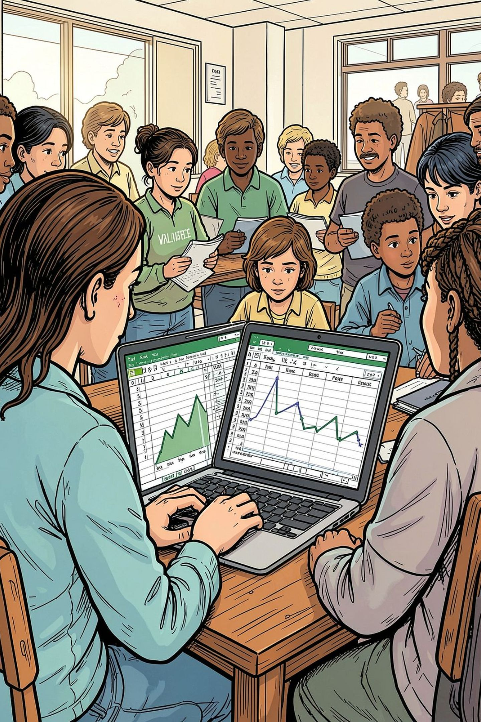
Core Responsibilities
Documentation
Maintain digital records of ground activities
Data
Organize surveys in Excel; create graphs
Content
Prepare PPTs, PDFs, posters; support social media

Slide 4
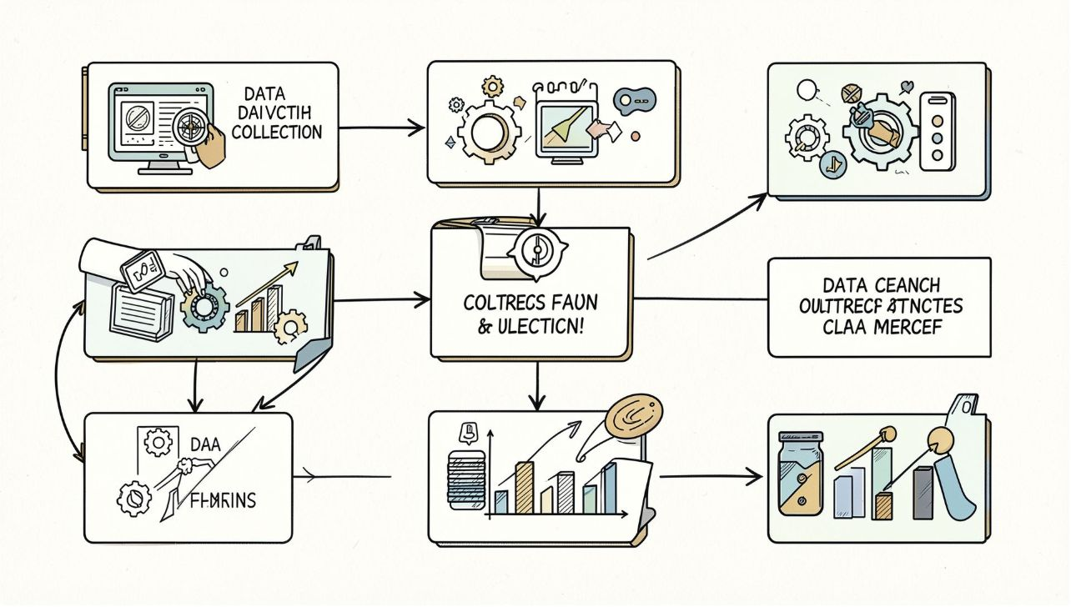
Operational Pipeline
Ground activities → Digital documentation
Excel organization → Survey analysis & graphs
Reports → PPTs/PDFs & awareness posters
Deploy in community outreach

Slide 5

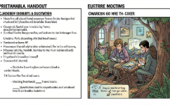
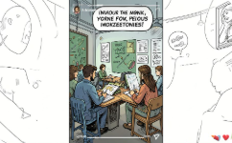
Educational Content
Simple & Visual
Printable PDFs
Social Assets
Slides tailored for school students with low access
High-res for print and projector use
Instagram-ready awareness creatives

Slide 6

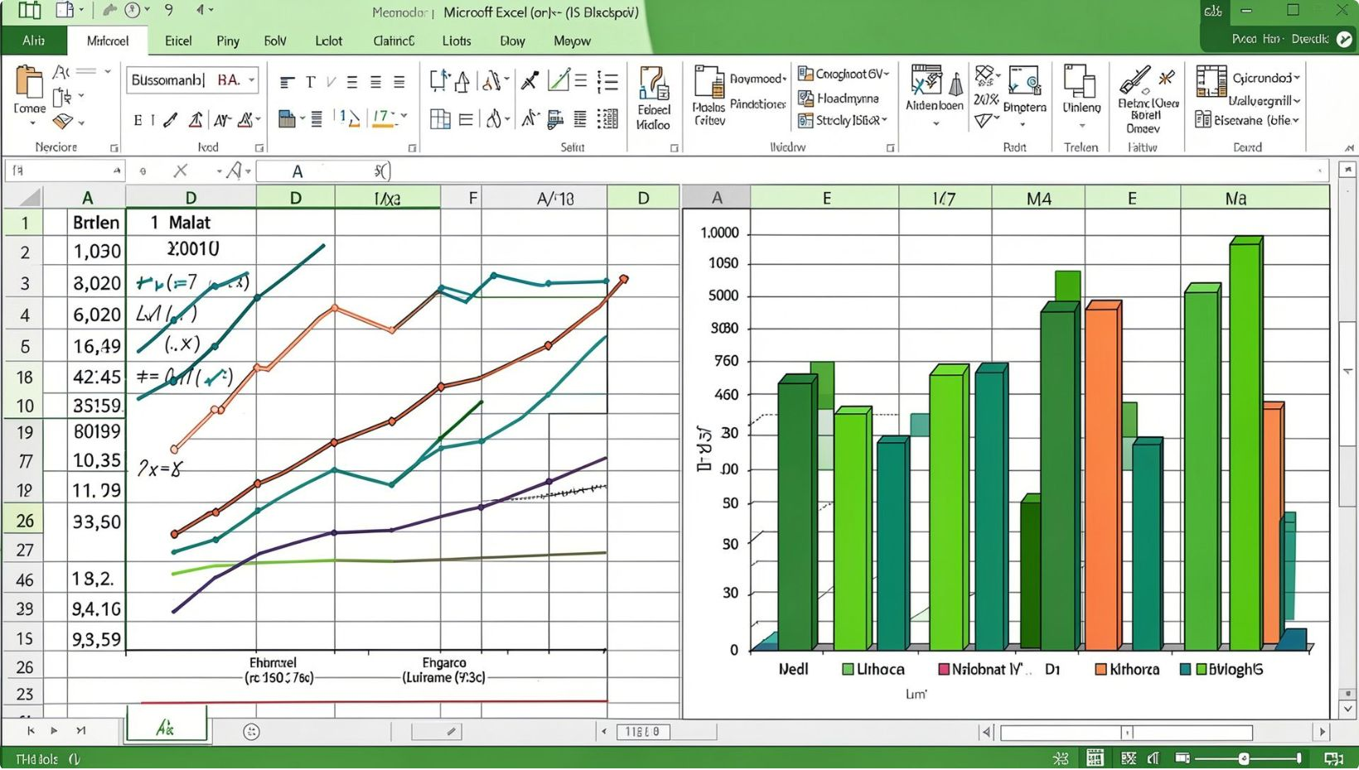

Data & Analysis
1
2
Survey Databases
Graphs
Student & youth demographics
Visualize findings for reports
3
Fund Analysis
Basic expenditure summaries

Slide 7





Design & Tools
MS Word
MS Excel
PowerPoint
Documentation & reports
Data organization & charts
Educational slide decks
Figma & Canva
Google Drive
Posters, layouts, prototyping
Cloud collaboration & storage

Slide 8
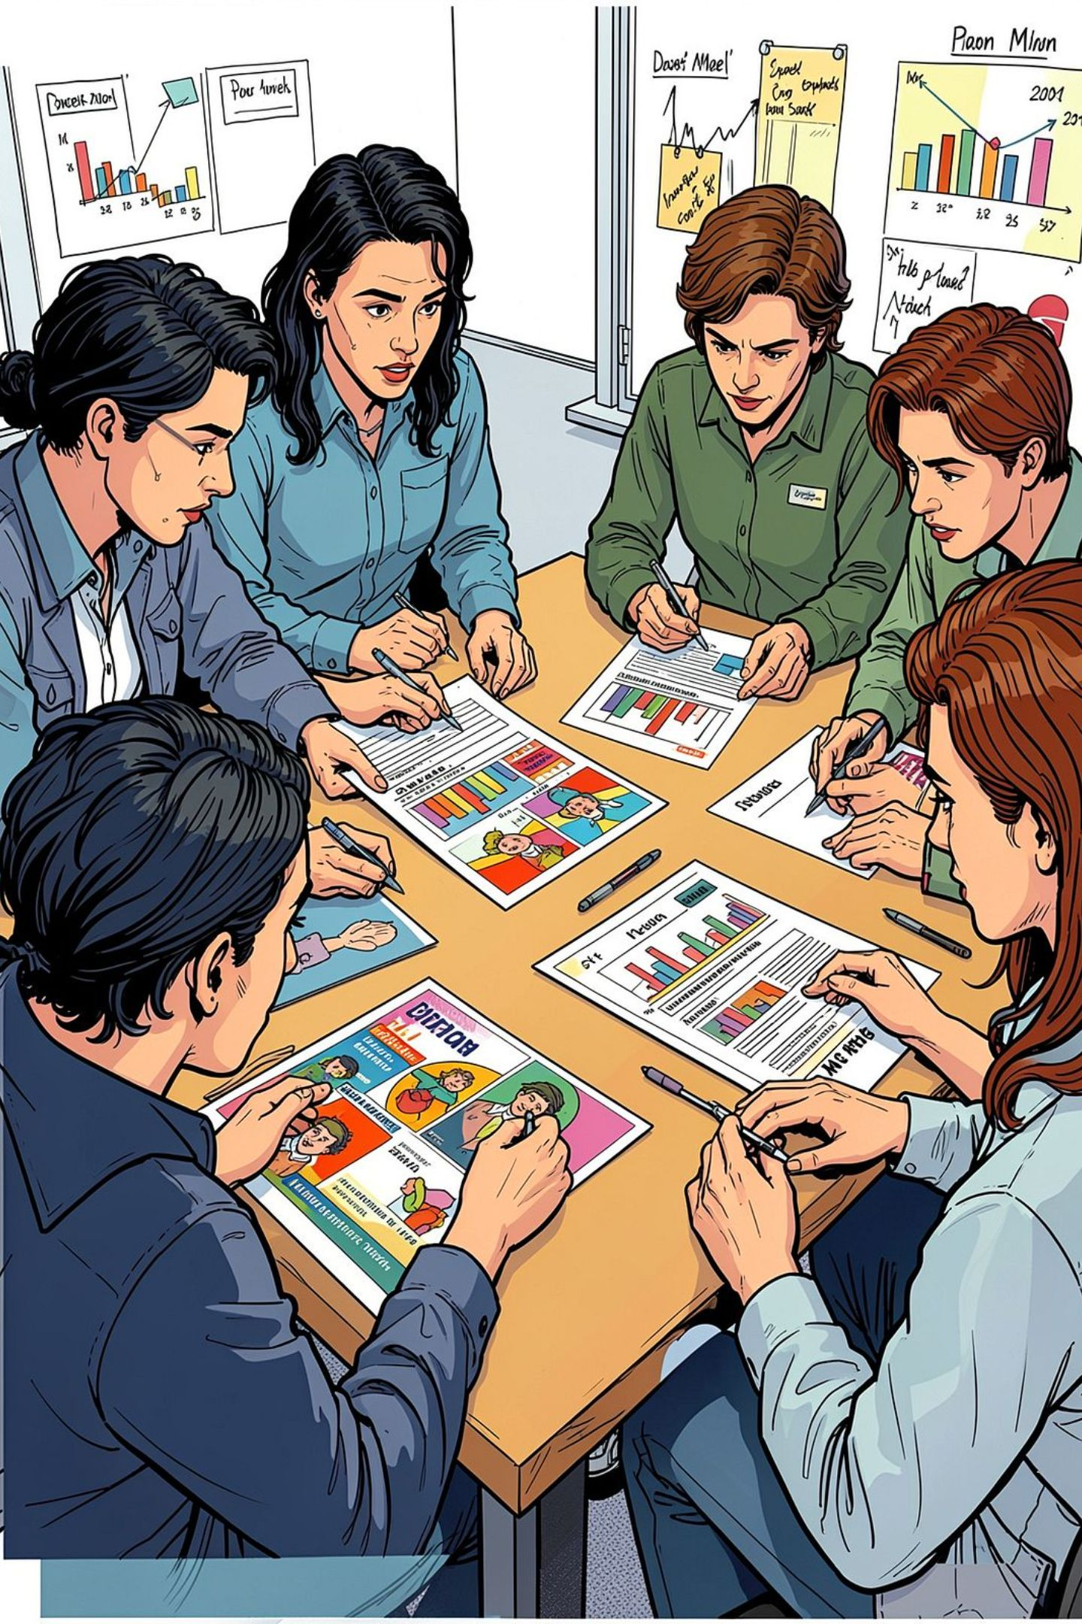
Methodology
01
Gather
Requirements & field input
02
Modularize
Break topics into bite-sized lessons
03
Visualize
Design slides, posters, PDFs
04
Iterate
Incorporate ground feedback

Slide 9
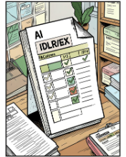
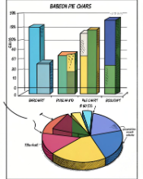


Deliverables
Digital Logs
Analytics
Learning Modules
Awareness Assets
Ground visit records & follow-ups
Survey charts for decision-making
PPTs & PDFs for students
Posters & Instagram content

Slide 10


Key Learnings & Next Steps
Impact
Skills
Simple tools drive measurable community value
Data structuring, visual design, collaborative workflow
Future
Standard templates, automated intake, modular curricula
Use these slides as a concise PPT — expand slides 5–9 with examples when presenting.

