Slide 1

BREAST CANCER PROGNOSIS & SUBTYPE CLASSIFICATION
“A Machine Learning and Bioinformatics Approach”

Slide 2
Team Details
Breast Cancer Prognosis & Subtype Classification
Mentor
Swatantra Pradhan
Team Leader
Manish Kumar Baitharu Regd No: 2341002004
Team Members
1. Amit Roshan Biswal Regd.No:2341002212
2. Priyanshu Kumar Sahoo Regd.No:2341019047
3. Priyansu Rout Regd.No:2341018172
4. Priyanshu Behera Regd.No:2341002114
5. Sidharth Behera Regd.No:2341002120
Department of Computer Science & Engineering (AI&ML)
Institute of Technical Education and Research
Jagamohan Nagar, Jagamara, Bhubaneswar, Odisha - 751030

Slide 3
Outline
Introduction and motivation
Problem statement
Project contributions
Dataset description
Proposed methodology and workflow
Feature importance analysis
Consensus-based gene selection
Survival analysis
Breast cancer subtype classification model
Evaluation Metrics
Results and discussion
Limitations
Conclusion and Future Scope
1

Slide 4
Introduction
Breast cancer is among the most common cancers around the world.
It has various molecular subtypes that differ from each other biologically and clinically.
Information on molecular characteristics of breast cancer is provided by gene expression profiles.
ML and bioinformatics approaches can assist in finding genes that characterize the molecular subtypes of breast cancer.
Survival analysis can be helpful in studying the connection between gene expression profile and patient survival.
2

Slide 5
Motivation
Classification of Subtypes: To find out the possibility of using machine learning algorithms to classify various subtypes of breast cancer molecules.
Gene Identification: To discover significant genes from an extensive pool of gene-related features.
Feature Selection by Consensus: To use multiple selection approaches to find genes that are important consistently.
Survival Analysis: To see if the selected genes give additional information besides the clinical variables in survival analysis.
Reduced Feature Space: To test if a set of selected genes is enough to conduct breast cancer classification with reduced feature space.
Improvement in Research: To see if there is any possibility in the combination of machine learning and bioinformatics techniques with the requirement of independent validation.
3

Slide 6
Problem Statement
Clinical information including a patient’s age, tumor size and cancer stages could be used to predict patient outcomes in breast cancer. Nevertheless, this clinical information alone might not be sufficient since there are instances where two patients having identical clinical characteristics might experience different outcomes due to variations in gene expression within their tumor cells.
Thus, the purpose of this project is to determine whether the addition of genomic information to clinical information increases the ability to predict patient outcomes in breast cancer. In this study, important genes that contribute to classifying patients with breast cancer will be identified and the association between these genes and patient survival will be determined.
4
Notes:
Lead with the problem, not the method. Most of your audience works in a different subfield. One concrete number here is worth three adjectives. About 1 minute.

Slide 7
Project Contributions
Consensus-based feature selection: Uses ten different techniques instead of focusing on one importance metric.
Selection of candidate genes: Chooses EGFR, CDK1, GATA3, ERBB2 and ERBB3 for further analysis.
Subtype classification: Investigates machine learning performance on seven labels for the subtypes.
Comparison of models: Investigates model performance when using 490 features vs. only the five selected genes.
Exploratory survival analysis: Employs Kaplan-Meier plots, Cox proportional-hazards model and the c-index.
Interpretability: Has a smaller number of features to be analyzed.
5

Slide 8
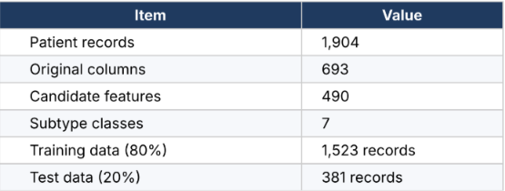
DATASET OVERVIEW FOR BREAST CANCER ANALYSIS
Dataset Description
Dataset Overview
The project uses the METABRIC RNA Mutation.csv dataset reported in the notebook.
Each row indicates one medical file for patients.
The columns hold various attributes including genomics, clinical, and outcome details.
In the current study, the target subtype is first isolated from the candidate attributes prior to classification.
The dataset is split into two parts: training and testing datasets in order to validate the performance of the model.
6

Slide 9
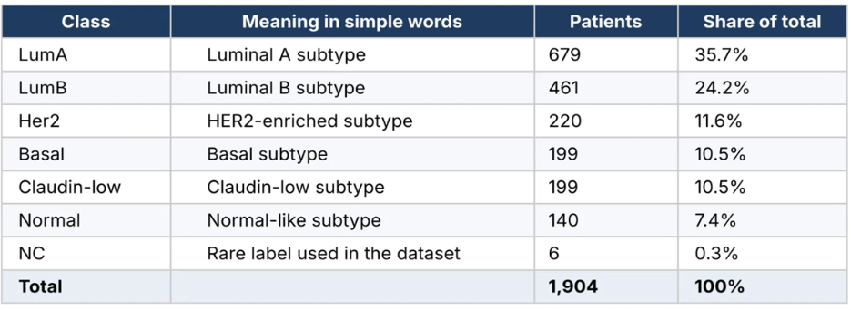
Distribution of seven molecular subtype classes in the breast cancer dataset
Subtype Distribution
The classification target is called pam50 + claudin-low subtype. It contains seven observed labels.
LumA is the biggest class in the dataset.
NC is the smallest class because it only has six entries.
This inequality in class sizes leads to a class imbalance problem.
A model can work efficiently with big classes but fail with small classes.
7

Slide 10
Dataset Preprocessing
Missing value imputation: Missing values of features are imputed using medians computed on the basis of the training dataset.
Feature selection: Clinical features, identifiers, survival status, target features and mutation features ending in "mut" are excluded from the list of potential features, as mentioned in the report.
Train-test splitting: The dataset is divided into 80% training records and 20% test records.
Stratification: The split ensures that the distribution of subtypes is maintained in both datasets.
Scaling: Scaling is used if needed for specific methods.
8

Slide 11
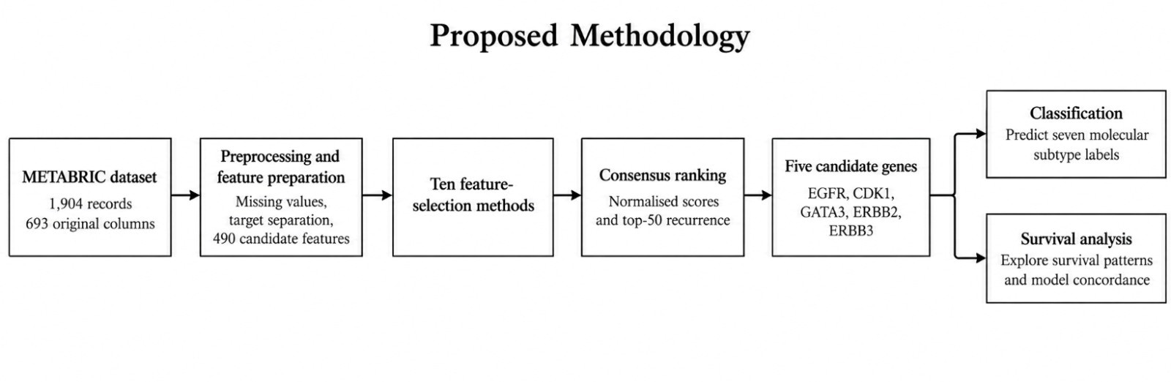
Proposed methodology and workflow
Data Set Preparation: The METABRIC data set consists of 1,904 records of patients and 693 original features. Preprocessing is done to handle missing data, target variables, and to select 490 candidate features.
Feature Selection: Ten different types of complementary feature selection methods are used to assess the importance of features and find out the genes which are related to them.
Consensus Ranking: The ranking of importance scores is done using normalization and top-50 selection frequency method.
Gene Selection: Candidate genes such as EGFR, CDK1, GATA3, ERBB2, and ERBB3 are considered.
Classification: Machine learning technique is used to classify seven breast cancer molecular subtypes.
Survival Analysis: Survival analysis is carried out by means of Cox proportional-hazards models, concordance index, and Kaplan–Meier estimator.
9

Slide 12
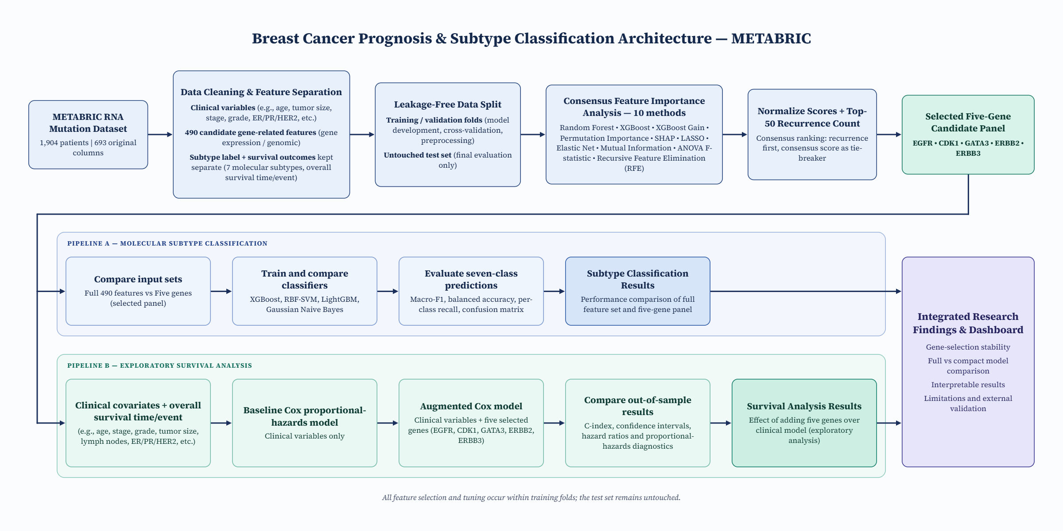
8
10
Notes:
Put the takeaway in words on the slide — do not make the audience derive it from the numbers. Report variance, not just headline figures, and do not claim an improvement that sits inside the error bars. 1–2 minutes.

Slide 13
Feature Importance Analysis
Understanding Feature Importance
Feature Importance is used to determine how informative input features are in a machine learning algorithm.
It aids in finding out the features which are most significant for prediction and classification.
For instance, in the breast cancer study, the important features are the ones that aid in differentiating between molecular subtypes of breast cancer.
The features could be in the form of genes which have been found to have certain expressions which give information about tumor.
Finding out such genes would aid in improving the efficiency of the classification model.
Feature importance would help in minimizing the impact of useless features on the prediction process.
For this project, various methods are employed for feature selection to find out
which genes are most relevant from the METABRIC data set.
11

Slide 14
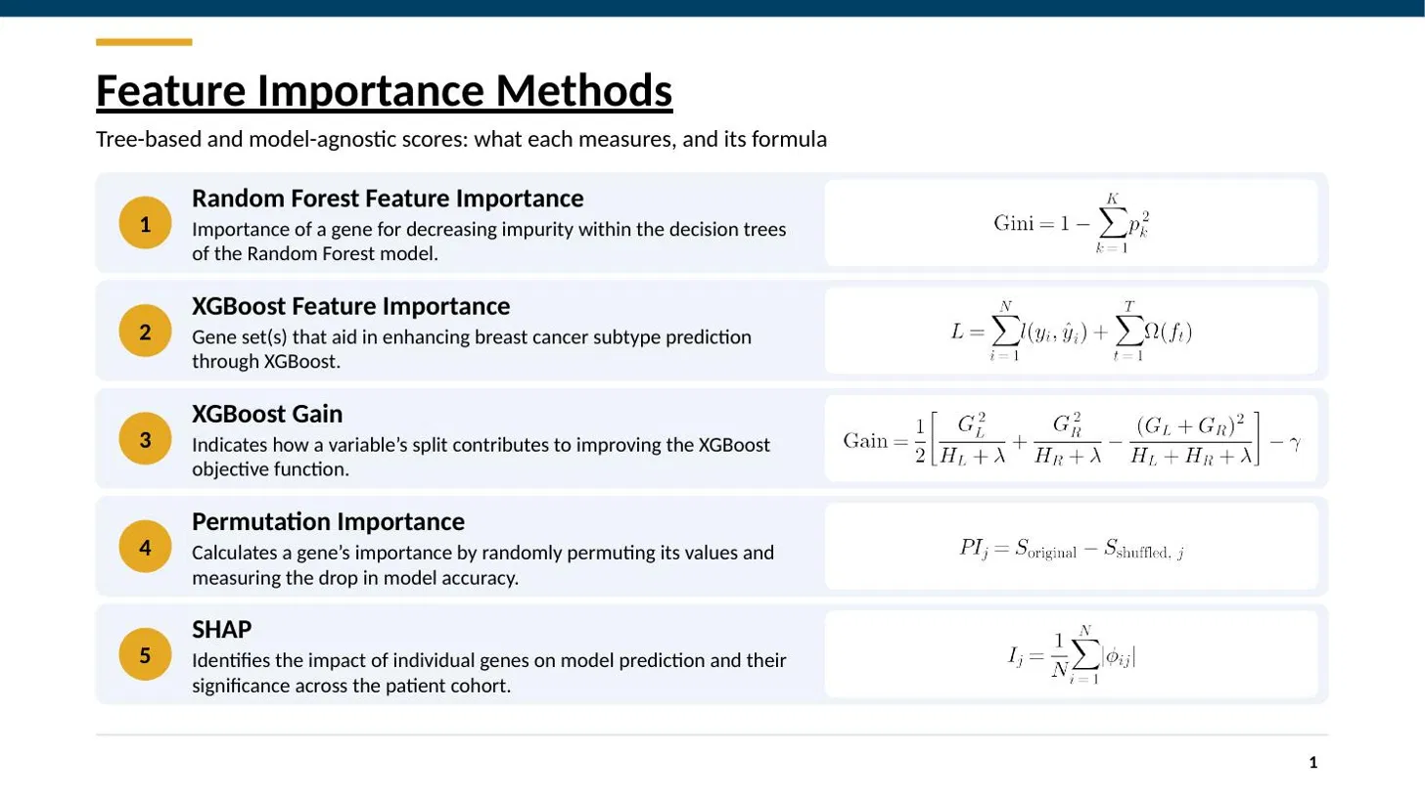
12

Slide 15
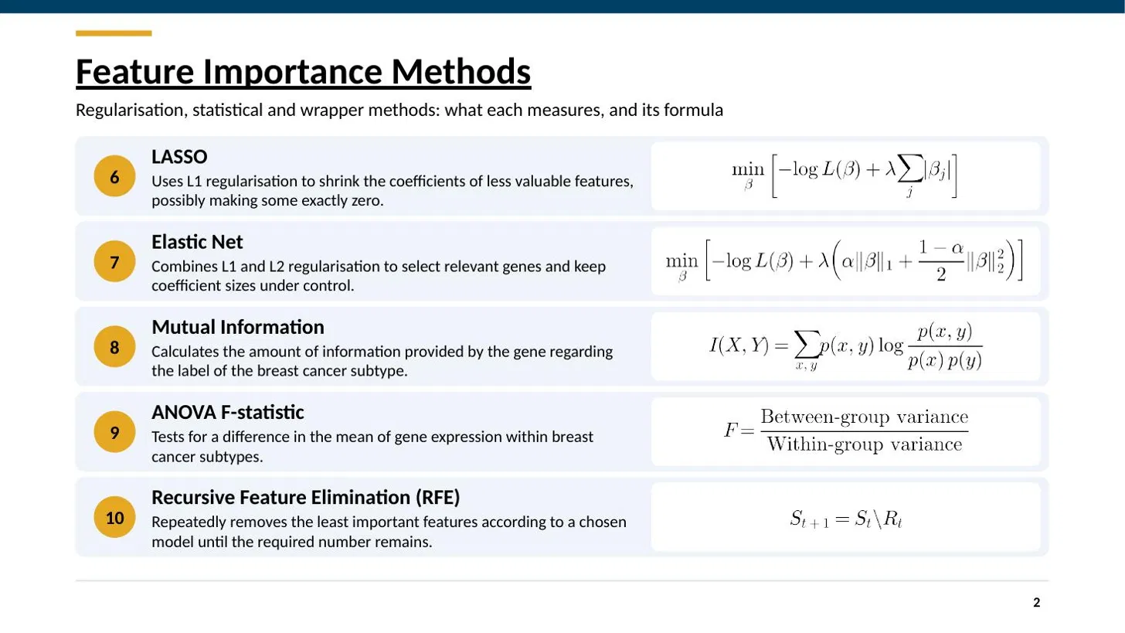
13

Slide 16
Combining Multiple Methods for Reliable Gene Selection
The importance of a feature may vary depending on the method used.
Tree-based methods consider the way features operate in tree models.
LASSO and Elastic Net examine the coefficients of the feature.- Mutual information and ANOVA measure statistical association.
SHAP and permutation importance estimate the influence of feature information on the model prediction.
This combination makes possible to rely on the perspective of a certain method.
Important: If several methods agree, it provides justification for a further study of the gene, yet it doesn't mean that the gene can cause cancer.
14

Slide 17
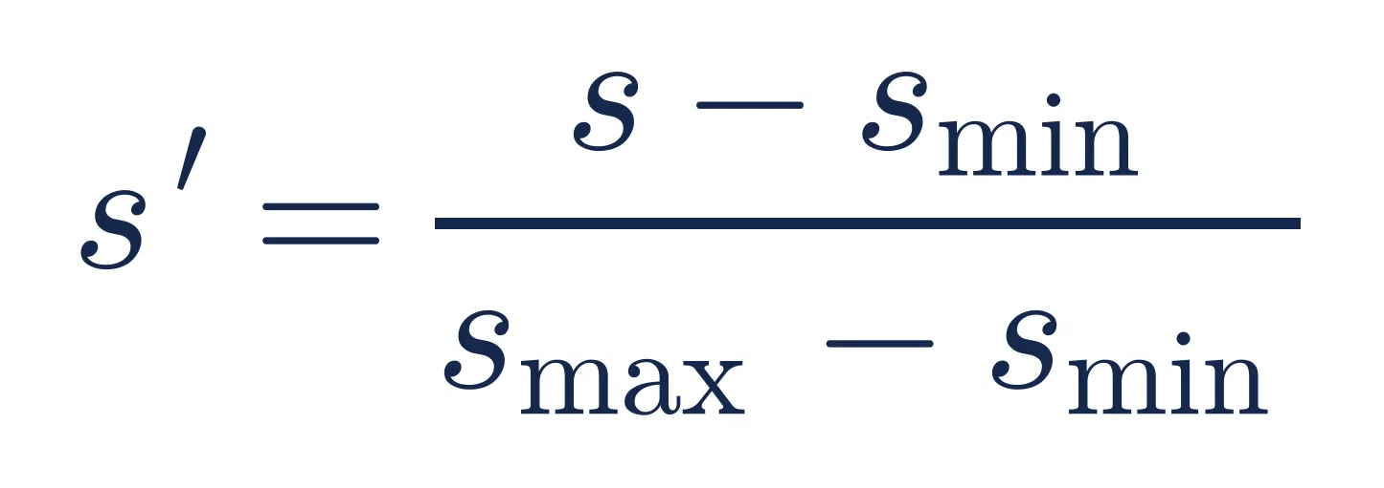
_{Calculation of consensus score}
The report identifies two main types of evidence for the calculation of consensus:
Normalized importance score: The scores for each of the methods are normalized to be in the [0; 1] range using the min–max normalization.
Top-50 recurrence: The number of occurrences of each feature among the top 50 selected features for the methods.
The formula for the normalization is
where (s) is the initial score and (s') is its normalized counterpart.
Example: For a score set of 2, 5 and 8 the normalized scores will be 0, 0.5 and 1 respectively.
The average of the normalized scores is used to calculate the consensus score. The final ordering takes into account top-50 recurrence before the consensus score. That's why the final ordering doesn't just follow the descending order of consensus score.
15

Slide 18
Consensus-based gene selection
What is meant by consensus selection?
Consensus stands for agreement between multiple algorithms.
Each algorithm rates the features based on their importance scores.
The project identifies features that consistently rank highly across multiple algorithms.
Recurrence is used in conjunction with normalized scores.
Five genes are selected as candidates for further investigation.
16

Slide 19
What is the reason to choose five genes rather than all 490?
Five genes are simpler to analyze compared to 490 features.
It makes the analysis simpler to understand.
It decreases the number of input features by 98.98%.
It enables scientists to concentrate on a manageable subset of candidates.
But, on the other hand, a decrease in feature set means a loss of some valuable information and decreased classification efficiency.
This fact is important to remember, because the five gene set is a concise scientific finding, but not a substitution for the whole feature set.
17

Slide 20
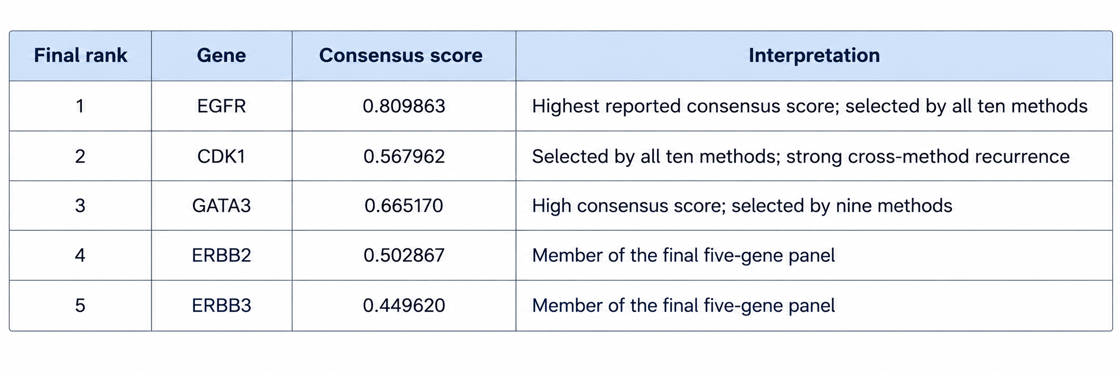
Selected genes and their biological relevance
The function of these genes in biology is related to cell growth, signaling or cell identity studies.
Their inclusion in this project means that they were identified as good candidates based on the feature-selection method used.
This does not imply that all the five genes individually contribute to breast cancer or predict survival.
18

Slide 21
Survival Analysis
Definition of survival analysis
Survival analysis deals with the duration until a specific event happens.
In the current project, the survival analysis looks at survival rates of patients.
The analysis attempts to find out if the chosen genes provide any additional information to clinical variables.
This is distinct from the prediction of breast cancer subtypes.
19

Slide 22
Cox proportional-hazards model
The Cox model determines the relationship between the variables and hazard, which is the event rate at any point in time.
The first model is based on clinical parameters.
The second model includes both the five chosen genes and the clinical parameters.
Comparison of the models is done via the concordance index.
Coefficients of the genes along with their significance are also analyzed.
20

Slide 23
Concordance Index (C-index)
The C-index reflects how accurately a survival model can rank-order patients based on their survival experience.
A value near 0.5 suggests that ranking accuracy is no better than that of random ranking.
The closer the value is to 1, the more accurate the ranking.
This index does not indicate how long a patient will survive.
21

Slide 24
Kaplan-Meier estimator
The Kaplan-Meier estimator computes an estimated probability of survival without events with respect to time.
The project plots survival curves for those patients with relatively high and low expression of the genes chosen.
The genes are separated into high and low expression groups based on the median of the cohort.
This helps visualize the potential differences between the groups.
The difference observed visually does not make it statistically significant.
22

Slide 25
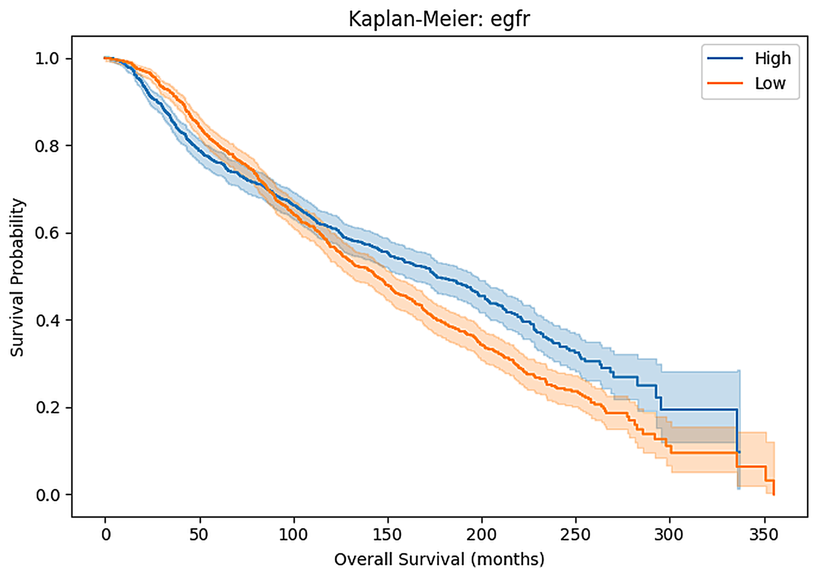
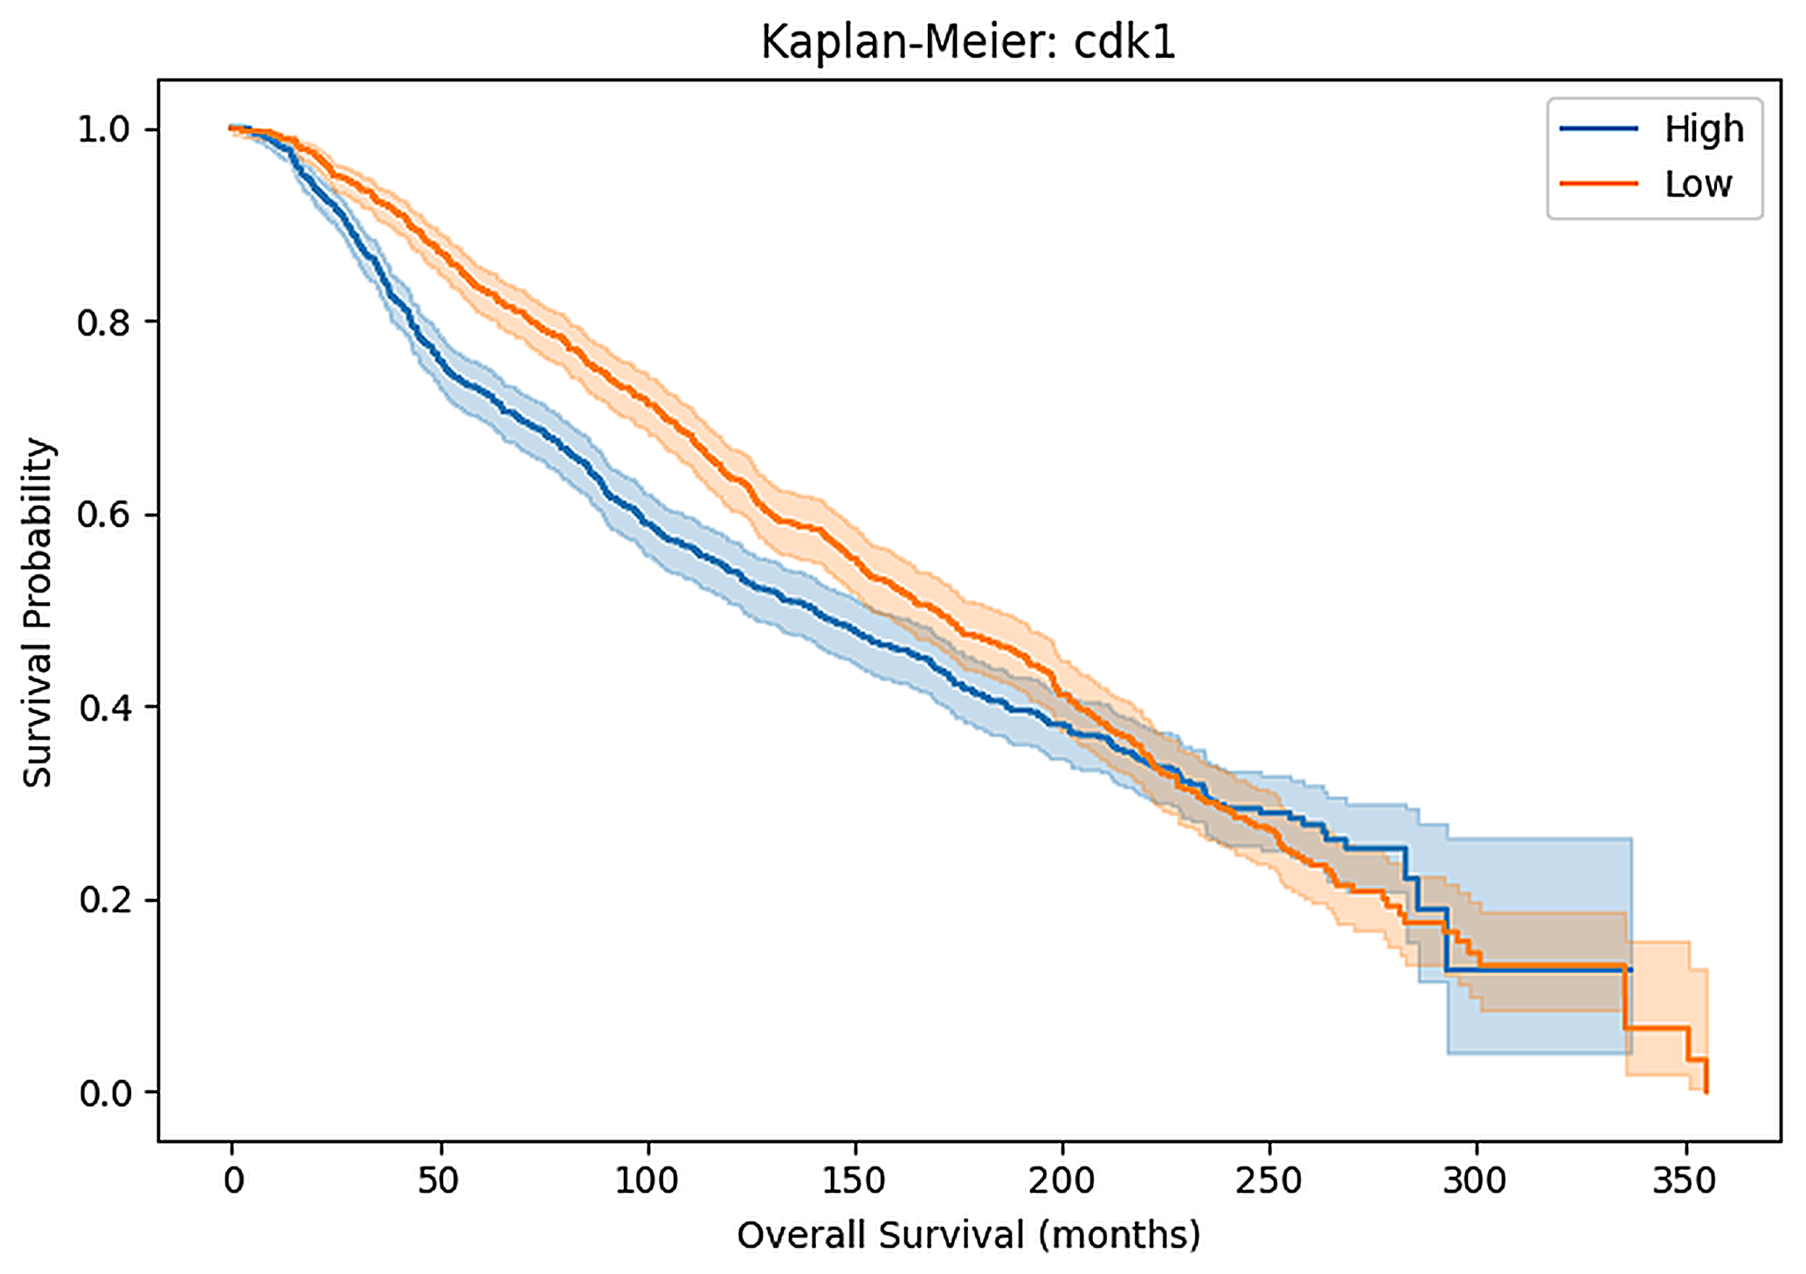
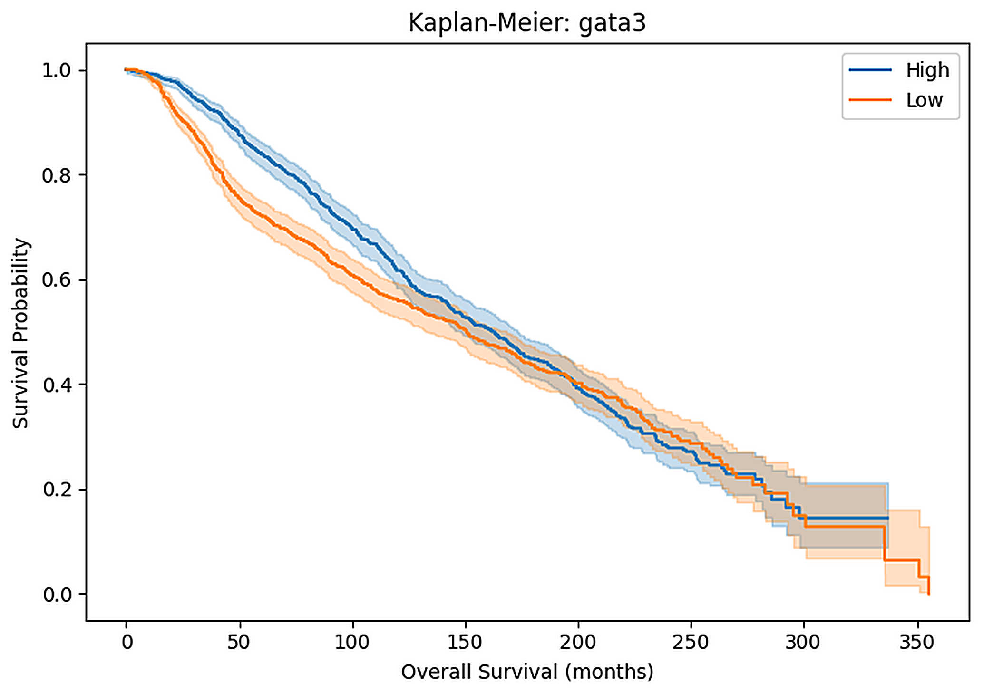
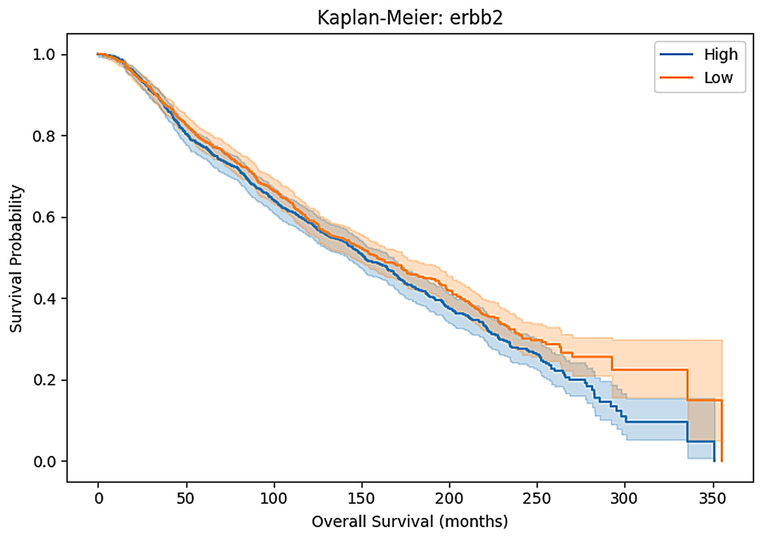
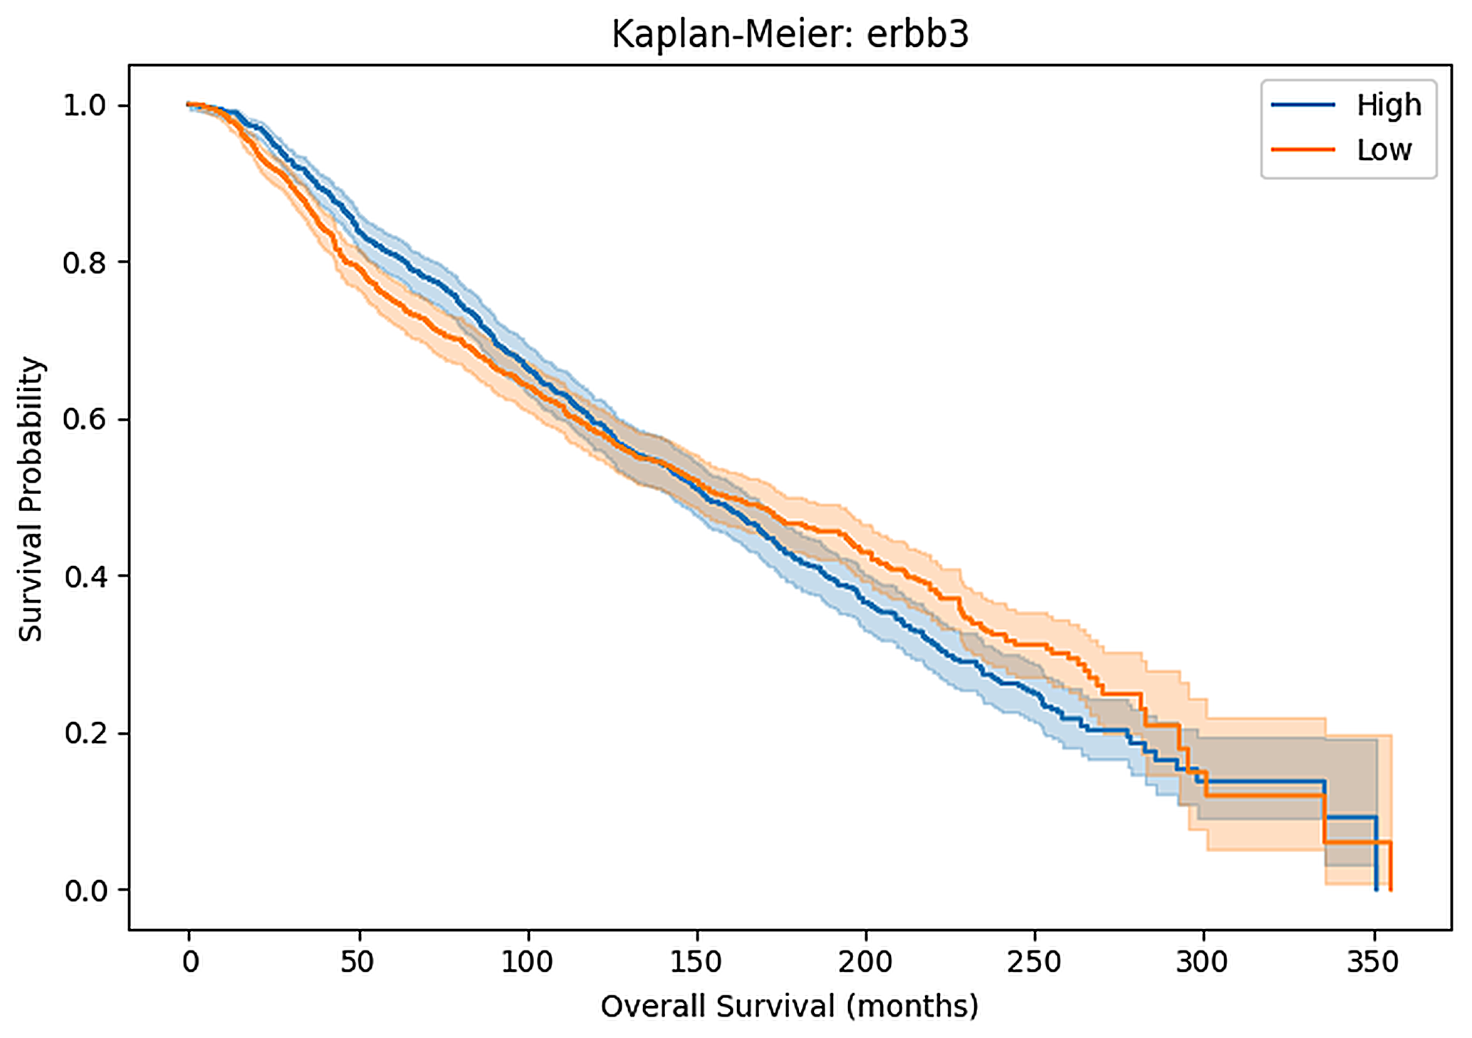
Gene Expression and Overall Survival
High vs Low expression of EGFR, CDK1, GATA3, ERBB2 and ERBB3
Reading the curves
EGFR High ahead after ~100 mo
CDK1 High behind until ~200 mo
GATA3 High ahead until ~125 mo
ERBB2 Small gap, bands overlap
ERBB3 Low slightly ahead after ~150 mo
23

Slide 26
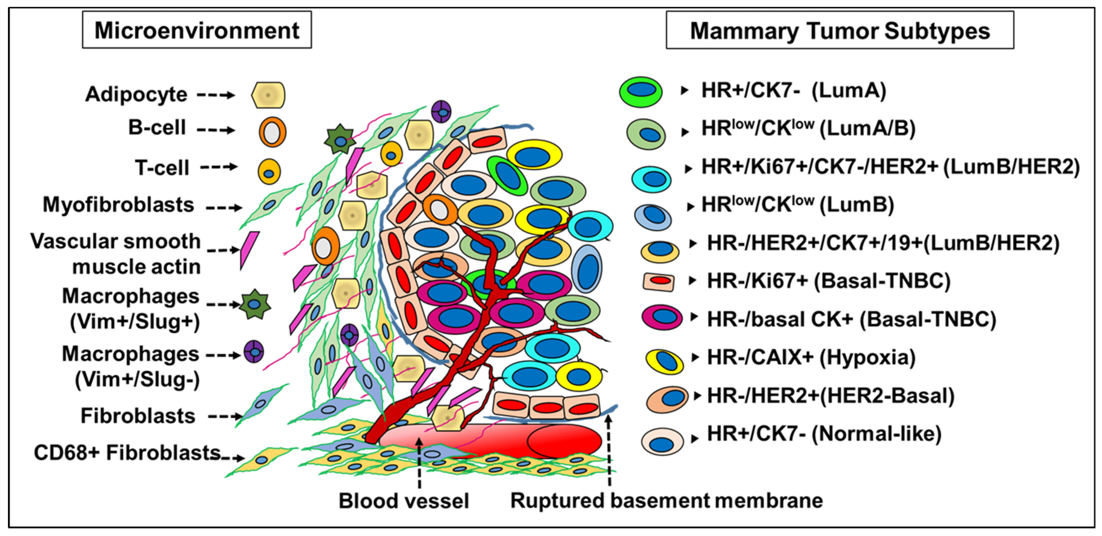
Breast cancer subtype classification model
What is classification?
Classification is a process of machine learning in which the model assigns the observation to any of several classes.
It learns patterns based on previous labeled training datasets.
Its output is defined into classes, not continuous numerical figures.
24

Slide 27
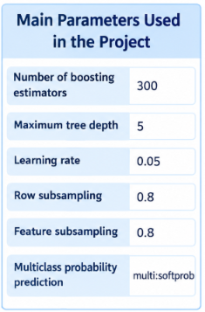
What is XGBoost?
XGBoost is a machine learning method that constructs decision trees sequentially. Every newly constructed tree improves the predictive power of the whole model.
The main parameters of XGBoost algorithm used in the project are as follows:
- number of boosting estimators equals 300;
- maximum tree depth equals 5;
- learning rate equals 0.05;
- row subsampling equals 0.8;
- feature subsampling equals 0.8;
- multiclass probability prediction via multi:softprob.
All the parameters presented above are training parameters of the classifier.
25

Slide 28
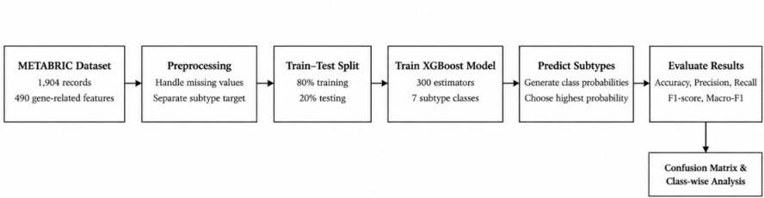
How does the model work?
The model receives the gene-related features for a patient.
It learns patterns between those features and the known subtype labels in the training data.
It generates probabilities for the seven possible subtype labels.
It predicts the label with the highest estimated probability.
Its predictions are compared with the actual labels in the test data.
26

Slide 29
Evaluation Metrics
\
Metrics for Classification
Accuracy: Computes the percentage of samples of breast cancer data that are correctly classified among all the samples tested.
Macro-F1 Score: The F1 score of each subtype is computed and then the mean is calculated equally weighting each class.
Precision: Computes the number of samples that are correctly predicted to be of a certain subtype.
Recall: Computes the number of samples that are of a certain subtype and correctly identified.
Confusion Matrix: Illustrates the predictions, both true and false for each of the seven molecular subtypes.
Survival Analysis Metric
Concordance Index (C-index): It is a metric that measures the ability of the survival analysis model to rank patients in order of their survival probability.
27

Slide 30
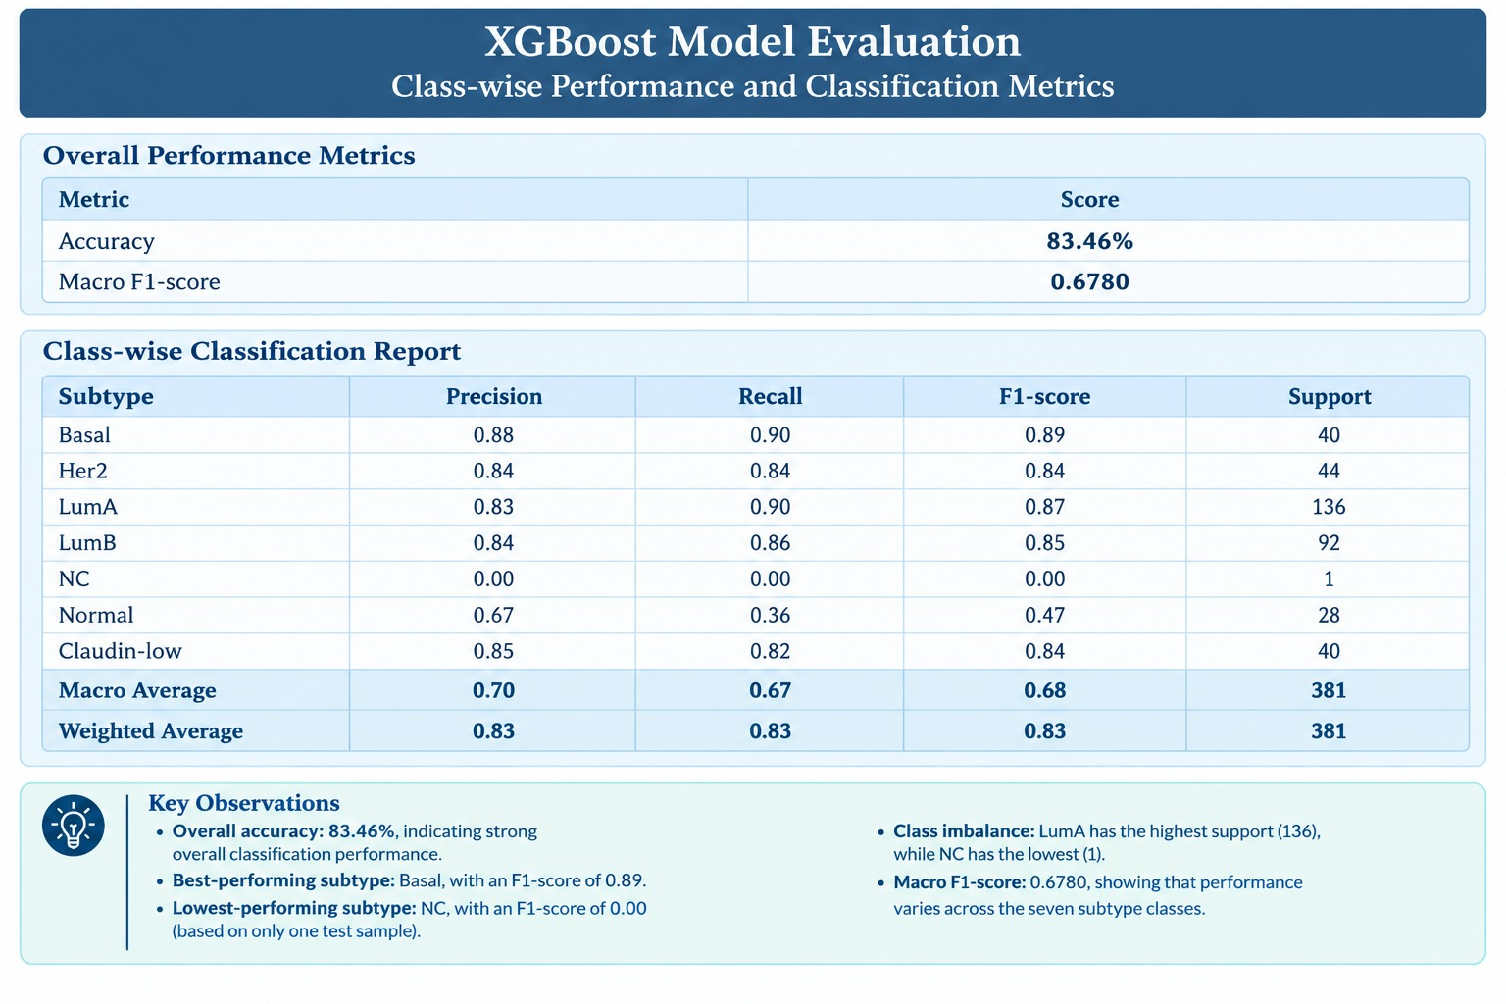
28

Slide 31
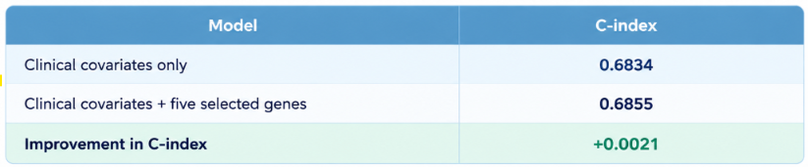
Results of survival analysis
With the addition of the five genes, the C-index was reported to have increased by about 0.0021.
This is an extremely small change.
According to the report, the coefficients of the genes failed to be statistically significant at the standard cut-off of (p < 0.05).
The two C-indexes are both calculated in-sample, i.e., using the same data to fit and evaluate the models.
Hence, this does not show that the genes are independent predictors of survival or add clinical value.
29

Slide 32
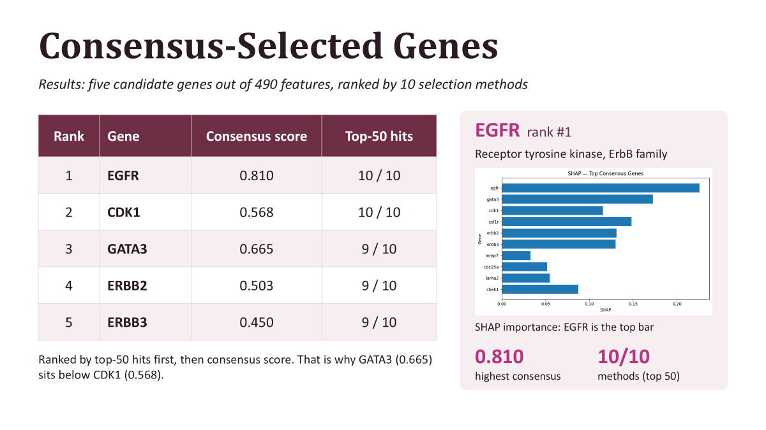
30

Slide 33
Limitations
Restriction of Dataset: This study adopts METABRIC dataset that might not be representative of all populations of breast cancer patients.
Class Imbalance: The sample size of some of the molecular subtypes is very small.
Selection Bias: The test set information may have affected feature selection.
Insufficiency of Genes: Only five selected genes worked poorly compared to the whole feature set.
Small Increase of Survival Time: The C-index increased only by 0.0021.
No External Validation: The results need validation on other external data sets.
31

Slide 34
Conclusion and Future Scope
Selection of Genes: Five genes were selected by the Consensus based Feature Selection method: EGFR, CDK1, GATA3, ERBB2, and ERBB3.
Classification Subtype: XGBoost attained an accuracy rate of 83.46% and macro-F1 score of 0.6780 on full feature set.
Survival analysis: The addition of five genes resulted in an improvement of C-index value from 0.6834 to 0.6855.
Conclusion: This work shows that the combination of Machine Learning, Gene selection, and Survival analysis is helpful for breast cancer classification and prognosis.
Future Scope
External Validity: Validate the models on external breast cancer data sets.
Enhanced Feature Selection: Employing nested cross-validation to minimize data leakage and feature
selection bias.
Imbalanced Data Problem: Address this issue through class weighting or resampling.
More Complex Algorithms: Try out deep learning and ensemble methods for better classification.
Further Survival Analysis: Perform this on more clinical and genetic features using proper validation.
Future Research Possibility: See whether the chosen genes can contribute to further research on
breast cancer.
32

Slide 35
Thank you
Notes:
Leave this slide up during questions so the chair and attendees can see your contact details. Repeat each question before answering — online audio is unreliable and not everyone will have heard it.

