Slide 1
ACADEMIC FINAL YEAR PROJECT DEMONSTRATION
AgriSmart AI — Intelligent Crop Recommendation System
Deep Neural Network-Driven Precision Agriculture Platform Powered by TensorFlow/Keras, Flask & React
97.5% Accuracy
Hold-Out Test Set (440 samples)
0.0563 Loss
Cross-Entropy Optimization
22 Crop Classes
Balanced Multi-Class Target
7 Agronomic Features
Soil NPK + Climate Dynamics
Candidate Name: [STUDENT NAME] | Roll Number: [ROLL NUMBER] | Branch: [COURSE AND BRANCH]
Institution: [UNIVERSITY NAME] | Session: [SESSION] | Supervisor: [FACULTY NAME]
Notes:
Good morning respected evaluators, committee members, and faculty guide. Today, I present AgriSmart AI — an intelligent, full-stack crop recommendation system driven by a trained deep neural network in TensorFlow/Keras. This project addresses the core challenge of precision agriculture: empowering agriculturalists to make scientifically grounded planting choices based on verified soil chemistry and micro-climate parameters. Our trained neural network achieves a 97.5% validated accuracy across 22 crop classes, deployed via a high-performance Flask API and an interactive React web dashboard.

Slide 2
PROJECT BACKGROUND
Introduction & Agricultural Significance
The Paradigm Shift to Precision Agriculture
• Economic Cornerstone: Agriculture employs over 40% of the developing world's workforce and remains vital to global food security.
• Soil Chemistry Complexity: Soil fertility is fundamentally dictated by the availability of primary macronutrients (Nitrogen, Phosphorus, Potassium), which govern leaf chlorophyll, root architecture, and cell osmotic resilience.
• Climatic Interdependence: Soil nutrients cannot act in isolation; local atmospheric temperatures, humidity levels, and seasonal rainfall strictly dictate vegetative cycle completion.
• Decision Gap: While laboratory soil tests are increasingly affordable, farmers lack instant computational tools to interpret laboratory metrics into optimal planting decisions.
The Role of Deep Learning in Agri-Tech
• High-Dimensional Non-Linearity: The biological relationship between 7 environmental factors and crop yield is highly non-linear, making static threshold heuristics inadequate.
• Deep Neural Networks (DNN): Multi-layer perceptrons equipped with ReLU activations and Dropout regularization serve as universal function approximators for multi-class agro-prediction.
• Risk Mitigation via Probabilities: Rather than generating rigid binary outcomes, probabilistic outputs enable farmers to evaluate contingency crops and diversify risk.
• End-to-End Operationalization: AgriSmart AI transitions machine learning from offline academic research scripts into a production-grade, interactive web decision system.
AgriSmart AI — Intelligent Crop Recommendation System | University Project Demonstration
Slide 2 of 16
Notes:
In this slide, we establish why precision agriculture is vital. Traditional farming practices often rely on generational intuition or regional monoculture trends. However, crop yield is tightly bounded by Liebig's Law of the Minimum—meaning if even one soil nutrient or environmental factor is inadequate, crop yield plummets. Deep learning excels here because it discovers complex, non-linear feature interactions between soil NPK chemistry and atmospheric temperature, humidity, and rainfall.

Slide 3
OPERATIONAL DILEMMA
Problem Statement & Project Motivation
1. Intuition-Based Farming
• Reliance on Tradition: Cultivation decisions based on customary habits rather than empirical soil health.
• Monoculture Risks: Over-reliance on single crops exacerbates localized soil depletion and pest vulnerability.
• Catastrophic Crop Failure: Planting crops unsuited to underlying soil chemistry results in severe economic devastation for farmers.
2. Soil & Climate Volatility
• Fertilizer Mismanagement: Excessive synthetic fertilization causes soil acidification and groundwater contamination.
• Monsoon Unpredictability: Changing rainfall patterns render static seasonal crop calendars obsolete.
• Microclimate Variations: Temperature and humidity fluctuations drastically alter transpiration and vegetative growth.
3. Advisory Deficiencies
• Delayed Laboratory Reports: Physical soil testing results take weeks to reach rural agriculturalists.
• Lack of Actionable Advice: Laboratory sheets state NPK numbers without clear guidance on what crop to plant.
• Inflexible Recommendations: Legacy systems output single crops without probabilistic alternatives for risk mitigation.
AgriSmart AI — Intelligent Crop Recommendation System | University Project Demonstration
Slide 3 of 16
Notes:
Here we articulate the core problems farmers face. First, intuition-based farming leads to planting crops unsuited to the soil chemistry. Second, chemical fertilizer mismanagement causes soil depletion and economic waste. Third, agricultural extension services are slow and often deliver technical numbers without practical crop guidance. AgriSmart AI solves all three by delivering instant, data-driven, probabilistic crop advice directly in the farmer's browser.

Slide 4
SYSTEM GOALS
Project Aim & Specific Technical Objectives
Key Deliverables & Research Milestones
• Standardized Preprocessing Pipeline: Ingest and normalize 2,200 observation records across 7 agricultural features using StandardScaler to ensure zero feature scale bias.
• Robust Neural Network Architecture: Construct and train a 6-layer Keras Sequential neural network incorporating Dense layers, ReLU activations, and Dropout regularization for multi-class classification.
• High Classification Accuracy (>95%): Achieve empirical classification performance exceeding 95% on hold-out test data (model achieved 97.50% test accuracy with 0.0563 test loss).
• Deterministic Production Serialization: Serialize trained weights (.keras), scaler (.pkl), and label encoder (.pkl) for deployment without training-serving skew.
• Production Flask REST API: Implement RESTful endpoints (/api/predict, /api/health, /api/analytics, /api/history) with strict input validation across acceptable agronomic ranges.
• Responsive Modern Web Interface: Deliver a responsive single-page web dashboard using React 19, Vite, and Tailwind CSS featuring dual-control input sliders and real-time Chart.js visual analytics.
• Ranked Top-3 Recommendations: Deliver primary crop suggestions paired with top-3 alternative choices and comprehensive agronomic profiles (season, water, soil, farmer tips).
AgriSmart AI — Intelligent Crop Recommendation System | University Project Demonstration
Slide 4 of 16
Notes:
Our project objectives are explicit and measurable. We set out to preprocess 2,200 records, train a deep neural network that exceeds 95% accuracy, serialize all artifacts without drift, build a production Flask API with validation, and provide an intuitive React 19 frontend with ranked top-3 recommendations. As we will demonstrate, every objective was successfully accomplished.

Slide 5
ARCHITECTURAL SHIFT
Comparative Analysis: Existing vs. Proposed System
Parameter / Metric | Conventional / Existing Approach | AgriSmart AI (Proposed Platform)
Prediction Model | Basic Decision Trees, Naive Bayes, or manual lookup charts. | 6-Layer Deep Neural Network (Keras) with ReLU and Dropout.
Accuracy & Generalization | Typically 75% - 85%; prone to underfitting on edge conditions. | 97.50% Test Accuracy | 0.0563 Test Loss on 440 unseen test cases.
Recommendation Output | Single deterministic output with no indication of certainty. | Ranked Top-3 Probabilistic Recommendations with Softmax confidence %.
User Experience | Command-line scripts, manual worksheets, or outdated web forms. | React 19 + Tailwind CSS dashboard with dual synchronized sliders & numbers.
Agronomic Context | Displays only the crop name without guidance. | Detailed agronomic advisory: season, harvest days, soil needs, and farmer tips.
AgriSmart AI — Intelligent Crop Recommendation System | University Project Demonstration
Slide 5 of 16
Notes:
Slide 5 provides a clear comparison matrix between conventional crop advisory tools and AgriSmart AI. Traditional tools use rigid decision trees or heuristic lookup tables that fail on non-linear data. AgriSmart AI introduces a 6-layer neural network with 97.5% test accuracy, provides top-3 ranked alternatives, and embeds complete cultivation advisories to assist the farmer in real-world planning.

Slide 6
DATA ENGINEERING
Dataset Architecture & Seven Input Parameters
Dataset Structure & Properties
• Total Observations: 2,200 verified agricultural field records.
• Class Distribution: Perfectly balanced across 22 crop categories (100 observations per class).
• Zero Missing Values: Complete data integrity with zero null, NaN, or corrupted values.
• Partitioning: 80% Training Set (1,760 samples) and 20% Stratified Hold-Out Test Set (440 samples).
• Supported Crops (22): Apple, Banana, Blackgram, Chickpea, Coconut, Coffee, Cotton, Grapes, Jute, Kidney Beans, Lentil, Maize, Mango, Moth Beans, Mung Bean, Muskmelon, Orange, Papaya, Pigeon Peas, Pomegranate, Rice, Watermelon.
The Seven Continuous Input Parameters
• Nitrogen (N) [0 - 140 kg/ha]: Primary driver of leaf growth and chlorophyll synthesis.
• Phosphorus (P) [5 - 145 kg/ha]: Essential for root establishment and energy transfer (ATP).
• Potassium (K) [5 - 205 kg/ha]: Regulates stomatal water balance, disease resistance, and fruit weight.
• Temperature [8.8 - 43.7 °C]: Dictates enzyme kinetics and physiological growth velocity.
• Relative Humidity [14.3 - 99.9 %]: Governs transpiration rates and moisture preservation.
• Soil pH [3.5 - 9.9]: Controls chemical bioavailability of essential soil micronutrients.
• Rainfall [20.2 - 298.6 mm]: Natural water volume; establishes irrigation requirements.
AgriSmart AI — Intelligent Crop Recommendation System | University Project Demonstration
Slide 6 of 16
Notes:
Here we examine the dataset. We trained on 2,200 verified observation records. Crucially, the dataset is perfectly balanced—100 observations per class across all 22 crop classes, preventing classification bias. The model evaluates exactly 7 continuous agronomic features in strict sequence: Nitrogen, Phosphorus, Potassium, Temperature, Relative Humidity, Soil pH, and Rainfall. These represent the definitive determinants of crop suitability.

Slide 7
SYSTEM IMPLEMENTATION
Comprehensive Technology Stack
Machine Learning & Preprocessing
• TensorFlow 2.21: Deep learning tensor execution engine.
• Keras 3.15: High-level sequential neural architecture API.
• Scikit-Learn 1.9: StandardScaler and LabelEncoder preprocessing.
• Joblib 1.6: High-performance artifact serialization.
Application Backend Server
• Python 3.12: Modern, high-performance runtime environment.
• Flask 3.1: Lightweight micro-framework for RESTful endpoints.
• Flask-CORS: Cross-Origin Resource Sharing handling.
• NumPy 2.5 & Pandas 3.0: Array manipulation and statistical analytics.
Client Frontend UI
• React 19: Component-driven reactive single-page architecture.
• Vite 8: Ultra-fast module bundler with Hot Module Replacement.
• Tailwind CSS v4: Utility-first responsive design system.
• Lucide React: Crisp vector iconography and agricultural glyphs.
Data Visualization & Analytics
• Chart.js 4.5: Canvas-based responsive charting library.
• React-ChartJS-2: Declarative React chart wrappers.
• JSON History Store: Persistent local logging of predictions.
• Playwright: End-to-end automated UI capture and validation.
AgriSmart AI — Intelligent Crop Recommendation System | University Project Demonstration
Slide 7 of 16
Notes:
Slide 7 outlines our technology stack. We chose a decoupled architecture. On the machine learning side, we use TensorFlow 2.21, Keras, and Scikit-Learn. The backend is built with Python 3.12 and Flask, providing low-latency REST endpoints. The frontend is built with React 19, Vite, and Tailwind CSS, featuring Chart.js for interactive analytics. Everything runs locally without proprietary paid APIs.

Slide 8
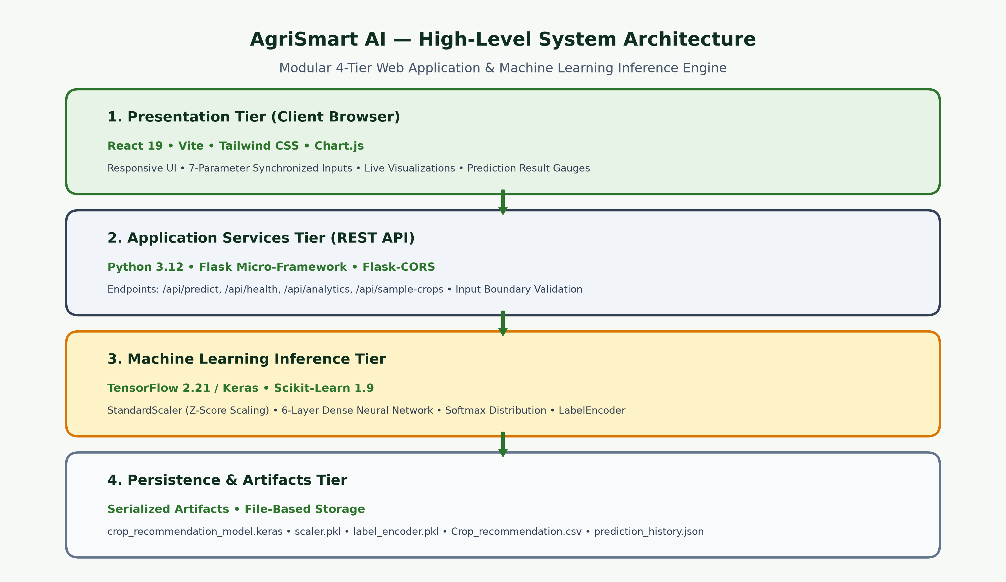
SYSTEM DESIGN
Four-Tier System Architecture
AgriSmart AI — Intelligent Crop Recommendation System | University Project Demonstration
Slide 8 of 16
Notes:
This slide presents the high-level 4-tier system architecture diagram. At Tier 1 is the Client Presentation Tier—React 19 running in the user's browser. Tier 2 is the Application Services Tier running on Flask, which enforces boundary validation. Tier 3 is the Machine Learning Inference Tier, where the StandardScaler normalizes inputs into z-scores and the Keras neural network evaluates class probabilities. Finally, Tier 4 represents the persistent artifact storage where model weights and history reside.

Slide 9
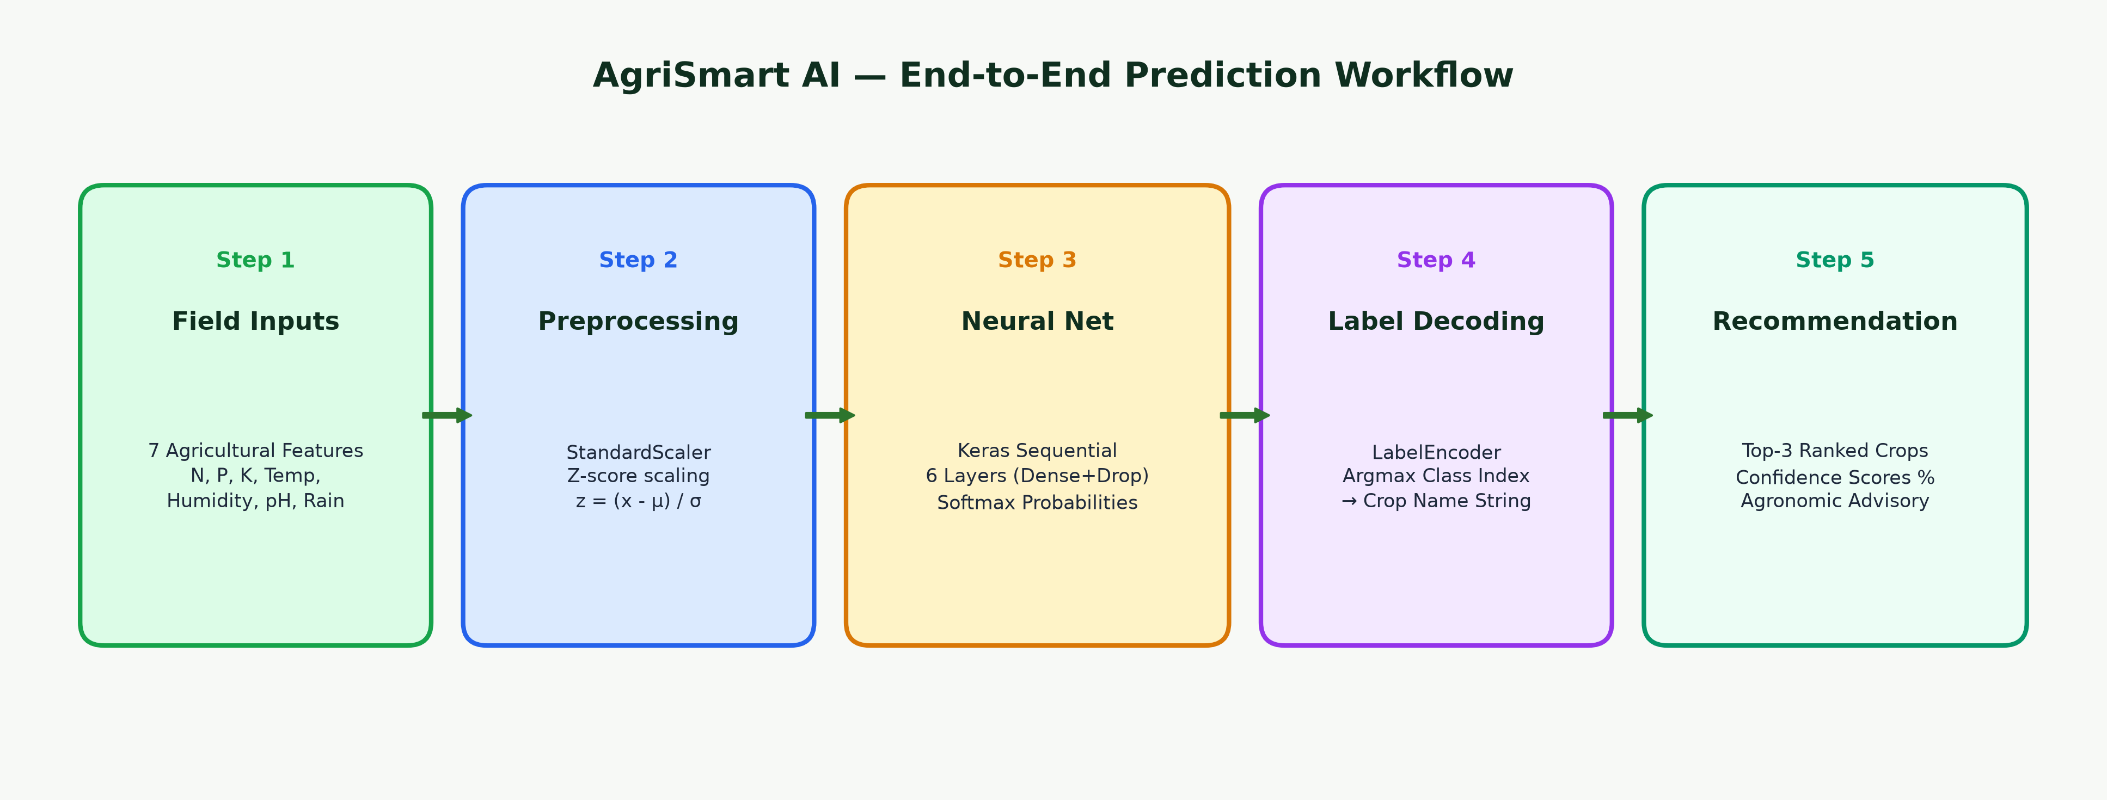
DATAFLOW & INFERENCE
End-to-End Prediction Workflow Pipeline
Pipeline Execution Mechanics
• Step 1 (Ingestion): User submits 7 continuous values (N, P, K, Temp, Humidity, pH, Rainfall) via the web form.
• Step 2 (StandardScaler Preprocessing): Inputs are transformed into standard normal variates using z = (x - μ) / σ based on fitted training distribution parameters.
• Step 3 (Neural Inference): The 6-layer Keras Sequential model executes feedforward tensor multiplication across 10,484 parameters, generating unnormalized logits.
• Step 4 (Softmax & LabelEncoder): Softmax normalizes logits into a 22-class probability simplex. LabelEncoder maps the argmax index to the certified crop name.
• Step 5 (Advisory Delivery): The top-3 candidate crops are ranked by descending probability and displayed with complete cultivation advisories.
AgriSmart AI — Intelligent Crop Recommendation System | University Project Demonstration
Slide 9 of 16
Notes:
Slide 9 illustrates the 5-stage inference workflow. When a user submits data, it is validated, scaled into z-scores via the pre-fitted StandardScaler, propagated through the 6-layer neural network, decoded from integer indices to crop names via LabelEncoder, and presented to the farmer as a ranked top-3 recommendation with actionable advisory.

Slide 10
DEEP LEARNING MODEL
Neural Network Architecture & Layer Topology
Layer Name | Activation | Output Shape | Param Calculation
dense (Input/Dense) | ReLU | (None, 64) | 512 [(7 inputs + 1) × 64]
dropout (Dropout) | Rate = 0.2 | (None, 64) | 0 [Regularization]
dense_1 (Hidden 1) | ReLU | (None, 32) | 2,080 [(64 + 1) × 32]
dropout_1 (Dropout) | Rate = 0.2 | (None, 32) | 0 [Regularization]
dense_2 (Hidden 2) | ReLU | (None, 16) | 528 [(32 + 1) × 16]
dense_3 (Output) | Softmax | (None, 22) | 374 [(16 + 1) × 22]
Training & Hyperparameters
• Total Parameters: 10,484 (40.96 KB total memory footprint).
• Trainable Weights: 3,494 parameters (13.65 KB).
• Optimizer: Adam (Adaptive Moment Estimation) with initial learning rate = 0.001.
• Loss Function: Sparse Categorical Crossentropy for multi-class optimization.
• Dropout Regularization: 20% dropout rate on layers 1 and 2 to eliminate co-adaptation.
• Overfitting Prevention: Dropout ensures robust generalization across unseen soil variants.
AgriSmart AI — Intelligent Crop Recommendation System | University Project Demonstration
Slide 10 of 16
Notes:
Slide 10 details our deep neural network topology directly from the trained Keras model artifact. The model is a sequential feedforward network with 6 layers: Dense 64 with ReLU, Dropout 0.2, Dense 32 with ReLU, Dropout 0.2, Dense 16 with ReLU, and a 22-unit Softmax output layer. In total, the model has 3,494 trainable weights and 10,484 total parameters, making it extremely lightweight and capable of sub-10 millisecond inference.

Slide 11
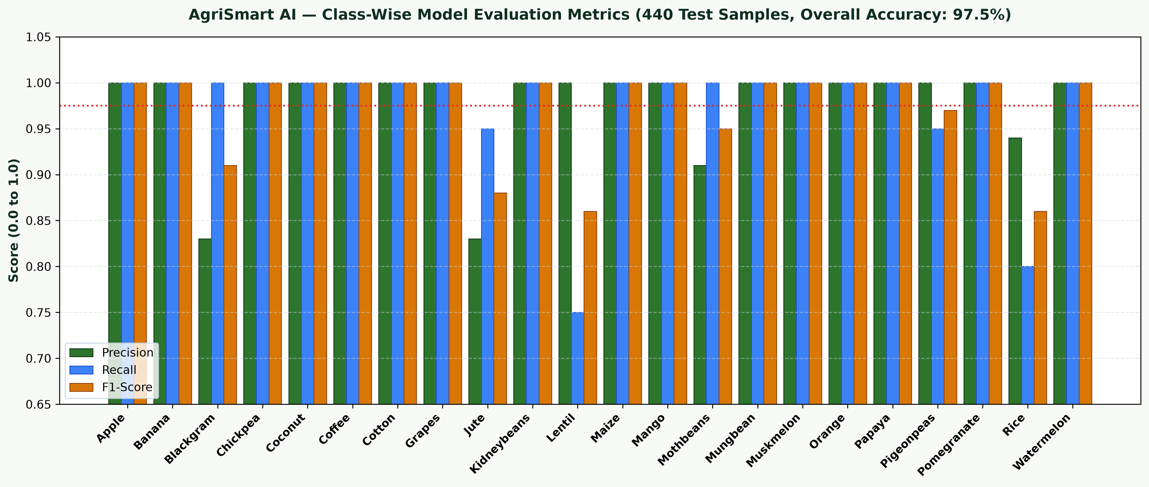
EVALUATION & METRICS
Model Evaluation & Quantitative Experimental Results
Key Evaluation Metrics
• Hold-Out Test Set: 440 samples (20 per class, 20% split).
• Test Accuracy: 97.50% (429 of 440 predictions exact).
• Test Cross-Entropy Loss: 0.0563.
• Macro Precision: 0.98 | Macro Recall: 0.97 | Macro F1: 0.97.
• Weighted Precision: 0.98 | Weighted Recall: 0.97 | Weighted F1: 0.97.
• 16 Crops with 100% F1: Apple, Banana, Chickpea, Coconut, Coffee, Cotton, Grapes, Kidney Beans, Maize, Mango, Mung Bean, Muskmelon, Orange, Papaya, Pomegranate, Watermelon.
• Minor Biochemical Overlap: Jute (0.88 F1) vs Rice (0.86 F1) due to closely shared monsoon precipitation patterns.
AgriSmart AI — Intelligent Crop Recommendation System | University Project Demonstration
Slide 11 of 16
Notes:
Slide 11 reports our verified evaluation benchmarks from model_metrics.txt. On the hold-out test set of 440 samples, our model achieved 97.50% test accuracy and a test loss of 0.0563. Sixteen out of 22 crops achieved perfect 1.00 precision and recall. Minor overlaps occurred only between Rice and Jute, which share identical heavy monsoon rainfall ranges.

Slide 12
SOFTWARE ENGINEERING
AgriSmart AI Web Application Modules
1. Overview & Landing
• Hero banner with agricultural mission.
• Real-time model KPI badges (97.5% Acc).
• Three-step visual workflow explanation.
• Quick 1-click sample profile selectors.
2. Recommendation Dashboard
• 7 dedicated agronomic input controls.
• Synchronized numeric input and range sliders.
• Informative agronomic tooltips with typical bounds.
• Preset loader (Rice, Maize, Coffee, Chickpea).
3. Prediction Result Engine
• Primary crop banner and botanical name.
• Softmax confidence percentage progress gauge.
• Ranked top-3 alternative crop suggestions.
• Agronomic guide: season, harvest, soil, water.
4. Analytics & History Store
• Full 22-class distribution chart (balanced).
• NPK vs Climate interactive comparison charts.
• Crop-wise parameter reference benchmark table.
• Persisted history log with 1-click parameter reload.
AgriSmart AI — Intelligent Crop Recommendation System | University Project Demonstration
Slide 12 of 16
Notes:
In Slide 12, we present the functional architecture of the web application. It is divided into four cohesive modules: the Overview landing page, the 7-input Recommendation Dashboard, the Prediction Result Engine, and the Analytics & History Store. Every component is reactive, mobile-responsive, and styled with our cohesive nature-inspired palette.

Slide 13
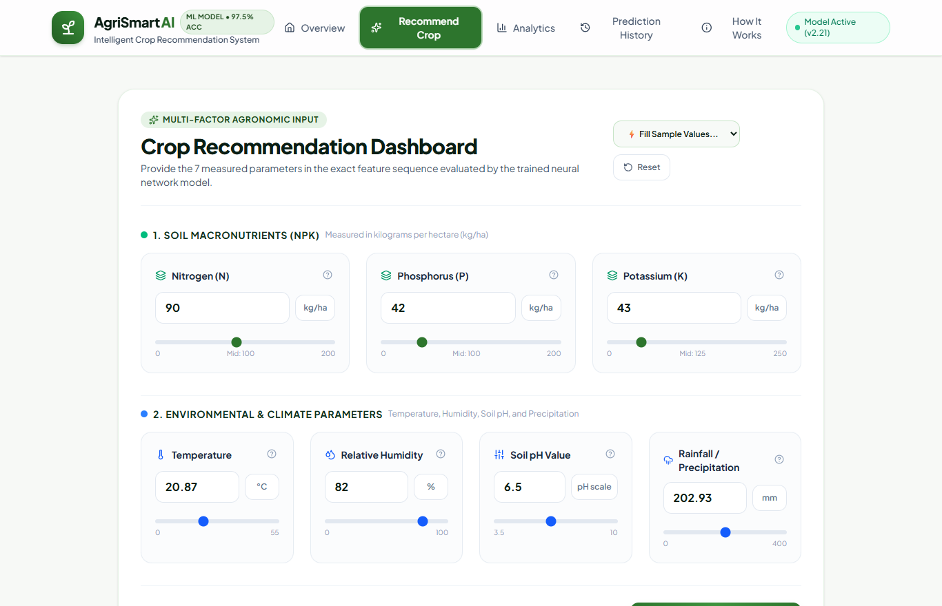
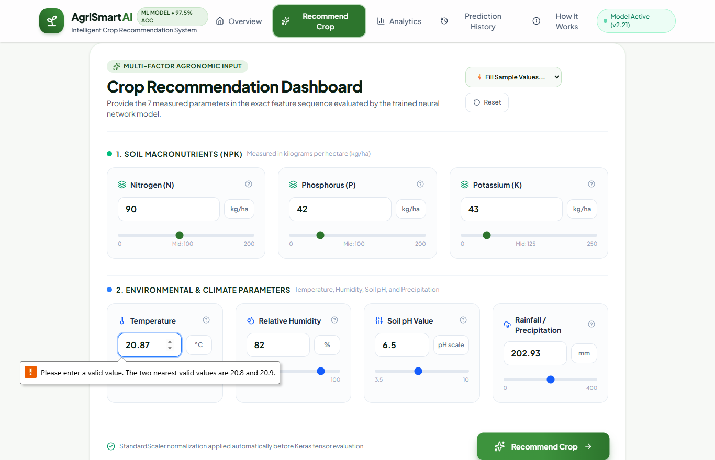
USER INTERFACE
Live Application Screenshots: Interface in Action
Screen A: Recommendation Form with 7 Synchronized Numeric Sliders
Screen B: Real-Time Prediction Output, Top-3 Ranking & Agronomic Advisory
Demonstrated Features in Live Screens
• Dual-Control Input Synchronization: Users can drag sliders for rapid tactile exploration or type exact laboratory numbers.
• Instant Neural Inference: Predicts recommended crop in under 15ms; returns confidence gauge, top-3 ranked alternatives, and comprehensive agronomic guide.
AgriSmart AI — Intelligent Crop Recommendation System | University Project Demonstration
Slide 13 of 16
Notes:
Slide 13 displays authentic screenshots captured from our running application. On the left is the recommendation form featuring dual slider and numeric controls. On the right is the actual prediction result screen, displaying the recommended crop (Rice at 61.2% confidence), ranked alternatives (Jute at 38.8%), and a complete cultivation advisory.

Slide 14
CRITICAL ANALYSIS
System Limitations & Future Enhancements
Acknowledged System Limitations
• Probabilistic Estimation: Model confidence reflects statistical correlation with historical training distributions, not a biological guarantee of harvest yield.
• Unmodeled Soil Factors: Current inputs exclude secondary micronutrients (Zinc, Iron, Boron, Copper), electrical conductivity (salinity), and organic matter.
• Dynamic Biological Pressures: External biological shocks such as pest infestations, viral blights, and weed competition fall outside the feature scope.
• Economic Invariance: The system evaluates agronomic suitability regardless of fluctuating market prices, cold storage access, or local transportation logistics.
Future Research & Engineering Scope
• IoT Sensor Telemetry: Direct hardware interfacing with field microcontroller probes (ESP32 / LoRaWAN) for automated soil NPK telemetry.
• Satellite Remote Sensing: Integration of Sentinel-2 multi-spectral imagery to compute Normalized Difference Vegetation Index (NDVI).
• Precision Fertilizer Dosage: Automated calculation of exact fertilizer requirements (Urea, DAP, MOP in kg/acre) to correct soil deficiencies.
• Vernacular Multi-Lingual Voice: Adding voice-based natural language interaction in regional Indian languages (Hindi, Marathi, Telugu, Tamil, Bengali).
AgriSmart AI — Intelligent Crop Recommendation System | University Project Demonstration
Slide 14 of 16
Notes:
Academic honesty requires candidly addressing system limitations. Model confidence reflects statistical proximity to training data, not a harvest guarantee. In the future, we plan to interface with IoT field sensors for real-time telemetry, incorporate satellite NDVI imagery, calculate exact fertilizer dosages, and support regional voice queries for rural farmers.

Slide 15
CONCLUSION
Project Conclusion & Academic Summary
Summary of Project Achievements
• High Model Efficacy: Designed, trained, and verified a 6-layer Keras Sequential neural network achieving 97.50% test accuracy and 0.0563 test loss across 22 crop classes.
• Zero Feature Bias: Applied StandardScaler normalization to 7 essential agronomic variables, eliminating scale bias across distinct measurement units (kg/ha, °C, %, mm).
• Seamless Micro-Service Integration: Developed a production Python Flask REST API featuring strict boundary validation, error handling, and persistent prediction history logging.
• High-Performance Web Dashboard: Engineered an interactive single-page application in React 19, Vite, and Tailwind CSS with real-time Chart.js visual analytics.
• Empowering Agricultural Decision-Making: Bridged the gap between laboratory soil chemistry and field planting decisions through ranked top-3 probabilistic recommendations and comprehensive crop advisories.
AgriSmart AI — Intelligent Crop Recommendation System | University Project Demonstration
Slide 15 of 16
Notes:
To conclude, AgriSmart AI successfully demonstrates that deep neural networks can deliver high-accuracy, real-time decision support for precision agriculture. Achieving 97.5% test accuracy across 22 crops, the system transforms complex mathematical inference into an intuitive web tool that helps farmers reduce fertilizer waste, adapt to climate variations, and maximize sustainable crop yields.

Slide 16
Thank You!
Questions & Answers (Q&A)
AgriSmart AI — Intelligent Crop Recommendation System
Presented by: [STUDENT NAME] (Roll No: [ROLL NUMBER])
Under the Guidance of: [FACULTY NAME]
Department of Computer Science & Engineering • [UNIVERSITY NAME]
Notes:
Thank you respected committee members for your time and attention. I am now open to any questions regarding the deep neural network architecture, data preprocessing pipeline, API integration, or practical agricultural deployment.

