Slide 1

MINI project PRESENTATION
FACE RECOGNITION LOGIN FREATURE & VOICE SEARCH
IMPLLEMENTED ON A WEBSITE
Prepared By - Priyansu Bisht
University Roll No. - 1918571
Student Id - 19011251
Section - E

Slide 2
About Project :
This a mini project, on embedding face recognition login feature and voice search into a website to make the website more accessible, user friendly, and secure. The project covers following features:
➢ User Friendly GUI
➢ Creating an account and storing the data
➢ Log in and Further security ensured by face recognition
➢ Provide user with books to read
➢ Voice search for easy search of books

Slide 3
why this???
This project can be very helpful like:
Individually
o Helpful in learning new technologies like note JS Mongoose database etc
o Increases the understanding of a technology by leaps and bounds
o A good way to get started in topics like machine learning and image processing
Socially
o Providing and online space to read book
o Help in strengthening web security
o Improving user interface and experience using voice search

Slide 4
Things I learned ???
Technologies
Node.JS
Mongoose Database
JavaScript
View Engine: EJS & HBS
Validation And Verification For Security
Got Familiar with Face Recognition Technologies
Got Familiar with Speech TO Text Technologies
Handling Server Side Requests And Responses

Slide 5
Face recognition
Automated facial recognition was pioneered in the 1960s. Woody Bledsoe, Helen Chan Wolf, and Charles Bisson worked on using the computer to recognize human faces. Their early facial recognition project was dubbed "man-machine" because the coordinates of the facial features in a photograph had to be established by a human before they could be used by the computer for recognition.
It analyses mathematically the incoming image with some margin of error, and it verifies that the biometric data matches the person who must use the service or is requesting access to an application, system or even building.
Face recognition make use of artificial intelligence (AI) and machine learning technologies.
Major Algorithms Used Nowadays:
Local Binary Patterns Histograms (LBPH) (1996)
Fisherfaces (1997)
Scale Invariant Feature Transform (SIFT) (1999)
Speed Up Robust Features (SURF) (2006)

Slide 6
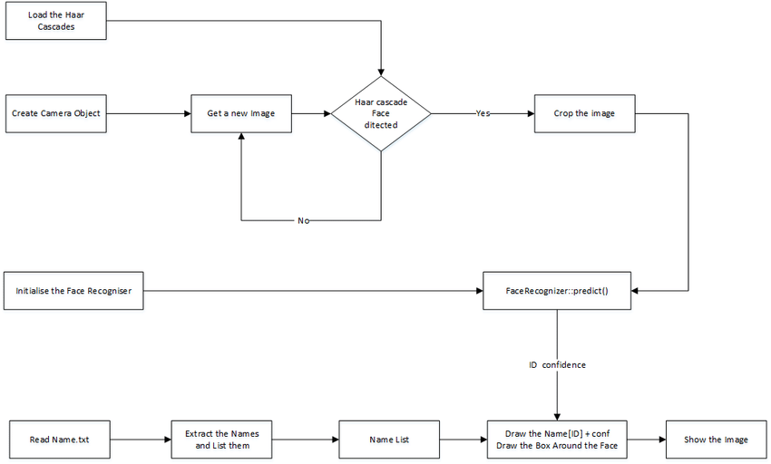

Slide 7
Speech to text conversion
Speech to text is a speech recognition software that enables the recognition and translation of spoken language into text through computational linguistics. It is also known as speech recognition or computer speech recognition. Specific applications, tools, and devices can transcribe audio streams in real-time to display text and act on it.
Major Algorithms Used Nowadays:
Mel frequency cepstral coefficients (MFCC)
Linear prediction cepstral coefficients (LPCC).
Most popular recognition models are
Vector quantization (VQ)
Dynamic time warping (DTW)
And artificial neural network (ANN)

Slide 8
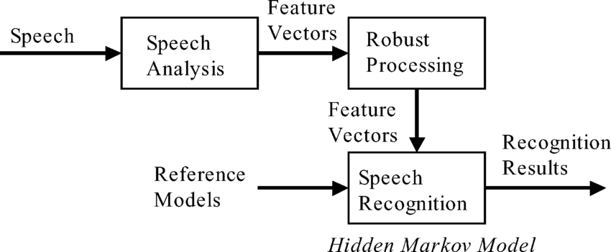
var speehToText = new webkitSpeechRecognition();
speehToText.lang = 'en-US';
speehToText.continuous = false;speehToText.interimResults = false;
speehToText.start();
speehToText.onresult = function ( e ) {
document.getElementById('searchBar').value = e.results[0][0].transcript;
document.getElementById('searchBar').innerHTML = e.results[0][0].transcript;
speehToText.stop();
};
speehToText.onerror = function (e) { speehToText.stop(); };

Slide 9
Project details
Technologies Used
Front End: HTML5, CSS3, Bootstrap
Back End: Node.js, Express.js
Database: Mongoose Database
Scripting: JavaScript
Platform: Windows OS, Mozilla Firefox, Google Chrome, VS Code, MongoDBCompass
Others: JSON

Slide 10
Project details
External Node Module / Dependencies Used
express: Used as a framework to setup custom Local Server
express-fileupload: Module used to Collect files send by the user and work on it.
express-handlebars: View engine used to display dynamic web content
express-session: Module used for session handling
face-api.js: face recognition JavaScript API build on tensorflow.JS
hbs: View engine used to display dynamic web content
mongoose: Module used to facilitate connection to the Mongoose database
nodemon: module that allows dynamic reloading of server at any change made on any file

Slide 11
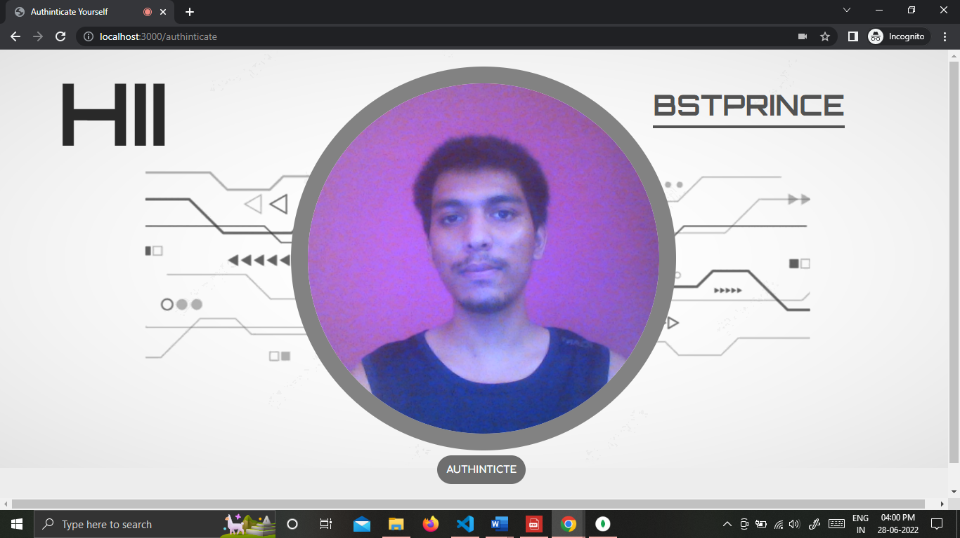
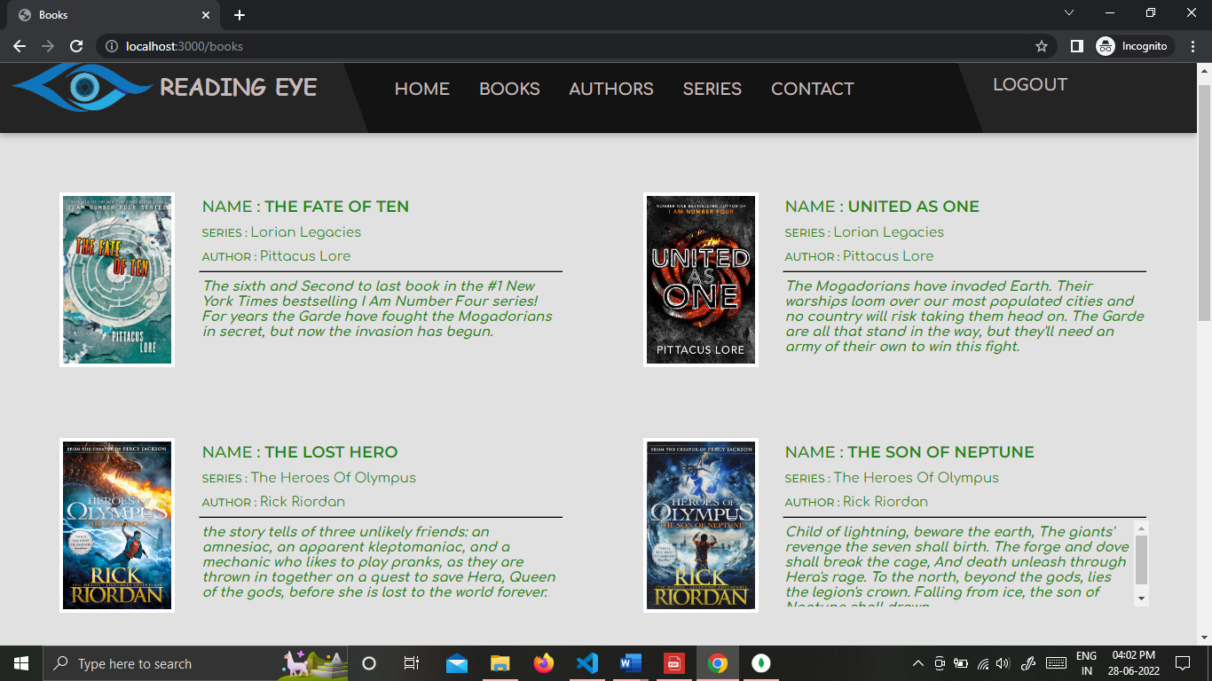
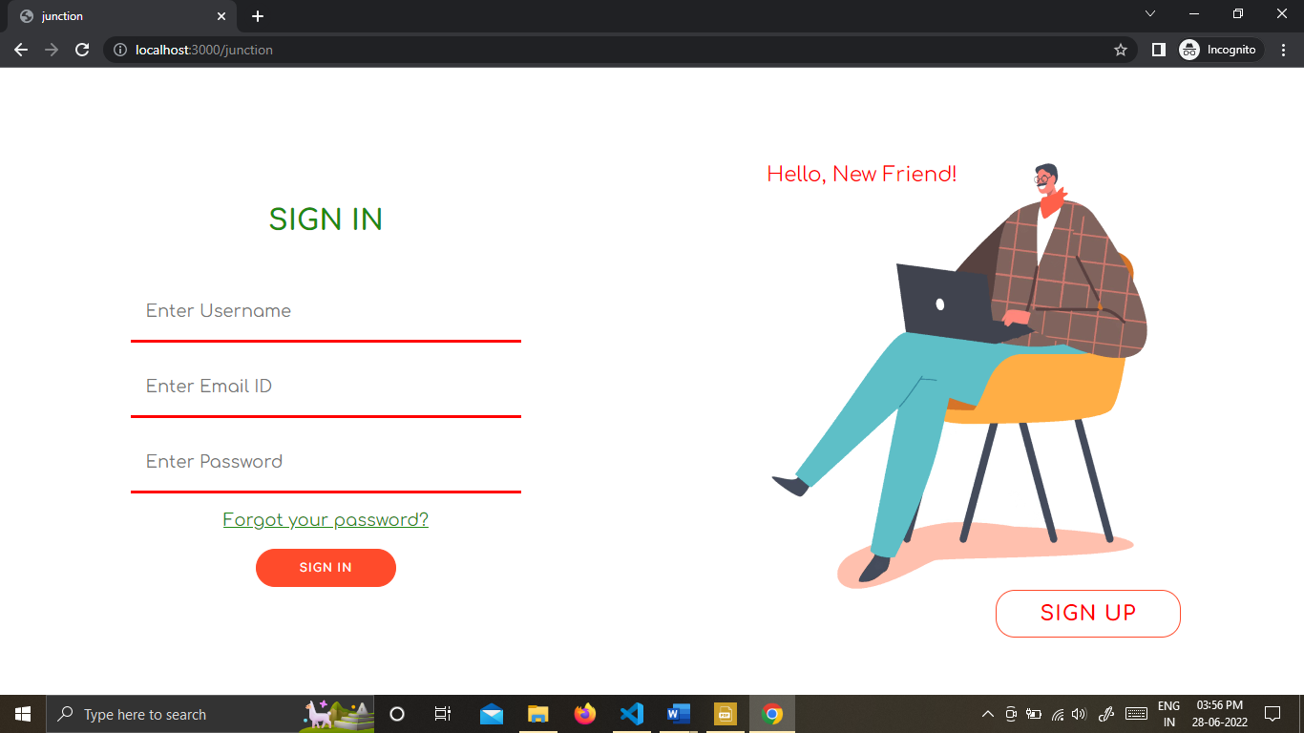
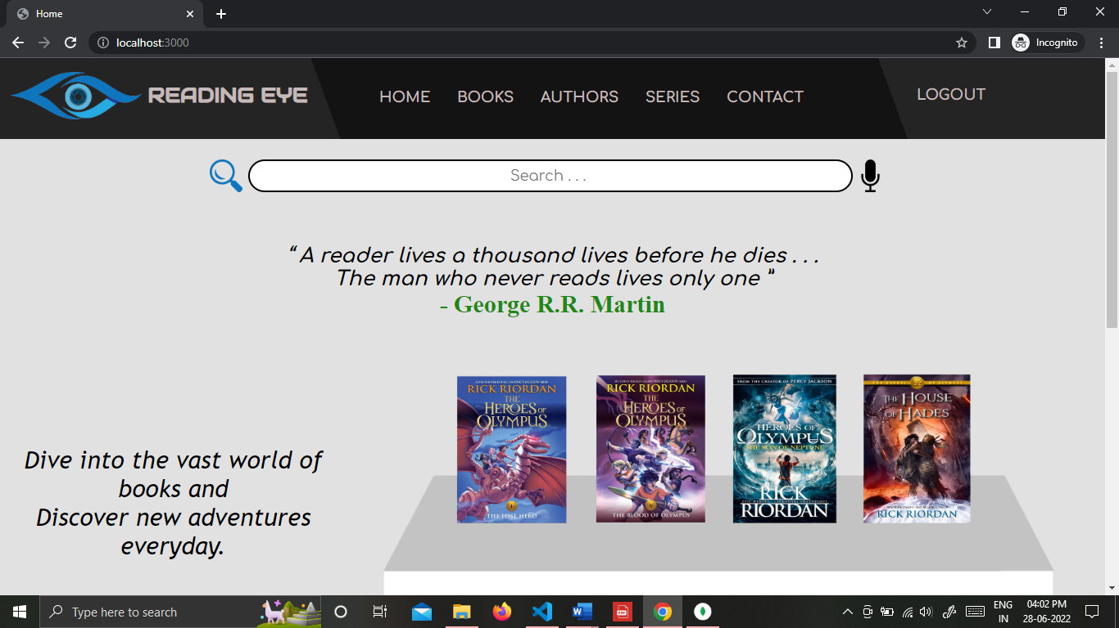
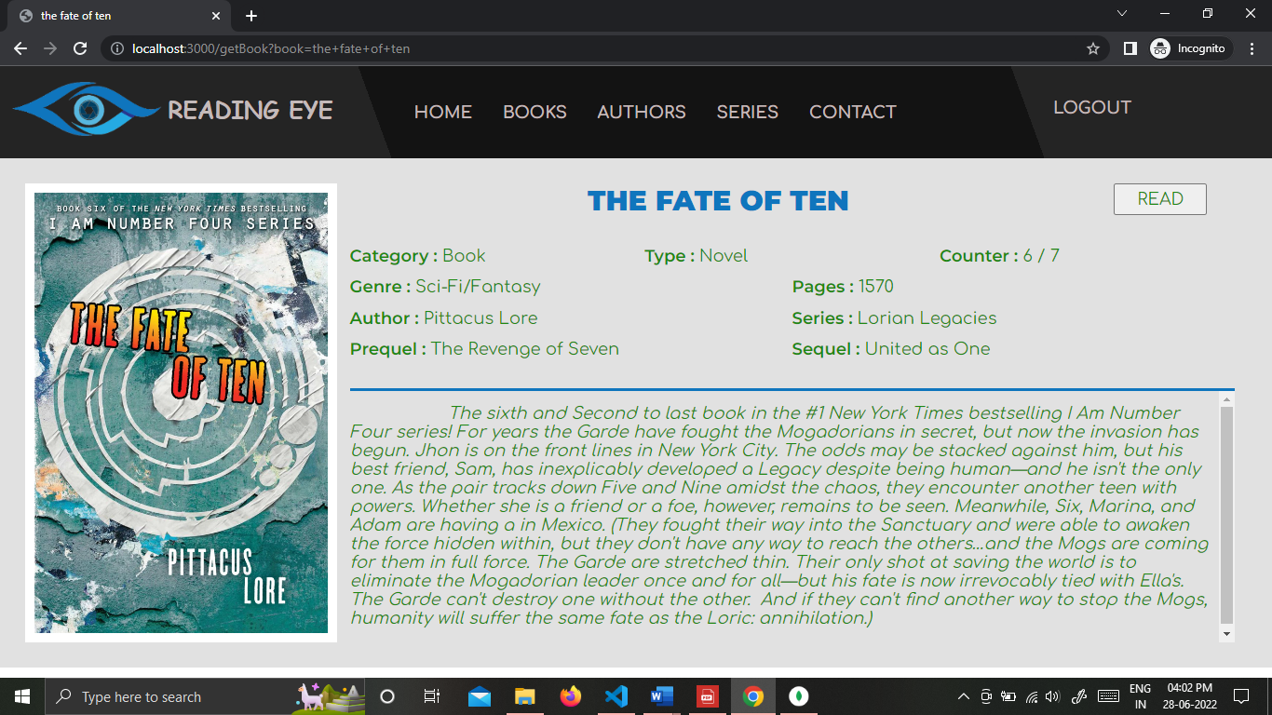

Slide 12
Future Works >>>
Improve the GUI
Apply node session and cookies modules to provide better security for the website
Create a user account page that Record users reading history and Suggestions based on it.
Add more books to the database
Provide more options other than reading like bookmarks, rating, etc.
Purchase e-books and permission to display the books to the public
Deploy the website

Slide 13
Thank You

